Slide 1
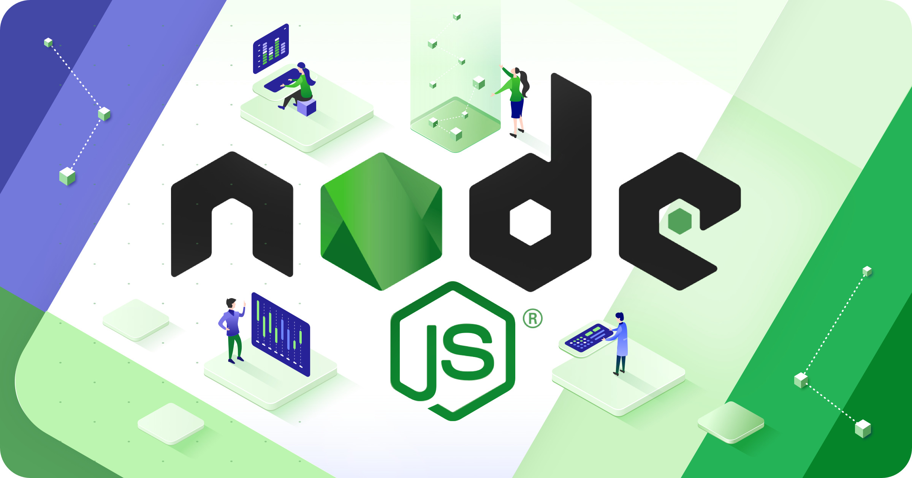
Node.js Workshop
Building Scalable Applications with JavaScript

Slide 2
What is Node.js?
Node.js is a JavaScript runtime built on Chrome's V8 engine. It allows developers to use JavaScript for server-side scripting, enabling the creation of dynamic web page content.
Node.js uses an event-driven, non-blocking I/O model that makes it lightweight and efficient.

Slide 3
Key Features of Node.js
Asynchronous and Event-Driven
Single-Threaded but Highly Scalable
Extensive Package Ecosystem (npm)
Cross-Platform Support

Slide 4
Core Concepts
Event Loop
Callbacks
Promises and Async/Await
Modules and npm

Slide 5
Getting Started with Node.js
Install Node.js from the official website.
Verify installation using 'node -v' in the terminal.
Create your first JavaScript file.
Use npm to manage packages.

Slide 6
Building a Simple Server
To create a simple HTTP server:
Import the 'http' module.
Use 'http.createServer()' to create a server.
Listen on a specified port.

Slide 7
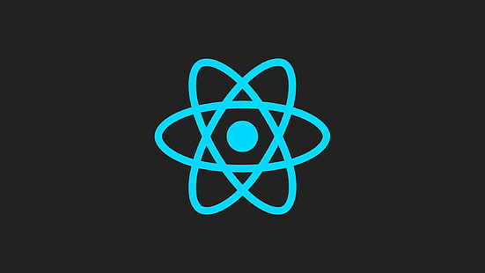
React Workshop
Building Interactive User Interfaces

Slide 8
What is React?
React is a JavaScript library for building user interfaces. It allows developers to create large web applications that can change data without reloading the page.
React is maintained by Facebook and a community of individual developers and companies.

Slide 9
Key Features of React
Key Features:
Component-Based Architecture
Virtual DOM for High Performance
One-Way Data Binding
Rich Ecosystem with Libraries

Slide 10
Core Concepts
Core Concepts:
Components
Props and State
Lifecycle Methods
Hooks
JSX Syntax

Slide 11
Getting Started with React
Install Node.js and npm.
Create a new React app using Create React App.
Understand the project structure.
Start the development server.

Slide 12
Building Your First React App
To build your first app:
Create components.
Manage state with useState.
Use props to pass data between components.
Render components in the App component.

Slide 13
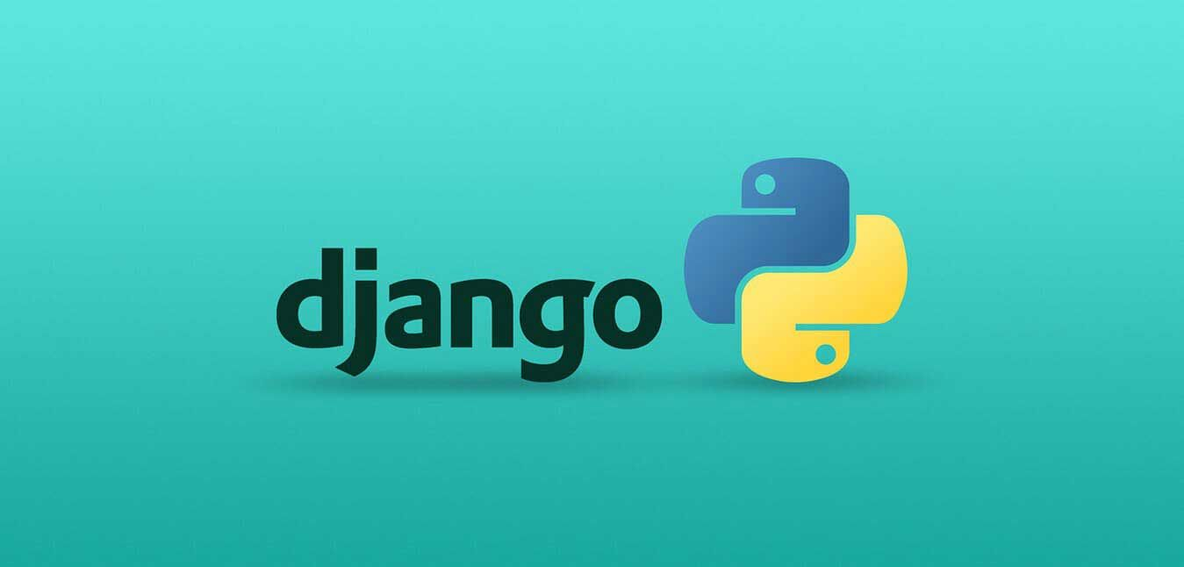
Django Workshop
Building Robust Web Applications

Slide 14
What is Django?
Django is a high-level Python web framework that encourages rapid development and clean, pragmatic design. It was created to help developers create web applications quickly and efficiently.

Slide 15
Key Features of Django
Key Features:
Fast Development with an Elegant Syntax
Built-in Admin Interface
ORM (Object-Relational Mapping) for Database Management
Secure by Default with Features Like CSRF Protection

Slide 16
Core Components
Core Components:
Models
Views
Templates
URLs
Forms

Slide 17
Getting Started with Django
Install Django via pip: pip install django.
Create a new project: django-admin startproject projectname.
Create a new app: python manage.py startapp appname.
Run the development server: python manage.py runserver.

Slide 18
Creating a Simple Django App
To create a simple Django app:
Define your models in models.py.
Create views in views.py.
Map URLs in urls.py.
Create templates for your views.

Slide 19


