Slide 1
Summarization of a stack of papers using LLMs: Stage 2
By Arianna Matienzo, Atharva Dalvi, Khushi Nankani, Olu Ogunnirian

Slide 2
Recap!
To start, let me briefly revisit Stage 1 — Topic Recognition. The main goal of this stage was to lay a solid foundation for summarization by organizing our dataset effectively. We used natural language processing (NLP) techniques to analyze the content of the papers and sort them based on their underlying topics. This step was crucial because it ensured that we could tackle the summarization process more systematically by working with smaller, topic-focused clusters rather than handling all the papers at once.

Slide 3
Recap!
Through NLP, the model was able to:
Identify key themes and patterns within the papers.
Group papers based on similar research areas or methodologies.
Adapt to different writing styles and technical language used in the semiconductor industry.
This stage allowed us to structure the data in a meaningful way, making it easier to summarize and extract insights moving forward.

Slide 4
What are we up to?
We are currently deep into Stage 2 — Summarization, which is where the core of the project really comes into play. Now that we’ve grouped the papers by topic, the focus is on condensing large amounts of information into concise, meaningful summaries while preserving the key insights and technical details.
We’ve developed a working prototype that can summarize 4 papers in 412 seconds. While this gives us a functional starting point, we recognize that this runtime is still on the higher side, especially when we consider scaling up to larger datasets. So, our current focus is on improving the efficiency and refining the quality of the summarization process.

Slide 5
What are we up to?
Here’s what we’re working on to enhance performance:
Optimization of the LLM’s processing pipeline – We’re fine-tuning the prompt structure and token limits to reduce processing time without losing critical information.
Parallel processing – We’re exploring ways to process multiple papers simultaneously rather than sequentially, which should help reduce overall runtime.

Slide 6
What are we up to?
Here’s what we’re working on to enhance performance:
Improved handling of technical language – Semiconductor-related papers tend to have complex, domain-specific language. We are working on training the model to better interpret and summarize this type of content accurately.
The goal is to achieve faster processing times while maintaining high-quality outputs that retain the depth and nuance of the original papers.

Slide 7

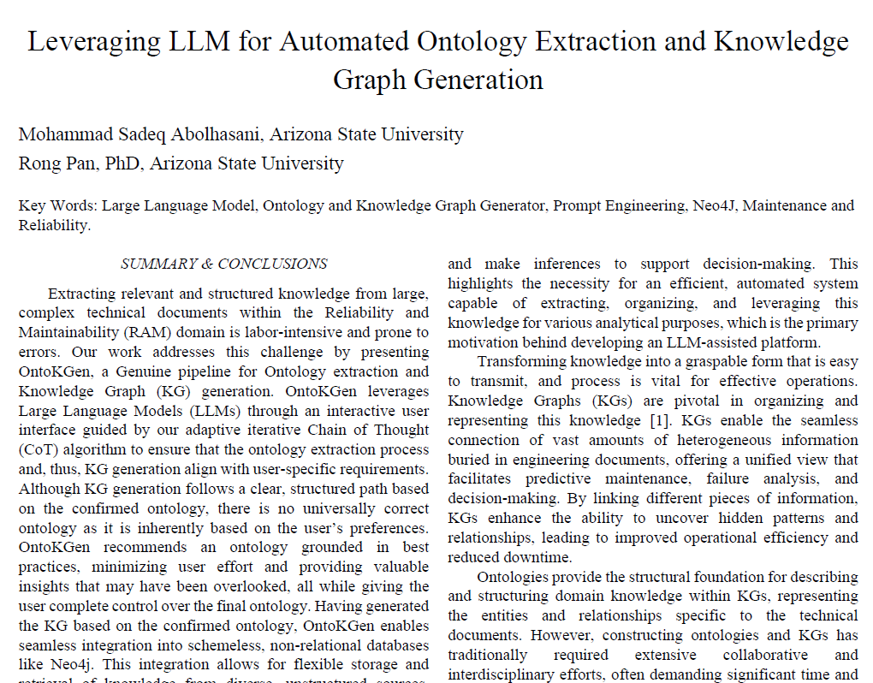
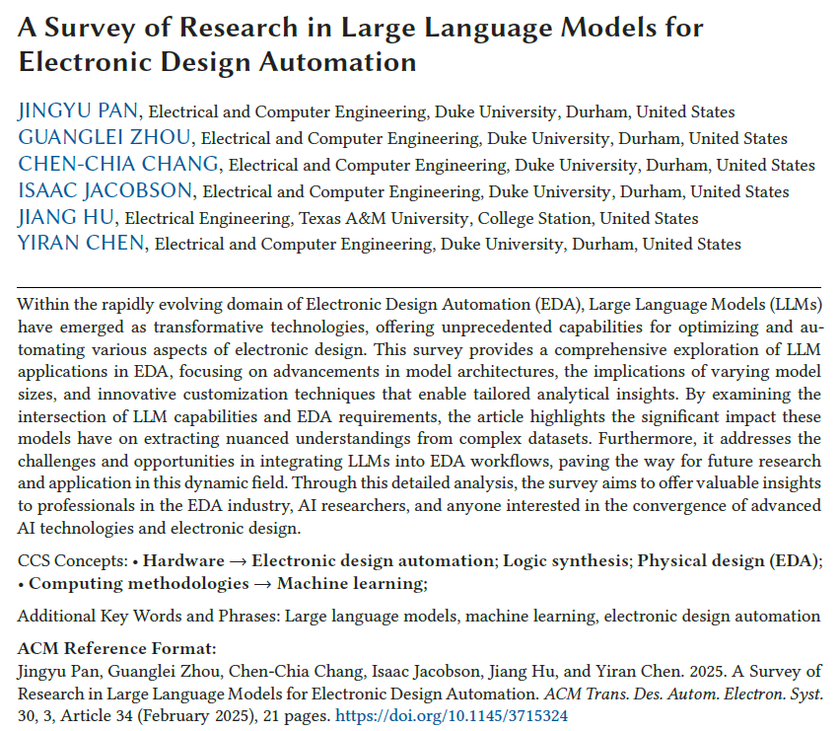
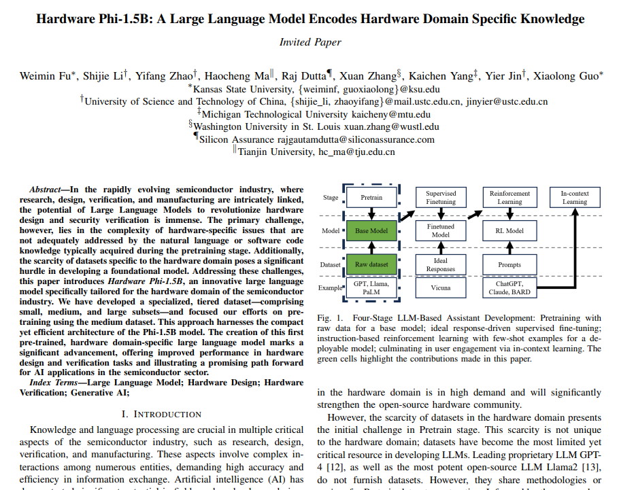
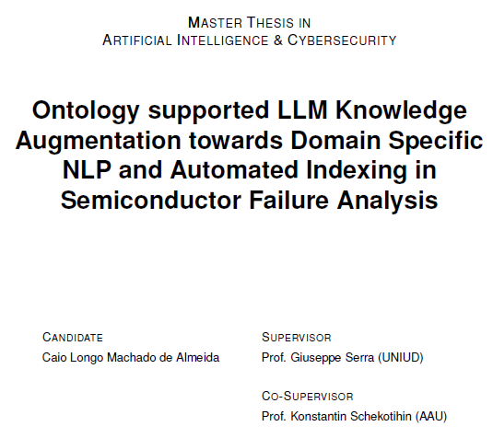
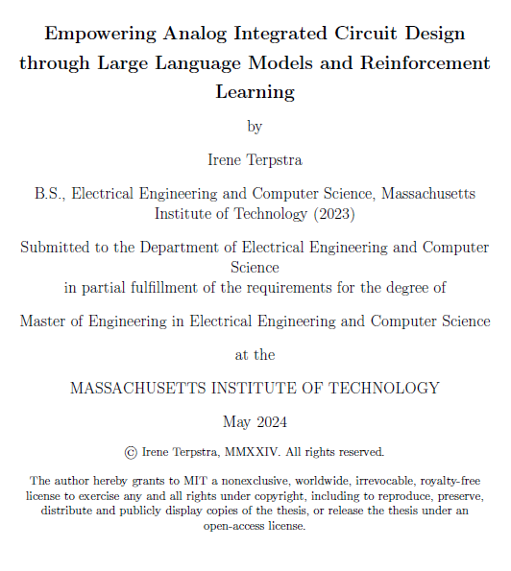
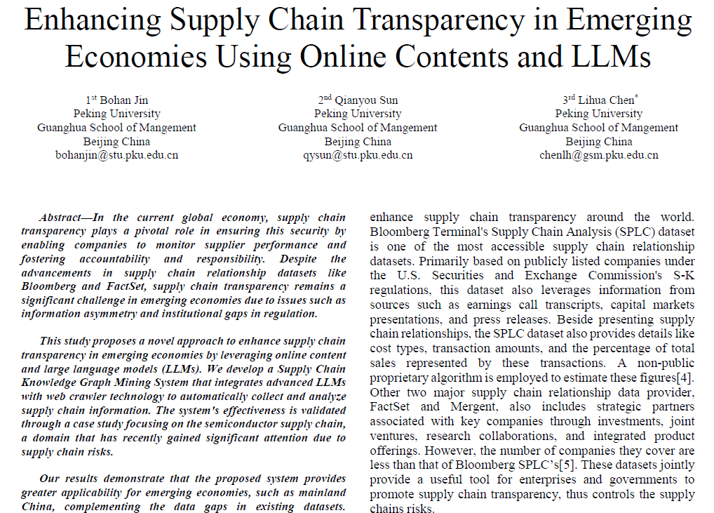
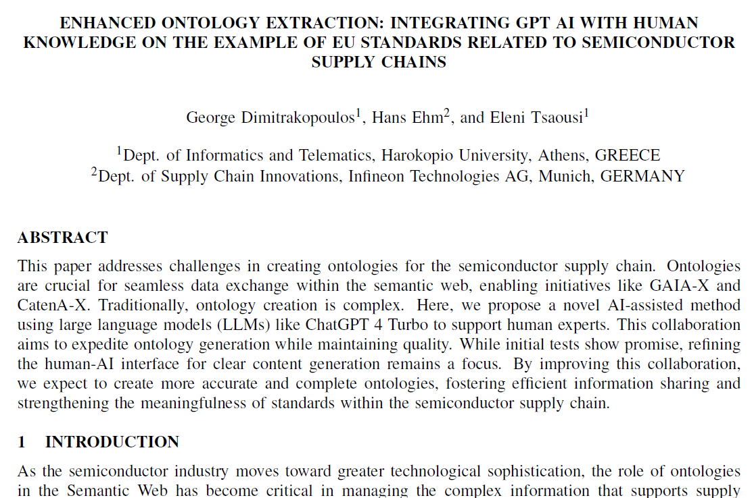
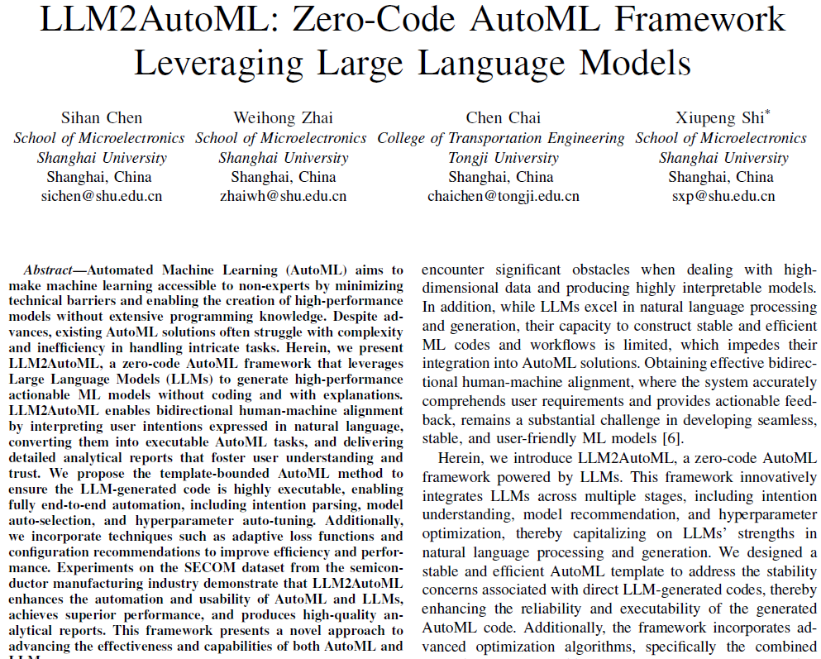
Papers papers and papers
We have reviewed 50 papers focused on the application of LLMs in the semiconductor industry. This has been an important part of the process because it’s helping us understand how LLMs are being used to drive advancements in this highly technical field.

Slide 8
Papers papers and papers…
The papers cover a wide range of areas, including:
Manufacturing process optimization – Techniques to improve yield rates and reduce production costs using machine learning models.
Defect detection and quality control – Using LLMs to analyze real-time production data to identify defects early in the manufacturing process.
Supply chain management – Applying predictive modeling to streamline inventory and logistics operations.
Chip design and testing – Automating the design validation process and improving testing accuracy using AI models.

Slide 9
Papers papers and papers…
By summarizing these papers, our goal is to provide researchers and industry professionals with a comprehensive yet easily digestible overview of current trends and breakthroughs. This will save time and allow them to quickly identify relevant information without going through hundreds of pages.

Slide 10
Next Steps
Once we’ve optimized the summarization process, we’ll move into Stage 3 — Collation. In this stage, the individual summaries will be compiled into a single, structured document. This final document will be designed for easy navigation, so users can quickly find summaries on specific topics or research areas. Essentially, it will serve as a knowledge base for anyone looking to understand how LLMs are shaping the semiconductor industry.
Our aim is not just to summarize but to create a resource that adds real value — something that helps researchers and professionals make faster, more informed decisions based on the latest research.

Slide 11
What do we have in our code?
PDF Processing: PyPDF2
Extract text from PDF
Remove unnecessary text like table of content, references, etc.
ThreadPoolExecutor to reduce loading time
Natural Language Processing: Sentence Transformers, Hugging Face model
Topic Modelling: BERTopic
Parallel Summarizing using ProcessPoolExecutor
Break large texts into chunks
Run tasks parallel to reduce execution time
Testing locally using visual studio code and the papers we found

Slide 12
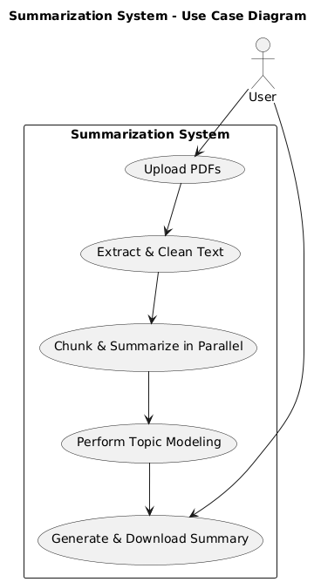
Use Case Diagram
The use case diagram outlines the interaction between the user and our Summarization System. The process begins with the user uploading PDFs, after which the system extracts and cleans the text. It then chunks the content for parallel summarization, performs topic modeling to identify key themes, and generates a final summary for download. This structured workflow ensures efficient and accurate summarization of research papers.

Slide 13
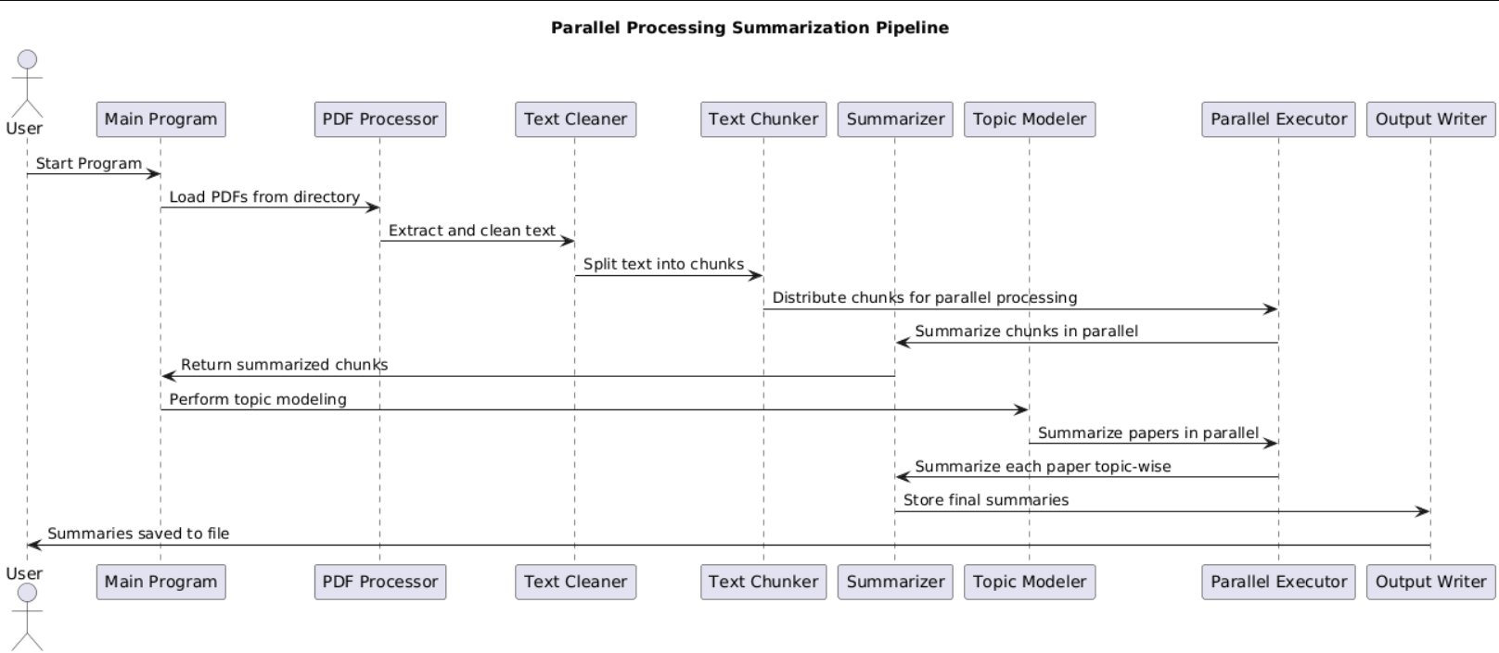
Sequence Diagram
The sequence diagram outlines the step-by-step interactions for efficient document summarization using parallel processing.
User starts the process.
Main Program loads PDFs and extracts text via the PDF Processor.
Text Cleaner processes the text, and Text Chunker splits it into smaller sections.
Summarizer processes chunks in parallel, and the Topic Modeler organizes them by topic.
Parallel Executor manages execution, and Output Writer stores the final summaries.
User receives the summaries.

Slide 14
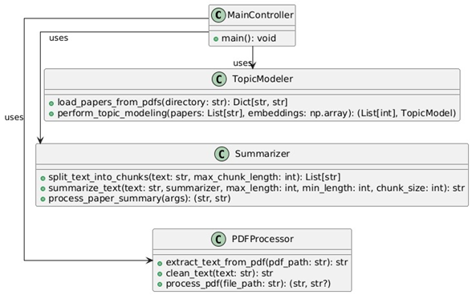
Class Diagram
Class Diagram: The diagram shows how four classes work together:
MainController starts the program and uses TopicModeler.
TopicModeler loads papers and analyzes topics, using Summarizer to summarize content.
Summarizer breaks text into chunks and summarizes them.
PDFProcessor extracts and cleans text from PDFs.
Together, they process PDFs, model topics, and summarize the content.

Slide 15
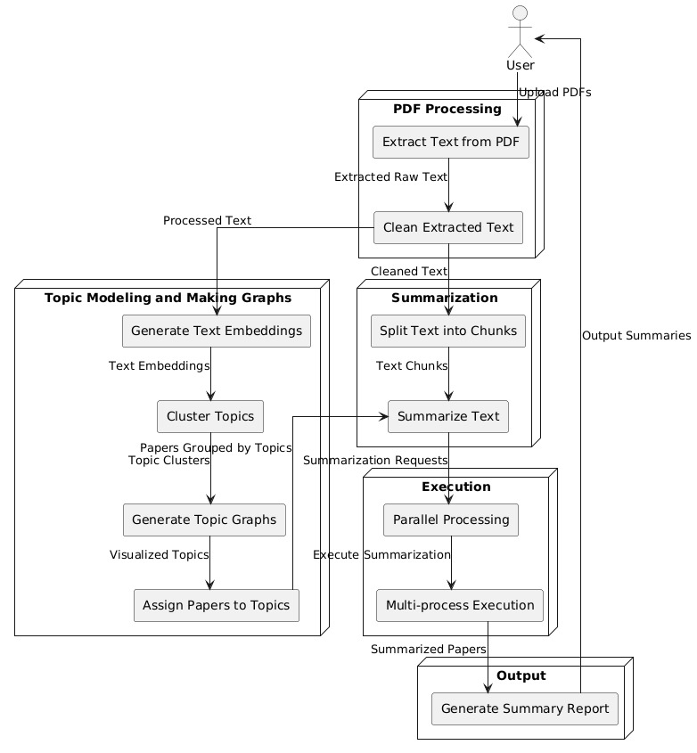
Architecture Diagram
This architecture diagram shows the process flow for handling PDF documents:
User: Uploads PDFs.
PDF Processing: Extracts and cleans text from PDFs.
Topic Modeling and Making Graphs: Generates text embeddings, clusters topics, assigns papers to topics, and creates topic graphs.
Summarization: Splits text into chunks and summarizes it.
Execution: Uses parallel processing to execute summarization.
Output: Generates a summary report.
Together, these steps process PDFs, model topics, and summarize the content efficiently.

Slide 16
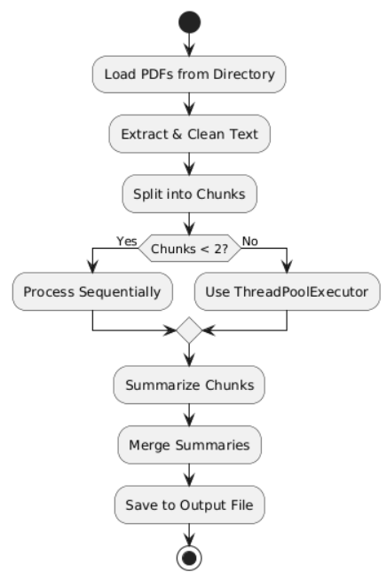
Algorithm and Flowchart
Algorithm for PDF Extraction & Cleaning
Extract text using PyPDF2.
Remove noise
Return clean text if it has enough words.
Algorithm for Chunking Strategy
Tokenize text into sentences (nltk.sent_tokenize).
Create text chunks up to a maximum length
Return chunks for processing.
Algorithm for Parallel Summarization
Use ThreadPoolExecutor for I/O-bound tasks (PDF processing).
Use ProcessPoolExecutor for CPU-bound tasks (summarization).
Summarize text in parallel chunks.

Slide 17
Algorithm and Flowchart
This flowchart outlines the process of handling PDFs:
Load PDFs from Directory.
Extract & Clean Text from the PDFs.
Split into Chunks for easier processing.
Decision Point: If there are fewer than 2 chunks:
Yes: Process sequentially.
No: Use ThreadPoolExecutor for parallel processing.
Summarize Chunks to condense the information.
Merge Summaries into a cohesive document.
Save to Output File for final use.
This flowchart ensures efficient and organized processing of PDF documents.

Slide 18
What do we need from our code? (Upcoming Tasks)
Increase the efficiency of the code
We can significantly reduce the runtime of the code if we change the model that we are using or reducing the size of the summary
Doing both if the above has an adverse effect on the quality of the code
Integrate a web interface to upload the PDF’s
Add a way such that the users can upload a zip file to make the interface simpler for the user

Slide 19
Thank You!

