Slide 1
Problem: Why Static and Dynamic Thresholds Fail
Problem Statement
Traditional anomaly detection relies on:
Static Thresholds (e.g., mean + 3·σ)
Dynamic Thresholds (adaptive quantile + smoothing)
Key Issue: High False Negatives (FNR)
Attack RMSEs often blend into the benign distribution tail.
Static threshold can miss subtle or stealthy attacks:
Fixed boundaries fail to adjust to context.
Dynamic threshold smooths too aggressively:
Lagging adaptation → slow reaction to fast anomalies.

Slide 2
Approach
Intuition Behind Distance-Based Unknown Pattern Detection
We extract rolling shape vectors from RMSE time series using a sliding window.
During training, we learn the centroid of these vectors to represent "benign behavior."
At test time, we check if the current vector lies within a tolerance radius from the centroid.
This gives a model-agnostic anomaly detector: deviations from known behavior are flagged as suspicious.

Slide 3
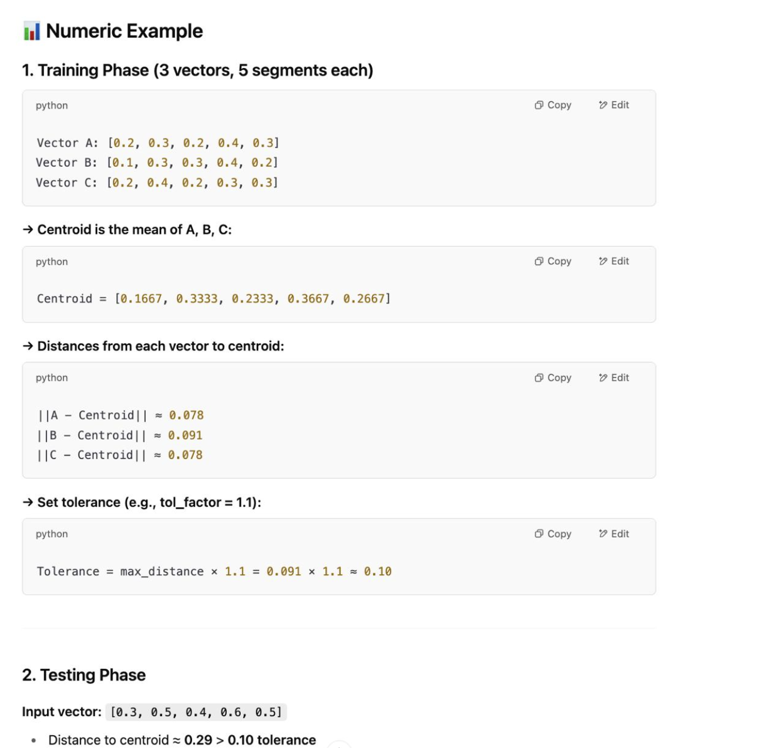

Slide 4
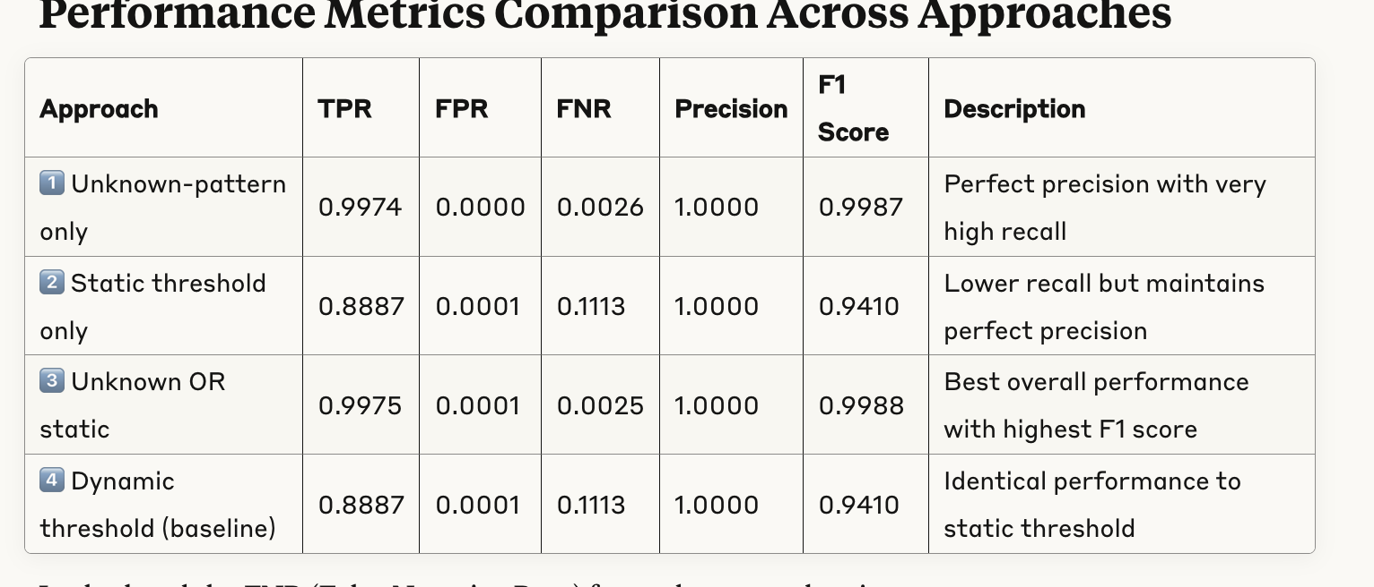
Results
Results comparing dynamic static and our unknown pattern using centroid on Mirai Botnet:

Slide 5
Results
1. Unkown vs unkown or static we found unkonwon performs at par with unknwon or static so we keep unkwon in our experiments only

Slide 6
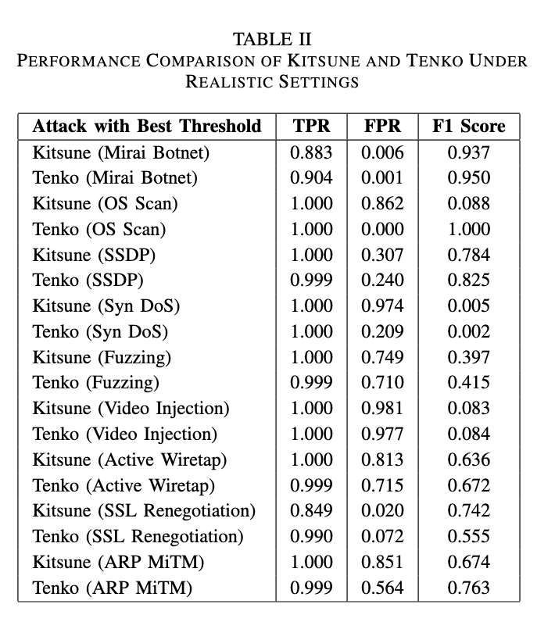
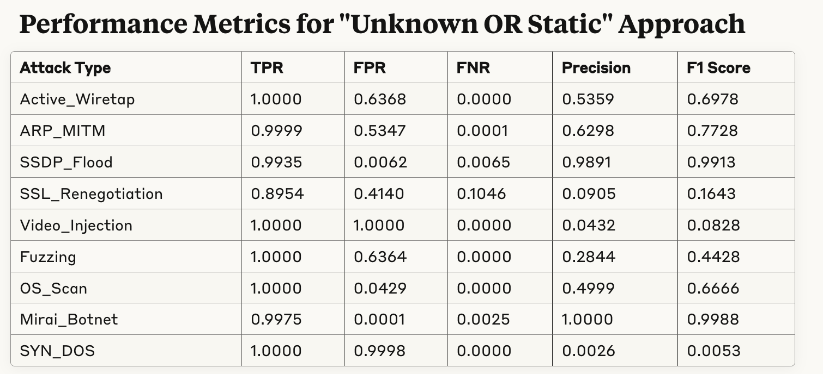
Centroid Results

Slide 7
Centroid Results Discussion
⚠️ Edge Cases to Improve
SSL_Renegotiation and OS_Scan: Outliers inflate max distance → loose boundary → high FPR
🔍 Empirical Observation
On attacks like SSL_Renegotiation, OS_Scan:
RMSEs do rise, but not enough to cross threshold
→ e.g., 95th percentile distance for tighter boundary
1. Centroid Tolerance Too Loose (SSL_Renegotiation)
One or few outlier vectors during training skew the max distance.
This inflates the decision boundary, classifying attacks as benign.
PCA plot shows:
Tight benign cluster
Attack vectors clearly outside
But tolerance circle is too large
✅ Fix: Use quantile (e.g., 95th percentile) for tolerance, not max.

Slide 8
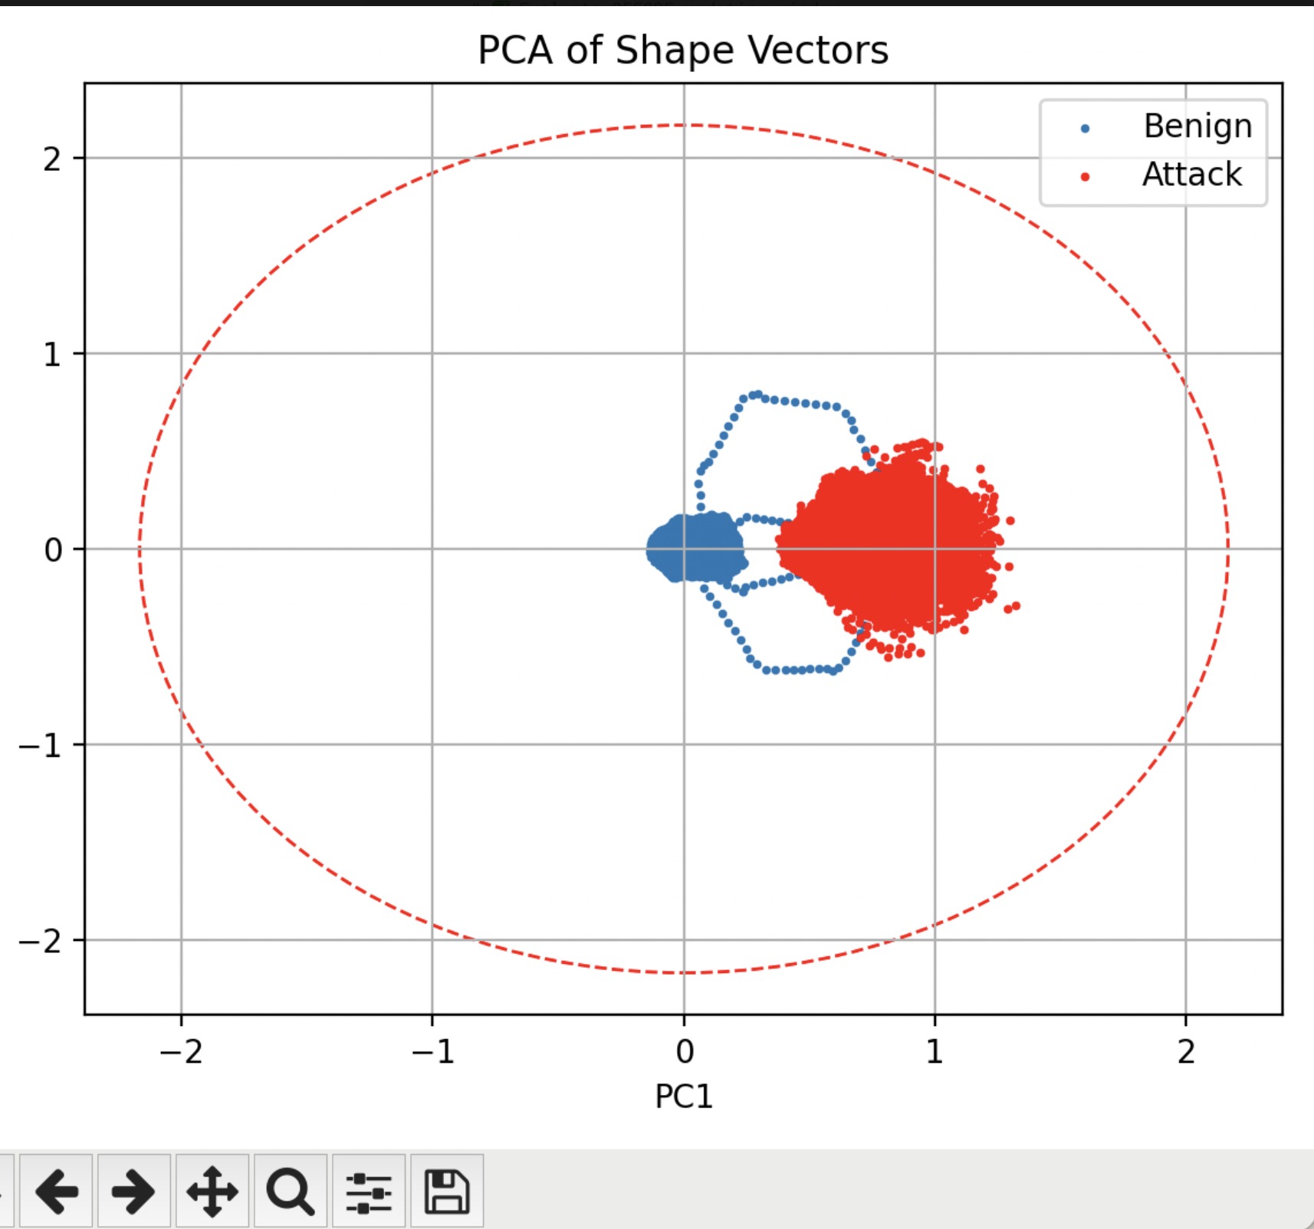
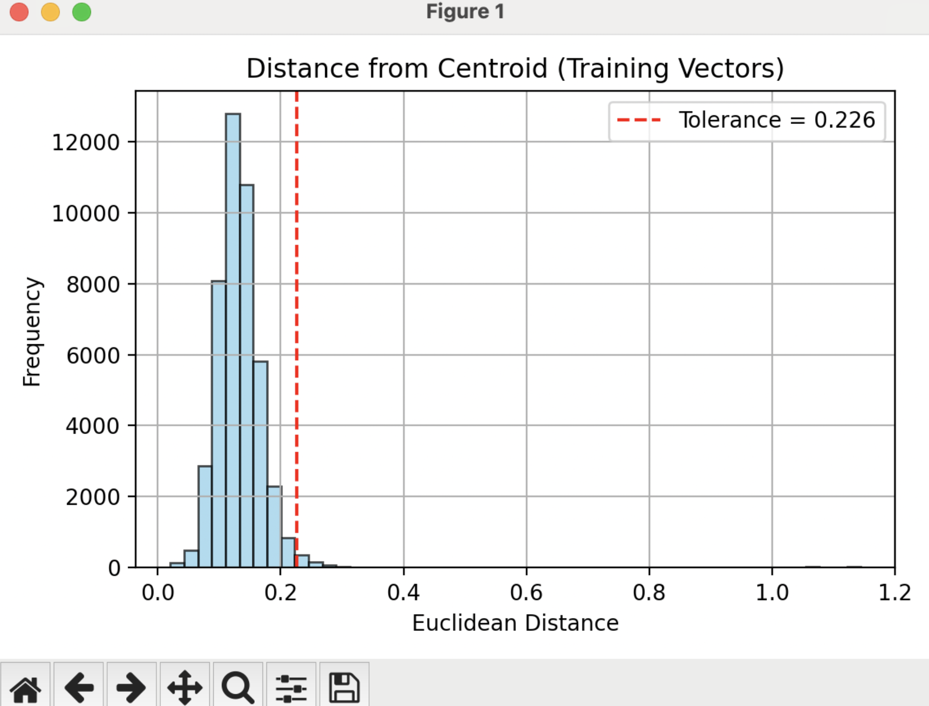
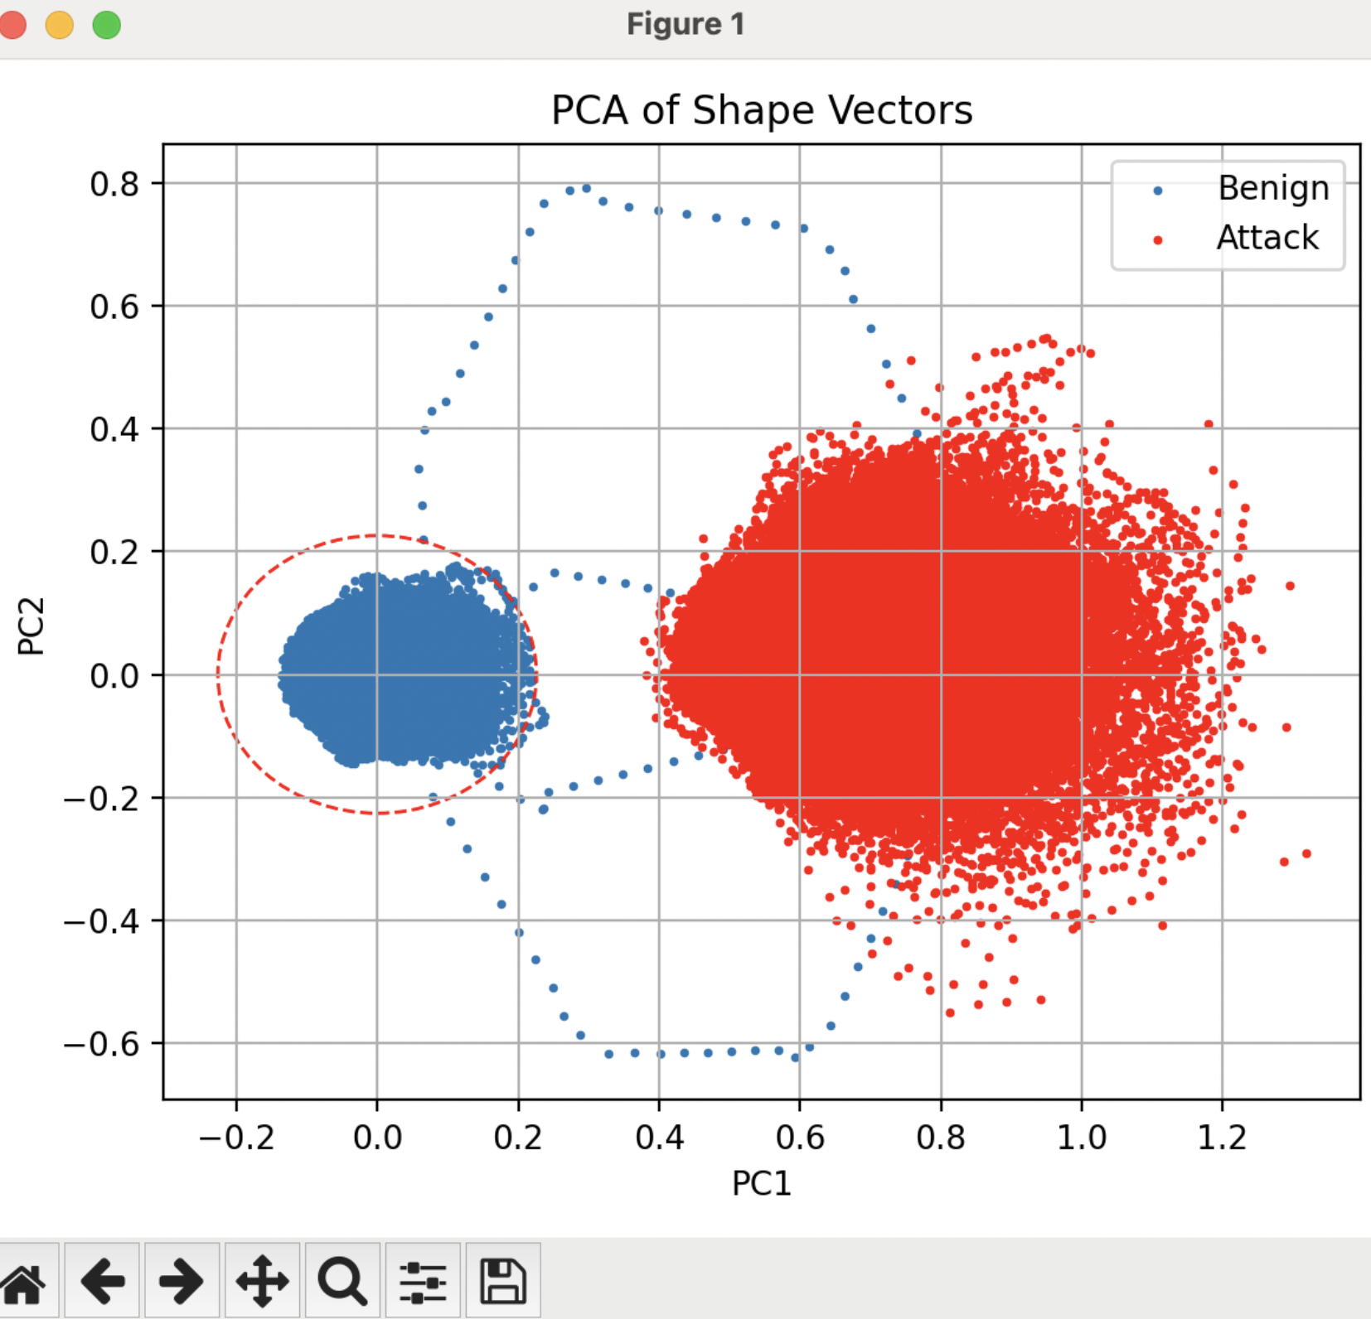
Centroid Results Root Cause: SSL
Without Quantile
With Quantile
With Quantile
With Quantile

Slide 9
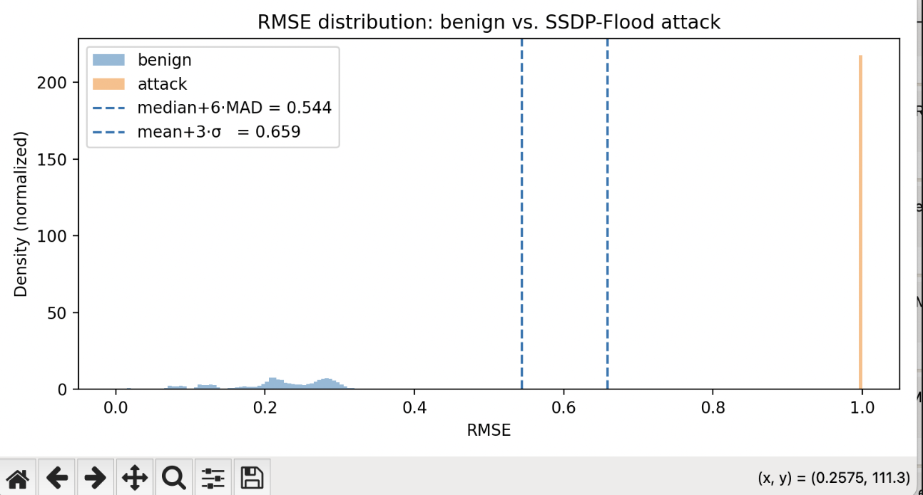
Centroid Results Root Cause: SSL
The Problem with Max Distance tolerance = max_distance_from_centroid × tol_factor
Issue: One noisy spike during training inflates the max_distance.
This results in an overly large boundary.
Almost every test vector is considered "benign", leading to:
False negatives (missed attacks)
Zero true positives (TPR = 0)
High False Positive Rate if patterns drift due to attack vectors.
💡 Real Example - OS_Scan & SSL_Renegotiation
Title: Example: Where Max Distance Fails
Scenario: One training vector (due to jitter, delayed packet burst, or device anomaly) lies very far from others.
Max distance now shifts from ~0.2 → 1.9+
All test vectors—even highly anomalous ones—are considered "normal".
Observed Result:
TPR = 0.0,
F1 = 0.0,
Zero attack detection.
PCA plots clearly show attack vectors are far from benign cluster but inside inflated boundary.

Slide 10
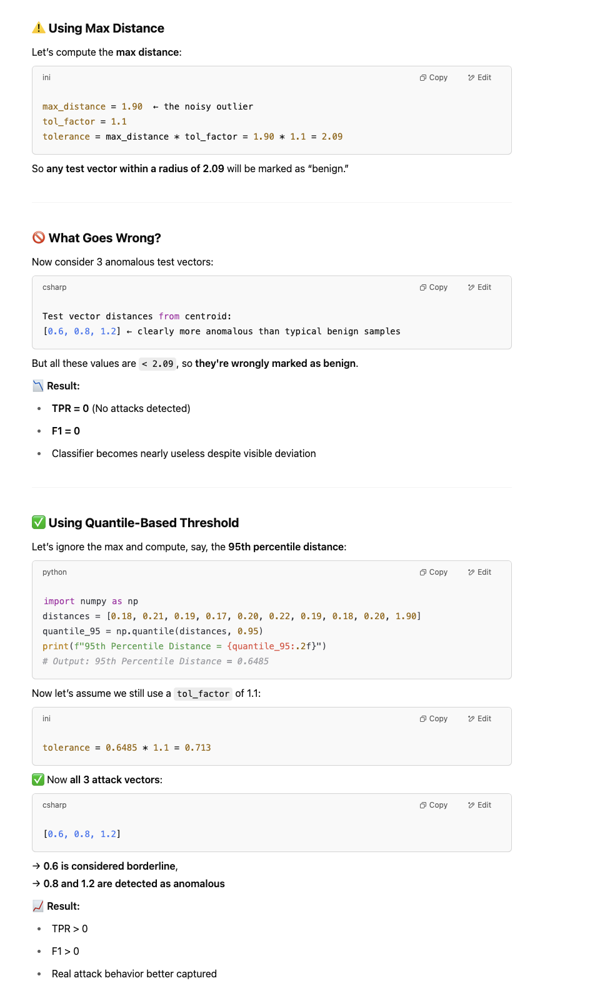
Centroid Results Root C ause: SSL Max Dist

Slide 11
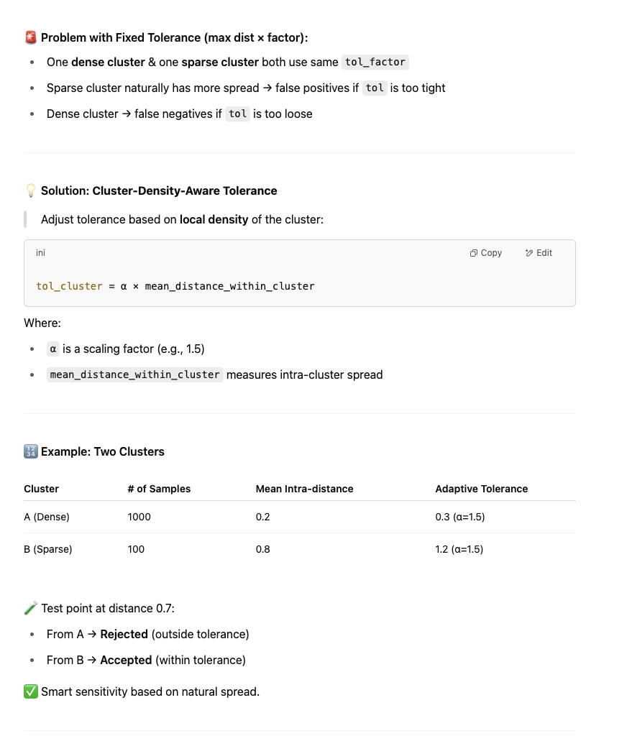
Future Work:
Switch from max(distances) → quantile(distances)
Use Mahalanobis distance to factor in spread: Mahalanobis Distance adjusts for feature correlation and variance. It gives low scores to “normal” spread and high scores to true outliers, even when they lie close in Euclidean terms.
Consider hybrid rule: Unknown OR (Some Method)
Try adaptive tolerance based on cluster density-Right now it’s a hyperparameter but I think there is a chance we can use a adaptive threshold based on the cluter density for deciding the tolerance.
Right now we are doing a binary search to find a tipping point of tolerance in terms of it acting as a hyperparameter

