Slide 1
Designing Data for the Open World of the Web
Dr Thomas Baker
Dublin Core Metadata Initiative
Linked Data Seminar
Florence, 18 June 2012

Slide 2
RDF – grammar for a language of data
ResourceA
Resource
ResourceB
relatedTo
ResourceA
Resource
describedBy
Some text
“Statements” (“triples”), like sentences, describe things.
URIs (and sometimes text) are the “words” of statements.
As Web addresses, URIs are like “footnotes” for data.

Slide 3
Example: “linking” two resources

Slide 4
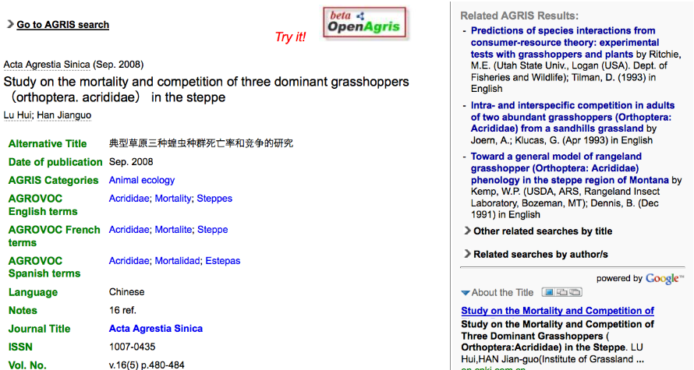
Resource A: Article indexed in AGRIS database
Topic of the article
Is “acrididae”, i.e.
“grasshoppers”.
One author is named
“Lu Hui”.

Slide 5
Statements about Resource A as “pseudo-triples”
Subject | Predicate | Object
Resource A | has the Title | 典型草原三种蝗虫种群死亡率的研究
Resource A | has an Author | Lu Hui
Resource A | has a Topic | Acrididae (grasshoppers)

Slide 6
Triplifying the description…
Subject | Predicate | Object
agris:CN2009002389 | has the Title | 典型草原三种蝗虫种群死亡率的研究
agris:CN2009002389 | has an Author | Lu Hui
agris:CN2009002389 | has a Topic | Acrididae (grasshoppers)
Resource A is identified by the URI http://agris.fao.org/resource/CN2009002389.
Let’s abbreviate this as agris:CN2009002389.

Slide 7
Triplifying the description…
Subject | Predicate | Object
agris:CN2009002389 | has the Title | 典型草原三种蝗虫种群死亡率的研究
agris:CN2009002389 | has an Author | agris-author:luhui
agris:CN2009002389 | has a Topic | Acrididae (grasshoppers)
The author is identified by the URI http://agris.fao.org/author/luhui.
Let’s abbreviate this as agris-author:luhui.

Slide 8
Triplifying the description…
Subject | Predicate | Object
agris:CN2009002389 | has the Title | 典型草原三种蝗虫种群死亡率的研究
agris:CN2009002389 | has an Author | agris-author:luhui
agris-author:luhui | has the Name | Lu Hui
agris:CN2009002389 | has a Topic | Acrididae (grasshoppers)
The author agris-author:luhui has the name Lu Hui.

Slide 9
Triplifying the description…
Subject | Predicate | Object
agris:CN2009002389 | has the Title | 典型草原三种蝗虫种群死亡率的研究
agris:CN2009002389 | has an Author | agris-author:luhui
agris-author:luhui | has the Name | Lu Hui
agris:CN2009002389 | has a Topic | agrovoc:c_4416
The topic is identified by the URI http://aims.fao.org/aos/agrovoc/c_4416.
Let’s abbreviate this as agrovoc:c_4416.

Slide 10
Triplifying the description…
Subject | Predicate | Object
agris:CN2009002389 | has the Title | 典型草原三种蝗虫种群死亡率的研究
agris:CN2009002389 | has an Author | agris-author:luhui
agris-author:luhui | has the Name | Lu Hui
agris:CN2009002389 | has a Topic | agrovoc:c_4416
agrovoc:c_4416 | has preferred label | Acrididae (en)
agrovoc:c_4416 | has preferred label | 蝗科 (zh)
The description of http://aims.fao.org/aos/agrovoc/c_4416 in the AGROVOC
Concept Scheme tells us how this concept is labeled in English and in Chinese.

Slide 11
Triplifying the description…
Subject | Predicate | Object
agris:CN2009002389 | dct:title | 典型草原三种蝗虫种群死亡率的研究
agris:CN2009002389 | has an Author | agris-author:luhui
agris-author:luhui | has the Name | Lu Hui
agris:CN2009002389 | has a Topic | agrovoc:c_4416
agrovoc:c_4416 | has preferred label | Acrididae (en)
agrovoc:c_4416 | has preferred label | 蝗科 (zh)
The Dublin Core element “Title” is identified by the URI http://purl.org/dc/terms/title.
Let’s abbreviate this as dct:title.

Slide 12
Triplifying the description…
Subject | Predicate | Object
agris:CN2009002389 | dct:title | 典型草原三种蝗虫种群死亡率的研究
agris:CN2009002389 | dct:creator | agris-author:luhui
agris-author:luhui | foaf:name | Lu Hui
agris:CN2009002389 | dct:subject | agrovoc:c_4416
agrovoc:c_4416 | has preferred label | Acrididae (en)
agrovoc:c_4416 | has preferred label | 蝗科 (zh)
Ditto for author (i.e., creator) and topic (i.e. subject).
Name is defined in the FOAF vocabulary.

Slide 13
Triplifying the description…
Subject | Predicate | Object
agris:CN2009002389 | dct:title | 典型草原三种蝗虫种群死亡率的研究
agris:CN2009002389 | dct:creator | agris-author:luhui
agris-author:luhui | foaf:name | Lu Hui
agris:CN2009002389 | dct:subject | agrovoc:c_4416
agrovoc:c_4416 | skos:prefLabel | Acrididae (en)
agrovoc:c_4416 | skos:prefLabel | 蝗科 (zh)
A property for the preferred label of a concept has been defined
In the Simple Knowledge Organization System (SKOS) vocabulary.

Slide 14
The triples seen as a graph
dct:title
典型草…
agris:CN…389
dct:subject
dct:creator
agrovoc:c_4416
agris-author:
luhui
foaf:name
Lu Hui
Subject | Predicate | Object
agris:CN2009002389 | dct:title | 典型草原三种蝗虫种群死亡率的研究
agris:CN2009002389 | dct:creator | agris-author:luhui
agris-author:luhui | foaf:name | Lu Hui
agris:CN2009002389 | dct:subject | agrovoc:c_4416

Slide 15
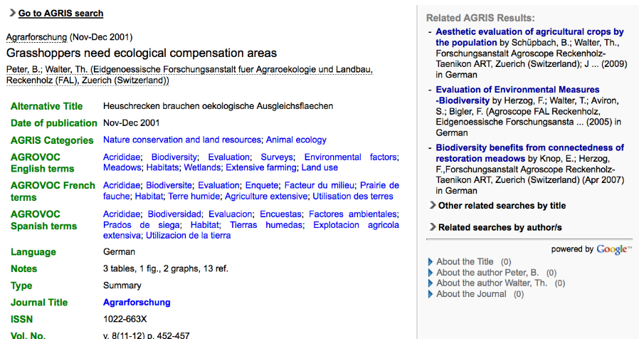
Resource B: AGRIS article in German

Slide 16
Triples describing Resource B seen as a graph
dct:title
Heuschrecken
agris:CH…179
dct:subject
dct:creator
agrovoc:c_4416
agris-author:
peterb
foaf:name
Peter, B.
Subject | Predicate | Object
agris:CH2001000179 | dct:title | Heuschrecken brauchen ökologische Ausgleichsflächen
agris:CH2001000179 | dct:creator | agris-author:peterb
agris-author:peterb | foaf:name | Peter, B.
agris:CH2001000179 | dct:subject | agrovoc:c_4416

Slide 17
Merging triples for Resource A…
Subject | Predicate | Object
agris:CN2009002389 | dct:title | 典型草原三种蝗虫种群死亡率的研究
agris:CN2009002389 | dct:creator | agris-author:luhui
agris-author:luhui | foaf:name | Lu Hui
agris:CN2009002389 | dct:subject | agrovoc:c_4416

Slide 18
…with triples for Resource B…
Subject | Predicate | Object
agris:CN2009002389 | dct:title | 典型草原三种蝗虫种群死亡率的研究
agris:CN2009002389 | dct:creator | agris-author:luhui
agris-author:luhui | foaf:name | Lu Hui
agris:CN2009002389 | dct:subject | agrovoc:c_4416
agris:CH2001000179 | dct:title | Heuschrecken brauchen ökologische Ausgleichsflächen
agris:CH2001000179 | dct:creator | agris-author:peterb
agris-author:peterb | foaf:name | Peter, B.
agris:CH2001000179 | dct:subject | agrovoc:c_4416

Slide 19
The computer detects matching URIs...
Subject | Predicate | Object
agris:CN2009002389 | dct:title | 典型草原三种蝗虫种群死亡率的研究
agris:CN2009002389 | dct:creator | agris-author:luhui
agris-author:luhui | foaf:name | Lu Hui
agris:CN2009002389 | dct:subject | agrovoc:c_4416
agris:CH2001000179 | dct:title | Heuschrecken brauchen ökologische Ausgleichsflächen
agris:CH2001000179 | dct:creator | agris-author:peterb
agris-author:peterb | foaf:name | Peter, B.
agris:CH2001000179 | dct:subject | agrovoc:c_4416

Slide 20
The computer detects matching URIs...
dct:title
Heuschrecken
agris:CH…179
dct:subject
dct:creator
agris-author:
peterb
foaf:name
agrovoc:c_4416
Peter, B.
dct:subject
agrovoc:c_4416
agris:CN…389
dct:title
dct:creator
典型草…
agris-author:
luhui
foaf:name
Lu Hui

Slide 21
…and merges (“links”) the graphs into one.
dct:title
Heuschrecken
agris:CH…179
dct:subject
dct:creator
agris-author:
peterb
foaf:name
agrovoc:c_4416
Peter, B.
Resources in different
languages, linked by
reference to a common
KOS Concept.
An “infinitely expandable
description”…!
dct:subject
agris:CN…389
dct:title
dct:creator
典型草…
agris-author:
luhui
foaf:name
Lu Hui

Slide 22
Casting a wider net

Slide 23
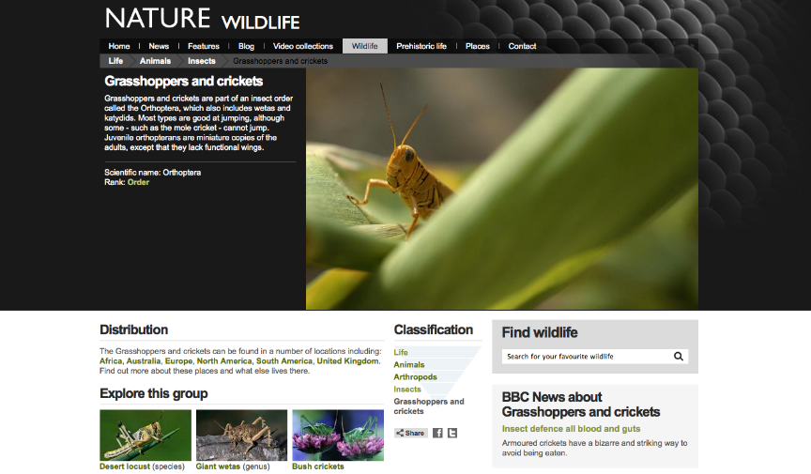
http://www.bbc.co.uk/nature/life/Orthoptera

Slide 24
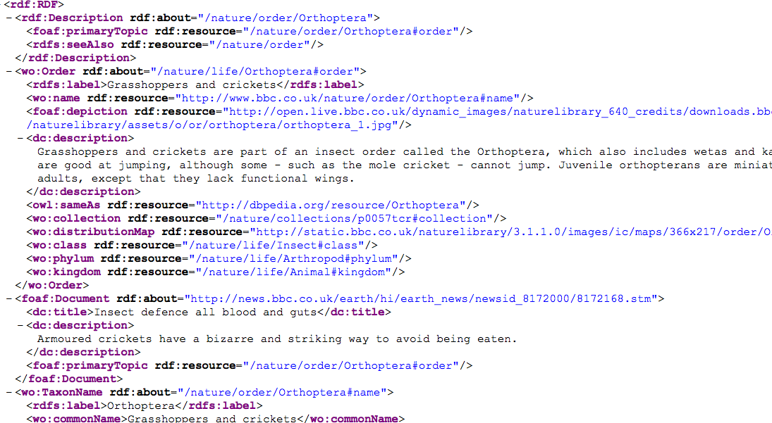
http://www.bbc.co.uk/nature/life/Orthoptera.rdf

Slide 25
http://www.bbc.co.uk/nature/life/Orthoptera.ttl
<http://www.bbc.co.uk/nature/life/Orthoptera#order>
rdf:type wo:Order ;
dc:description "Grasshoppers and crickets are part of an insect order called the Orthoptera, which also includes wetas and katydids. … " ;
wo:class <http://www.bbc.co.uk/nature/life/Insect#class> ;
wo:collection <http://www.bbc.co.uk/nature/collections/p0057tcr#collection> ;
wo:distributionMap <http://static.bbci.co.uk/naturelibrary/3.1.39/images/ic/maps/366x217/order/Orthoptera.gif> ;
wo:kingdom <http://www.bbc.co.uk/nature/life/Animal#kingdom> ;
wo:name <http://www.bbc.co.uk/nature/order/Orthoptera#name> ;
wo:phylum <http://www.bbc.co.uk/nature/life/Arthropod#phylum> ;
rdfs:label "Grasshoppers and crickets" ;
owl:sameAs <http://dbpedia.org/resource/Orthoptera> ;
foaf:depiction <http://ichef.bbci.co.uk/naturelibrary/images/ic/640x360/o/or/orthoptera/orthoptera_1.jpg> ;
.
<http://www.bbc.co.uk/nature/order/Orthoptera#name>
rdf:type wo:TaxonName ;
wo:className "Insecta" ; wo:commonName "Grasshoppers and crickets" ;
wo:kingdomName "animalia" ; wo:orderName "Orthoptera" ;
wo:phylumName "Arthropoda" ; wo:scientificName "Orthoptera" ;
rdfs:label "Orthoptera" ;
.
<http://news.bbc.co.uk/earth/hi/earth_news/newsid_8172000/8172168.stm>
rdf:type foaf:Document ;
dc:description "Armoured crickets have a bizarre and striking way to avoid being eaten." ;
dc:title "Insect defence all blood and guts" ;
foaf:primaryTopic <http://www.bbc.co.uk/nature/order/Orthoptera#order> ;
.

Slide 26
The BBC Grasshopper page links to a news article…

Slide 27
The BBC Grasshopper page links to a news article…
<http://www.bbc.co.uk/nature/life/Orthoptera#order>
rdf:type wo:Order ;
dc:description "Grasshoppers and crickets are part of an insect order called the Orthoptera, which also includes wetas and katydids. … " ;
wo:class <http://www.bbc.co.uk/nature/life/Insect#class> ;
wo:collection <http://www.bbc.co.uk/nature/collections/p0057tcr#collection> ;
wo:distributionMap <http://static.bbci.co.uk/naturelibrary/3.1.39/images/ic/maps/366x217/order/Orthoptera.gif> ;
wo:kingdom <http://www.bbc.co.uk/nature/life/Animal#kingdom> ;
wo:name <http://www.bbc.co.uk/nature/order/Orthoptera#name> ;
wo:phylum <http://www.bbc.co.uk/nature/life/Arthropod#phylum> ;
rdfs:label "Grasshoppers and crickets" ;
owl:sameAs <http://dbpedia.org/resource/Orthoptera> ;
foaf:depiction <http://ichef.bbci.co.uk/naturelibrary/images/ic/640x360/o/or/orthoptera/orthoptera_1.jpg> ;
.
<http://www.bbc.co.uk/nature/order/Orthoptera#name>
rdf:type wo:TaxonName ;
wo:className "Insecta" ; wo:commonName "Grasshoppers and crickets" ;
wo:kingdomName "animalia" ; wo:orderName "Orthoptera" ;
wo:phylumName "Arthropoda" ; wo:scientificName "Orthoptera" ;
rdfs:label "Orthoptera" ;
.
<http://news.bbc.co.uk/earth/hi/earth_news/newsid_8172000/8172168.stm>
rdf:type foaf:Document ;
dc:description "Armoured crickets have a bizarre and striking way to avoid being eaten." ;
dc:title "Insect defence all blood and guts" ;
foaf:primaryTopic <http://www.bbc.co.uk/nature/order/Orthoptera#order> ;
.

Slide 28
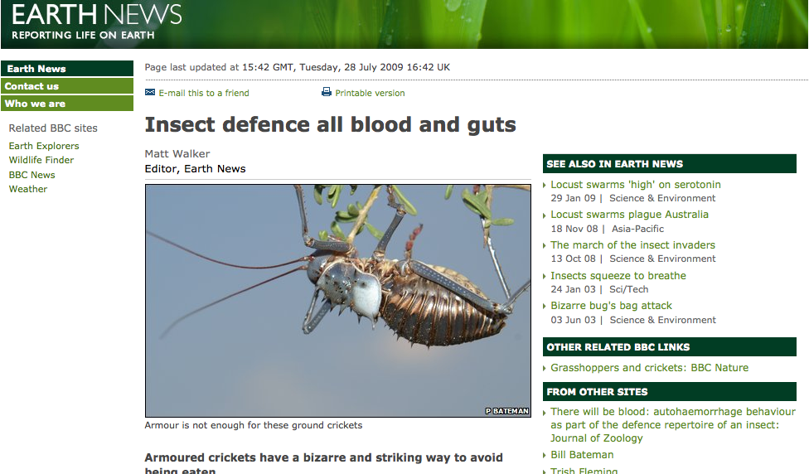
http://news.bbc.co.uk/earth/hi/earth_news/newsid_8172000/8172168.stm

Slide 29
…and to a DBPedia category…

Slide 30
…and to a DBPedia category…
<http://www.bbc.co.uk/nature/life/Orthoptera#order>
rdf:type wo:Order ;
dc:description "Grasshoppers and crickets are part of an insect order called the Orthoptera, which also includes wetas and katydids. … " ;
wo:class <http://www.bbc.co.uk/nature/life/Insect#class> ;
wo:collection <http://www.bbc.co.uk/nature/collections/p0057tcr#collection> ;
wo:distributionMap <http://static.bbci.co.uk/naturelibrary/3.1.39/images/ic/maps/366x217/order/Orthoptera.gif> ;
wo:kingdom <http://www.bbc.co.uk/nature/life/Animal#kingdom> ;
wo:name <http://www.bbc.co.uk/nature/order/Orthoptera#name> ;
wo:phylum <http://www.bbc.co.uk/nature/life/Arthropod#phylum> ;
rdfs:label "Grasshoppers and crickets" ;
owl:sameAs <http://dbpedia.org/resource/Orthoptera> ;
foaf:depiction <http://ichef.bbci.co.uk/naturelibrary/images/ic/640x360/o/or/orthoptera/orthoptera_1.jpg> ;
.
<http://www.bbc.co.uk/nature/order/Orthoptera#name>
rdf:type wo:TaxonName ;
wo:className "Insecta" ; wo:commonName "Grasshoppers and crickets" ;
wo:kingdomName "animalia" ; wo:orderName "Orthoptera" ;
wo:phylumName "Arthropoda" ; wo:scientificName "Orthoptera" ;
rdfs:label "Orthoptera" ;
.
<http://news.bbc.co.uk/earth/hi/earth_news/newsid_8172000/8172168.stm>
rdf:type foaf:Document ;
dc:description "Armoured crickets have a bizarre and striking way to avoid being eaten." ;
dc:title "Insect defence all blood and guts" ;
foaf:primaryTopic <http://www.bbc.co.uk/nature/order/Orthoptera#order> ;
.

Slide 31
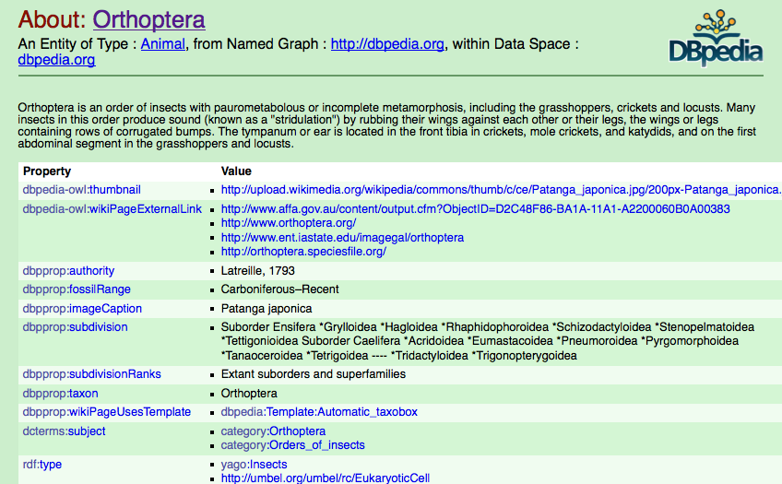
http://dbpedia.org/page/Orthoptera

Slide 32
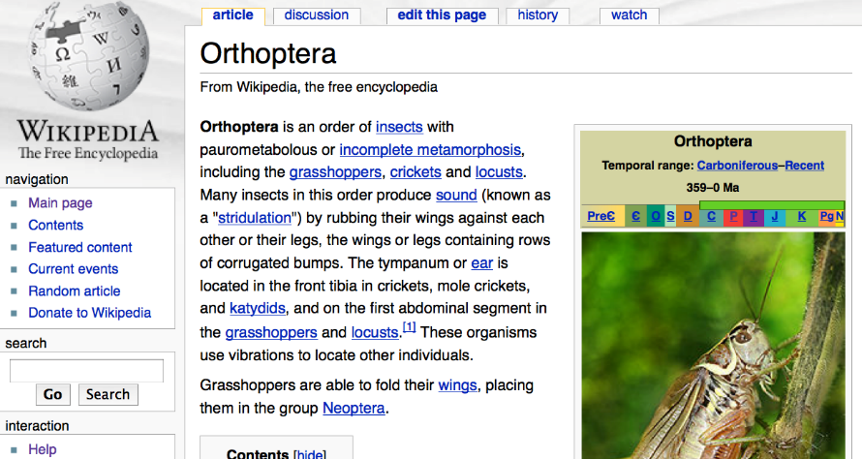
…using information extracted from Wikipedia.

Slide 33
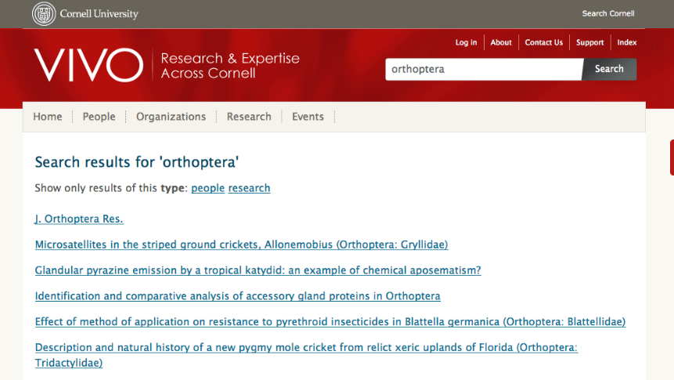
What else links to the DBPedia concept…?

Slide 34
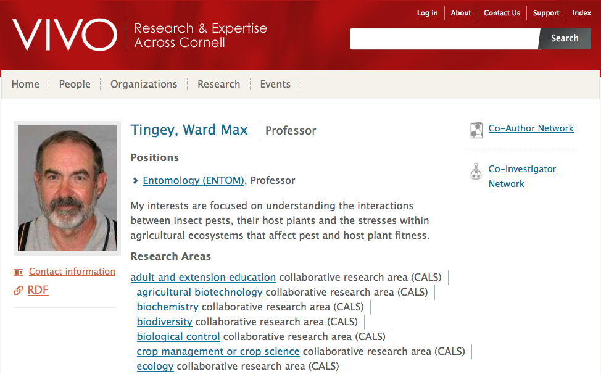
…the description of an expert!

Slide 35
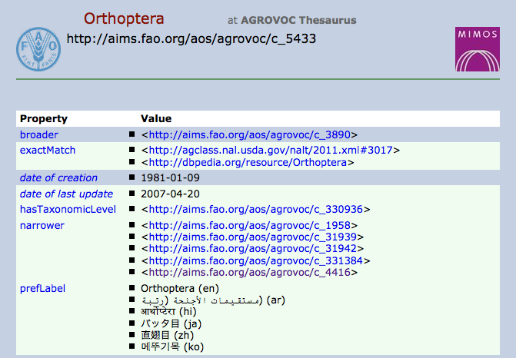
What else links to the DBPedia concept?
“exactly matches”
“broader than”

Slide 36
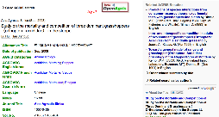
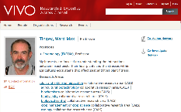
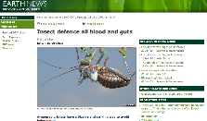
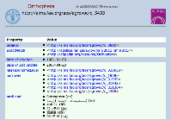
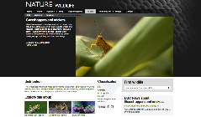
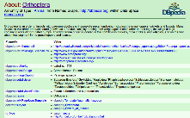
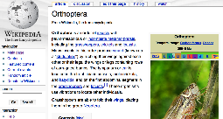
“Six degrees of (linked-data) separation”…
BBC News
AGRIS record
VIVO Expert
AGROVOC
concept
BBC Web page
DBPedia
concept
Wikipedia
page

Slide 37
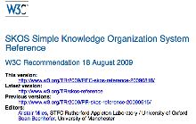
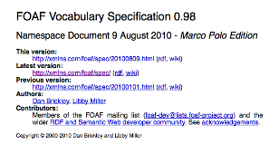
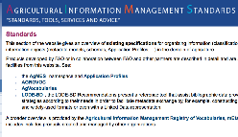
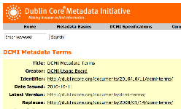
“Record”: cluster of triples, many outward-pointing URIs
SKOS
AGRIS record
AGROVOC
FOAF
Dublin Core
AGRIS Authors

Slide 38
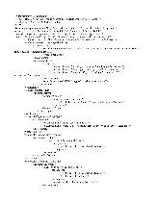
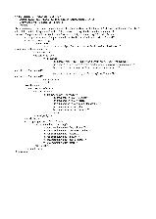
Traditional paradigm: Map between structured Records
Schema A
Schema B
Schema C
same
as
mapped
to

Slide 39
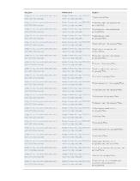
Linked Data: Applications create good triples
Application A
Application B
Application C

Slide 40
Data “speaks for itself” independently of “applications”
Application A
Application B
Application C

Slide 41




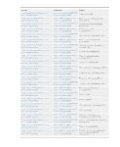
…as long as its source vocabularies are preserved
FRBR
SKOS
FOAF
DC
RDA
VIAF
LCSH

Slide 42
tom@tombaker.org

