Slide 1
BCube - CyberWay
Steve Browdy
OMS Tech,, Inc.

Slide 2
Background
BCube was an EarthCube project funded in 2013
Components worked with
BCube Broker (to support science scenarios for the project)
NSIDC Crawler (to search for data supporting project science scenarios)
FGDC Service Status Checker
Successes
BCube Broker was successfully configured for appropriate datasets and catalogs, and allowed access to harvested metadata/data
NSIDC Crawler was successfully deployed in AWS, and then again in ECITE (EarthCube Integrated Test Environment)
FGDC Service Status Checker was used to test endpoints found by the crawler and configured into the broker

Slide 3
FGDC Service Status Checker

Slide 4
Basic Information
Provided and managed by FGDC
Performs validity checks on geospatial services that provide access to metadata and data
Currently 103,358 services are registered and tested daily
Receive alert notifications for service interruptions or status reports
Provides an API so that service reports can be integrated into custom code
Supports test results based on a configured service feed or an instant live test

Slide 5
Supported Standards/Protocols
Metadata
CSW
WAF
Z39.50
Data
OGC Services (WMS, WCS, WFS, SOS)
ArcGIS Server (Image, Map, Feature)
OPeNDAP
Others can be developed

Slide 6
Results of a Test
Summary
URL tested
currentSpeed: the time taken (in seconds) to perform the test
currentScore: is a reliability score calculated as a factor of currentSpeed and the correctness of the response
Tests (depends on service type)
For OPeNDAP
httpServer test
getCatalog test
getDDS test
getData test

Slide 7
Example Live Request
Make sure to have API key
Form request URL
https://statuschecker.fgdc.gov/api/v2/liveTest?auth=8ef56da73c12a00e83b76c597ca012bc&type=opendap&url=https://disc2.gesdisc.eosdis.nasa.gov/opendap/TRMM_L3/TRMM_3B43.7/
Submit request via browser or programmatically
Get result (see web page)
JSON format (by default)
Live test also supports XML

Slide 8
CyberWay Architecture

Slide 9
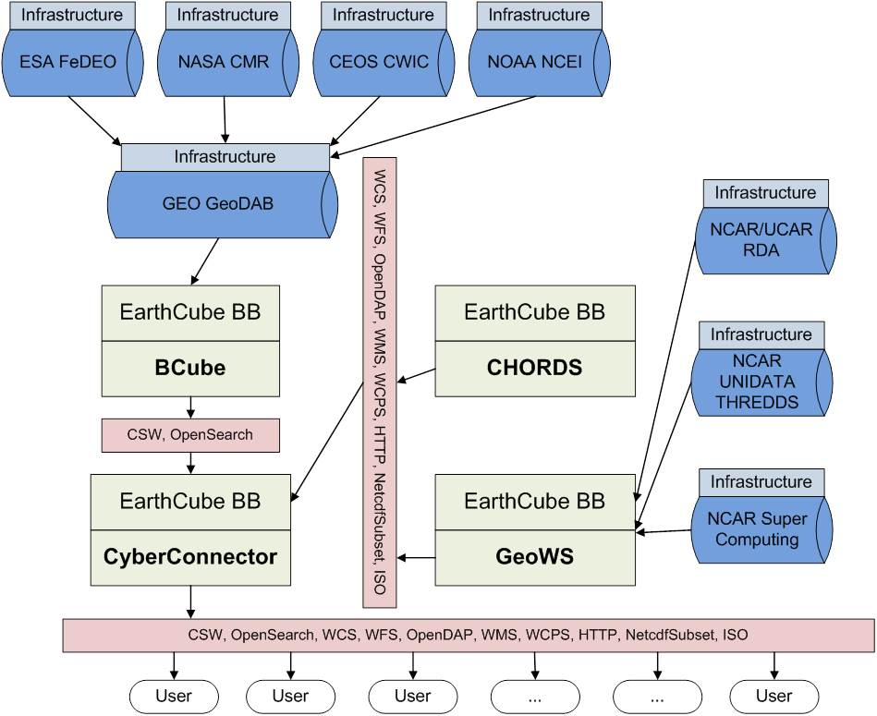
Current Architecture

Slide 10
Proposed Architecture
X
BCube Broker
BCube Crawler
FGDC Status Checker

