Slide 1
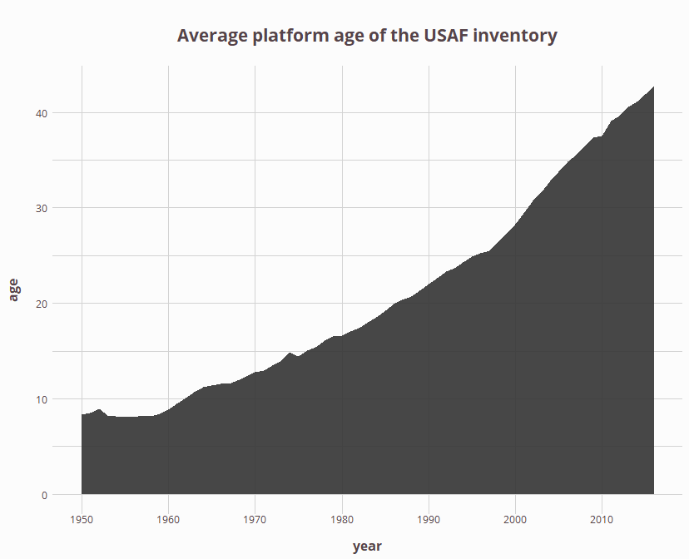
Notes:
P_total_age
This chart takes the entire USAF inventory and calculates the average platform age. Our team determined the age for each aircraft in a given year by calculating the first year that each platform entered the active USAF inventory, and then weighting the age by its inventory relative to the inventory of the total force in a given year. For example, according to our sources, the F-16 was introduced in 1975 and the F-35 was introduced in 2010. In 2015, the platform age is 40 for the F-16 and 5 for the F-35. So, if the entire USAF inventory consisted of 80% F-16s and 20% F-35s, we would calculate the ‘Average platform age of the USAF inventory’ to be 33 years (calculation: 40 * .8 + 5 * .2 = 33).
Given the available data, it would be extremely difficult or impossible to calculate the average age of engines within the military. But, the USAF has relatively good data on its inventory, and we can therefore calculate the platform age. The trend is clear. The USAF is confronting the challenge of an aging force. And although we don’t have the level of specificity for Army and Navy, the trends are similar.
A single platform may go through different engines throughout its life time, whether it’s a replacement engine or an engine upgrade. And this chart can’t reflect that. For example, the F-16 (introduced in 1975) had 4 distinct engines.
The average age of the USAF in

Slide 2
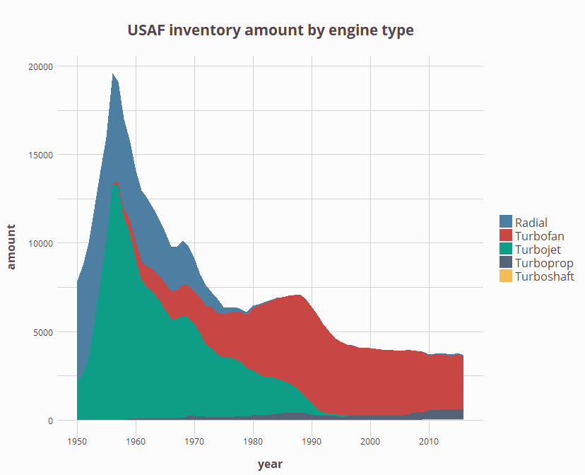
Notes:
P_type (excluding helicopters and trainers)

Slide 3
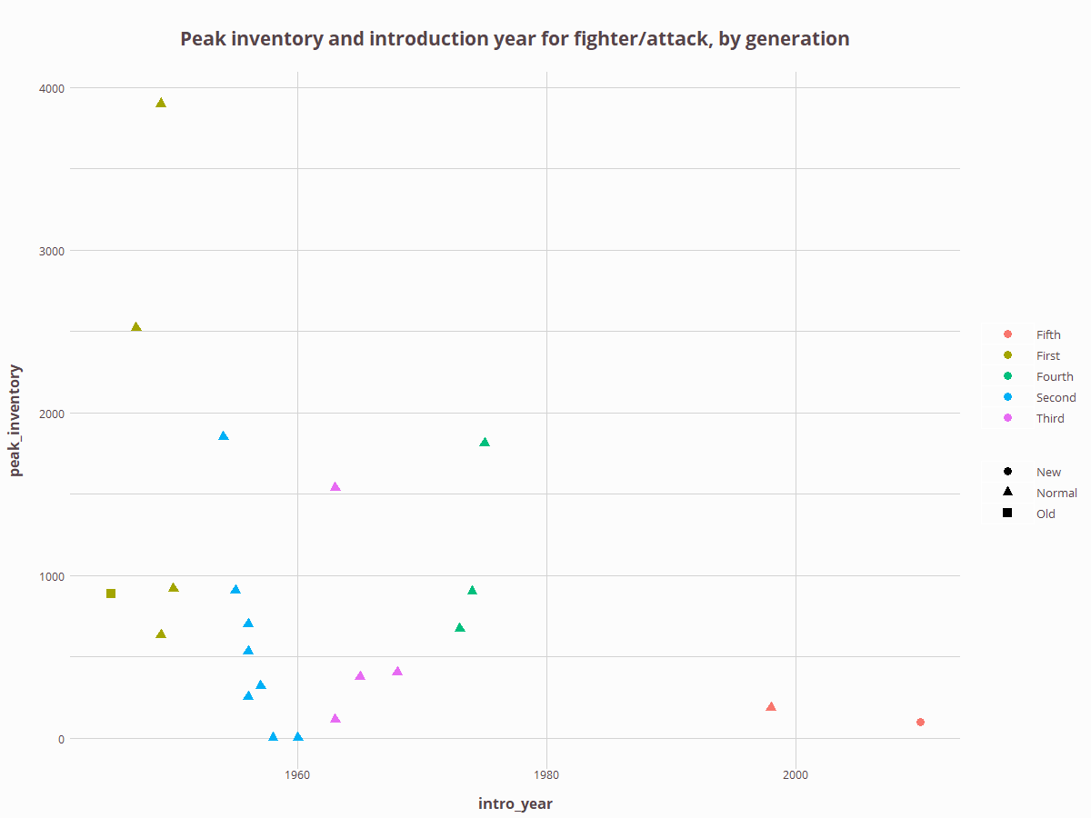
Notes:
p_peak_inventory_generation

Slide 4
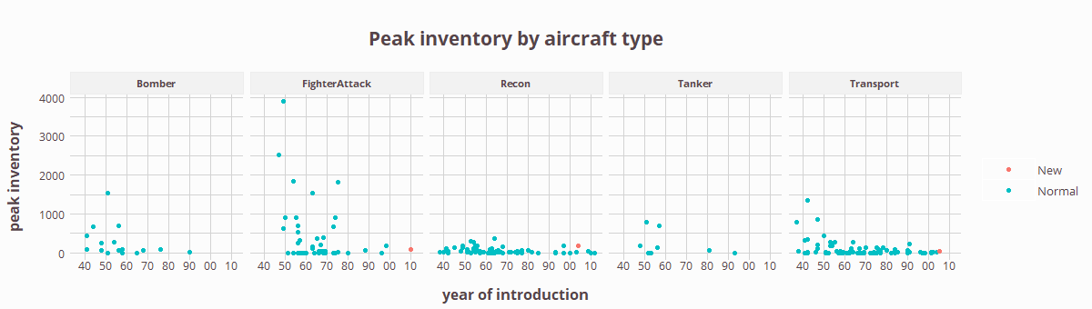
Notes:
p_peak_inventory

Slide 5
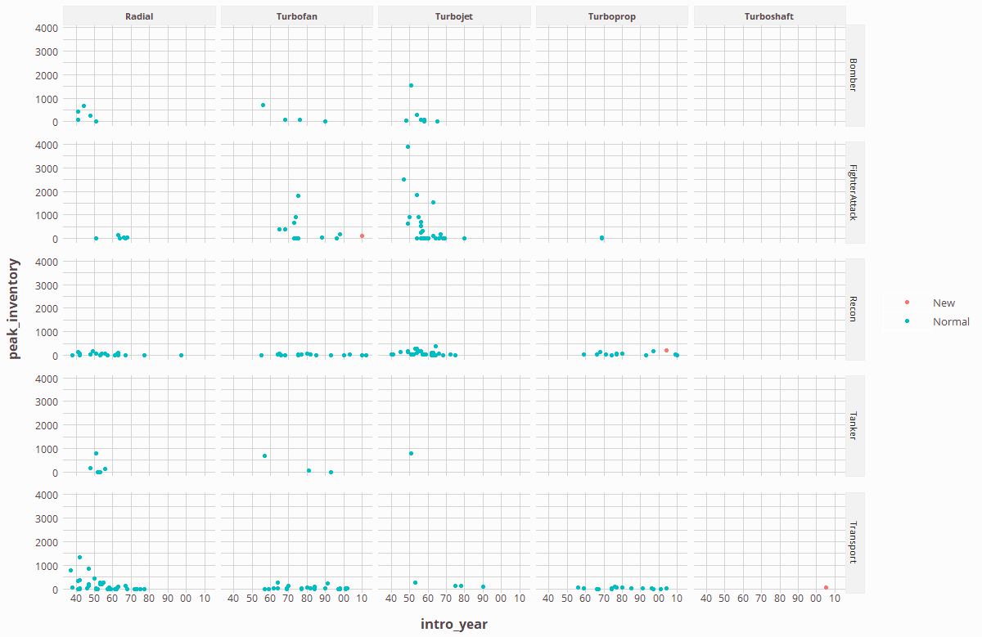
Notes:
p_peak_inventory_grid

Slide 6
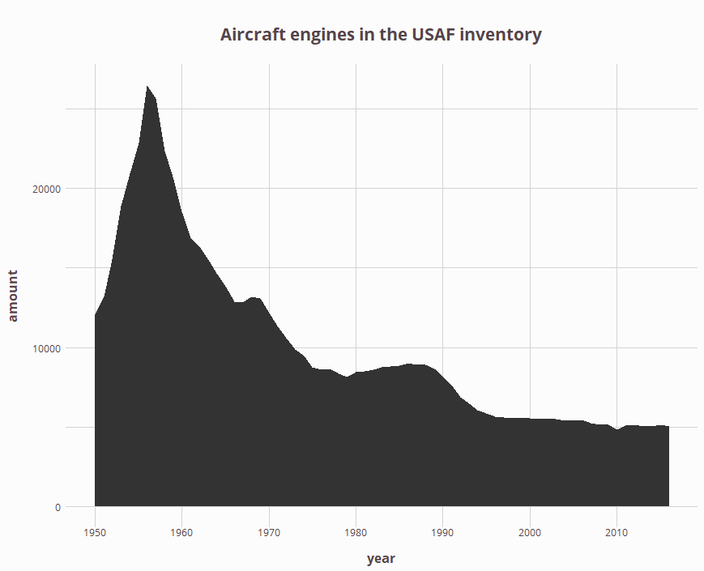
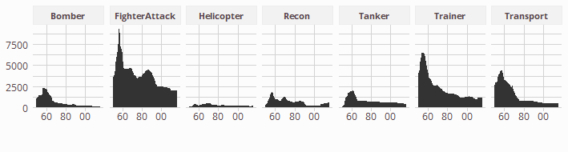

Slide 7
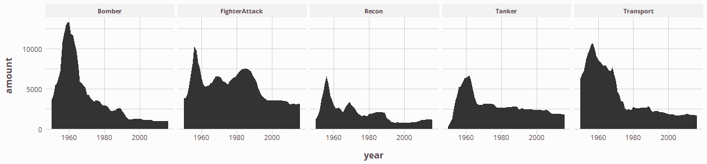
Notes:
P (number of engines in the USAF inventory)

Slide 8
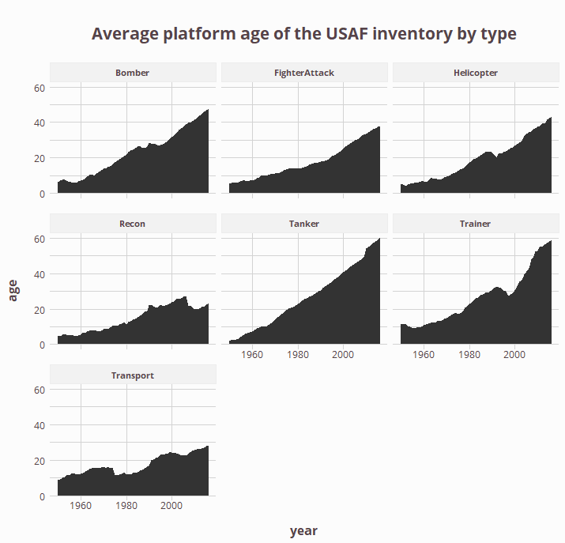

Slide 9
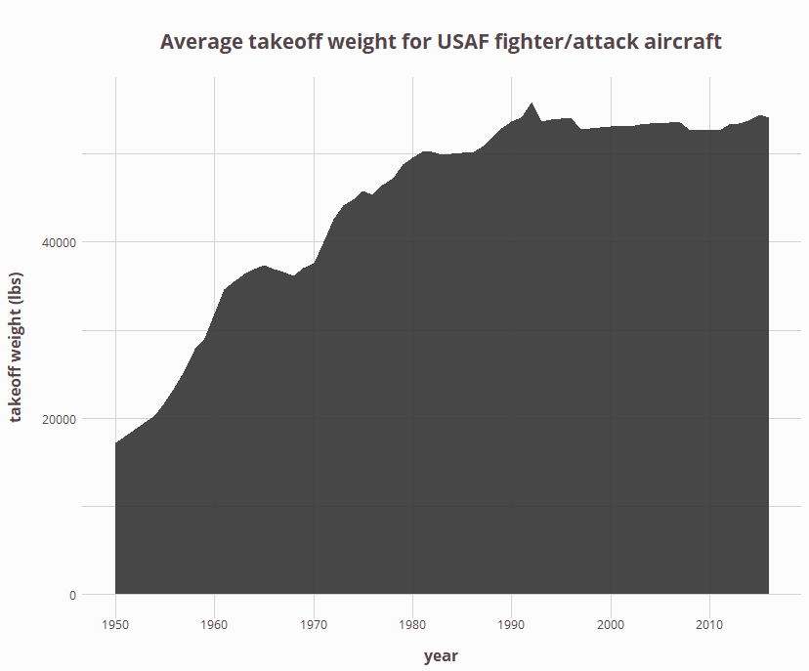
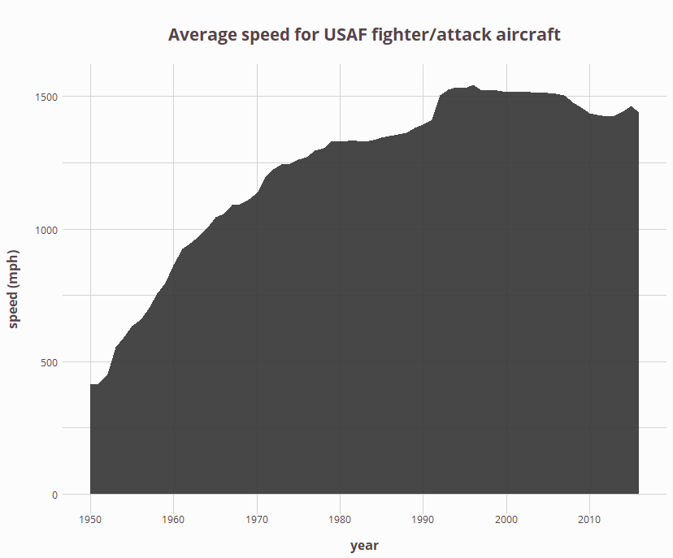
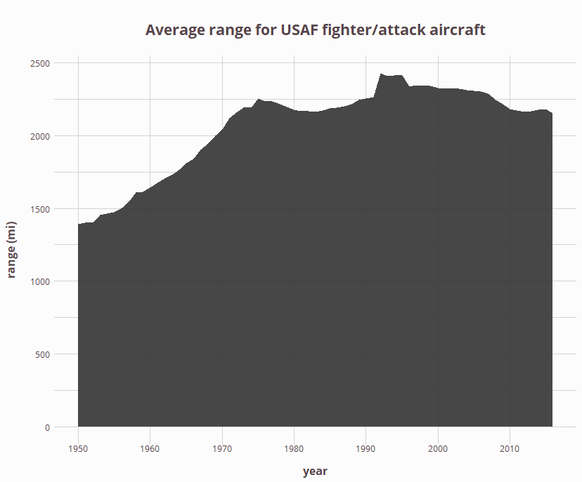
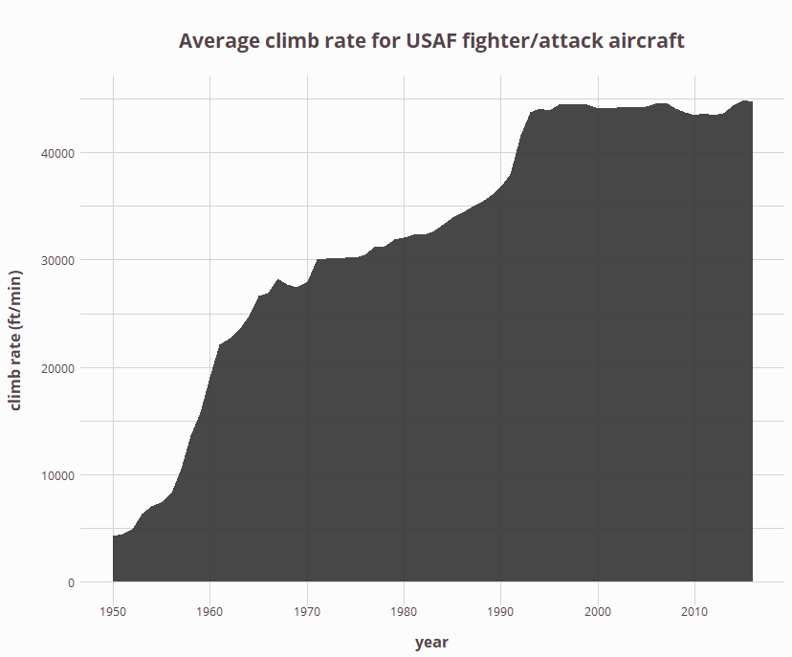
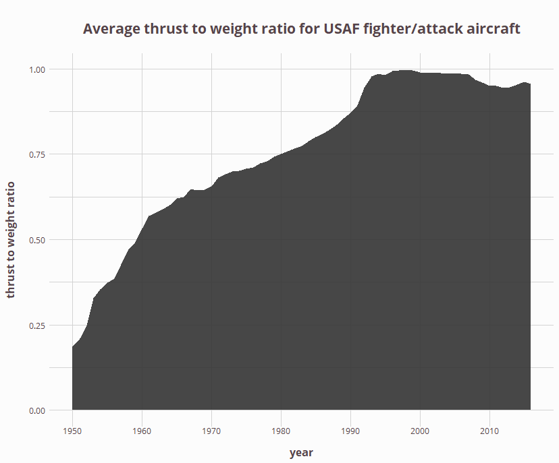
Notes:
p_takeoff_weight
p_speed
p_range
p_ceiling
p_climb_rate
p_thrust_weight_aircraft

Slide 10
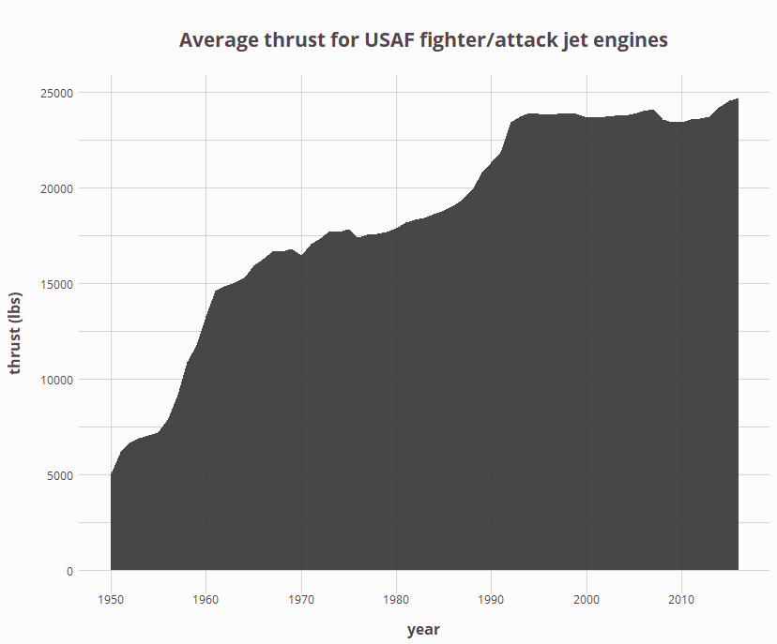
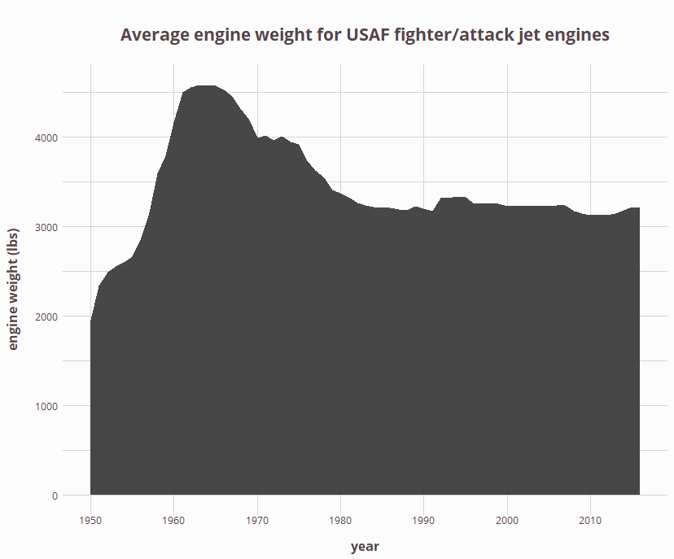
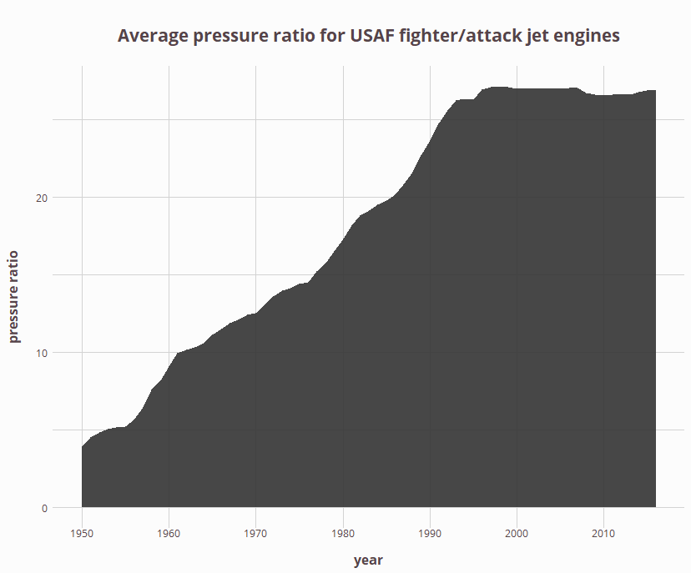
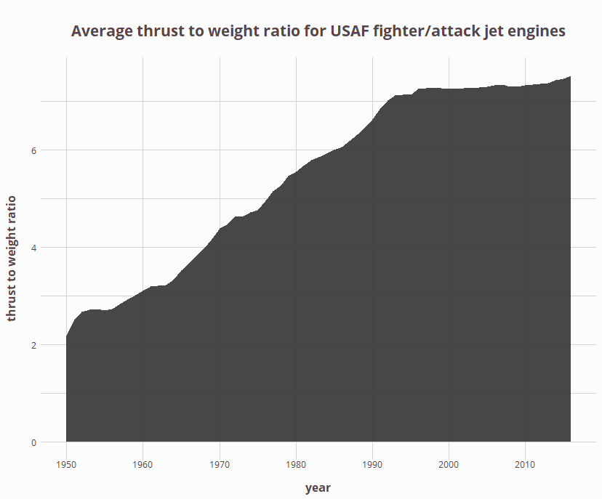
Notes:
p_thrust
p_pressure_ratio
p_engine_weight
p_thrust_weight_engine

Slide 11
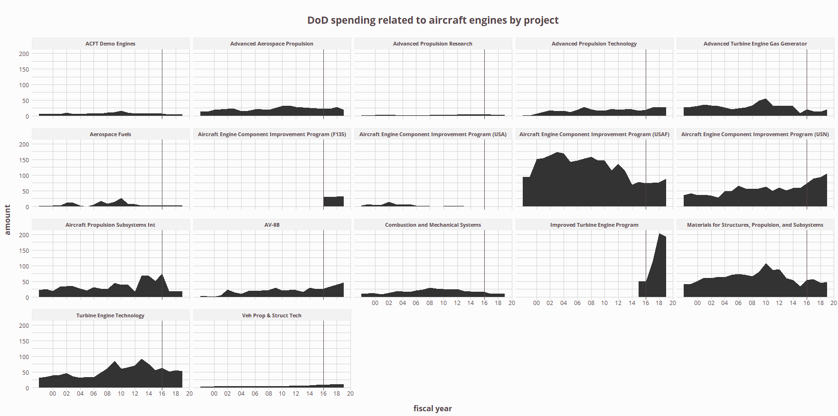

Slide 12
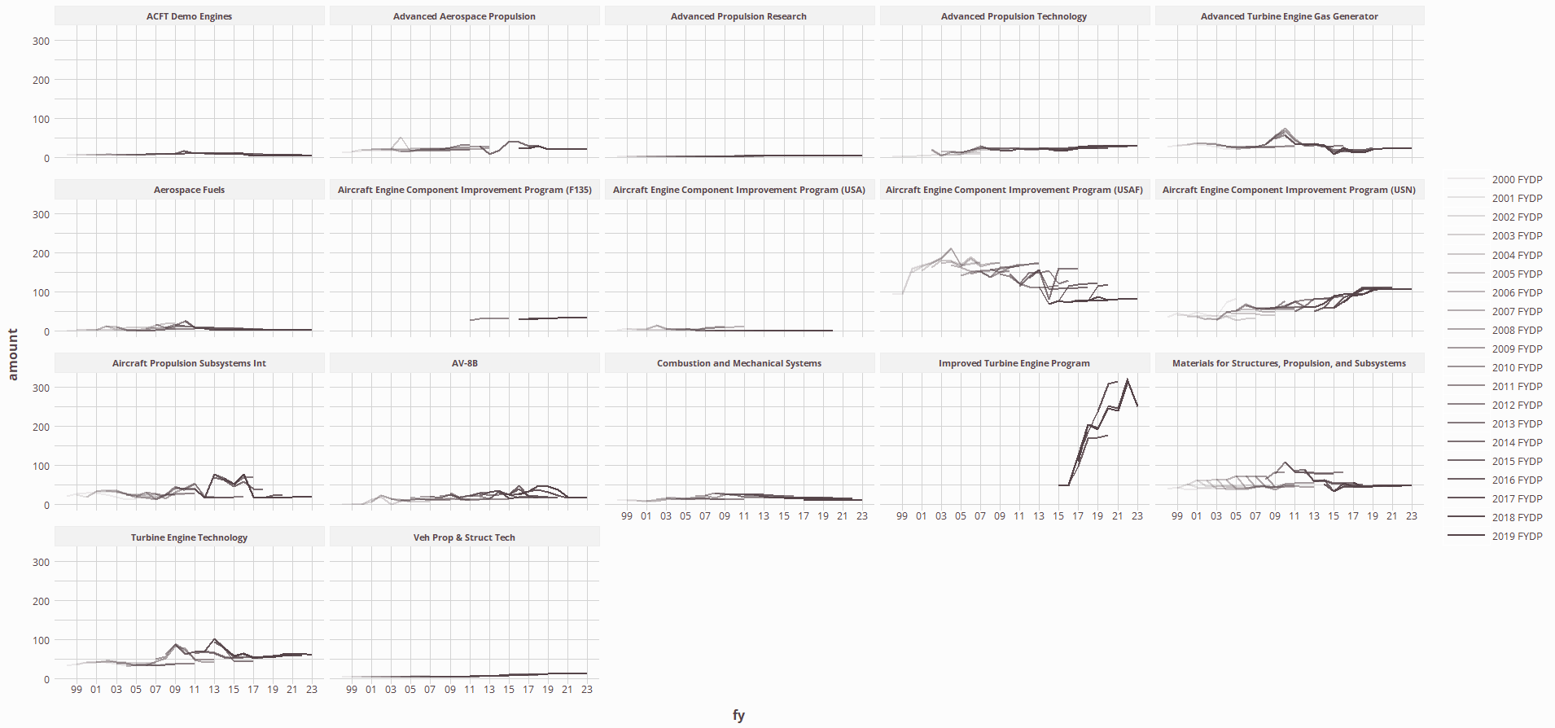

Slide 13
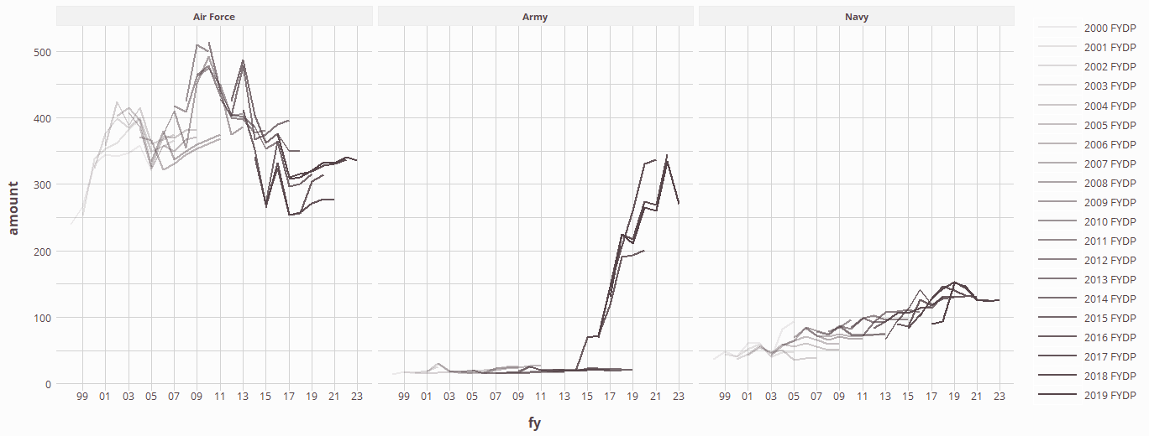

Slide 14
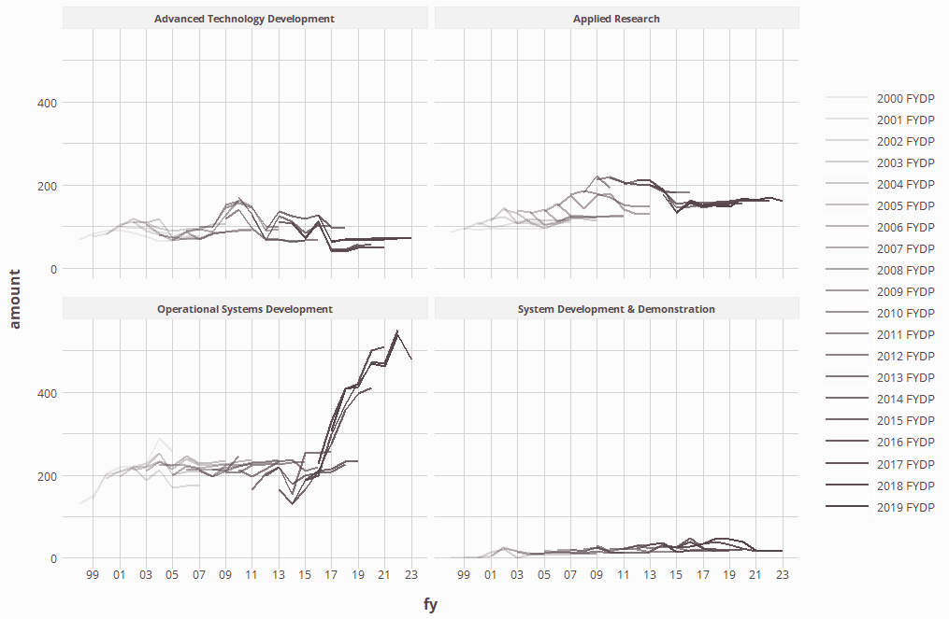

Slide 15
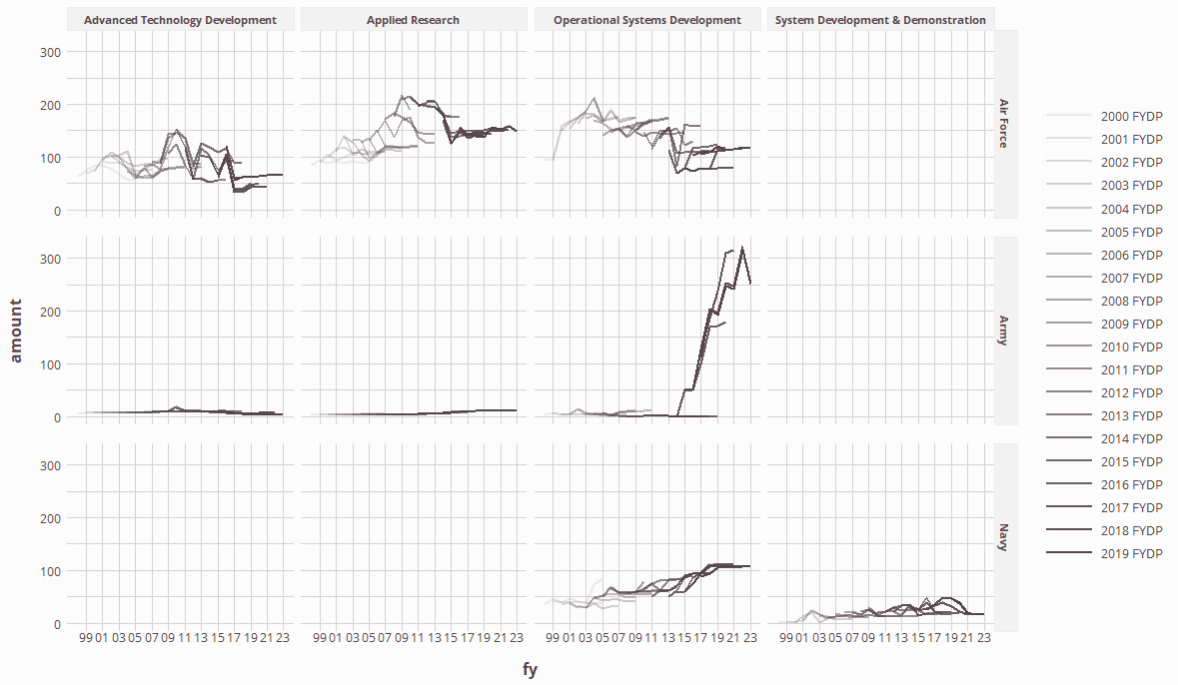

Slide 16
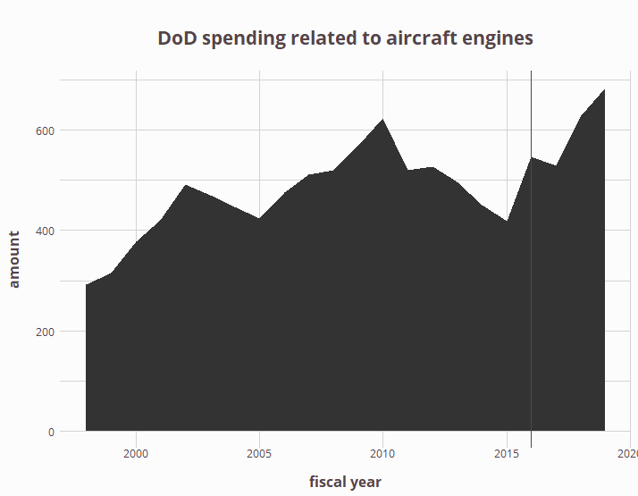

Slide 17
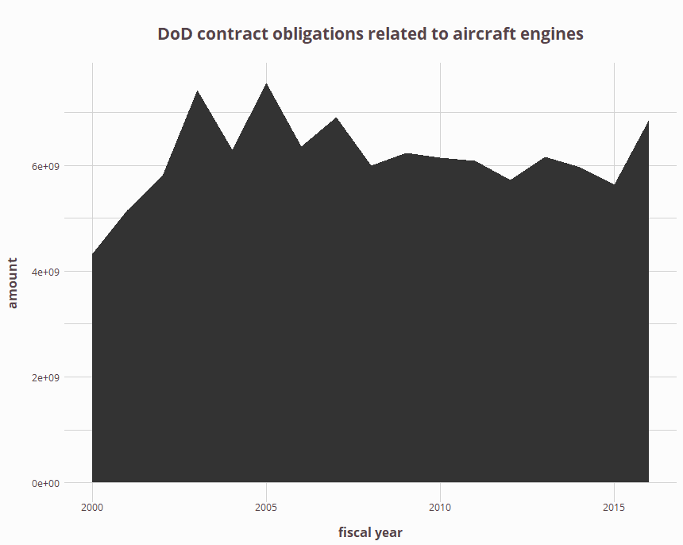

Slide 18
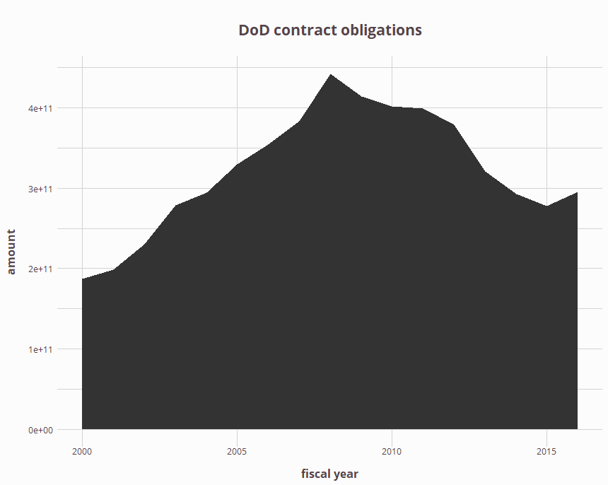

Slide 19
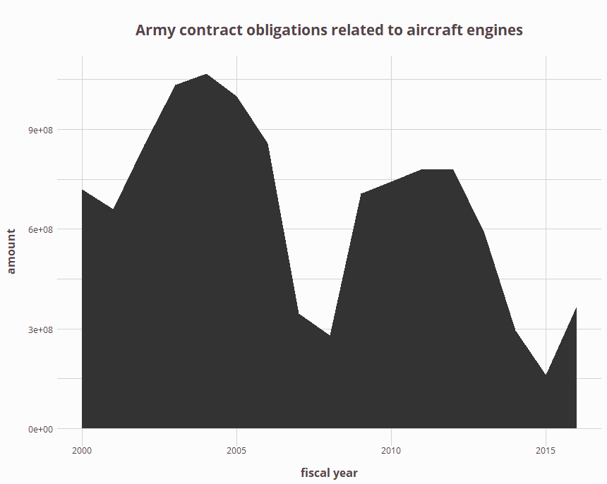

Slide 20
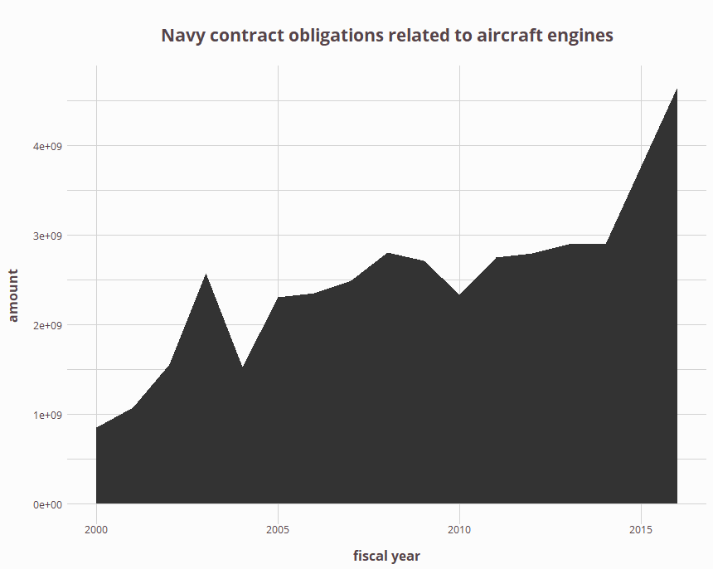

Slide 21
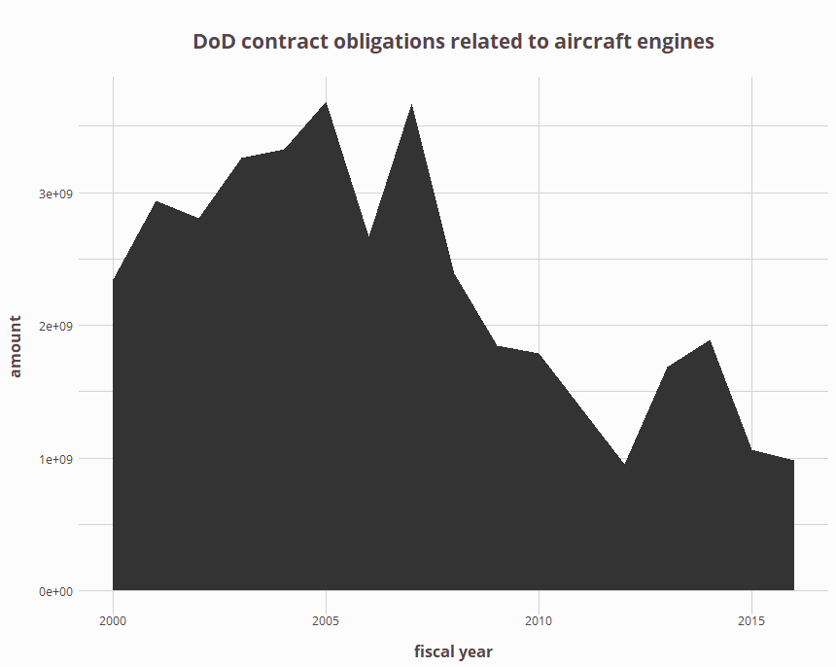

Slide 22
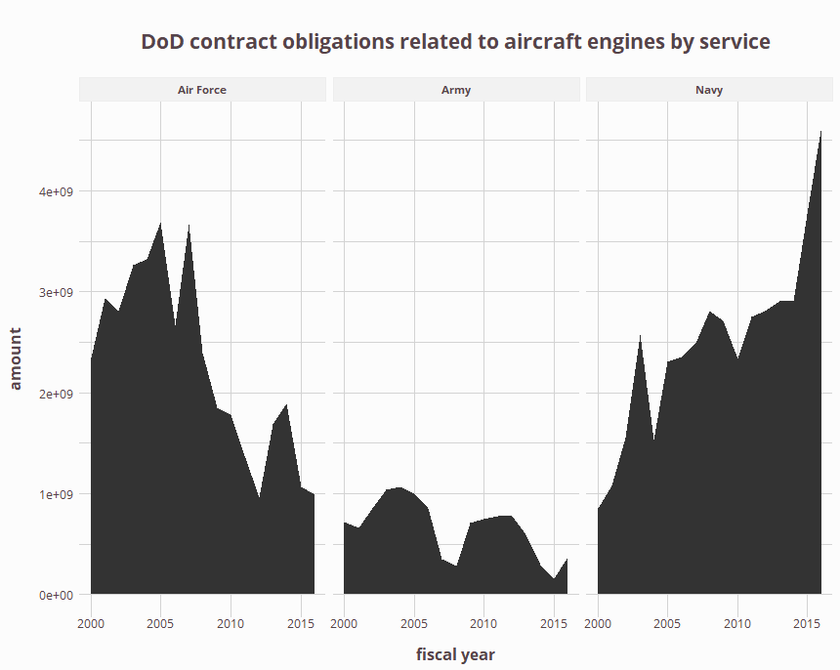

Slide 23
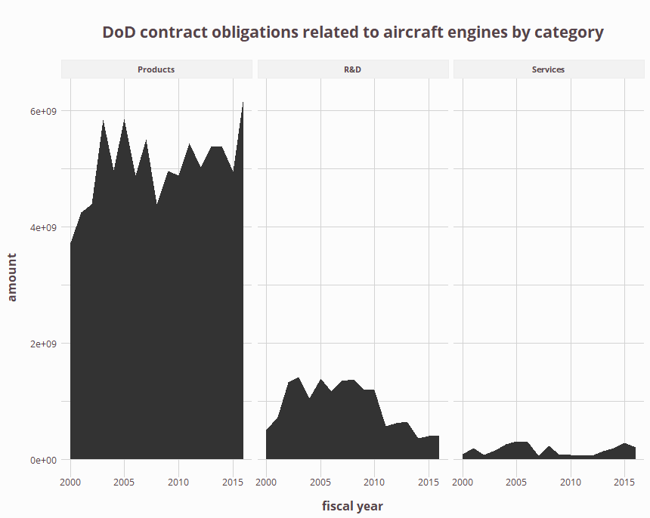

Slide 24
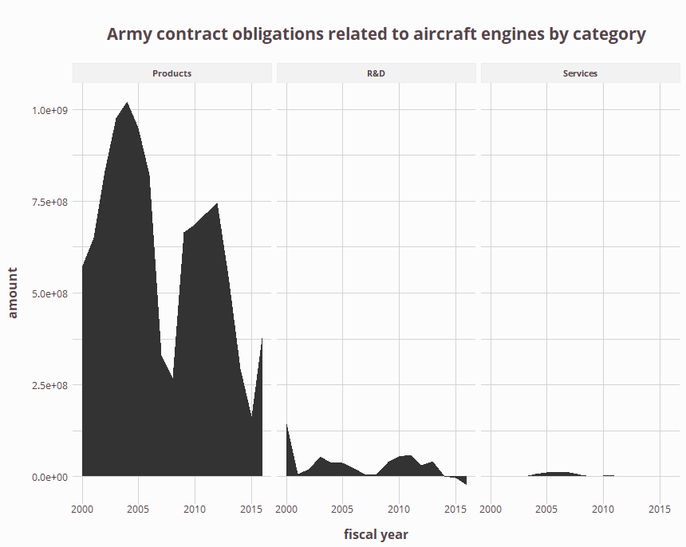

Slide 25
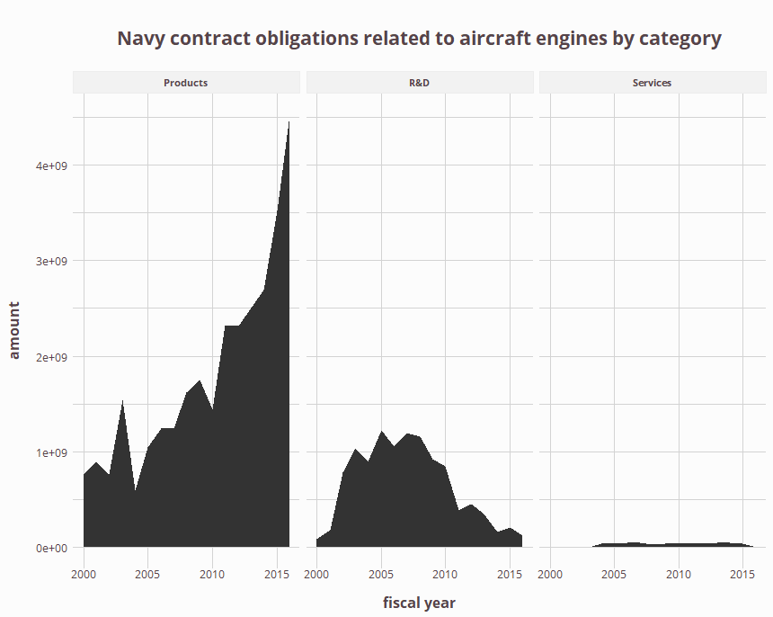

Slide 26
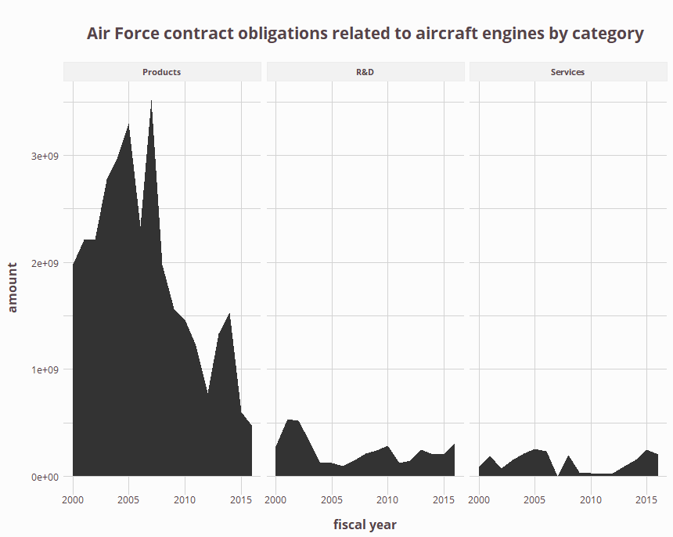

Slide 27
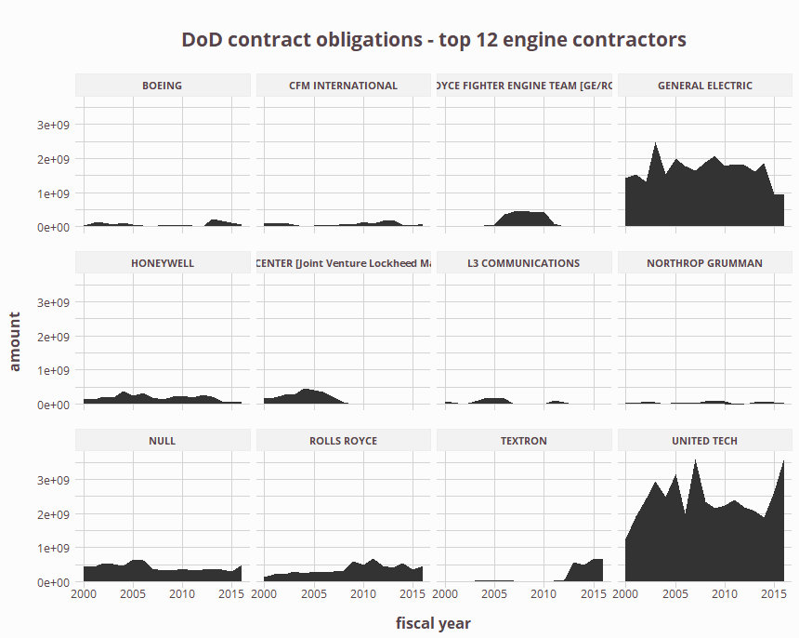

Slide 28
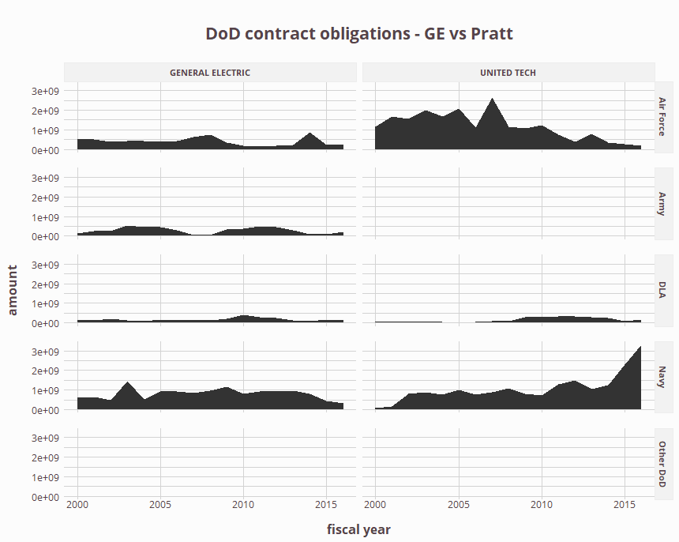

Slide 29
