Slide 1

Mass Notification System (MNS)

Slide 2
Problem:
Students arriving late in any college event or in class
Effects:
Student missing the lecture
Decrease in their attendance rate
Decline in academic performance
Cause disruption in the college event or in the lecture class

Slide 3
Solutions
Inform via email
Call student in their cell phone
Create a centralized system where students outside the class can be notified about the college event (meetings, talk program, club activities, etc.) or lectures in time. [MNS application]

Slide 4
Benefits from MNS:
Class representatives won't have to call each student in their cell phone who are outside the class
Saves money of calling the students
Saves time of writing email
Students won't be missing any college events so they won't have to face the punishments
Missing the lecture classes will be minimized

Slide 5
Users of MNS application:
1. Students of DWIT
2. Faculty Members

Slide 6
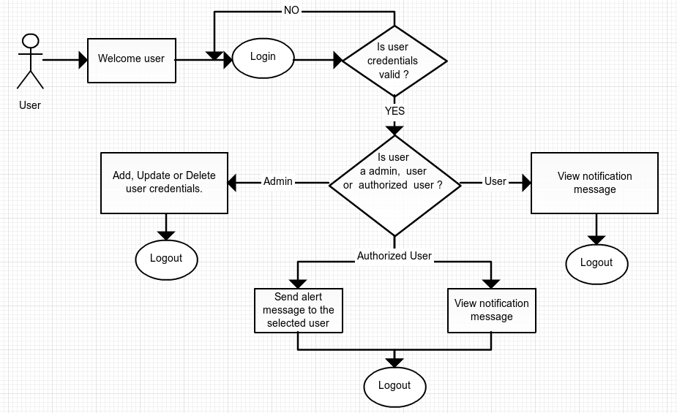
Work flow of MNS application

Slide 7
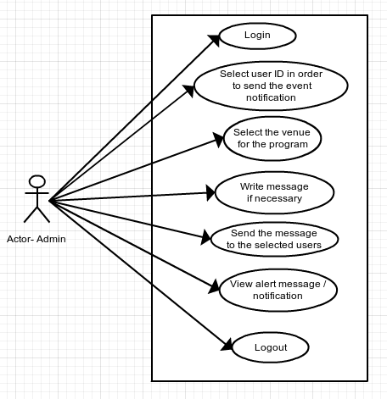
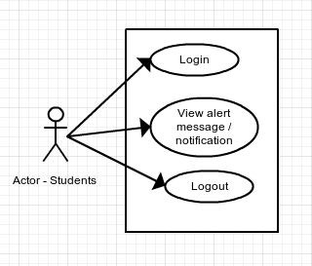
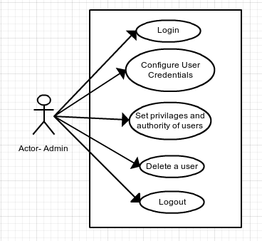

Slide 8
Questions and queries ?
Questions and queries ?

