Slide 1
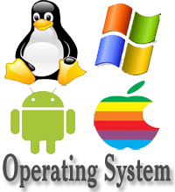
MULTIPROGRAMMING OPERATING SYSTEM (MOS)
Team Members:
Sagar Giri
Krishna Chauhan
Ujjwal Upreti
Anish Thakuri

Slide 2
Introduction:
An operating system (OS) is software that manages computer hardware resources and provides common services for computer programs.(wikipedia)
The operating system is an essential component of the system software in a computer system.(wikipedia)
Application programs usually require an operating system to function.(wikipedia)

Slide 3
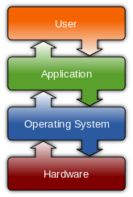
Introduction:

Slide 4
Classification of Operating systems
Multi-user: Allows two or more users to run programs at the same time. Some operating systems permit hundreds or even thousands of concurrent users.
Multiprocessing : Supports running a program on more than one CPU.
Multitasking : Allows more than one program to run concurrently.
Multithreading : Allows different parts of a single program to run concurrently.
Real time: Responds to input instantly. General-purpose operating systems, such as DOS and UNIX, are not real-time.

Slide 5
Implementation of MOS (Multiprogramming Operating System)
This project clearly falls into the category of simulator of an OS.
Simulation based OS intentionally shields the bare essentials of any particular machine architecture and allows focusing on implementing operating system concepts like memory management, Input Output management and process management.
The intension of this version is to focus on CPU hardware and its behavior (fetch – decode – execute).

Slide 6
Job card for this project.
$AMJ050100300008
GD30PD30GD40LR40SR50LR42SR51PD50LR43SR51
PD50LR44SR51PD50LR41SR60LR42SR61PD60LR43
SR61PD60LR44SR61PD60GD60PD60H
$DTA
Simulating Queue
ENQ DEQ 1 2 3
CALL ME: First In First Out
$END0501

Slide 7
Output Obtained:
Simulating Queue
ENQ 1
ENQ 2
ENQ 3
DEQ 1
DEQ 2
DEQ 3
CALL ME : First In First Out
Thank You!

Slide 8
Thank You

