Slide 1
Implementing Threads in User Space
Presented By : Sagar Giri

Slide 2
Contents:
What are threads in OS?
Advantages of threads.
Types of Thread
Implementing Threads in User Space
Pros and Cons of User Space Threads

Slide 3
What are threads in OS?
A thread of execution is the smallest sequence of programmed instructions.
A thread is a flow of execution through the process code, with its own program counter, system registers and stack.
The implementation of threads differs from one operating system to another.
Threads provide a way to improve application performance through parallelism.

Slide 4
What are threads in OS?(contd...)
Each thread belongs to exactly one process and no thread can exist outside a process.
Each thread represents a separate flow of control.
Threads have been successfully used in implementing network servers and web server.
Multiple threaded processes use fewer resources.
  Examples: opening multiple tabs in a browser is a process of multi-threading.
  One example of multithreading is when you are downloading a video while playing it at the same time.

Slide 5
Advantages of Thread
Thread minimize context switching time.
Use of threads provides concurrency within a process. (e.g. computation and I/O in one process)
Resource sharing (i.e. leads to less memory being used)
Utilization of multiprocessor architectures to a greater scale and efficiency.
  For example, a program that reads input, process it, and outputs could have three threads, one for each task.

Slide 6
Types of Thread
Threads are implemented in following two ways
  User Level Threads -- User managed threads
  Kernel Level Threads -- Operating System managed threads acting on kernel, an operating system core.

Slide 7
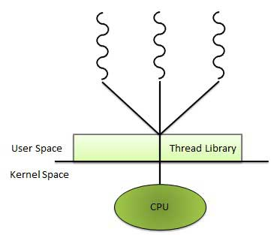
Implementing Threads in User Space

Slide 8
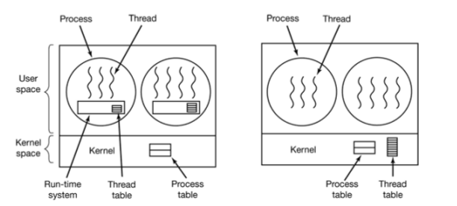
Implementing Threads in User Space(contd...)
In this process threads packages are entirely in user space. The kernel knows nothing about them.
When threads are managed in user space, each process needs its own private thread table to keep track of the threads in that process.

Slide 9
Pros & Cons of User space Threads
ADVANTAGES
  Thread switching does not require Kernel mode privileges hence it is faster.
  User level thread can run on any operating system.
  Scheduling can be application specific in the user level thread.
  User level threads are fast to create and manage.
DISADVANTAGES
  In a typical operating system, most system calls are blocking.
  User-level threads requires non-blocking systems call i.e. , a multithreaded kernel. Otherwise, entire process will blocked in the kernel.
    For example, if one thread causes a page fault, the process blocks.

Slide 10

THANK YOU !!!

