Slide 1
Page Replacement Algorithms
Want lowest page-fault rate
Evaluate algorithm by running it on a particular string of memory references (reference string) and computing the number of page faults on that string
For example, a reference string is
1, 2, 3, 4, 1, 2, 5, 1, 2, 3, 4, 5

Slide 2
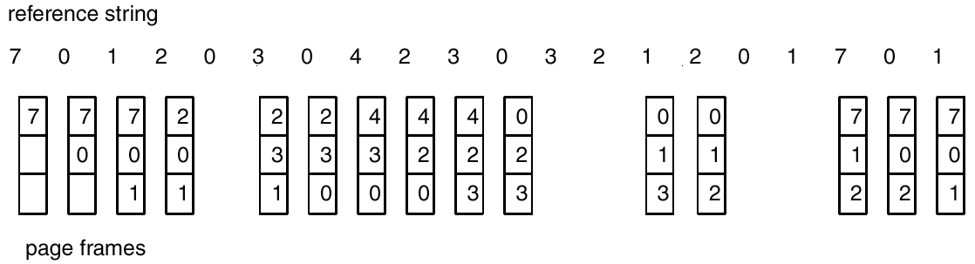
FIFO Page Replacement

Slide 3
FIFO Page Replacement
It replaces the page that has been in memory the longest
Thus, it focuses on the length of time a page has been in memory rather than on how much the page is being used
FIFO’s main asset is that it is simple to implement
Its behavior is not particularly well suited to the behavior of most programs, however, (it is completely independent of the locality of the program), so few systems use it

Slide 4
Number of Page Fault: FIFO Anomaly
To illustrate the “weirdness” of FIFO, consider the following reference string
1, 2, 3, 4, 1, 2, 5, 1, 2, 3, 4, 5
Compute the number of page faults for this reference string with
  3 frames
  4 frames

Slide 5

FIFO Illustrating Belady’s Anomaly

Slide 6
Belady’s Anomaly
This most unexpected result is known as Belady’s anomaly – for some page-replacement algorithms, the page fault rate may increase as the number of allocated frames increases
Is there a characterization of algorithms susceptible to Belady’s anomaly?

Slide 7
Stack Algorithms
Certain demand algorithms are more “well behaved” than others
(In the FIFO example), the problem arises because the set of pages loaded with a memory allocation of 3 frames is not necessarily also loaded with a memory allocation of 4 frames
There are a set of demand paging algorithms whereby the set of pages loaded with an allocation of m frames is always a subset of the set of pages loaded with an allocation of m +1 frames. This property is called the inclusion property
Algorithms that satisfy the inclusion property are not subject to Belady’s anomaly. FIFO does not satisfy the inclusion property and is not a stack algorithm

Slide 8
Optimal Page Replacement
An optimal page replacement algorithm has the lowest page-fault rate of all algorithms and will never suffer from Belady’s anomaly
Such an algorithm does exist and has been called OPT or MIN. It is simply this:
Replace the page that will not be used for the longest period of time
Use of this page-replacement algorithm guarantees the lowest possible page-fault rate for a fixed number of pages

Slide 9
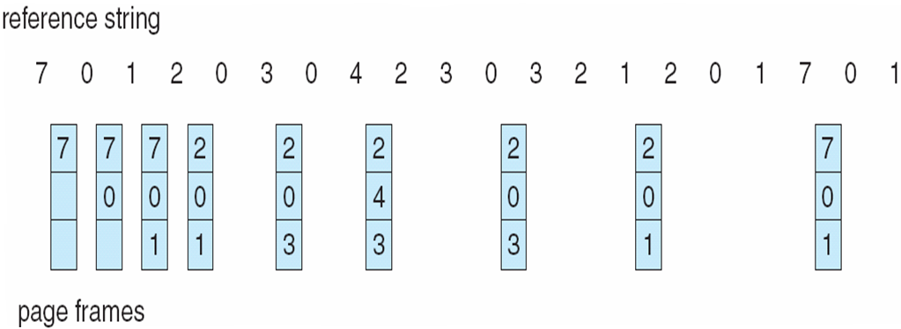
Optimal Page Replacement

Slide 10
Optimal Page Replacement
Unfortunately, OPT is difficult to implement, because it requires future knowledge of the reference string
As a result, OPT is used mainly for comparison purposes
For instance, it may be useful to know that, although a new page-replacement algorithm is not optimal, it is within 12.3 % of optimal at worst and within 4.7 % on average

Slide 11
Least Recently Used (LRU) Algorithm
If OPT is not feasible, perhaps an approximation of OPT is possible
The key distinction between FIFO and OPT (other than looking backward versus forward in time) is that FIFO uses the time when a page was brought into memory whereas OPT uses the time when a page is to be used
If we use the recent past as an approximation of the near future, then we can replace the page that has not been used for the longest period of time
This approach is the least-recently-used (LRU) algorithm

Slide 12
Least Recently Used (LRU) Algorithm
LRU associates with each page the time of that page’s last use
When a page must be replaced, LRU chooses the page that has not been used for the longest period of time
We can think of this strategy as OPT looking backward in time, rather than forward

Slide 13
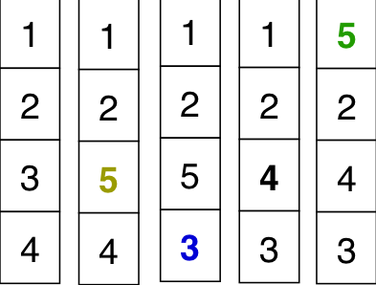

Least Recently Used (LRU) Algorithm
Reference string: 1, 2, 3, 4, 1, 2, 5, 1, 2, 3, 4, 5

Slide 14
LRU Page Replacement
LRU is designed to take advantage of “normal” program behavior
Programs are written to contain loops, which cause the main line of the code to execute repeatedly, with special-case code rarely being executed
This set of pages that contain the code that is executed repeatedly is called the code locality of the process
The LRU replacement algorithm is explicitly designed to take advantage of locality by assuming that if a page has been referenced recently, it is likely to be referenced again soon

Slide 15
LRU Page Replacement
LRU is often used as a page replacement algorithm and is considered to be good
The major problem is how to implement LRU replacement
An LRU page replacement algorithm may require substantial hardware assistance

Slide 16
LRU Page Replacement
The problem is to determine an order for the frames defined by the time of last use. Two implementations are feasible
  Counter implementation
    Every page entry has a time-of-use field; every time page is referenced through this entry, copy the clock into this field
    When a page needs to be changed, look at the fields to determine which are to change
  Stack implementation – keep a stack of page numbers implemented as a doubly linked list
    Page referenced
      move it to the top
      requires 6 pointers to be changed
    No search for replacement

Slide 17

Use Of A Stack to Record The Most Recent Page References

Slide 18
LRU Approximation Algorithms
Reference bit
  With each page associate a bit, initially = 0
  When page is referenced bit set to 1
  Replace the one which is 0 (if one exists)
    We do not know the order, however
Second chance
  Need reference bit
  Clock replacement
  If page to be replaced (in clock order) has reference bit = 1 then:
    set reference bit 0
    leave page in memory
    replace next page (in clock order), subject to same rules

Slide 19
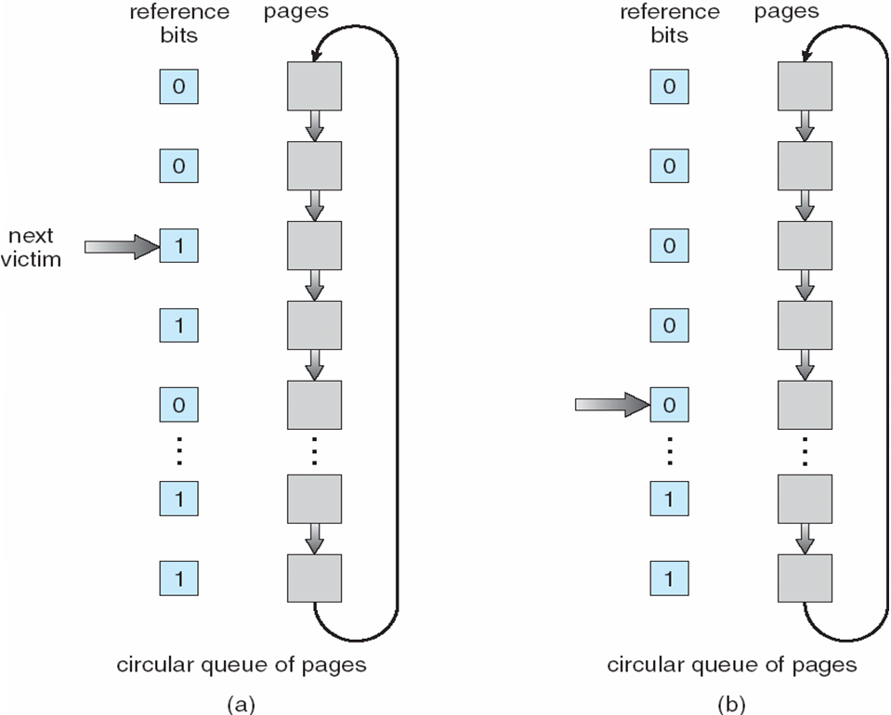
Second-Chance (clock) Page-Replacement Algorithm

Slide 20
Counting Algorithms
Keep a counter of the number of references that have been made to each page
LFU Algorithm: replaces page with smallest count
MFU Algorithm: based on the argument that the page with the smallest count was probably just brought in and has yet to be used

Slide 21
Allocation of Frames
Each process needs minimum number of pages
Example: IBM 370 – 6 pages to handle SS MOVE instruction:
  instruction is 6 bytes, might span 2 pages
  2 pages to handle from
  2 pages to handle to
Two major allocation schemes
  fixed allocation
  priority allocation

Slide 22


Fixed Allocation
Equal allocation – For example, if there are 100 frames and 5 processes, give each process 20 frames.
Proportional allocation – Allocate according to the size of process

Slide 23
Priority Allocation
Use a proportional allocation scheme using priorities rather than size
If process P_{i} generates a page fault,
  select for replacement one of its frames
  select for replacement a frame from a process with lower priority number

Slide 24
Global vs. Local Allocation
Global replacement – process selects a replacement frame from the set of all frames; one process can take a frame from another
Local replacement – each process selects from only its own set of allocated frames

Slide 25
Thrashing
If a process does not have “enough” pages, the page-fault rate is very high. This leads to:
  low CPU utilization
  operating system thinks that it needs to increase the degree of multiprogramming
  another process added to the system
Thrashing ≡ a process is busy swapping pages in and out

Slide 26
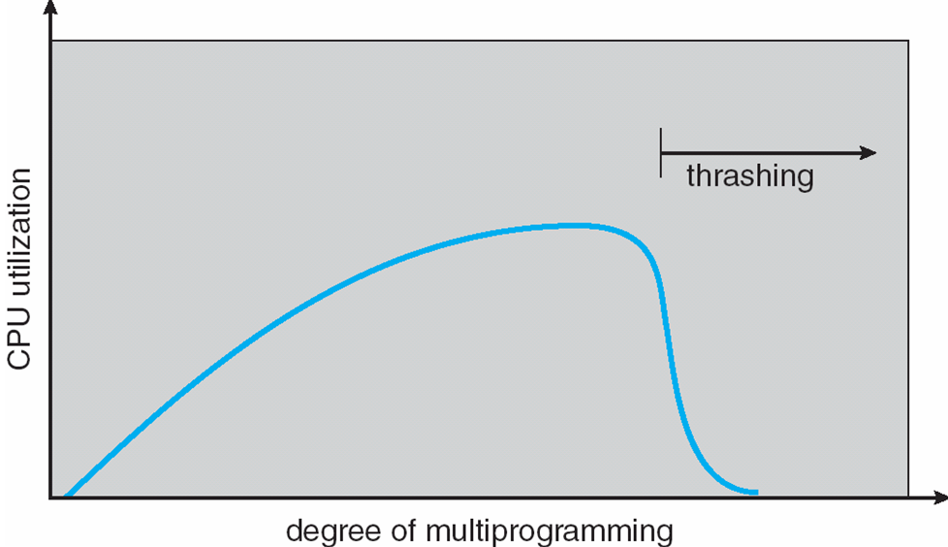
Thrashing (Cont.)

Slide 27
Demand Paging and Thrashing
Why does demand paging work?
Locality model
  Process migrates from one locality to another
  Localities may overlap
Why does thrashing occur?
Σ size of locality > total memory size

