Slide 1
R-Language
Notes:
‹#›

Slide 2

Today’s discussion…
R is an open source programming language and software environment for statistical computing and graphics.
The R language is widely used among statisticians and data miners for developing statistical software and data analytics tools

Slide 3
History of R
Modelled after S & S-plus, developed at AT&T labs in late 1980s.
R project was started by Robert Gentleman and Ross Ihaka Department of Statistics, University of Auckland (1995).
Currently maintained by R core development team – an international team of volunteer developers (since 1997).

Slide 4
R resources
http://www.r-project.org/
http://cran.r-project.org/doc/contrib/Verzani-SimpleR.pdf

Slide 5
Download R and RStudio
Download R :
http://cran.r-project.org/bin/
Download RStudio :
http://www.rstudio.com/ide/download/desktop

Slide 6
Installation
Installing R on windows PC :
Use internet browser to point to : http://mirror.aarnet.edu.au/pub/CRAN
Under the heading Precompiled Binary Distributions, choose the link Windows.
Next heading is R for Windows; choose the link base.
Click on download option(R 3.4.1 for windows).
Save this to the folder C:\R on your PC.
When downloading is complete, close or minimize the Internet browser.
Double click on R 3.4.1-win32.exe in C:\R to install.
Installing R on Linux:
sudo apt-get install r-base-core

Slide 7
Installation
Installing RStudio:
Go to www.rstudio.com and click on the "Download RStudio" button.
Click on "Download RStudio Desktop.“
Click on the version recommended for your system, or the latest Windows version, and save the executable file. Run the .exe file and follow the installation instructions.

Slide 8
Version
Get R version
R.Version()
Get RStudio version
RStudio: Toolbar at top > Help > About RStudio

Slide 9
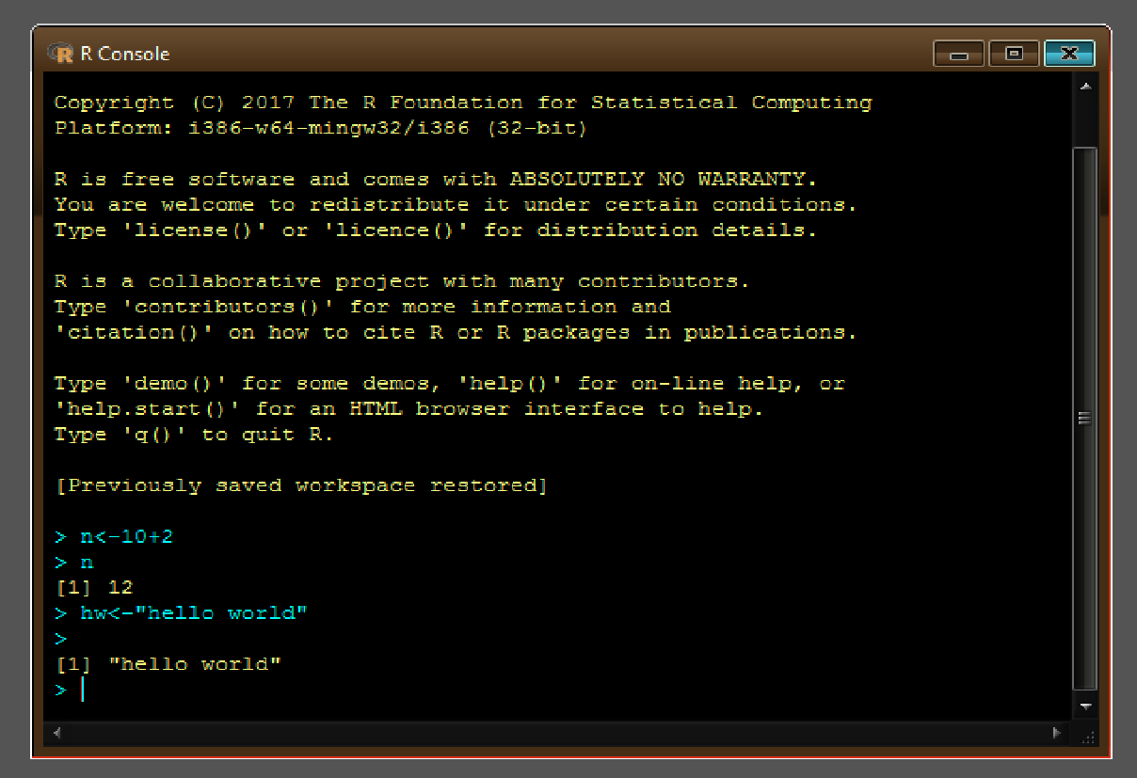
A test run with R in Windows
Double click the R icon on the Desktop and the R Console will open.
Wait while the program loads. You observe something like this.
You can type your own program at the prompt line >.

Slide 10
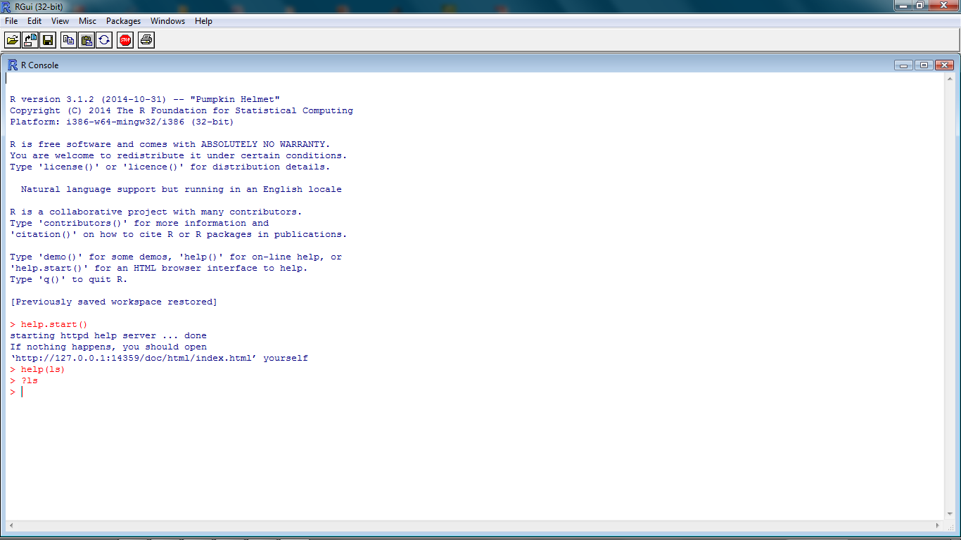
Getting help from R console
help.start()
help(topic)
?topic
??topic

Slide 11
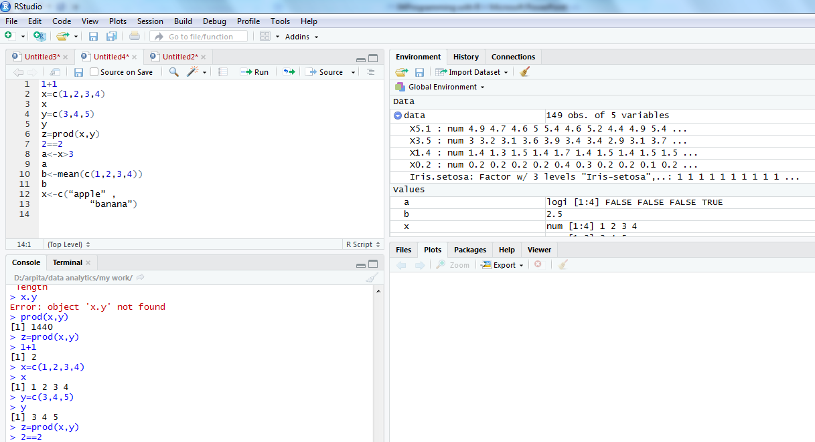
R command in integrated environment

Slide 12
How to use R for simple maths
> 3+5
> 12 + 3 / 4 – 5 + 3*8
> (12 + 3 / 4 – 5) + 3*8
> pi * 2^3 – sqrt(4)
>factorial(4)
>log(2,10)
>log(2, base=10)
>log10(2)
>log(2)
Note
R ignores spaces

Slide 13
How to store results of calculations for future use
> x = 3+5
> x
> y = 12 + 3 / 4 – 5 + 3*8
> y
> z = (12 + 3 / 4 – 5) + 3*8
> z
> A <- 6 + 8 ## no space should be between < & -
> a ## Note: R is case sensitive
>A

Slide 14
Identifiers naming
Don't use underscores ( _ ) or hyphens ( - ) in identifiers.
The preferred form for variable names is all lower case letters and words separated with dots (variable.name) but variableName is also accepted.
Examples: avg.clicks GOOD avgClicks OK avg_Clicks BAD
Function names have initial capital letters and no dots (e.g., FunctionName).

Slide 15
Using C command
> data1 = c(3, 6, 9, 12, 78, 34, 5, 7, 7) ## numerical data
> data1.text = c(‘Mon’, ‘Tue’, “Wed”) ## Text data
## Single or double quote both ok
##copy/paste into R console may not work
> data1.text = c(data1.text, ‘Thu’, ‘Fri’)

Slide 16
Scan command for making data
> data3 = scan() ## data separated by Space / Press
## Press Enter key twice to exit
1: 4 5 7 8
5: 2 9 4
8: 3
9:
> data3
[1] 4 5 7 8 2 9 4 3
## Read 8 items

Slide 17
Scan command for making data
> d3 = scan(what = ‘character’)
1: mon
2: tue
3: wed thu
5:
> d3
[1] "mon" "tue" "wed" "thu"
> d3[2]
[1] "tue"
> d3[2]='mon'
> d3
[1] "mon" "mon" "wed" "thu"
> d3[6]='sat'
> d3
[1] "mon" "mon" "wed" "thu" NA "sat"
> d3[2]='tue'
> d3[5] = 'fri'
> d3
[1] "mon" "tue" "wed" "thu" "fri" "sat"

Slide 18
Concept of working directory
>getwd()
[1] "C:\Users\DShweta\R\Database"
> setwd('D:\Data Analytics\Project\Database)
> dir() ## working directory listing
>ls() ## Workspace listing of objects
>rm(‘object’) ## Remove an element “object”, if exist
> rm(list = ls()) ## Cleaning

Slide 19
Reading data from a data file
> setwd("D:/shweta/data analytics/my work") #Set the working directory to file location
> getwd()
[1] "D:/shweta/data analytics/my work"
> dir()
[1] "Arv.txt" "DiningAtSFO" "LatentView-DPL" "TC-10-Rec.csv" "TC.csv"
rm(list=ls(all=TRUE)) # Refresh session
> data=read.csv('iris.csv', header = T, sep=",")
(data = read.table(‘iris.csv', header = T, sep = ','))
> ls()
[1] "data"
> str(data)
'data.frame': 149 obs. of 5 variables:
$ X5.1 : num 4.9 4.7 4.6 5 5.4 4.6 5 4.4 4.9 5.4 ...
$ X3.5 : num 3 3.2 3.1 3.6 3.9 3.4 3.4 2.9 3.1 3.7 ...
$ X1.4 : num 1.4 1.3 1.5 1.4 1.7 1.4 1.5 1.4 1.5 1.5 ...
$ X0.2 : num 0.2 0.2 0.2 0.2 0.4 0.3 0.2 0.2 0.1 0.2 ...
$ Iris.setosa: Factor w/ 3 levels "Iris-setosa",..: 1 1 1 1 1 1 1 1 1 1 ...

Slide 20
Accessing elements from a file
> data$X5.1
[1] 4.9 4.7 4.6 5.0 5.4 4.6 5.0 4.4 4.9 5.4 4.8 4.8 4.3 5.8 5.7
> data$X5.1[7]=5.2
> data$X5.1
[1] 4.9 4.7 4.6 5.0 5.4 4.6 5.2 4.4 4.9 5.4 4.8 4.8 4.3 5.8 5.7 #Note: This change has happened in workspace only not in the file.
How to make it permanent?
write.csv / write.table
>write.table(data, file =‘iris_mod.csv', row.names = FALSE, sep = ',')
If row.names is TRUE, R adds one ID column in the beginning of file.
So its suggested to use row.names = FALSE option
>write.csv(data, file ==‘iris_mod.csv', row.names = TRUE) ## to test

Slide 21
Different data items in R
Vector
Matrix
Data Frame
List

Slide 22
Vectors in R
>x=c(1,2,3,4,56)
>x
> x[2]
> x = c(3, 4, NA, 5)
>mean(x)
[1] NA
>mean(x, rm.NA=T)
[1] 4
> x = c(3, 4, NULL, 5)
>mean(x)
[1] 4

Slide 23
More on Vectors in R
>y = c(x,c(-1,5),x)
>length(x)
>length(y)
There are useful methods to create long vectors whose elements are in arithmetic progression:
> x=1:20
> x
If the common difference is not 1 or -1 then we can use the seq function
> y=seq(2,5,0.3)
> y
[1] 2.0 2.3 2.6 2.9 3.2 3.5 3.8 4.1 4.4 4.7 5.0
> length(y)
[1] 11

Slide 24
More on Vectors in R
> x=1:5
> mean(x)
[1] 3
> x
[1] 1 2 3 4 5
> x^2
[1] 1 4 9 16 25
> x+1
[1] 2 3 4 5 6
> 2*x
[1] 2 4 6 8 10
> exp(sqrt(x))
[1] 2.718282 4.113250 5.652234 7.389056 9.356469
It is very easy to add/subtract/multiply/divide two vectors entry by entry.
> y=c(0,3,4,0)
> x+y
[1] 1 5 7 4 5
> y=c(0,3,4,0,9)
> x+y
[1] 1 5 7 4 14
Warning message:
In x + y : longer object length is not a multiple of shorter object length
> x=1:6
> y=c(9,8)
> x+y
[1] 10 10 12 12 14 14

Slide 25
Matrices in R
Same data type/mode – number , character, logical
a.matrix <- matrix(vector, nrow = r, ncol = c, byrow = FALSE, dimnames = list(char-vector-rownames, char-vector-col-names))
## dimnames is optional argument, provides labels for rows & columns.
> y <- matrix(1:20, nrow = 4, ncol = 5)
>A = matrix(c(1,2,3,4),nrow=2,byrow=T)
>A
>A = matrix(c(1,2,3,4),ncol=2)
>B = matrix(2:7,nrow=2)
>C = matrix(5:2,ncol=2)
>mr <- matrix(1:20, nrow = 5, ncol = 4, byrow = T)
>mc <- matrix(1:20, nrow = 5, ncol = 4)
>mr
>mc

Slide 26
More on matrices in R
>dim(B) #Dimension
>nrow(B)
>ncol(B)
>A+C
>A-C
>A%*%C #Matrix multiplication. Where will be the result?
>A*C #Entry-wise multiplication
>t(A) #Transpose
>A[1,2]
>A[1,]
>B[1,c(2,3)]
>B[,-1]

Slide 27
Lists in R
Vectors and matrices in R are two ways to work with a collection of objects.
Lists provide a third method. Unlike a vector or a matrix a list can hold different kinds of objects.
One entry in a list may be a number, while the next is a matrix, while a third is a character string (like "Hello R!").
Statistical functions of R usually return the result in the form of lists. So we must know how to unpack a list using the $ symbol.

Slide 28
Examples of lists in R
>x = list(name="Arun Patel", nationality="Indian", height=5.5, marks=c(95,45,80))
>names(x)
>x$name
>x$hei #abbreviations are OK
>x$marks
>x$m[2]

Slide 29
Data frame in R
A data frame is more general than a matrix, in that different columns can have different modes (numeric, character, factor, etc.).
>d <- c(1,2,3,4)
>e <- c("red", "white", "red", NA)
>f <- c(TRUE,TRUE,TRUE,FALSE)
>myframe <- data.frame(d,e,f)
>names(myframe) <- c("ID","Color","Passed") # Variable names
>myframe
>myframe[1:3,] # Rows 1 , 2, 3 of data frame
>myframe[,1:2] # Col 1, 2 of data frame
>myframe[c("ID","Color")] #Columns ID and color from data frame
>myframe$ID # Variable ID in the data frame

Slide 30
Factors in R
In R we can make a variable is nominal by making it a factor.
The factor stores the nominal values as a vector of integers in the range [ 1... k] (where k is the number of unique values in the nominal variable).
An internal vector of character strings (the original values) mapped to these integers.
# Example: variable gender with 20 "male" entries and # 30 "female" entries >gender <- c(rep("male",20), rep("female", 30)) >gender <- factor(gender) # Stores gender as 20 1’s and 30 2’s
# 1=male, 2=female internally (alphabetically) # R now treats gender as a nominal variable >summary(gender)

Slide 31
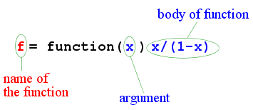
Functions in R
>g = function(x,y) (x+2*y)/3
>g(1,2)
>g(2,1)

Slide 32
Useful Functions in R
length(object) # number of elements or components
str(object) # structure of an object
class(object) # class or type of an object
names(object) # names
c(object,object,...) # combine objects into a vector
cbind(object, object, ...) # combine objects as columns
rbind(object, object, ...) # combine objects as rows
ls() # list current objects
rm(object) # delete an object
newobject <- edit(object) # edit copy and save a newobject
fix(object) # edit in place
Notes:
‹#›

Slide 33
Importing Data
Importing data into R is fairly simple.
For Stata and Systat, use the foreign package.
For SPSS and SAS I would recommend the Hmisc package for ease and functionality.
See the Quick-R section on packages, for information on obtaining and installing the these packages.
Example of importing data are provided below.
Notes:
‹#›

Slide 34
From A Comma Delimited Text File
# first row contains variable names, comma is separator
# assign the variable id to row names
# note the / instead of \ on mswindows systems mydata <- read.table("c:/mydata.csv", header=TRUE, sep=",", row.names="id")
Notes:
‹#›

Slide 35
From Excel
The best way to read an Excel file is to export it to a comma delimited file and import it using the method above.
On windows systems you can use the RODBC package to access Excel files. The first row should contain variable/column names.
# first row contains variable names
# we will read in workSheet mysheet library(RODBC) channel <- odbcConnectExcel("c:/myexel.xls") mydata <- sqlFetch(channel, "mysheet") odbcClose(channel)
Notes:
‹#›

Slide 36
From SAS
# save SAS dataset in trasport format libname out xport 'c:/mydata.xpt'; data out.mydata; set sasuser.mydata; run;
library(foreign)
#bsl=read.xport(“mydata.xpt")
Notes:
‹#›

Slide 37
Keyboard Input
Usually you will obtain a dataframe by importing it from SAS, SPSS, Excel, Stata, a database, or an ASCII file. To create it interactively, you can do something like the following.
# create a dataframe from scratch age <- c(25, 30, 56) gender <- c("male", "female", "male") weight <- c(160, 110, 220) mydata <- data.frame(age,gender,weight)
Notes:
‹#›

Slide 38
Keyboard Input
You can also use R's built in spreadsheet to enter the data interactively, as in the following example.
# enter data using editor mydata <- data.frame(age=numeric(0), gender=character(0), weight=numeric(0)) mydata <- edit(mydata) # note that without the assignment in the line above, # the edits are not saved!
Notes:
‹#›

Slide 39
Exporting Data
There are numerous methods for exporting R objects into other formats . For SPSS, SAS and Stata. you will need to load the foreign packages. For Excel, you will need the xlsReadWrite package.
Notes:
‹#›

Slide 40
Exporting Data
To A Tab Delimited Text File
write.table(mydata, "c:/mydata.txt", sep="\t")
To an Excel Spreadsheet
library(xlsReadWrite) write.xls(mydata, "c:/mydata.xls")
To SAS
library(foreign) write.foreign(mydata, "c:/mydata.txt", "c:/mydata.sas", package="SAS")
Notes:
‹#›

Slide 41
Viewing Data
There are a number of functions for listing the contents of an object or dataset.
# list objects in the working environment ls()
# list the variables in mydata names(mydata)
# list the structure of mydata str(mydata)
# list levels of factor v1 in mydata levels(mydata$v1)
# dimensions of an object dim(object)
Notes:
‹#›

Slide 42
Viewing Data
There are a number of functions for listing the contents of an object or dataset.
# class of an object (numeric, matrix, dataframe, etc) class(object)
# print mydata mydata
# print first 10 rows of mydata head(mydata, n=10)
# print last 5 rows of mydata tail(mydata, n=5)
Notes:
‹#›

Slide 43
Variable Labels
R's ability to handle variable labels is somewhat unsatisfying.
If you use the Hmisc package, you can take advantage of some labeling features.
library(Hmisc) label(mydata$myvar) <- "Variable label for variable myvar" describe(mydata)
Notes:
‹#›

Slide 44
Variable Labels
Unfortunately the label is only in effect for functions provided by the Hmisc package, such as describe(). Your other option is to use the variable label as the variable name and then refer to the variable by position index.
names(mydata)[3] <- "This is the label for variable 3" mydata[3] # list the variable
Notes:
‹#›

Slide 45
Value Labels
To understand value labels in R, you need to understand the data structure factor.
You can use the factor function to create your own value lables.
# variable v1 is coded 1, 2 or 3
# we want to attach value labels 1=red, 2=blue,3=green mydata$v1 <- factor(mydata$v1, levels = c(1,2,3), labels = c("red", "blue", "green"))
# variable y is coded 1, 3 or 5
# we want to attach value labels 1=Low, 3=Medium, 5=High
Notes:
‹#›

Slide 46
Value Labels
mydata$v1 <- ordered(mydata$y, levels = c(1,3, 5), labels = c("Low", "Medium", "High"))
Use the factor() function for nominal data and the ordered() function for ordinal data. R statistical and graphic functions will then treat the data appropriately.
Note: factor and ordered are used the same way, with the same arguments. The former creates factors and the later creates ordered factors.
Notes:
‹#›

Slide 47
Missing Data
In R, missing values are represented by the symbol NA (not available) . Impossible values (e.g., dividing by zero) are represented by the symbol NaN (not a number). Unlike SAS, R uses the same symbol for character and numeric data.
Testing for Missing Values
is.na(x) # returns TRUE of x is missing
y <- c(1,2,3,NA)
is.na(y) # returns a vector (F F F T)
Notes:
‹#›

Slide 48
Missing Data
Recoding Values to Missing
# recode 99 to missing for variable v1
# select rows where v1 is 99 and recode column v1
mydata[mydata$v1==99,"v1"] <- NA
Excluding Missing Values from Analyses
Arithmetic functions on missing values yield missing values.
x <- c(1,2,NA,3)
mean(x) # returns NA
mean(x, na.rm=TRUE) # returns 2
Notes:
‹#›

Slide 49
Missing Data
The function complete.cases() returns a logical vector indicating which cases are complete.
# list rows of data that have missing values mydata[!complete.cases(mydata),]
The function na.omit() returns the object with listwise deletion of missing values.
# create new dataset without missing data newdata <- na.omit(mydata)
Notes:
‹#›

Slide 50
Missing Data
Advanced Handling of Missing Data
Most modeling functions in R offer options for dealing with missing values. You can go beyond pairwise of listwise deletion of missing values through methods such as multiple imputation. Good implementations that can be accessed through R include Amelia II, Mice, and mitools.
Notes:
‹#›

Slide 51
Date Values
Dates are represented as the number of days since 1970-01-01, with negative values for earlier dates.
# use as.Date( ) to convert strings to dates
mydates <- as.Date(c("2007-06-22", "2004-02-13"))
# number of days between 6/22/07 and 2/13/04 days <- mydates[1] - mydates[2]
Sys.Date( ) returns today's date.
Date() returns the current date and time.
Notes:
‹#›

Slide 52
Date Values
The following symbols can be used with the format( ) function to print dates.
Symbol | Meaning | Example
%d | day as a number (0-31) | 01-31
%a %A | abbreviated weekday unabbreviated weekday | Mon Monday
%m | month (00-12) | 00-12
%b %B | abbreviated month unabbreviated month | Jan January
%y %Y | 2-digit year 4-digit year | 07 2007
Notes:
‹#›

Slide 53
Date Values
# print today's date
today <- Sys.Date()
format(today, format="%B %d %Y") "June 20 2007"
Notes:
‹#›

Slide 54
Any Question?

