Slide 1
Data Engineering for Market Analysis
Chris Joyce
IS6850

Slide 2

Topics
Project Overview
Pipeline Tasks
Limitations and Considerations
Q&A

Slide 3

Project Overview
Goal: create aggregated daily reports for stock performance
Use Case: market analysts running queries for long-term and daily performance
Sources: polygon.io API, Kaggle flat files
Notes:
P3 (lane assist, adaptive cruise control, etc.)
P4 $400 billion industry by 2035

Slide 4
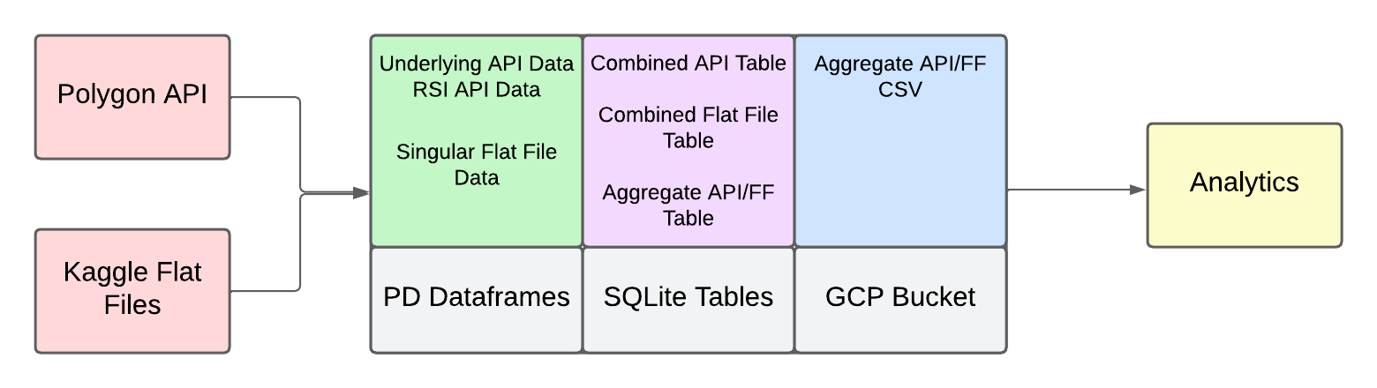
Data Engineering Lifecycle
Notes:
P1 1. Assisted steering OR braking. 2. Assisted steering AND braking. 3. Full driving tasks w/ human intervention. 4. Full driving tasks, even if human ignores requests. (geofenced). 5. Full driving tasks with no intervention (in an unrestricted area.)

Slide 5
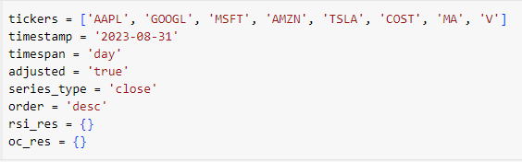
Sources
Polygon API: provides aggregate data for 8 tickers
AAPL, GOOGL, MSFT, AMZN, TSLA, MA, V
RSI (relative strength index): measure of stock momentum
Pre-market and after hours open/close
Restrictions…
Kaggle Files: provides our historical price data for 2023 for 8 tickers
Open/close price, high/low price, volume
Notes:
P3 Data throughput to an AV from an offsite data center would be too demanding/unpredictable. AVs still have network capability to send raw data to warehouses/storage centers/clouds to be used in the future.

Slide 6
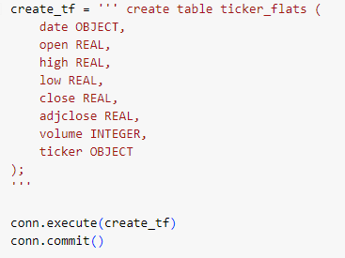
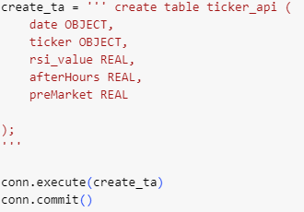
Ingestion
Polygon API
Iterate response through for loop for each ticker
Call 1: contains ticker, date, RSI value
Call 2: contains underlying data (PM, AH), ticker, date
JSON responses stored as dict, values combined into list
Stored in API table
Kaggle Files
Format into common columns/dtypes
Combine into flat file table
Notes:
P3 Data throughput to an AV from an offsite data center would be too demanding/unpredictable. AVs still have network capability to send raw data to warehouses/storage centers/clouds to be used in the future.

Slide 7
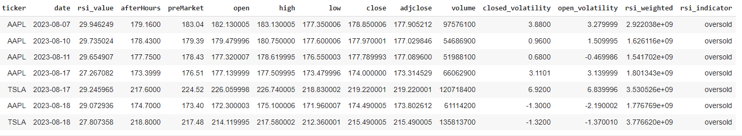
Transformation
Combined SQLite table
Weighted RSI: RSI value integrated with daily volume to verify price trend
Closed volatility: volatility for entire trading period (PM and AH)
Open volatility: volatility for open trading period
RSI indicator: Boolean response based on RSI value
Notes:
P3 Data throughput to an AV from an offsite data center would be too demanding/unpredictable. AVs still have network capability to send raw data to warehouses/storage centers/clouds to be used in the future.

Slide 8
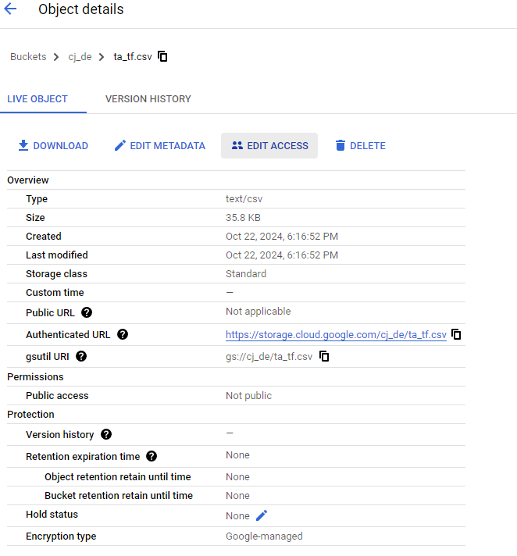

Serving
Google Cloud Bucket
Contains exported CSV of daily aggregates
Notes:
P3 Data throughput to an AV from an offsite data center would be too demanding/unpredictable. AVs still have network capability to send raw data to warehouses/storage centers/clouds to be used in the future.

Slide 9
Limitations and Considerations
Sources
Velocity: 5 API calls/min, FFs instantly available
Variety: 8 tickers available, potential for more
Volume: thousands of rows in FFs, only one per API call
Veracity: join conditions
Value: multiple data points/day via API, one via FF
Ingestion/Transformation
Pandas vs. SQLite
Single table vs multi-table storage
Serving
Use case for 8 tickers vs. an index
Notes:
P3 Data throughput to an AV from an offsite data center would be too demanding/unpredictable. AVs still have network capability to send raw data to warehouses/storage centers/clouds to be used in the future.

Slide 10
Questions?
Thank You!

