Slide 1
UX Scenario Document File Version 4.3
(Air Quality Monitoring App)
Submission Date | 2022 / 07 / 04
App Ver. | 1.0.4
App Developer | Name: MARISELVAM E-mail address: mariselvam.vialwin@gmail.com

Slide 2
Table of Contents
1. Basic Information
2. Document History
3. Page Description (Guideline)
4. Detailed Login Information
5. Building Selection Page
6. Main Page Description
7. Sub Page Description
8. Appendix

Slide 3
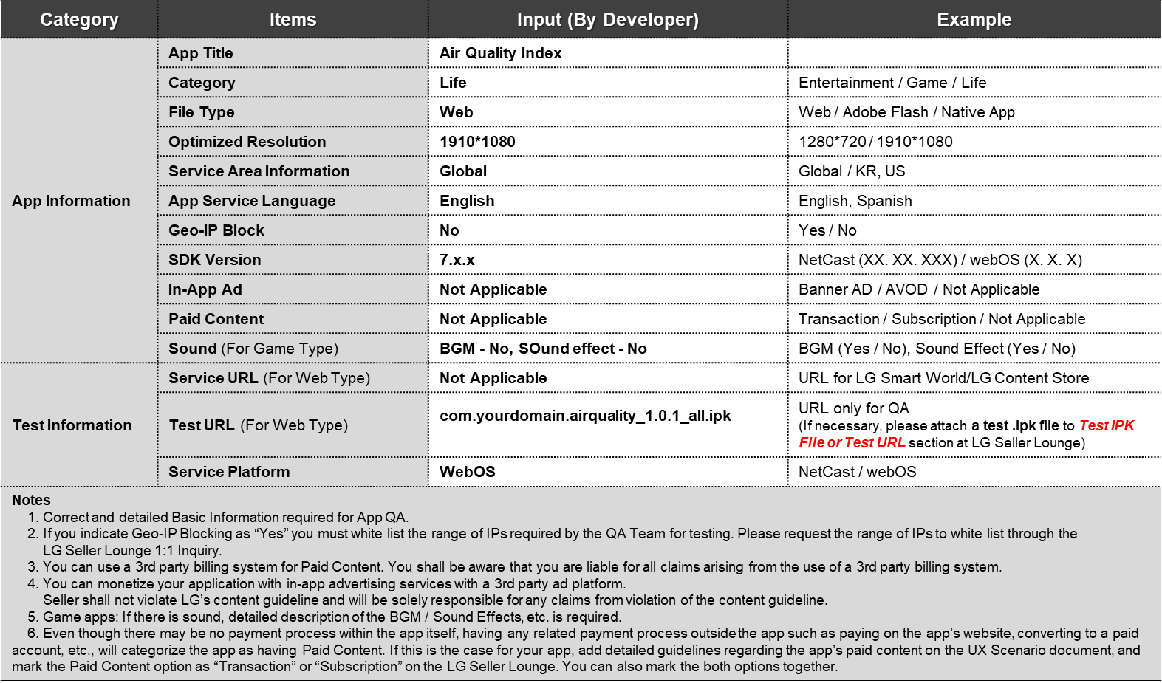
1. Basic Information

Slide 4
2. Document History
No. | Sent | Version | File Name | Contents
1 | 04.07.2022 | 1.0.4 | com.yourdomain.airquality_1.0.4_all.ipk | Upgraded version

Slide 5
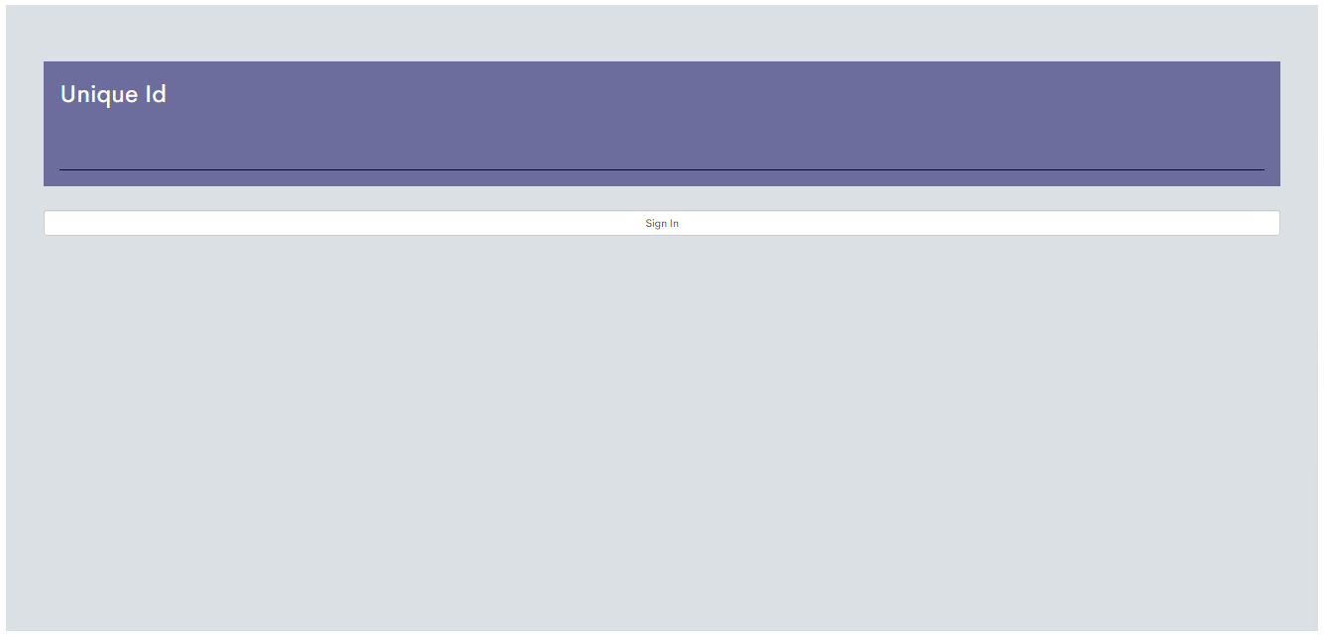
3. Page Description (Guideline)
1. (Sign In Page)
Description
1 | Unique Id text box,To to enter a unique id
2 | SignIn button , it will navigate to the next page after the successful SignIn
 | Test Account (Unique Id)
1 | Jazi12
Detailed Information
This is the sign In screen where the user have to enter the provided unique Id

Slide 6
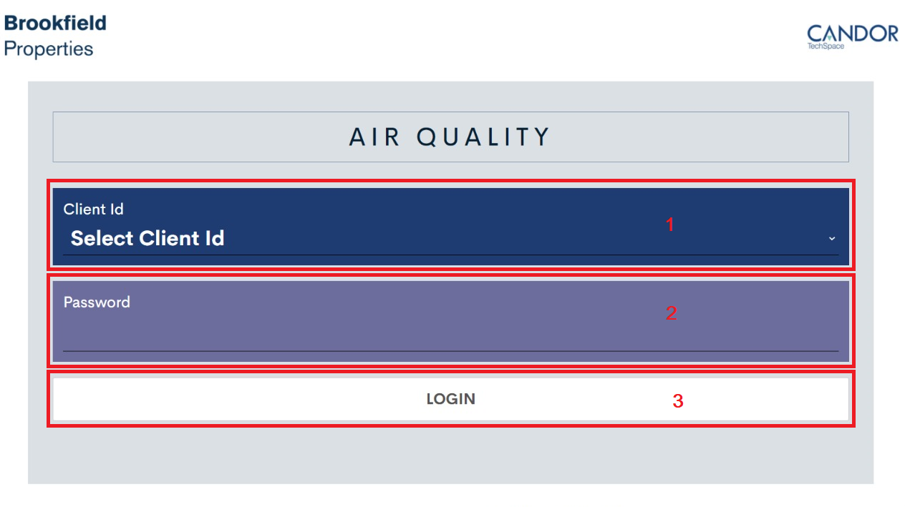
3. Page Description (Guideline)
2. (Login Page)
Description
1 | Client ID drop down text box,To seleca id
2 | Password field
3 | Login button , it will navigate to the next page after the successfull login
Detailed Information
This is the login screen where the user have to select an client id and the password for the respective id

Slide 7
4. Detailed Login Information
Description
1 | Client Id
2 | Password
3 | Login button
Test Accounts (ID / PW)
1 | ID ( FLD001 ) / PW ( Demo@123 )
2 | ID ( FLD002 ) / PW ( Demo@123 )
3 | ID ( FLD003 ) / PW (Demo@123 )
Activation Codes
1
2
3
①
②
Detailed Information
- Select the client Id
- Enter the respected password for selected client Id
- Click on the logi button, It will redirect to the next page

Slide 8
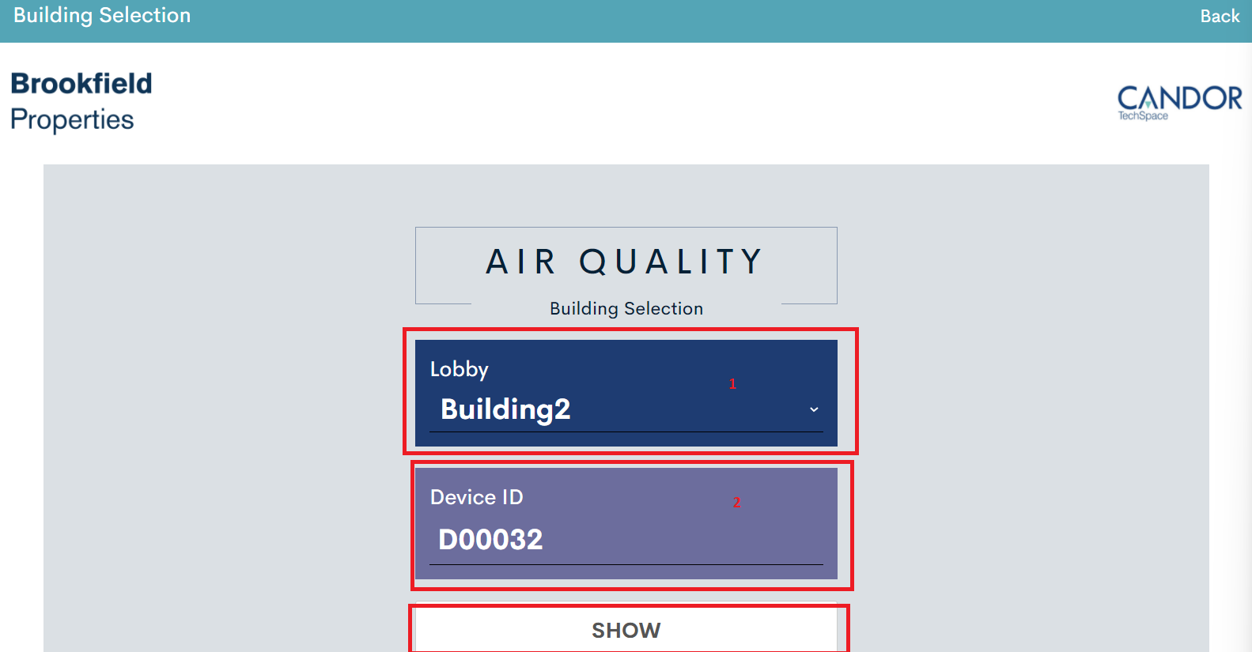
5. Building selection page
Description
1 | Select the Building from the Lobby dropdown
2 | Device Id will be automatically populated with respect to the selected lobby
3 | Show button , it will navigate to the next page on clicking on it
Detailed Information
- In this page we will be selecting the lobby which is populated based on the client Id which is selected on the previous login page
- On selecting the lobby , the device Id will be populated automatically and which is a readonly textbox
- On clicking the Show button, It will redirect to the next page where we will be displaying the air-quality
- On clicking on the back button, It will be redirected to the previous page

Slide 9
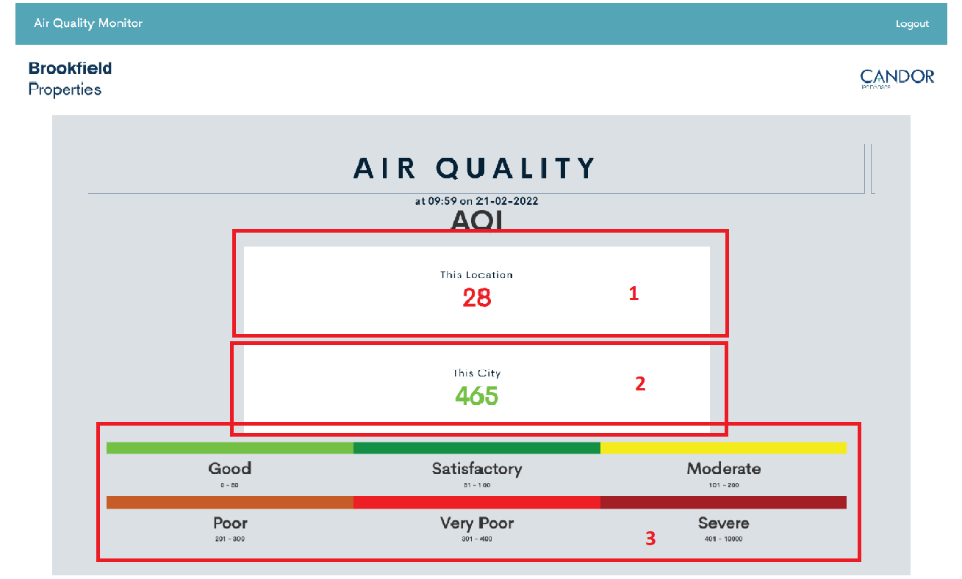
6. Main Page Description
Description
1 | Displaying the Air quality data inside the building
2 | Displaying the Air quality data outside the building
3 | Color representation data based on the air quality
①
①
②
②

③
Detailed Information
In this page, this Location column will be displaying the air quality index data inside the building
- In city column, we will be displaying the air qiuality index data outdoor the building
- The Indoor and outdoor AQI data value can be identified by the color represention label
- We will be getting all these data’s from the my sql data base
- On clicking on the logout button, it will be redirected to the login page
- It is the carousel view, different set of data’s will be displayed like AQI, PM 2.5 and PM 1.0 in the interval of 1 second
- The data’s will be refreshed in every one minute of time span

Slide 10
7. Sub Page Description
1. Flow Chart(Optional)
Start
Login
Builing Selection
Air quality
Display
Stop
Detailed Information
After the successfull login it will display all the Air quality data
*Note
- This page is added for better understanding for sub page’s location and movement during QA.

Slide 11
[Appendix]
If you have anything to let the LG QA Management know, please comment here. Any detailed references will be welcome.
This application is just to display the air quality index data

