Slide 1
Order 1

Slide 2
Break Case

Slide 3
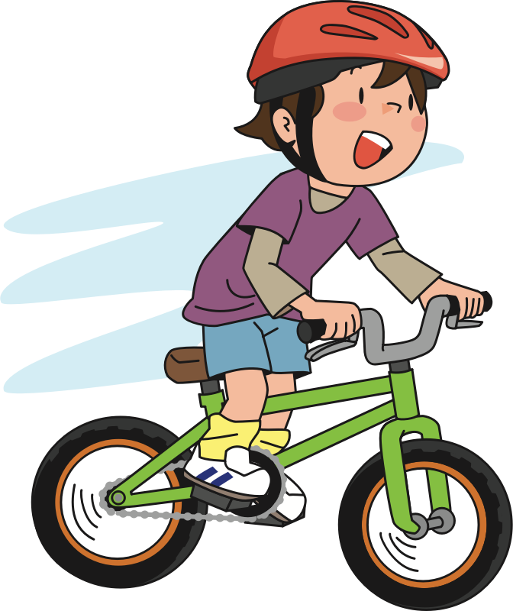
Here is Andy. He is at the park riding his bike.

Slide 4


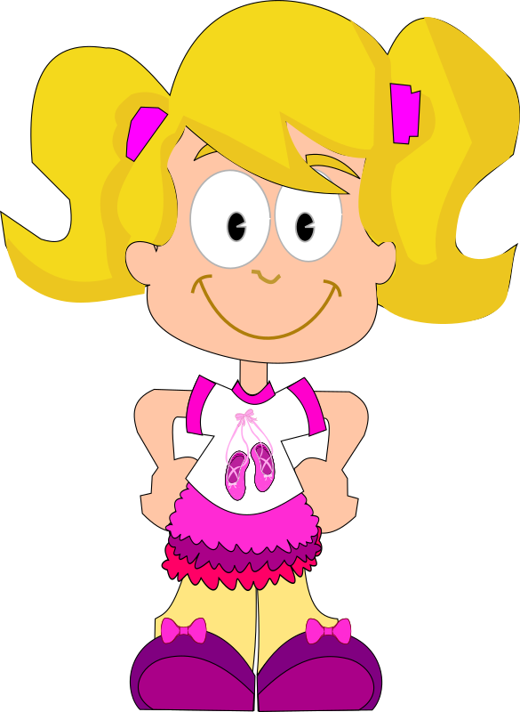
Here is Suzy. She is at the park watching butterflies.

Slide 5
Andy is riding his bike very fast and is coming around a corner.

Slide 6
As he comes around the corner, he ends up running right into Suzy! Suzy fell into the fence!

Slide 7
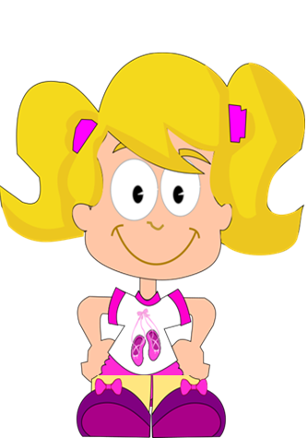
The fence ended up breaking! See the fence is broken!

Slide 8
Luckily nobody got hurt—Suzy and Andy were both OK.

Slide 9
Now that you saw what happened, we will ask you a couple of questions

Slide 10
Who caused the fence to break?

Slide 11
Who broke the fence?

Slide 12
Whose fault is it that the fence broke?

Slide 13
Should anyone be punished for the broken fence?

Slide 14
Who should be punished?

Slide 15
Crack Case

Slide 16
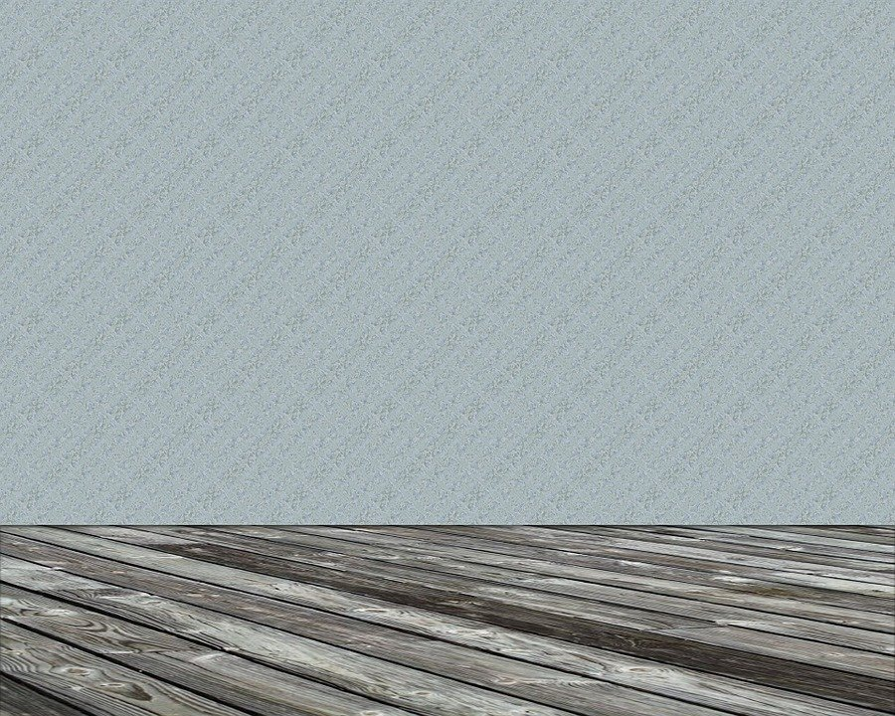
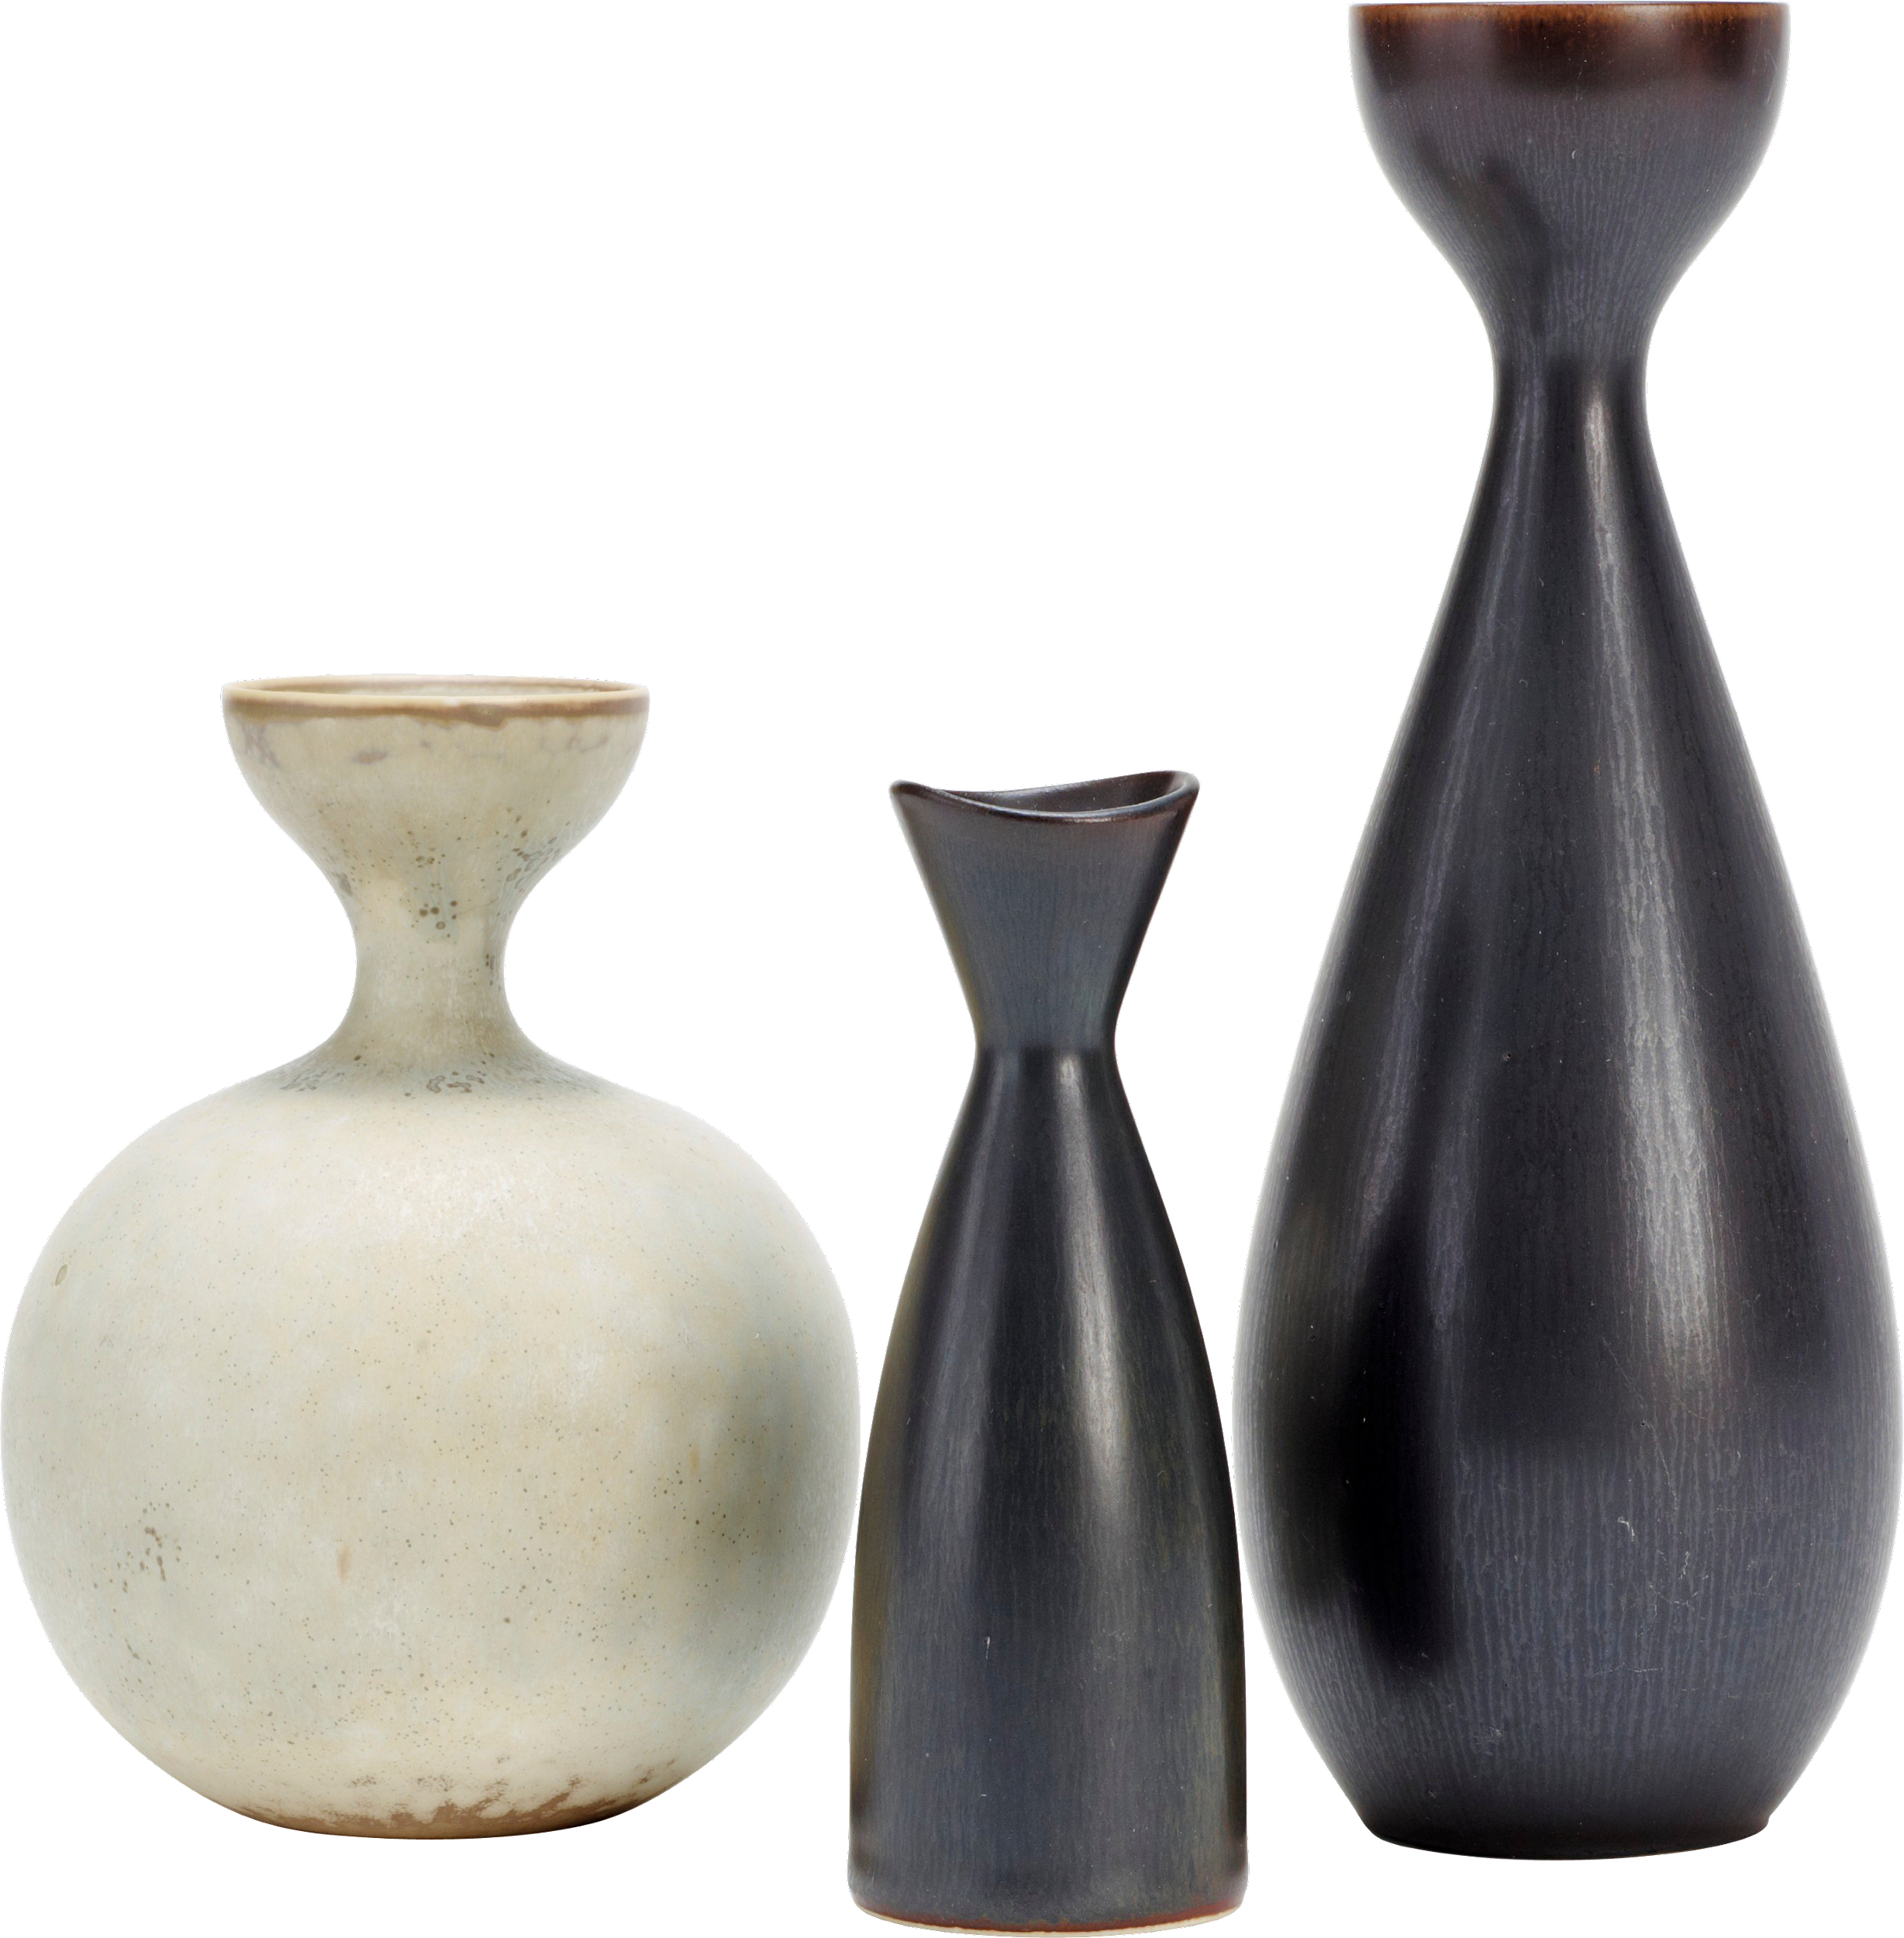

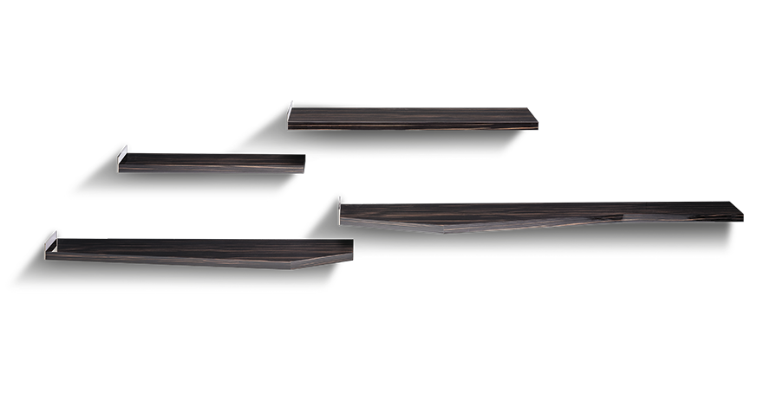
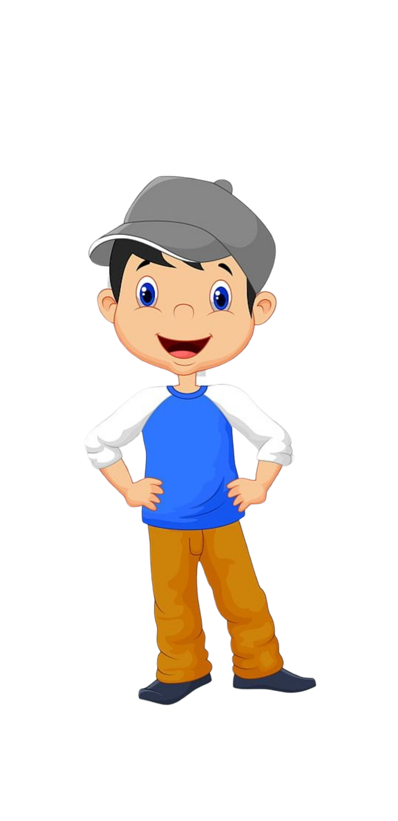





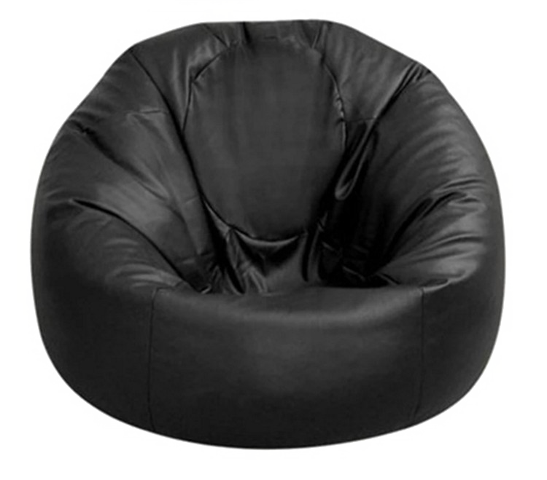
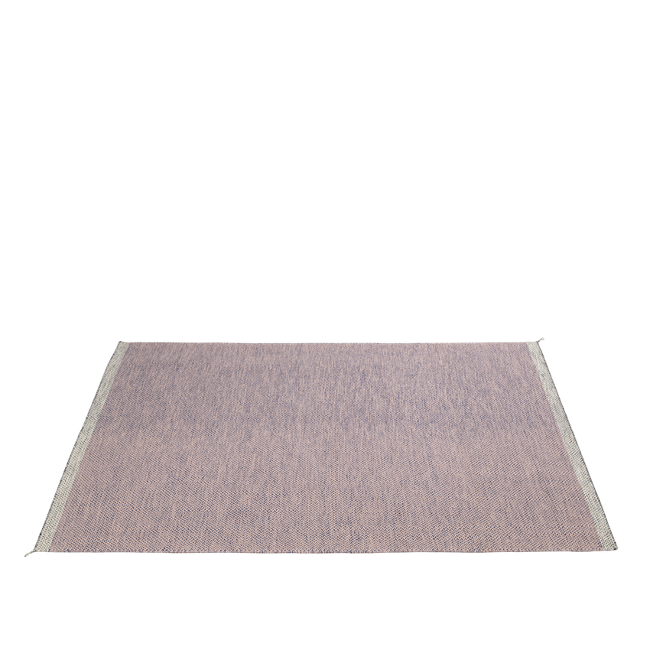

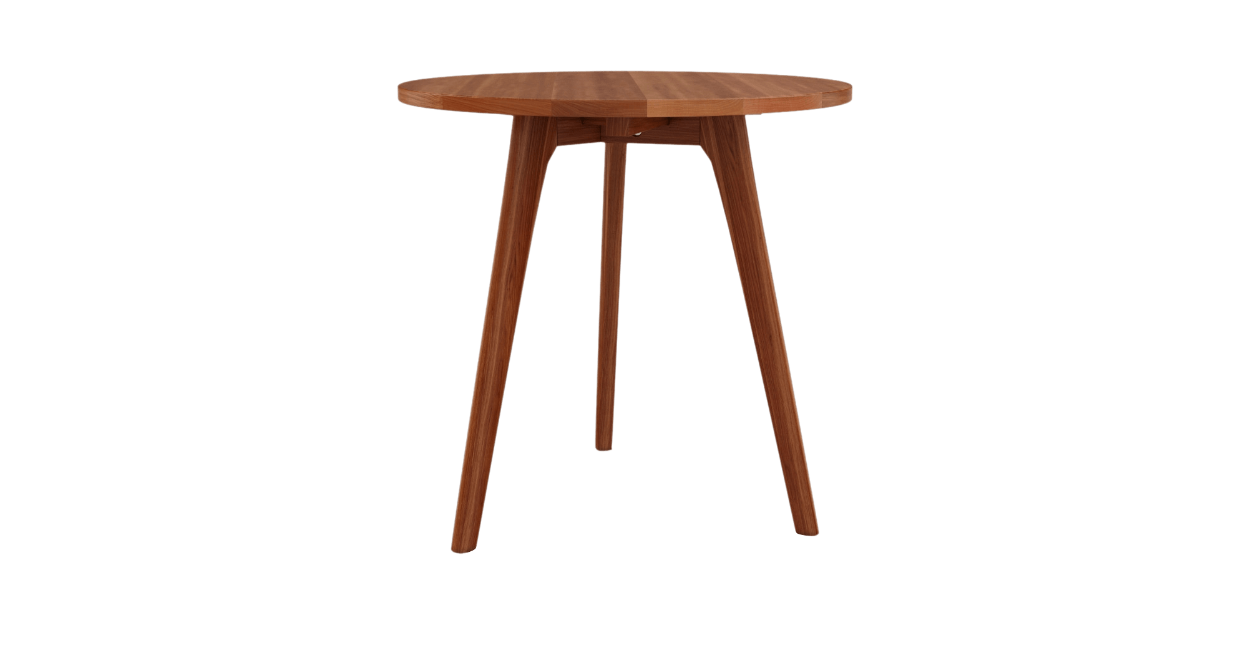
This is Bobby

Slide 17

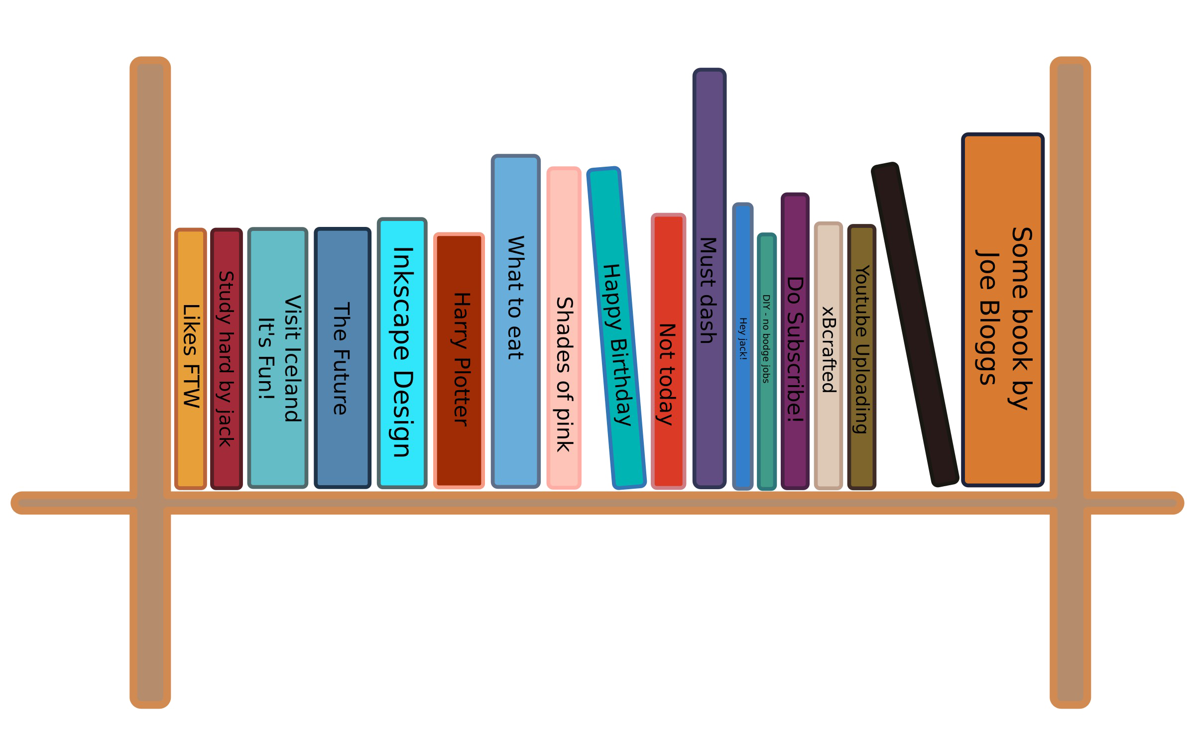


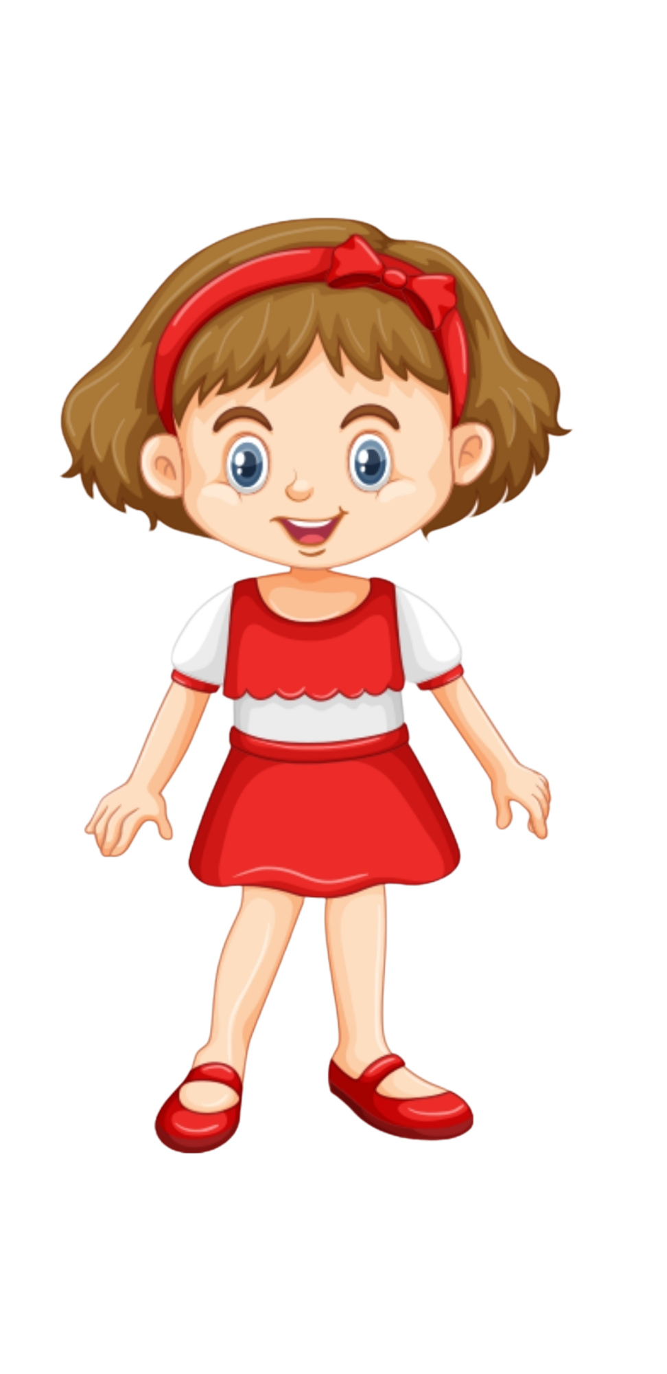


And this is Sophia

Slide 18
Sophia decides that she wants to scare Bobby

Slide 19
Sophia decides that she will hide behind the chair

Slide 20
Then she will call Bobby into the room and jump out to scare him!

Slide 21
Sophia goes to hide behind the chair.

Slide 22
See Sophia is hiding behind the chair.

Slide 23
Now she calls Bobby into the room

Slide 24
Bobby is now in the room

Slide 25
Sophia then jumps out and goes …

Slide 26
Boo!

Slide 27
Bobby falls into the mirror!

Slide 28
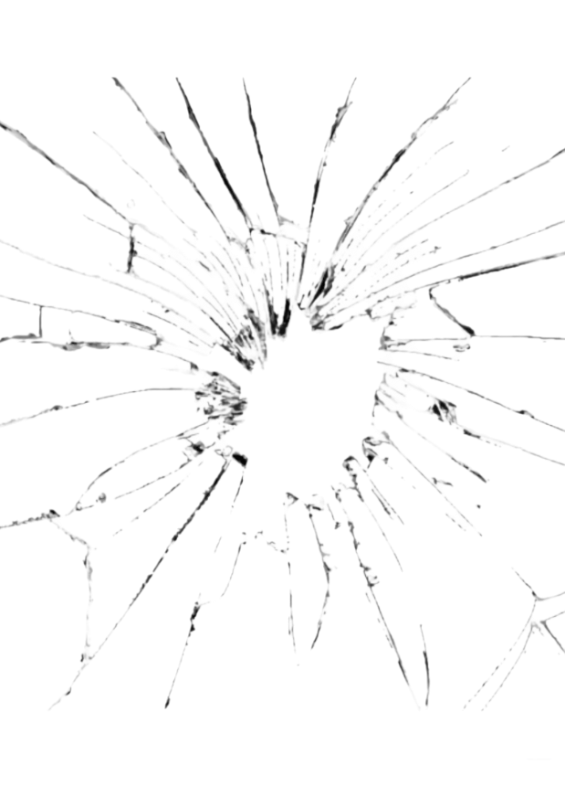
The mirror ended up cracking. See the mirror is cracked!

Slide 29
Luckily nobody got hurt—Bobby was OK.

Slide 30
Now that you saw what happened we would like to ask you a couple of questions

Slide 31
Who caused the mirror to crack?

Slide 32
Who cracked the mirror?

Slide 33
Whose fault is it that the mirror cracked?

Slide 34
Should anyone be punished for the cracked mirror?

Slide 35
Who should be punished?

Slide 36
Order 2

Slide 37
Break Case

Slide 38
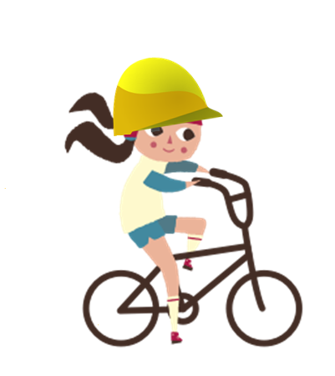
Here is Suzy. She is at the park riding her bike.

Slide 39

Here is Andy. He is at the park watching butterflies.

Slide 40

Suzy is riding her bike very fast and is coming around a corner.

Slide 41

As she comes around the corner, she ends up running right into Andy! Andy fell into the fence!

Slide 42



The fence ended up breaking! See the fence is broken!

Slide 43
Luckily nobody got hurt—Suzy and Andy were both OK.

Slide 44
Now that you saw what happened, we will ask you a couple of questions

Slide 45
Who caused the fence to break?

Slide 46
Who broke the fence?

Slide 47
Whose fault is it that the fence broke?

Slide 48
Should anyone be punished for the broken fence?

Slide 49
Who should be punished?

Slide 50
Crack Case

Slide 51
This is Sophia

Slide 52
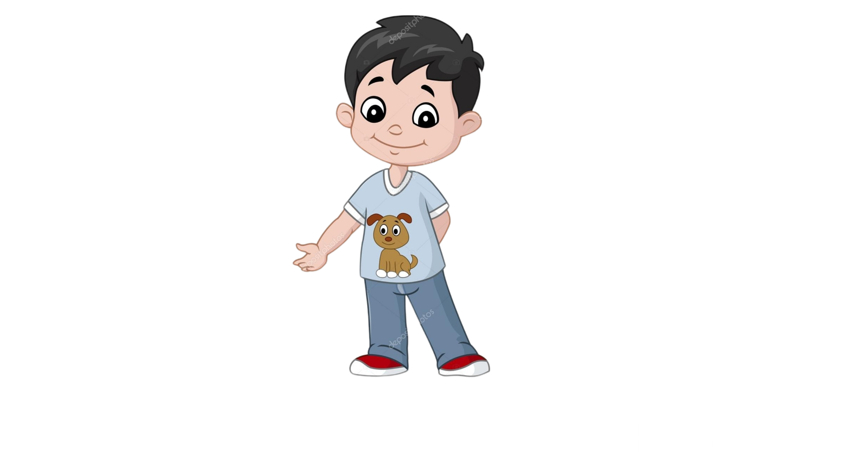
And this is Bobby

Slide 53
Bobby decides that he wants to scare Sophia

Slide 54
Bobby decides that he will hide behind the chair

Slide 55
Then he will call Sophia into the room and jump out to scare her!

Slide 56
Bobby goes to hide behind the chair.

Slide 57
See Bobby is hiding behind the chair.

Slide 58
Now he calls Sophia into the room

Slide 59
Sophia is now in the room

Slide 60
Bobby then jumps out and goes …

Slide 61
Boo!

Slide 62
Sophia falls into the mirror!

Slide 63
The mirror ended up cracking. See the mirror is cracked!

Slide 64
Luckily nobody got hurt—Sophia was OK.

Slide 65
Now that you saw what happened we would like to ask you a couple of questions

Slide 66
Who caused the mirror to crack?

Slide 67
Who cracked the mirror?

Slide 68
Whose fault is it that the mirror cracked?

Slide 69
Should anyone be punished for the cracked mirror?

Slide 70
Who should be punished?

