Slide 1



You will now meet Andy and Suzy, who are in the park.
To start, click next.

Slide 2



You will now meet Sophia and Bobby, who are in the room.
To start, click next.

Slide 3



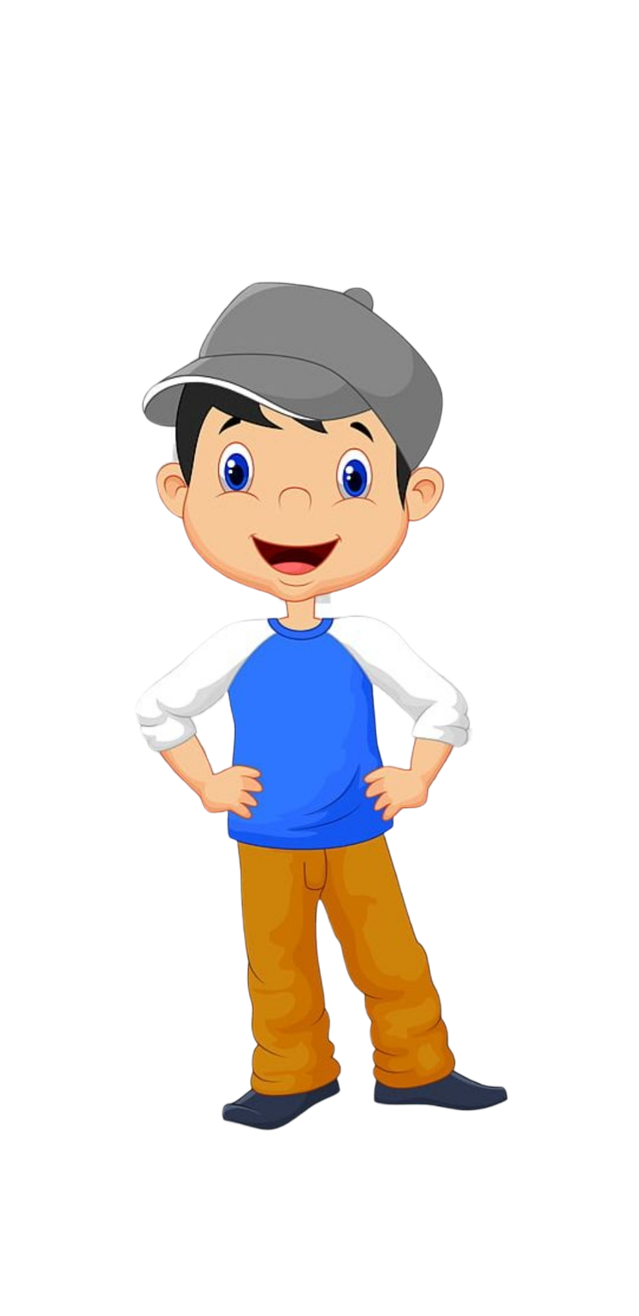
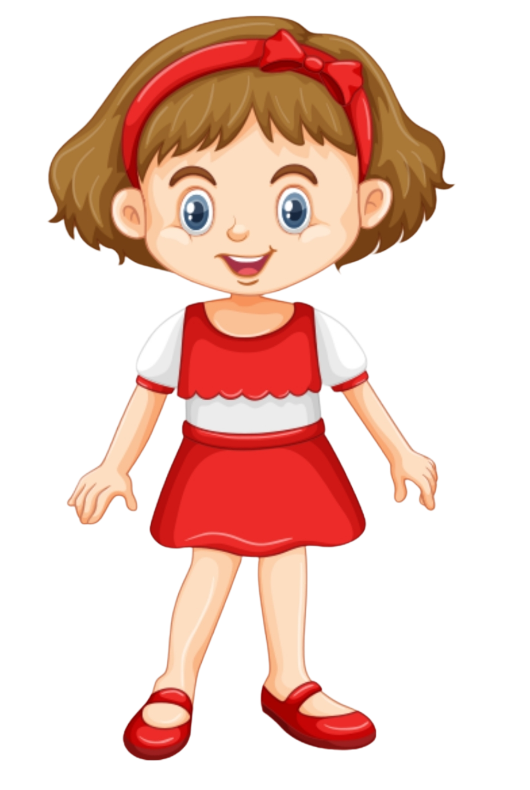

This is the end of our game!
Thanks so much for playing it with me.
I had a lot of fun and I hope that you did too!

