Slide 1

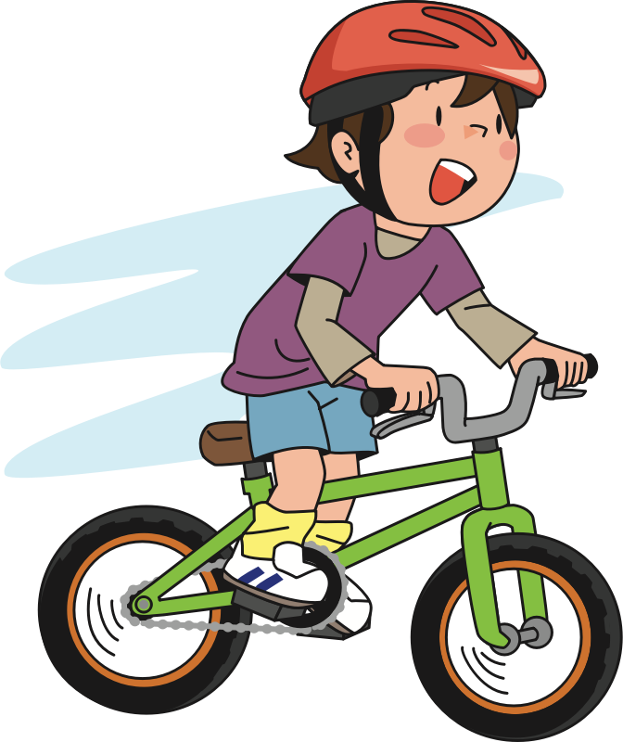
Response option
Andy
Suzy

Slide 2

Response option
Sophia
Bobby

Slide 3
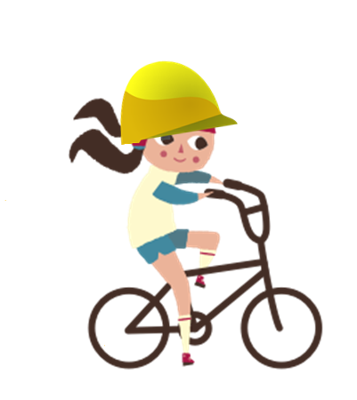
Response option
Suzy
Andy

Slide 4
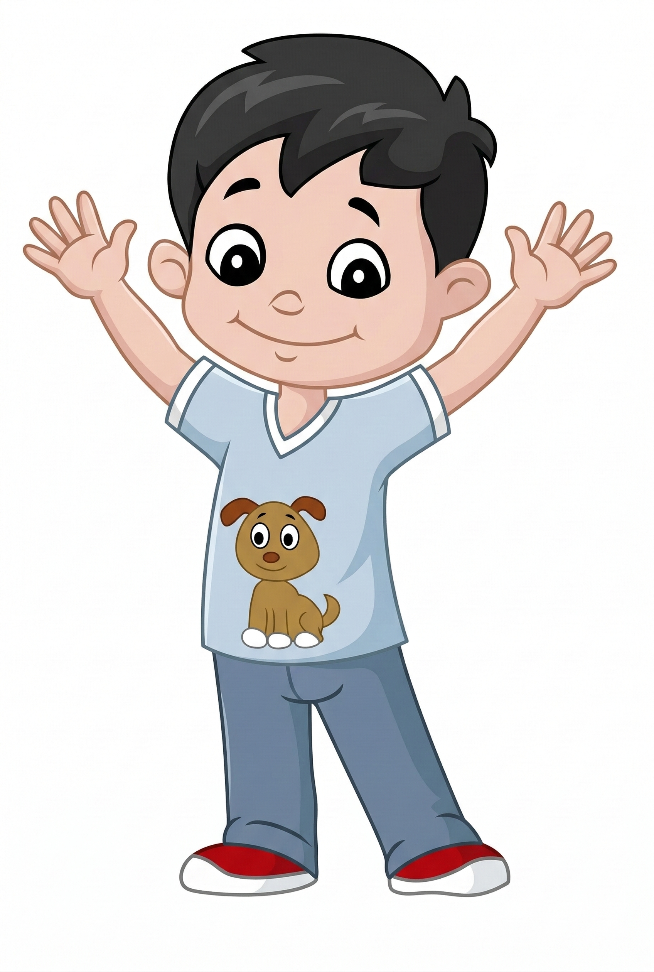
Response option
Bobby
Sophia

Slide 5


Response option
Yes
No

