Slide 1
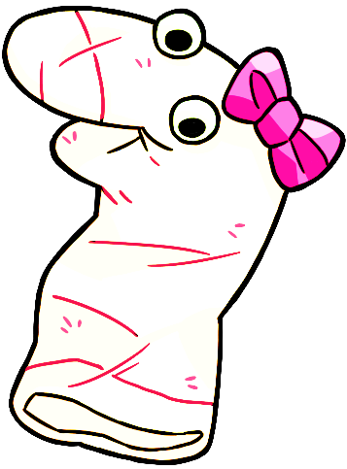
This is Maggie!

Slide 2
Let’s say hi to Maggie!

Slide 3
OK let’s practice giving answers by pressing a button of the screen.

Slide 4
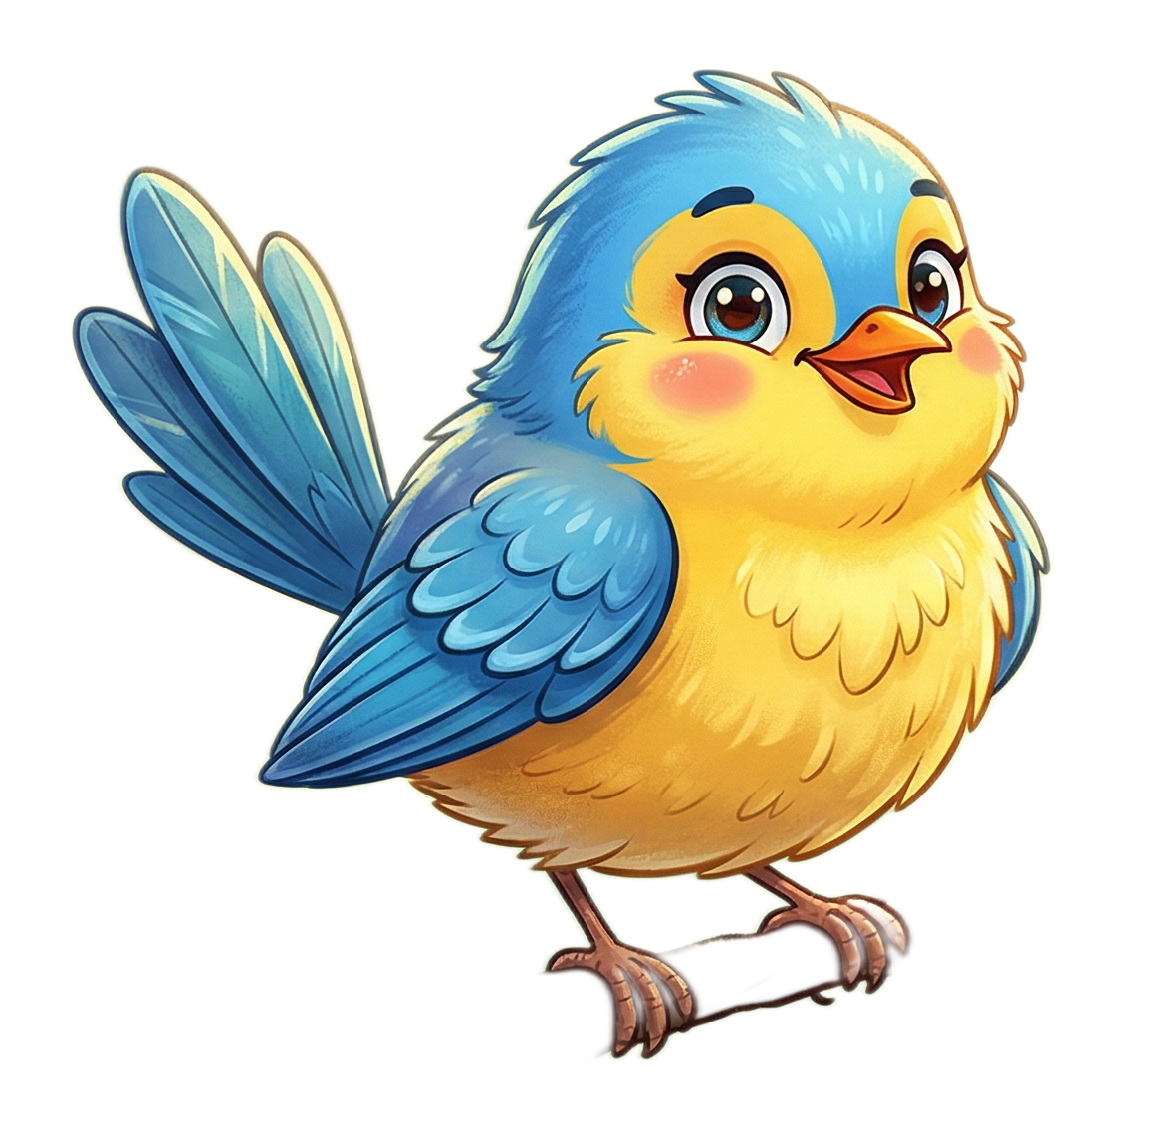
Maggie sees this.

Slide 5
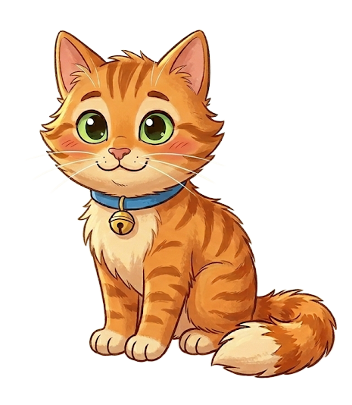
And Maggie sees this.

Slide 6
Maggie asks, “Which one is a bird?”

Slide 7
Please select one of the pictures on the bottom by clicking it.

Slide 8
Response options

