Slide 1
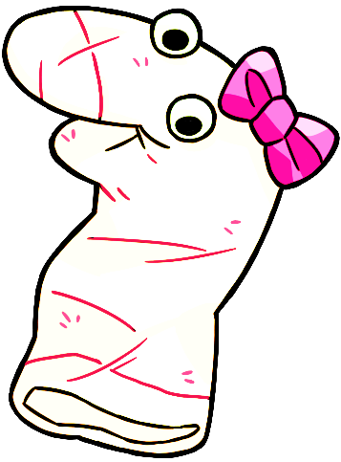
Thanks for helping Maggie!

Slide 2
Let’s practice giving another answer by pressing a button of the screen.

Slide 3
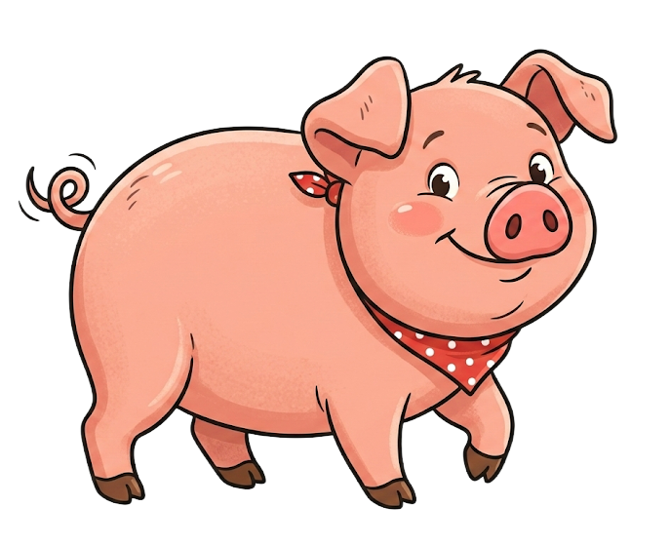
Maggie sees this.

Slide 4

And Maggie sees this.

Slide 5
Maggie asks, “Which one is a fish?”

Slide 6
Please select one of the pictures on the bottom by clicking it.

Slide 7
Response options

