Slide 1
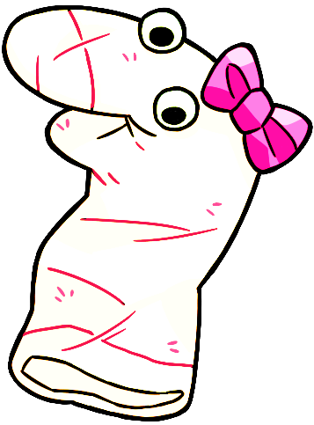
Thanks for helping Maggie!

Slide 2
Let’s practice giving another answer by pressing a button on the screen.

Slide 3
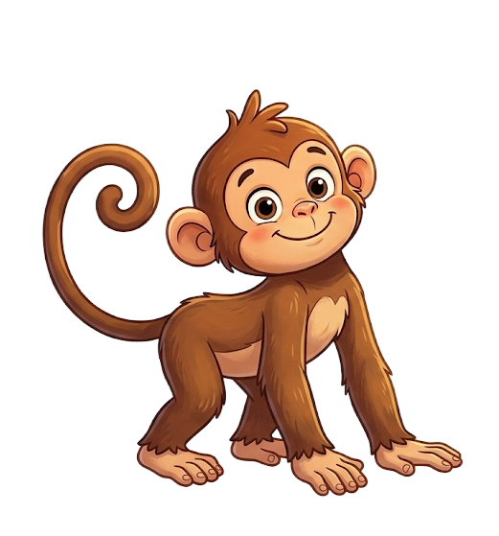
Maggie sees this.

Slide 4
Maggie says, “This is an elephant”.

Slide 5
Do you think this is an elephant?

Slide 6
Please select one of the pictures on the bottom by clicking it.

Slide 7


Response options
Yes
No

