Slide 1
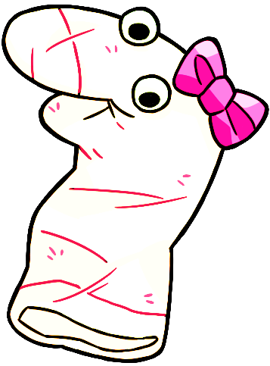
Thanks for helping Maggie!

Slide 2
Let’s practice giving another answer by pressing a button of the screen.

Slide 3
This time Maggie will ask a question and you will answer “Yes” or “No”.

Slide 4

If you think the answer is “Yes” then press this button.

Slide 5

If you think the answer is “No” then press this button.

Slide 6
OK let’s help Maggie!

Slide 7
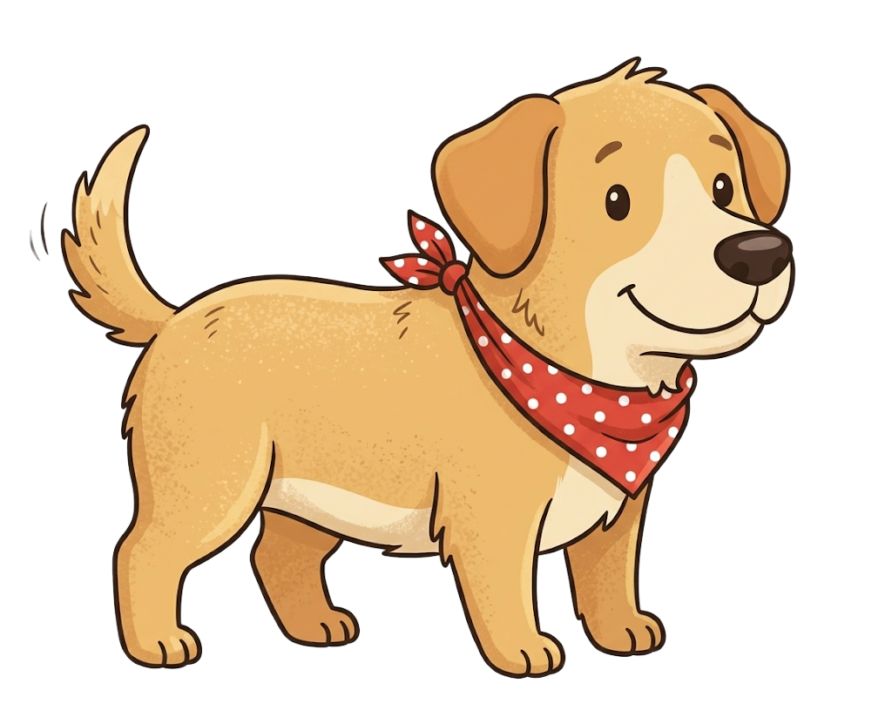
Maggie sees this.

Slide 8
Maggie says, “This is a dog”.

Slide 9
Do you think this is a dog?

Slide 10
Please select one of the pictures on the bottom by clicking it.

Slide 11
Response options
Yes
No

