Slide 1



Project: New Plant Disease Detection
CSML1020 – Group 3: Jerry Khidaroo, Paul Doucet
Instructor: Karthik Kuber, PhD, MS

Slide 2
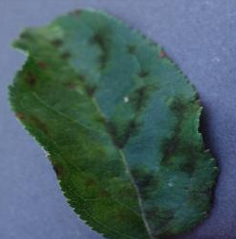
CSML1020 – Final Project
Introduction
Dataset: New Plant Diseases Dataset
Data Preparation
Data Exploration
Data Augmentation
Custom Defined Models
Pre-Trained Models with Transfer Learning
Hyperparameter Tuning
Results
Model Selection
Example Predictions
Next Steps
References

Slide 3
Introduction
Project Definition:
The project is a supervised multi-class image classification analysis to identify plant diseases by the image of their leaves.
The dataset consists of 38 categories of images which are divided into training and validation folders

Slide 4
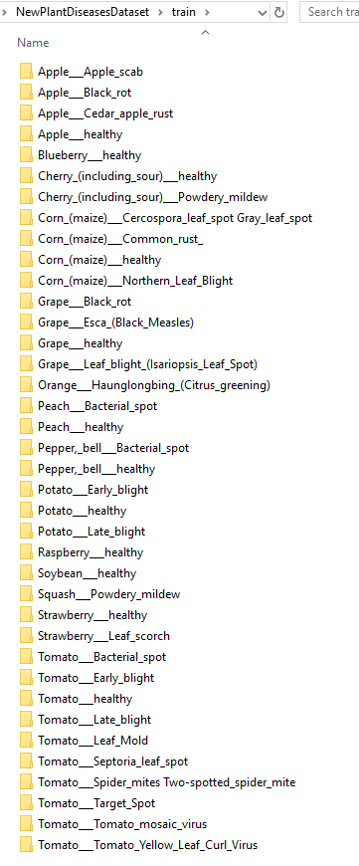
Dataset: New Plant Diseases Dataset from Kaggle
The data can be obtained from the following location:
https://www.kaggle.com/vipoooool/new-plant-diseases-dataset
38 Categories of Images

Slide 5

Data Preparation
The image dataset was well prepared and did not require any modification
The images were divided into training and validation folders:
70295 training images
17572 validation images
The folder names were parsed to obtain some data exploration data

Slide 6
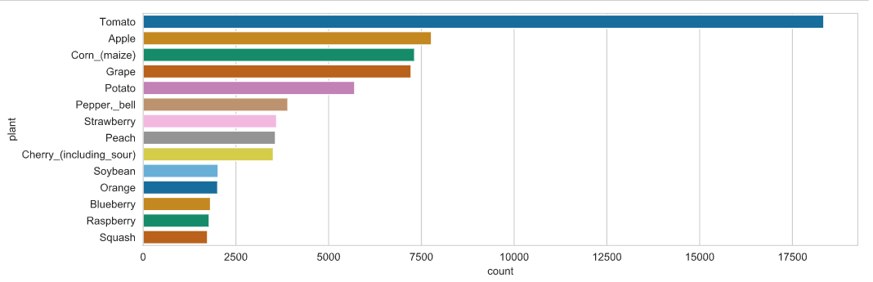
Data Exploration
Number of Images by Plant

Slide 7
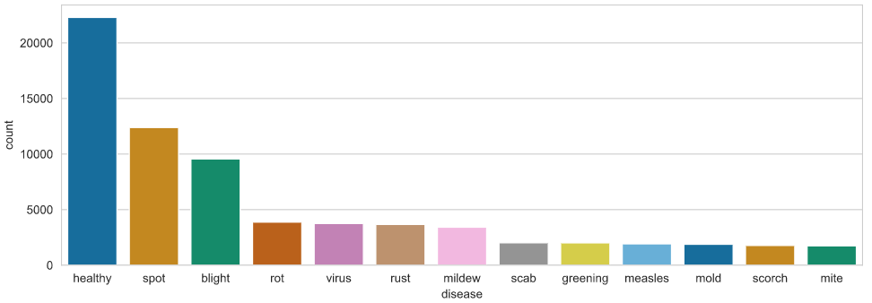
Data Exploration
Number of Images by Disease

Slide 8
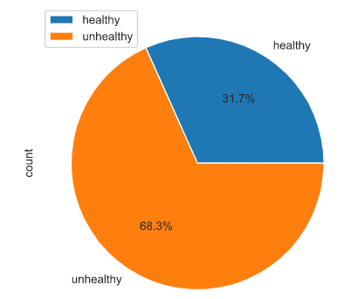
Data Exploration
Relative Percentages by Health Status

Slide 9
Data Preprocessing
The following data preprocessing methods will be evaluated to determine the best data augmentation for our input layer:
Random Shear
Random Brightness
Random Zoom
The following methods were omitted because the dataset was already pre-processed with those methods:
Random Horizontal Shift
Random Vertical Shift
Random Horizontal Flip
Random Vertical Flip

Slide 10
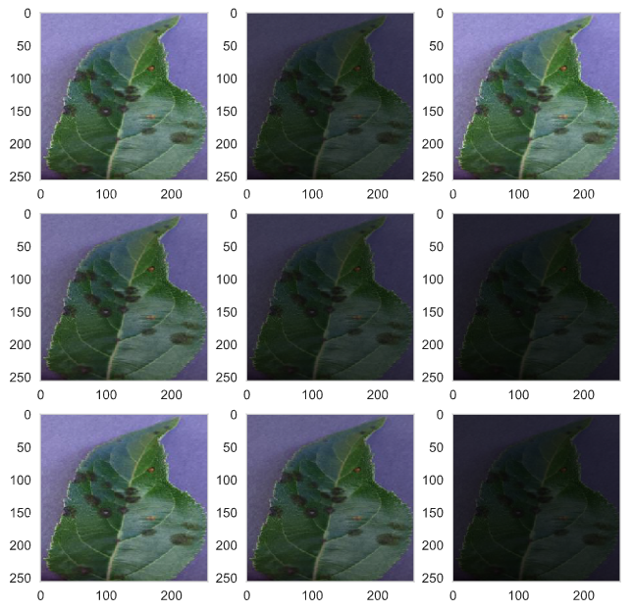
Data Augmentation Visualization For Random Brightness

Slide 11
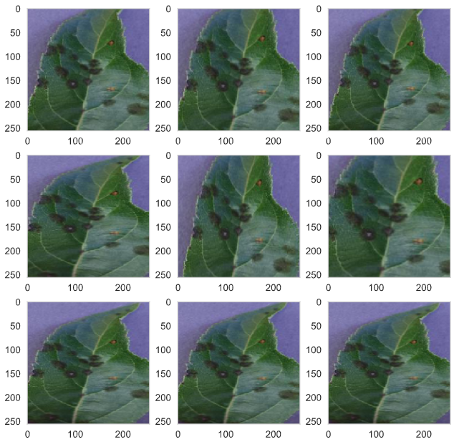
Data Augmentation Visualization For Random Zoom

Slide 12
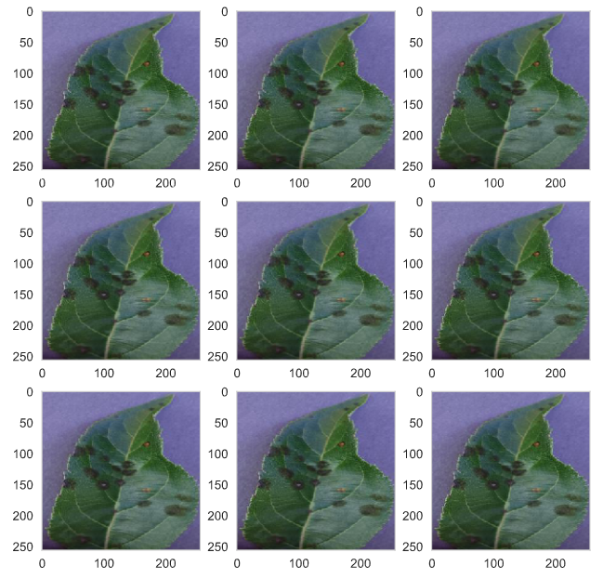
Data Augmentation Visualization For Random Shear

Slide 13
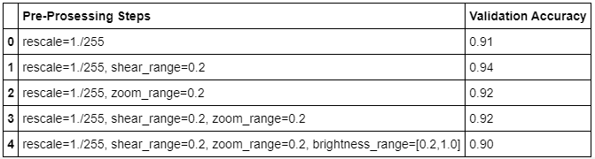
Preprocessing Results
Selected Preprocessing Method

Slide 14
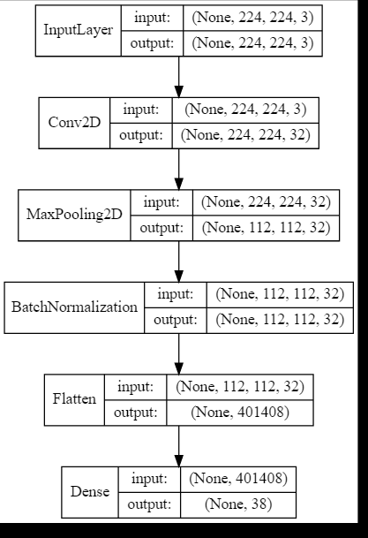
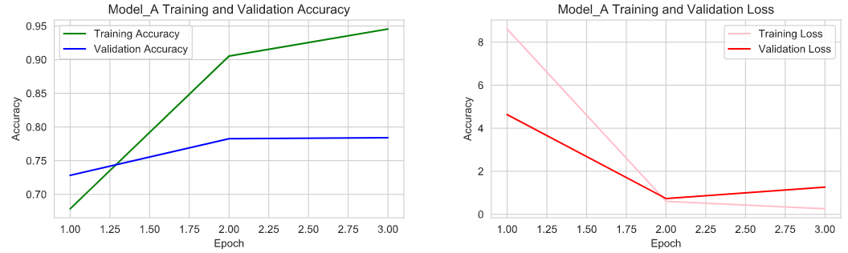

Model A
Model with one convolution layer, max pooling layer, batch normalization layer and a flatten layer.

Slide 15
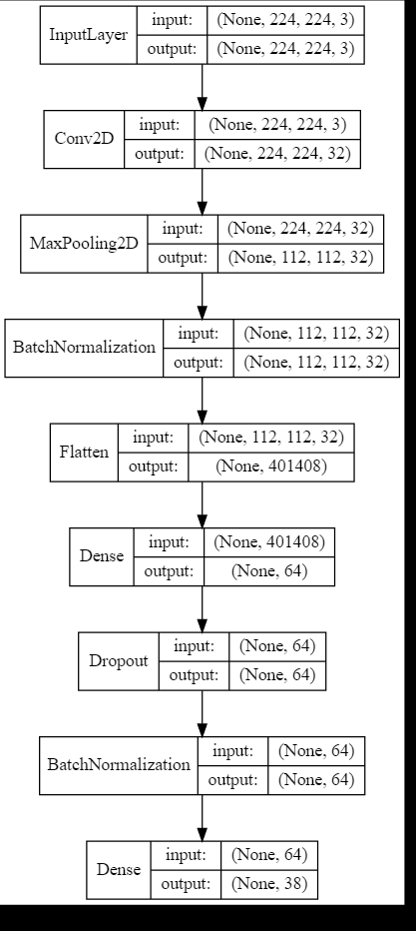
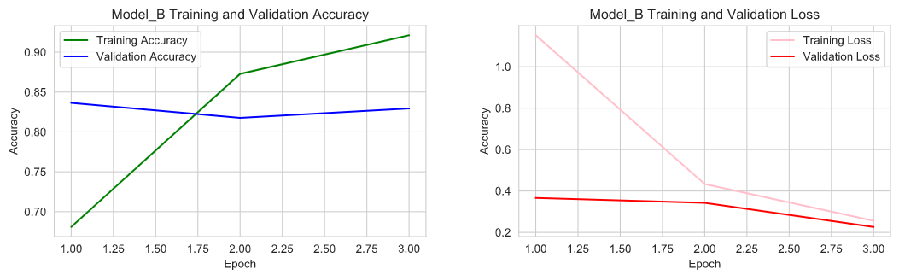

Model B
Second model, with dropout layer and batch normalization before the output layer.

Slide 16
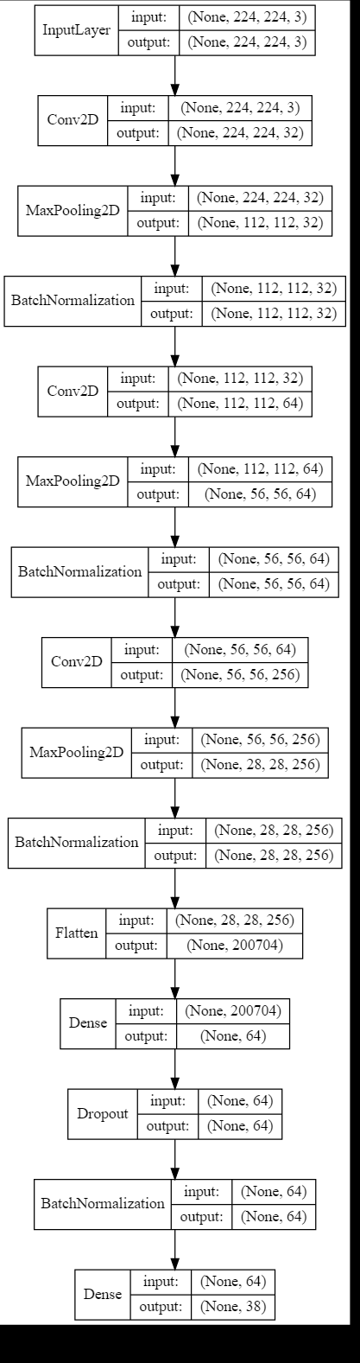
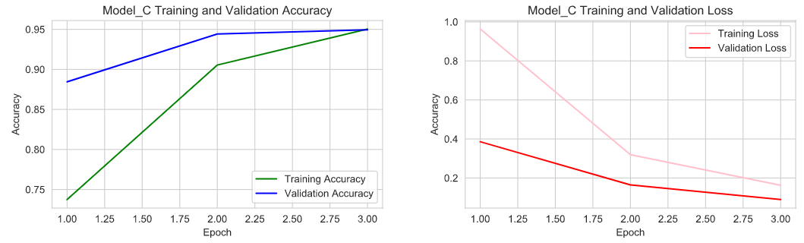

Model C
Third model, added two additional convolutional layers, with max pooling and batch normalization.

Slide 17
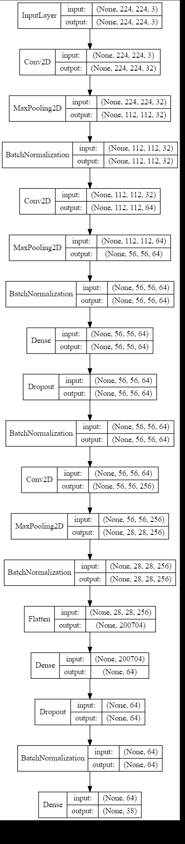
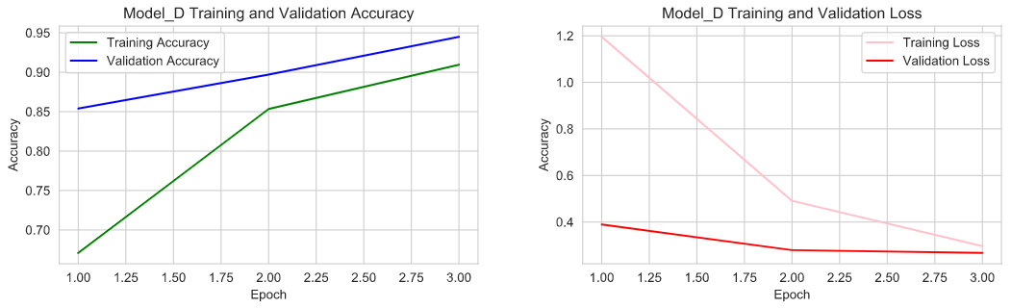

Model D
Fourth model, added dense layer, dropout layer and a batch normalization layer in between the second and third convolutional layers.

Slide 18
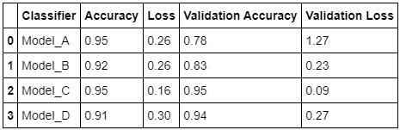
Benchmarks for Custom Defined Models
Model_C Selected

Slide 19
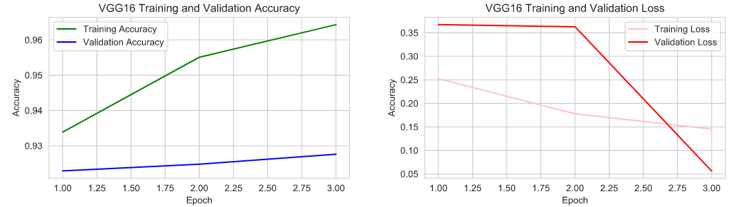
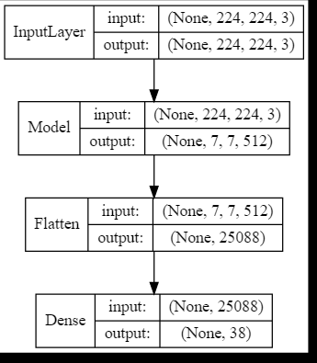
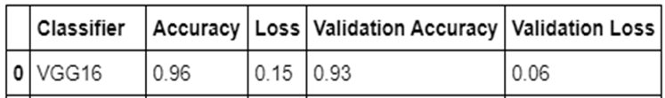
VGG16
Pre-trained model using VGG16 with default weights

Slide 20
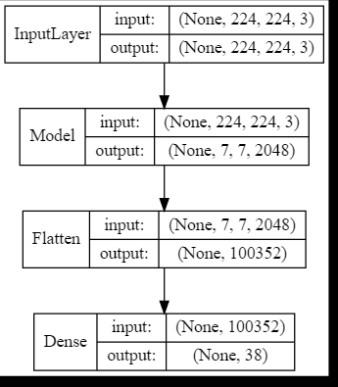
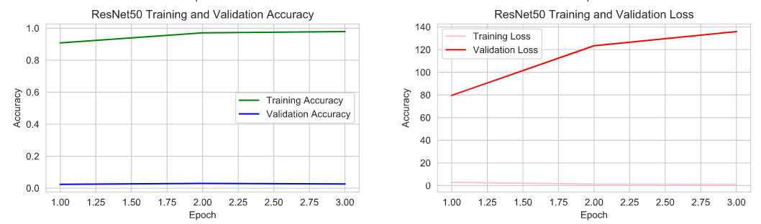
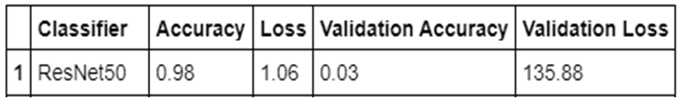
ResNet50
Pre-trained model using ResNet50 with default weights
Note: Model is severely over-fitting

Slide 21
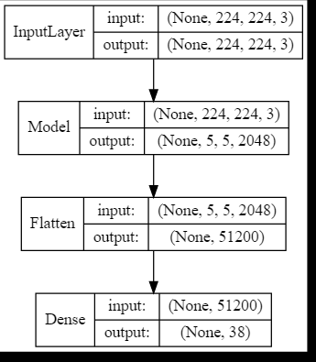
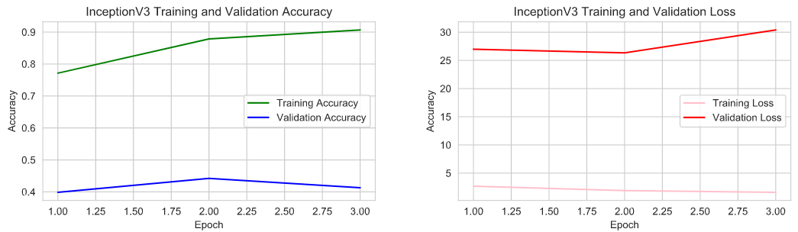
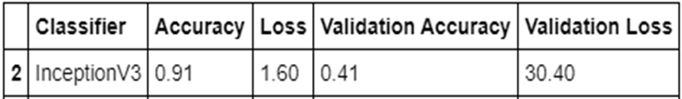
InceptionV3
Pre-trained model using InceptionV3 with default weights

Slide 22
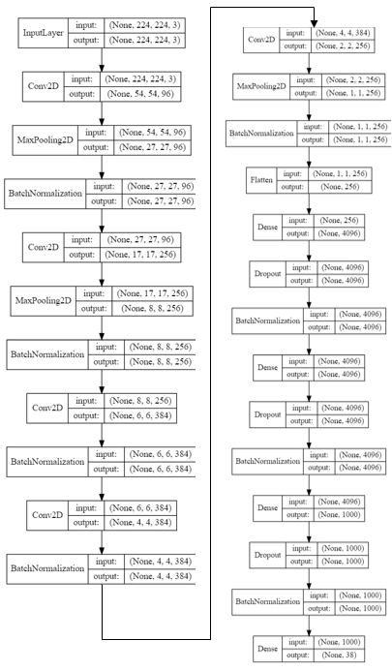
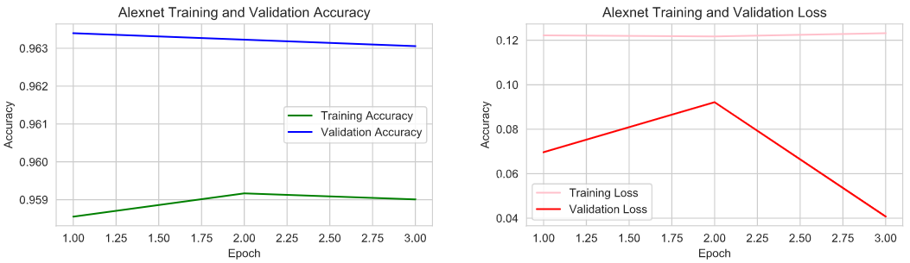
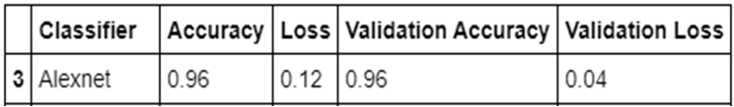
AlexNet
Pre-trained model using AlexNet initialized with best weights from reference example from: https://www.kaggle.com/vipoooool/plant-diseases-classification-using-alexnet

Slide 23
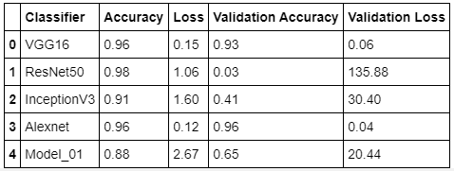
Benchmarks for Pre-Trained Models with Transfer Learning
VGG16 and AlexNet Selected

Slide 24
Hyperparameter Tuning with GridSearch
Model | Learning_Rate | Epochs | Batch Size | Activation
VGG16 | 0.001 | 5 | 64 | softmax
Model_C | 0.001 | 5 | 48 | softmax
AlexNet | 0.01 | 3 | 32 | softmax
Best Parameters

Slide 25
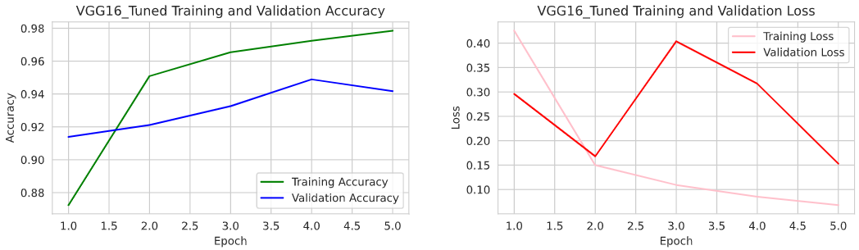

VGG16 Using Best Hyper-Parameters
Model | Learning_Rate | Epochs | Batch Size | Activation
VGG16 | 0.001 | 5 | 64 | softmax
VGG16 Pre-trained model using best found hyperparameters using gridsearch

Slide 26
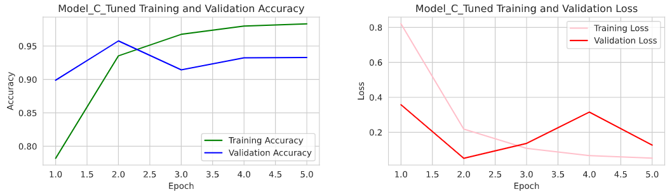

Model_C Using Best Hyper-Parameters
Model | Learning_Rate | Epochs | Batch Size | Activation
Model_C | 0.001 | 5 | 48 | softmax
Model_C Pre-trained model using best found hyperparameters using gridsearch

Slide 27
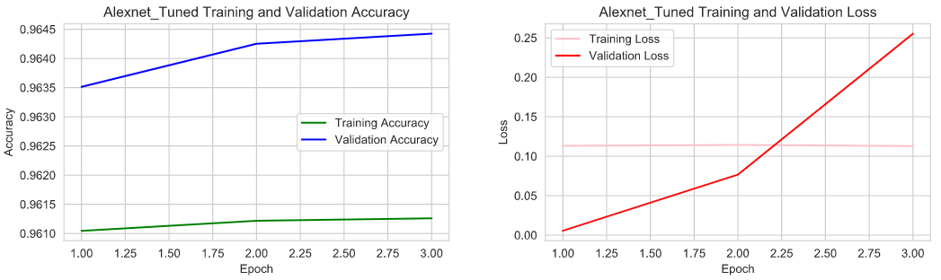

AlexNet Using Best Hyper-Parameters
Model | Learning_Rate | Epochs | Batch Size | Activation
AlexNet | 0.01 | 3 | 32 | softmax
AlexNet Pre-trained model using best found hyperparameters using gridsearch

Slide 28
Hyperparameter Tuning Benchmarks
 | Classifier | Accuracy | Loss | Validation Accuracy | Validation Loss
0 | VGG16_Tuned | 0.98 | 0.07 | 0.94 | 0.15
1 | Model_C_Tuned | 0.98 | 0.05 | 0.93 | 0.13
2 | AlexNet_Tuned | 0.96 | 0.11 | 0.96 | 0.26

Slide 29
Summary of Benchmark Results for all Models
 | Classifier | Training Accuracy | Training Loss | Validation Accuracy | Validation Loss
1 | Model_A | 0.95 | 0.26 | 0.78 | 1.27
2 | Model_B | 0.92 | 0.26 | 0.83 | 0.23
3 | Model_C | 0.95 | 0.16 | 0.95 | 0.09
4 | Model_D | 0.91 | 0.30 | 0.94 | 0.27
5 | VGG16 | 0.96 | 0.15 | 0.93 | 0.06
6 | ResNet50 | 0.98 | 1.06 | 0.03 | 135.88
7 | InceptionV3 | 0.91 | 1.60 | 0.41 | 30.40
8 | AlexNet | 0.96 | 0.12 | 0.96 | 0.04
9 | VGG16_Tuned | 0.98 | 0.07 | 0.94 | 0.15
10 | Model_C_Tuned | 0.98 | 0.05 | 0.93 | 0.13
11 | AlexNet_Tuned | 0.96 | 0.11 | 0.96 | 0.26

Slide 30
Models Selected
 | Classifier | Training Accuracy | Training Loss | Validation Accuracy | Validation Loss
3 | Model_C | 0.95 | 0.16 | 0.95 | 0.09
8 | AlexNet | 0.96 | 0.12 | 0.96 | 0.04

Slide 31
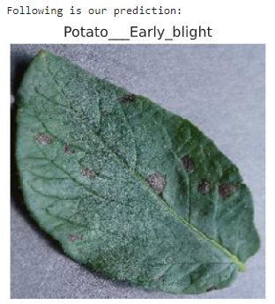
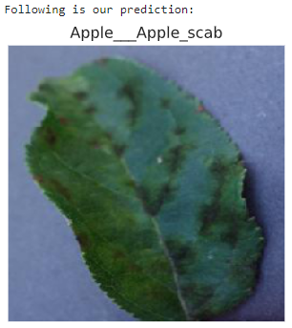
Example Predictions

Slide 32
Next Steps
Ensemble Models
Deploy a Detection Application
Spark Scaling to speed up the processing

Slide 33

Conclusion
Thank you for listening to our presentation
Questions
Contact Information
jkhidaroo@gmail.com
pjdoucet@gmail.com

Slide 34
References
[1] Wiwid Setiawan, 2020. T Plant Desease Classifictaion-VGG16 https://www.kaggle.com/wiwidsetiawan/plant-desease-classifictaion-vgg16
[2] Vimal Adit. 2019. Fork of Plant Diseases Classification Using incep3 https://www.kaggle.com/vimaladit/fork-of-plant-diseases-classification-using-incep3
[3] Jason Brownlee 2019, Introduction to Python Deep Learning with Keras https://machinelearningmastery.com/introduction-python-deep-learning-library-keras/
[4] Antrixsh Gupta 2020, How to mount Cloud Storage bucket with GCP compute engine https://medium.com/@antrixsh/how-to-mount-cloud-storage-bucket-with-gcp-compute-engine-ba7c95ad5349
[5] Keras Documentation, Keras Applications https://keras.io/api/applications/
[6] Jason Brownlee 2019, How to Configure Image Data Augmentation in Keras https://machinelearningmastery.com/how-to-configure-image-data-augmentation-when-training-deep-learning-neural-networks/
[7] ACM Website, ACM Master Article Template https://www.acm.org/publications/proceedings-template
[8]Acknowledgments https://elc.polyu.edu.hk/FYP/html/ack.htm#:~:text=A%20page%20of%20acknowledgements%20is,in%20carrying%20out%20the%20research.

