Slide 1

Project: Conversation Dialogue Identification
CSML1010 – Milestone 2 Group 3: Jerry Khidaroo, Paul Doucet
Instructor: Dr. Annie En-Shiun Lee

Slide 2
CSML1010 – Milestone 2
Dataset: Taskmaster-1 from Google
NLP Multi-Class Text Classification Problem
Data Preparation
Data Clean Up
Exploratory Data Analysis
Feature Extraction & Engineering
Feature Scaling & Selection
Modeling
Model Evaluation & Tuning

Slide 3
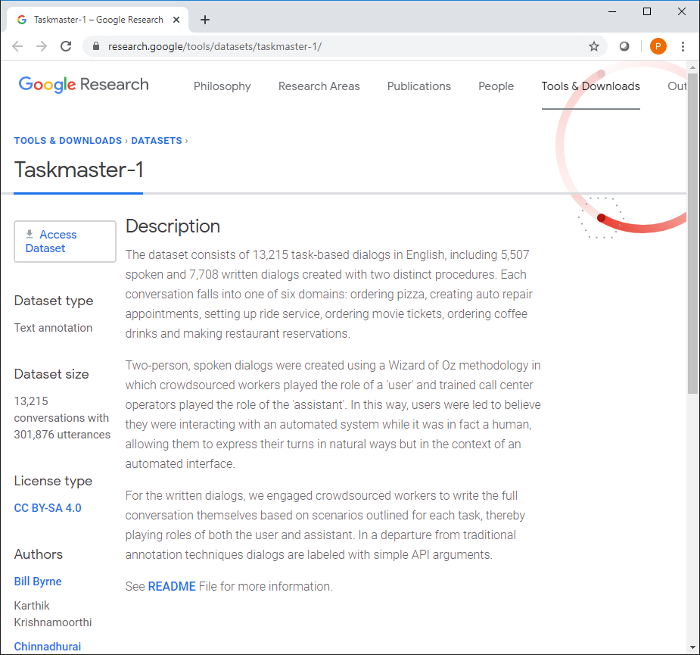
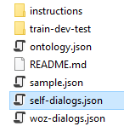
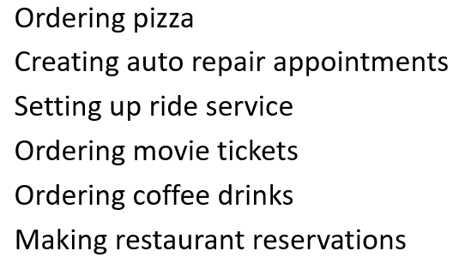
Dataset: Taskmaster-1 from Google https://research.google/tools/datasets/taskmaster-1/
The dataset selected is the Taskmaster-1 from Google
The dataset consists of task-based dialogs falling into one of six domains divided into 14 categories
We will be using the self-dialogs file which contains 7,708 conversations: ‘self-dialogs.json’

Slide 4
Description of Categorical Variable (Instruction_id)
Instruction_id | Conversation Dialogue Description
Auto-repair-appt-1 | Users will pretend they need to take their car to the mechanic, so they need to get an appointment scheduled
Coffee-ordering-1 | Users will pretend they’ve decided to order a coffee drink from a coffee shop
Coffee-ordering-2 | Users will pretend they’ve decided to order a coffee drink, and makes changes to the drink after the initial options have been requested
movie-finder | User is looking for a movie to see at home
movie-tickets-1 | User wants to see a movie playing now
movie-tickets-2 | User wants to see a movie playing now, settling for a second choice
movie-tickets-3 | User wants to see one of two movies
Pizza-Ordering-1 | User orders one pizza, and ask all relevant details
Pizza-Ordering-2 | User orders one pizza with two toppings, and ask all relevant details
restaurant-table-1 | Users will pretend they are searching for a restaurant and book a table
restaurant-table-2 | Users will pretend they are searching for a restaurant and book a table, and will need to find an alternative when choice is not available
restaurant-table-3 | Users will pretend they are searching for a restaurant and book a table, and will look at options at two restaurants
uber-lyft-1 | Users will pretend they need to order a car for a ride inside a city
uber-lyft-2 | Users will pretend they need to order a car for a ride inside a city, and looking for an alternative when choice is not available

Slide 5
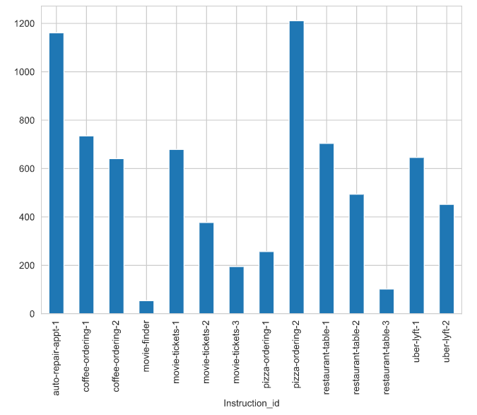
Distribution of Categorical Variable (Instruction_id)
Notes:
]

Slide 6
Project: Conversation Identification
The problem we will examine is a supervised multi-class text classification problem.
Goal: Build a model that identifies the category for dialogue conversations
Input: conversation dialogue text and labels
Output: model that predicts the “instruction_id” category
Input
Conversation Dialogue text and labels
Machine Learning
Machine Learning Steps
Output
Model that predicts the “instruction_id” category

Slide 7
Modeling, Model Evaluation & Tuning
Step | Description
1. Benchmark Using Bag of Words features Feature Selection using Chi² | Logistic Regression
 | Multinomial Naïve Bayes
 | Random Forest Classifier
 | Linear SVC
2. Optimized Hyperparameters | GridSearchCV
3. Learning Curves | Accuracy
 | Errors
4. Ensemble Learning | Bagging
 | Boosting
 | Stacking

Slide 8
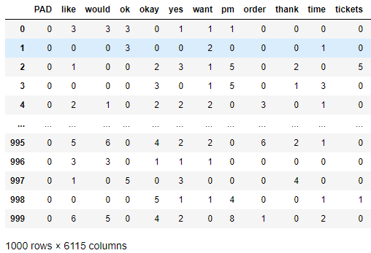
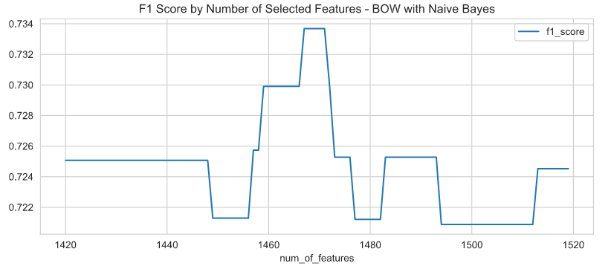

Bag of Words
Feature Extraction
Feature Selection – Univariate with Chi²
Benchmarking

Slide 9
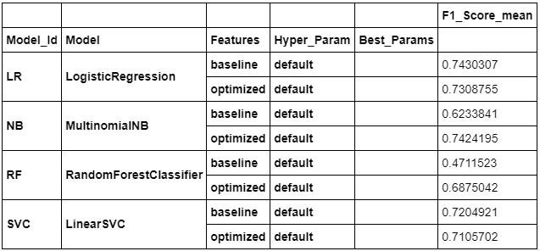
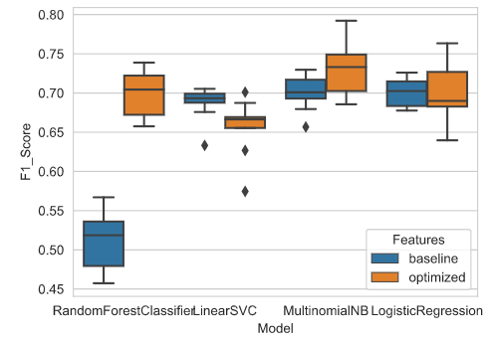
1. Models Benchmark Comparison
Baseline: Bag of Words Features
Optimized: Bag of Words using Univariate Chi² feature selection method
Notes:
TODO:
Review Title “Models Benchmark Comparison” is this ok?
Change the graph with the last run with the stops included

Slide 10
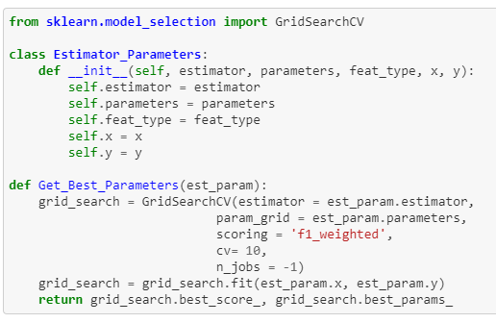
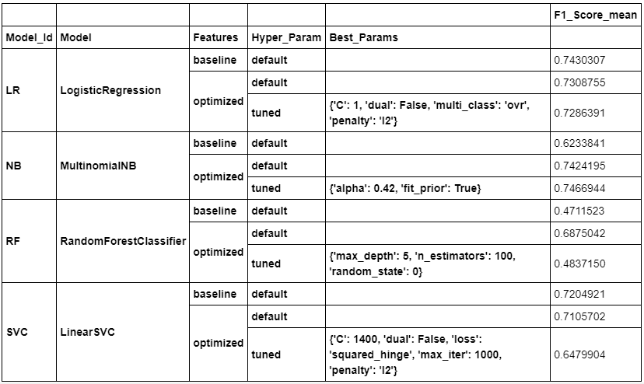
2. Optimized Hyperparameters Using GridSearchCV
Notes:
TODO:

Slide 11
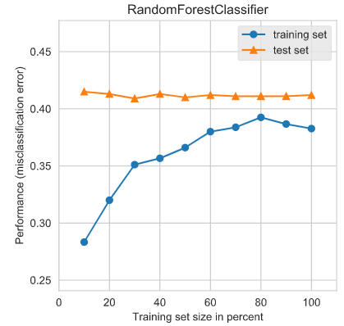
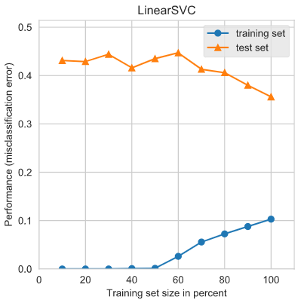
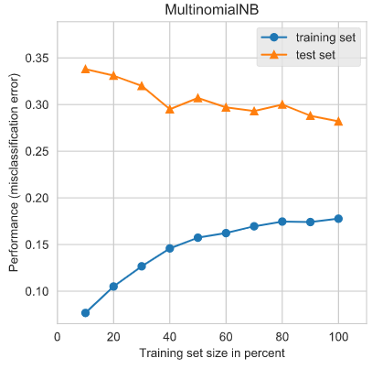
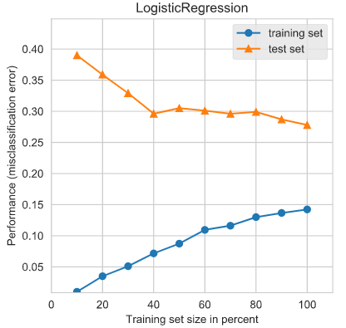
3a. Learning Curves – Training/Testing Errors
Random Forest Classifer:
High Bias
Low Variance
Linear SVC:
Low Bias
High Variance
MultinomialNB:
Low Bias
Medium Variance
Logistic Regression:
Low Bias
Medium Variance
Notes:
TODO:

Slide 12
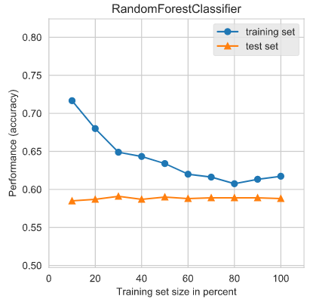
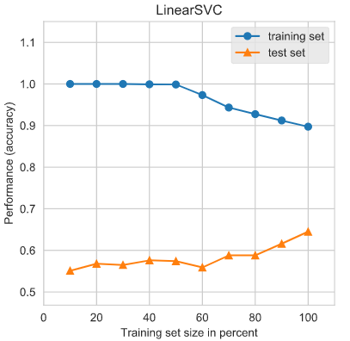
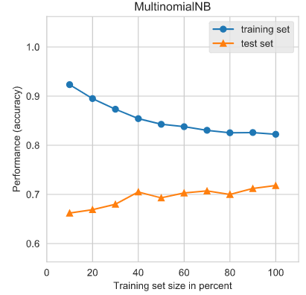
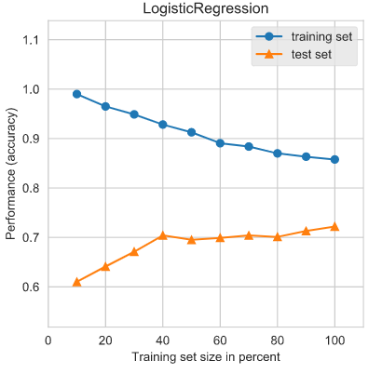
3b. Learning Curves – Training/Testing Accuracy
Random Forest Classifer:
High Bias
Low Variance
Linear SVC:
Low Bias
High Variance
MultinomialNB:
Low Bias
Medium Variance
Logistic Regression:
Low Bias
Medium Variance
Notes:
TODO:

Slide 13
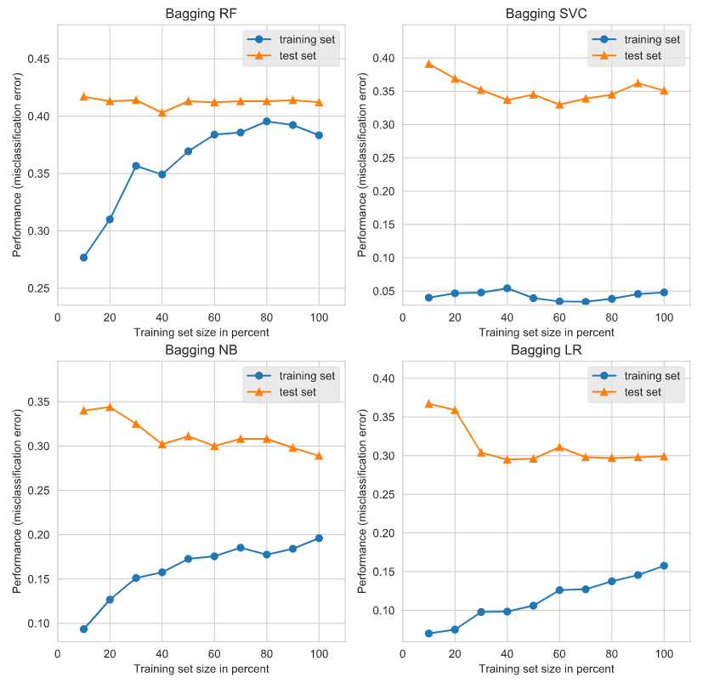
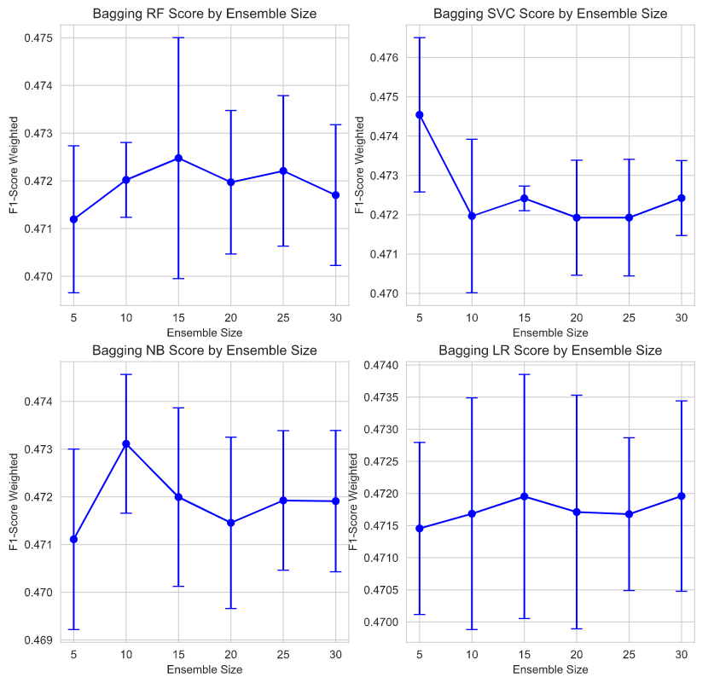
4a. Ensemble Learning – Bagging
Learning Curves Test/Train Errors
Cross-Validation Score by Ensemble Size
Notes:
TODO:

Slide 14
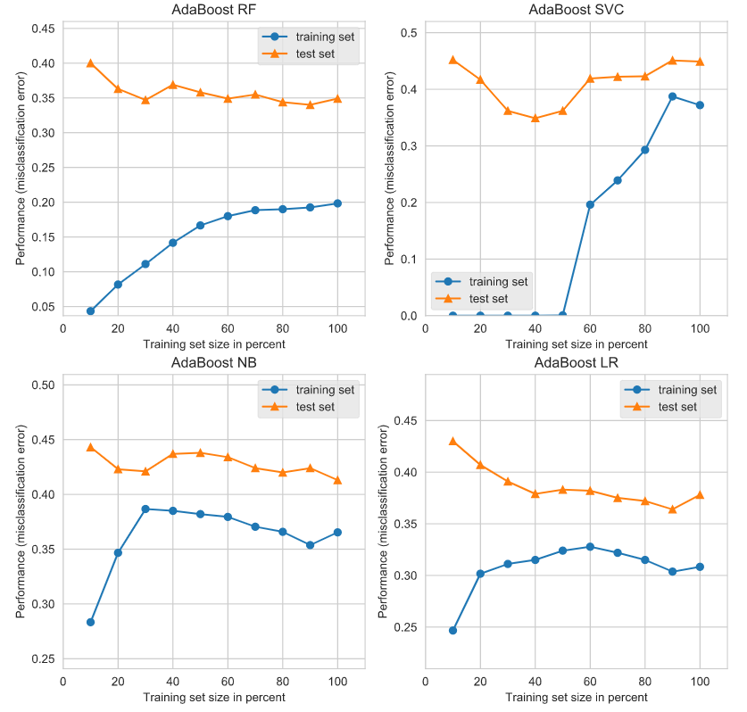
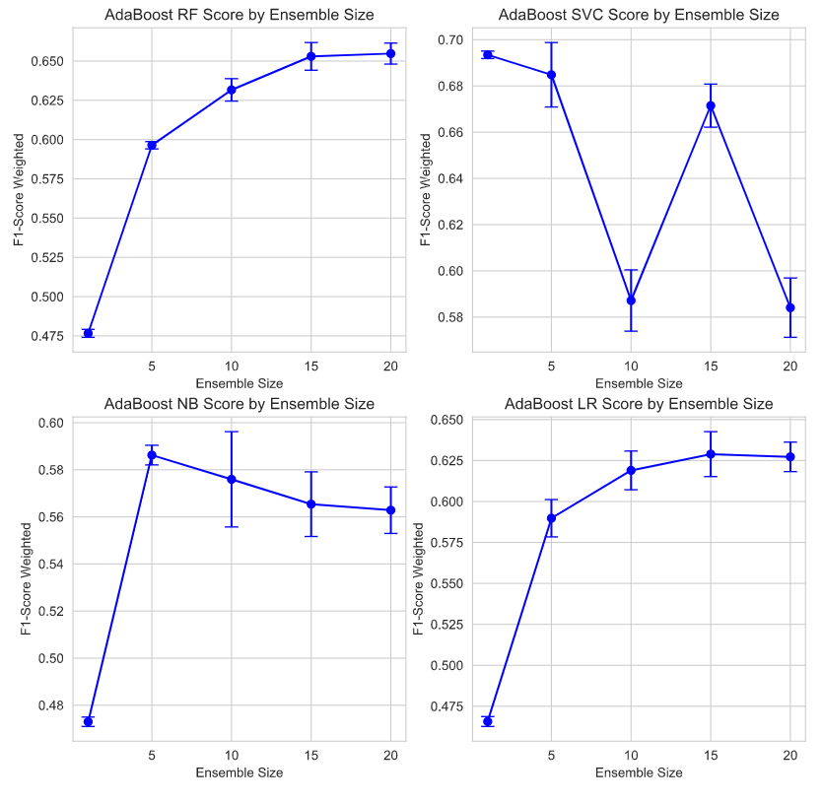
4b. Ensemble Learning – Boosting
Learning Curves Test/Train Errors
F1-Score Weighted by Ensemble Size
Notes:
TODO:

Slide 15
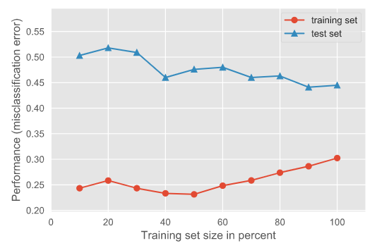
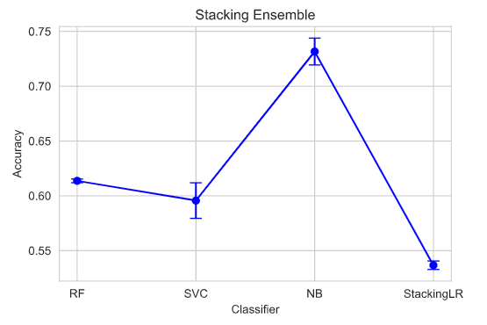
4c. Ensemble Learning – Stacking
Random Forest -> Linear SVC -> Multinomial Naïve Bayes -> Stacking Logistic Regression
Learning Curves Test/Train Errors
Stacking Ensemble Accuracy by Classifier
Notes:
TODO:

Slide 16
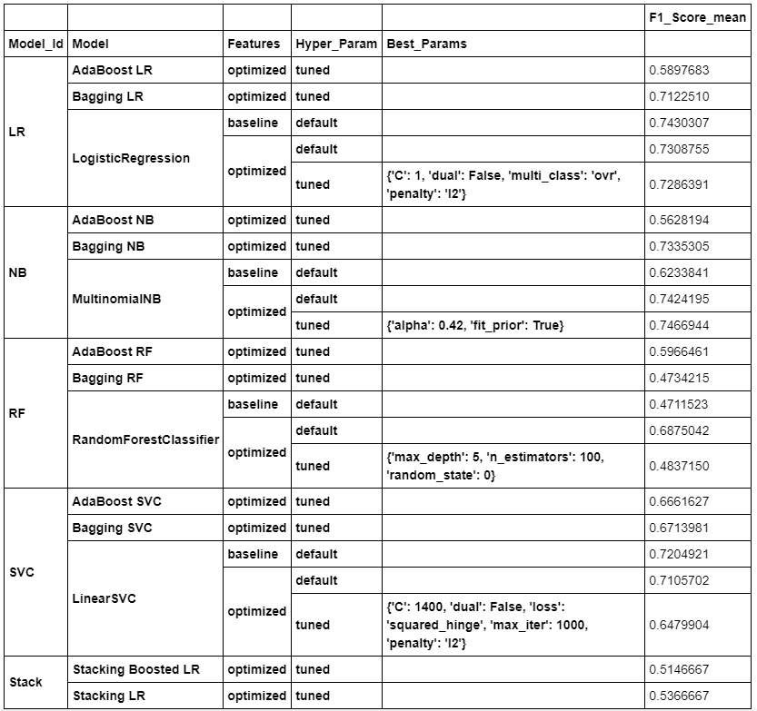
Summary

Slide 17
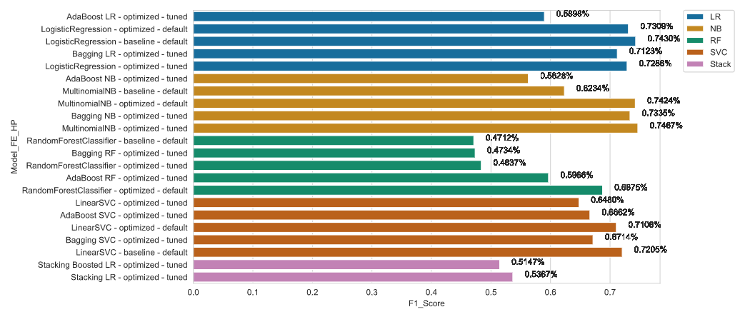
Summary
Notes:
TODO:

Slide 18
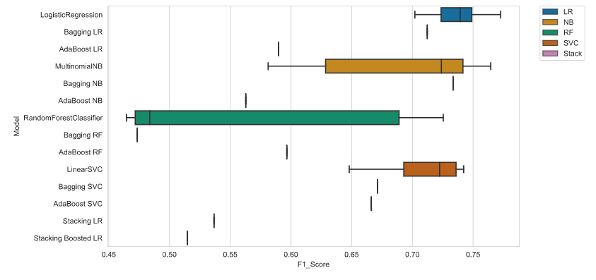
Summary
Notes:
TODO:

