Slide 1

Project: Conversation Dialogue Identification
CSML1010 – Milestone 1 Group 3: Jerry Khidaroo, Paul Doucet
Instructor: Dr. Annie En-Shiun Lee

Slide 2
CSML1010 – Milestone 1
Dataset: Taskmaster-1 from Google
NLP Multi-Class Text Classification Problem
Data Preparation
Data Clean Up
Exploratory Data Analysis
Feature Extraction & Engineering
Feature Scaling & Selection
Modeling
Model Evaluation & Tuning

Slide 3
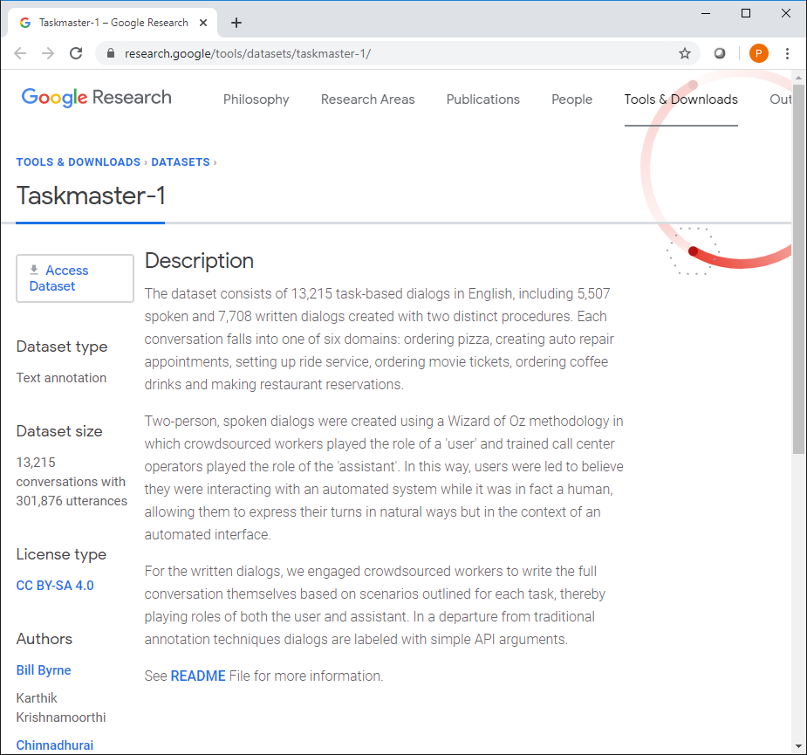
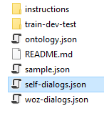
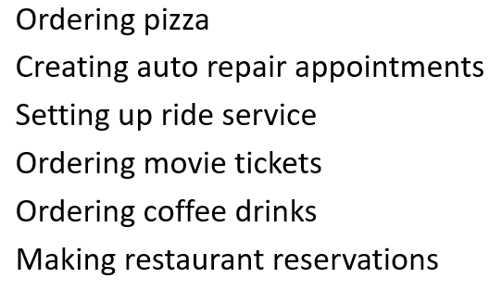
Dataset: Taskmaster-1 from Google https://research.google/tools/datasets/taskmaster-1/
The dataset selected is the Taskmaster-1 from Google
The dataset consists of task-based dialogs falling into one of six domains divided into 14 categories
We will be using the self-dialogs file which contains 7,708 conversations: ‘self-dialogs.json’

Slide 4
Project: Conversation Identification
The problem we will examine is a supervised multi-class text classification problem.
Goal: Build a model that identifies the category for dialogue conversations
Input: conversation dialogue text and labels
Output: model that predicts the “instruction_id” category
Input
Conversation Dialogue text and labels
Machine Learning
Machine Learning Steps
Output
Model that predicts the “instruction_id” category

Slide 5
Description of Categorical Variable (Instruction_id)
Instruction_id | Conversation Dialogue Description
Auto-repair-appt-1 | Users will pretend they need to take their car to the mechanic, so they need to get an appointment scheduled
Coffee-ordering-1 | Users will pretend they’ve decided to order a coffee drink from a coffee shop
Coffee-ordering-2 | Users will pretend they’ve decided to order a coffee drink, and makes changes to the drink after the initial options have been requested
movie-finder | User is looking for a movie to see at home
movie-tickets-1 | User wants to see a movie playing now
movie-tickets-2 | User wants to see a movie playing now, settling for a second choice
movie-tickets-3 | User wants to see one of two movies
Pizza-Ordering-1 | User orders one pizza, and ask all relevant details
Pizza-Ordering-2 | User orders one pizza with two toppings, and ask all relevant details
restaurant-table-1 | Users will pretend they are searching for a restaurant and book a table
restaurant-table-2 | Users will pretend they are searching for a restaurant and book a table, and will need to find an alternative when choice is not available
restaurant-table-3 | Users will pretend they are searching for a restaurant and book a table, and will look at options at two restaurants
uber-lyft-1 | Users will pretend they need to order a car for a ride inside a city
uber-lyft-2 | Users will pretend they need to order a car for a ride inside a city, and looking for an alternative when choice is not available

Slide 6
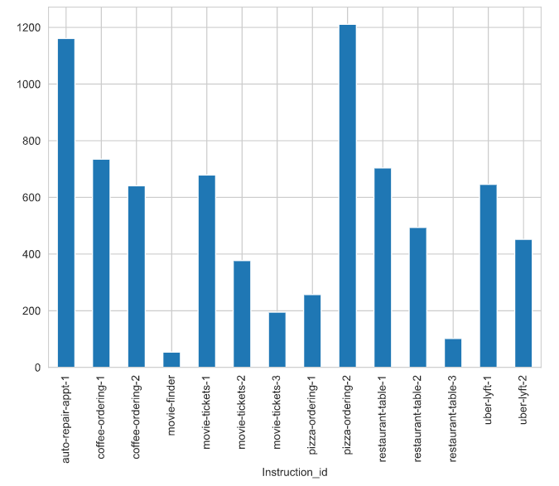
Distribution of Categorical Variable (Instruction_id)

Slide 7
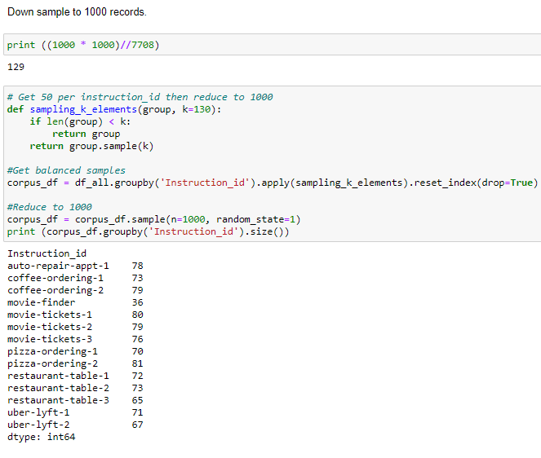
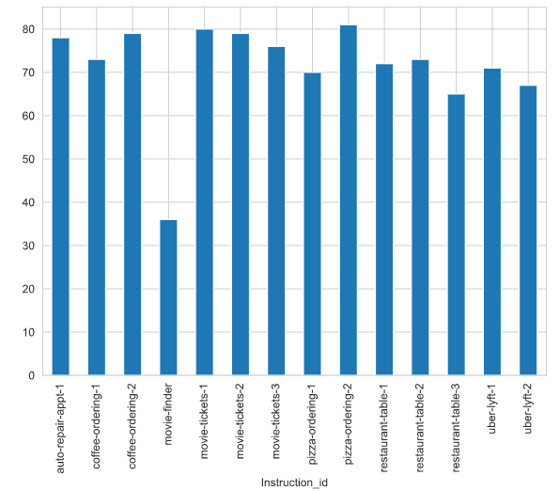
Balanced Sample of Dataset

Slide 8
Feature Extraction and Selection Summary
Vector Types | Feature Extracted | Scaling | Feature Selection Method
Count Vectors | Bag-of-words | MinMaxScaler() | Univariate Chi²
 | Bag of n-grams | MinMaxScaler() | Univariate Chi²
 | Bag-of-words | MinMaxScaler() | PCA
 | Bag-of-words + Bag of n-grams | MinMaxScaler() | Univariate Chi²
 | TF-IDF | MaxAbsScaler() | Univariate Chi²
Word Embeddings | Word2Vec from Word2Vec model | MinMaxScaler() | Univariate Chi²
 | Word2Vec from FastText model | MinMaxScaler() | Univariate Chi²
 | GloVe Embeddings with Flair | MinMaxScaler() | Univariate Chi²

Slide 9
Scaling Used for the Features
MinMaxScaler. Transform features by scaling each feature to a given range. This estimator scales and translates each feature individually such that it is in the given range on the training set, e.g. between zero and one. ... This transformation is often used as an alternative to zero mean, unit variance scaling.
MaxAbsScaler. Scale each feature by its maximum absolute value. This estimator scales and translates each feature individually such that the maximal absolute value of each feature in the training set will be 1.0. It does not shift/center the data, and thus does not destroy any sparsity.

Slide 10
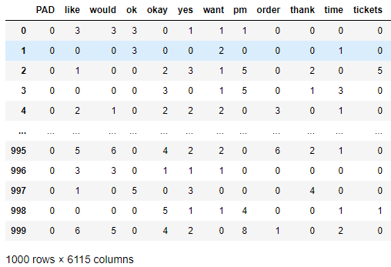
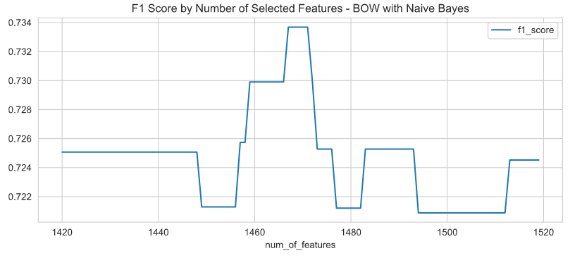

Bag of Words
Feature Extraction
Feature Selection – Univariate with Chi²
Benchmarking

Slide 11
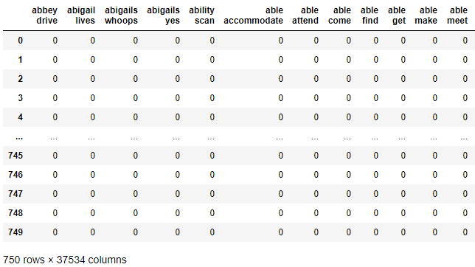
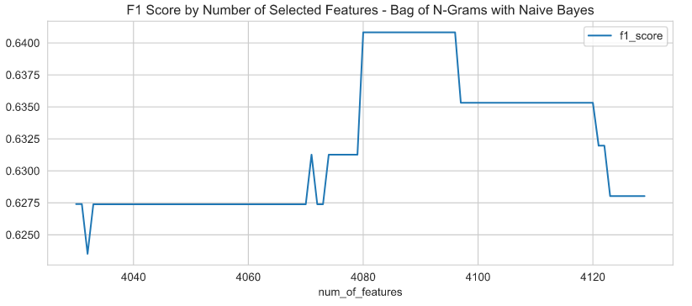

Bag of n-Grams
Feature Extraction
Feature Selection – Univariate with Chi²
Benchmarking

Slide 12
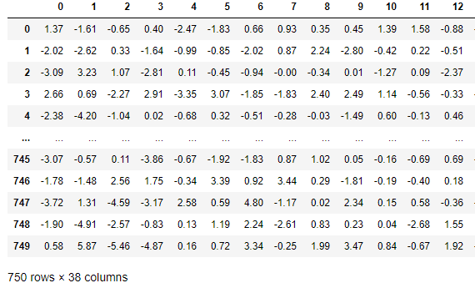
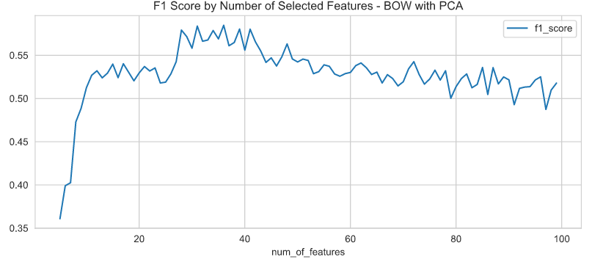
PCA on Bag of Words
Feature Extraction
Feature Selection – PCA
Benchmarking

Slide 13
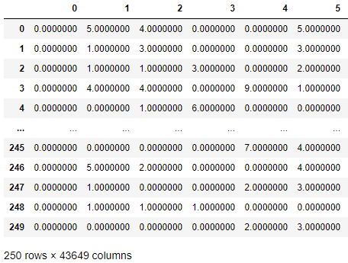
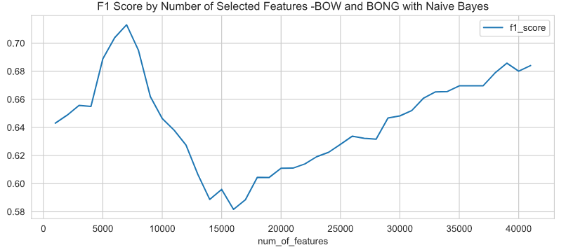
Combination – BOW and Bag of nGrams
Feature Extraction
Feature Selection – Univariate with Chi²
Benchmarking
Notes:
Add new format 4/17 -

Slide 14
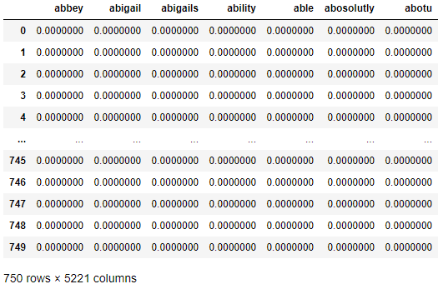
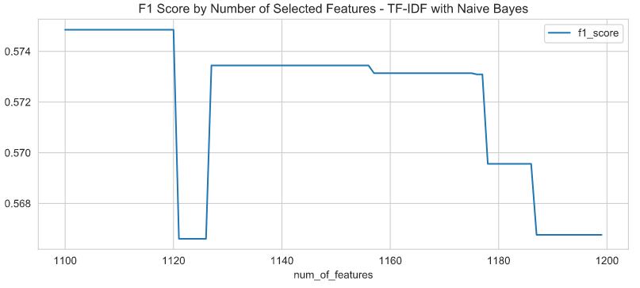

TF-IDF
Feature Extraction
Feature Selection – Univariate with Chi²
Benchmarking

Slide 15
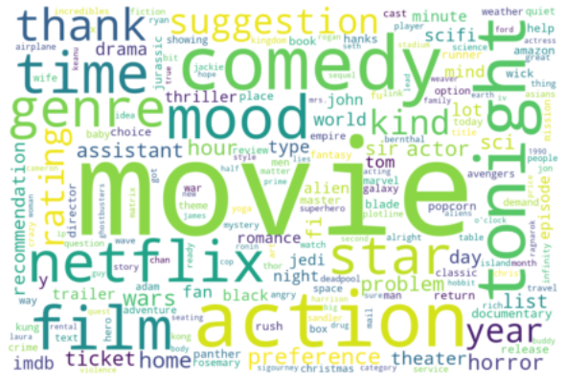
Count Vectors
Word Cloud visualization of count vectors

Slide 16
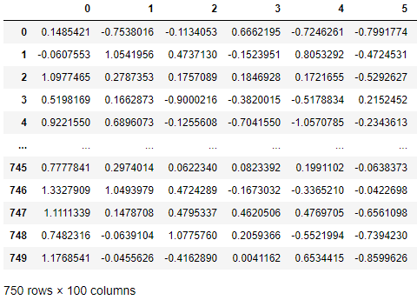
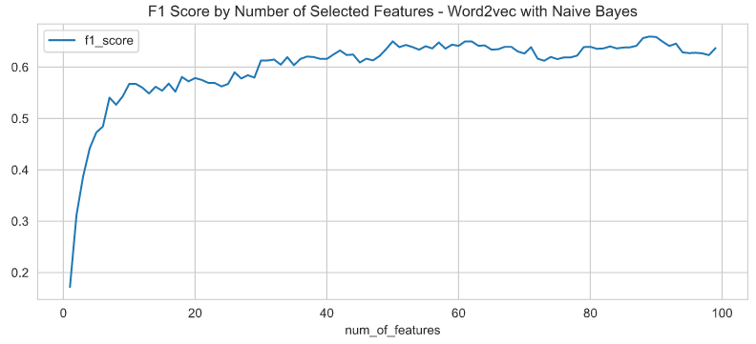

Word2Vec
Feature Extraction
Feature Selection – Univariate with Chi²
Benchmarking

Slide 17
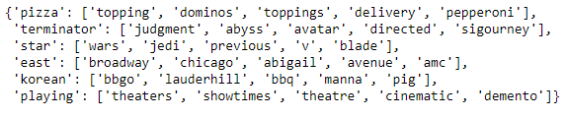
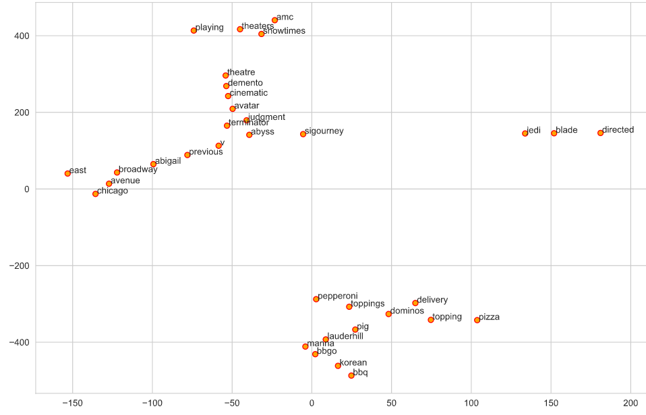
Word2Vec – Word Embeddings
Word Embeddings
Visualization of Word Embeddings

Slide 18
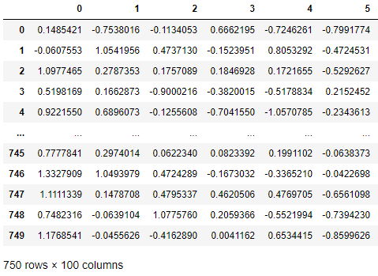
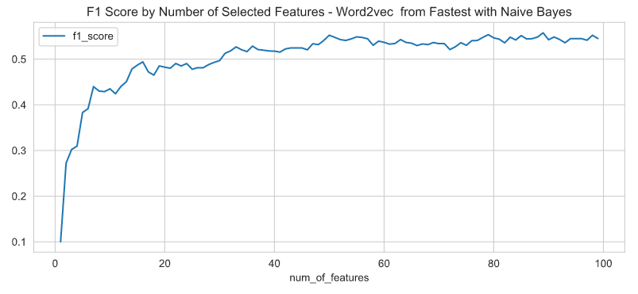

Word2Vec from FastText
Feature Extraction
Feature Selection – Univariate with Chi²
Benchmarking

Slide 19
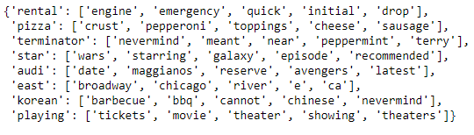
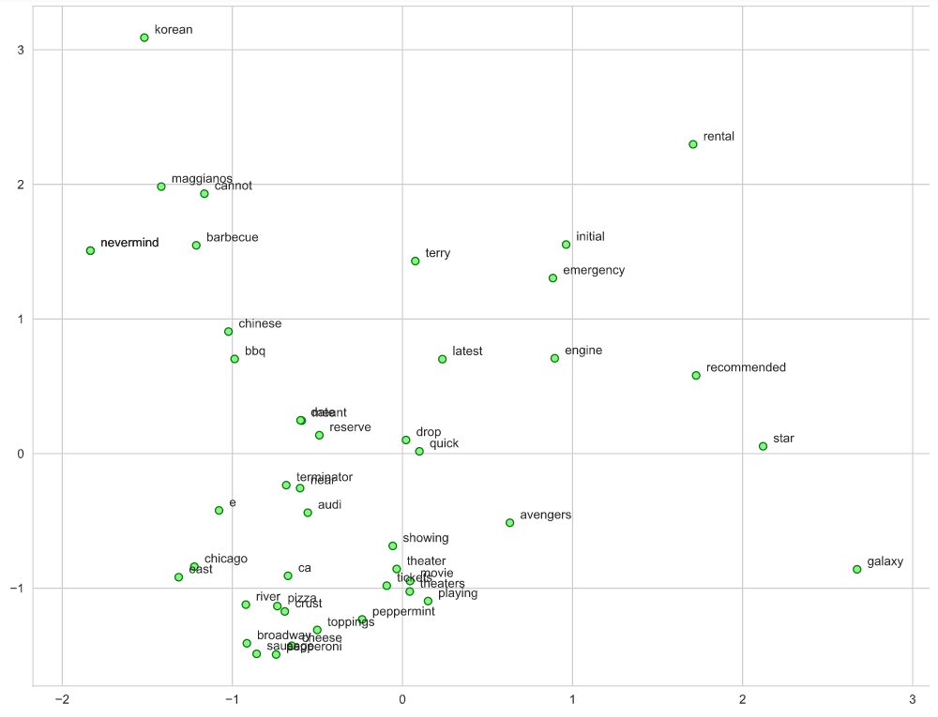
Word2Vec – FastText
Word Embeddings
Visualization of Word Embeddings

Slide 20
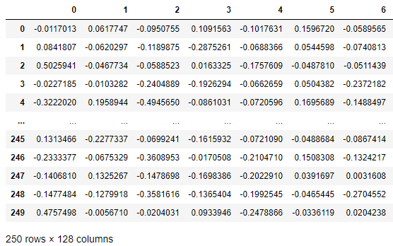
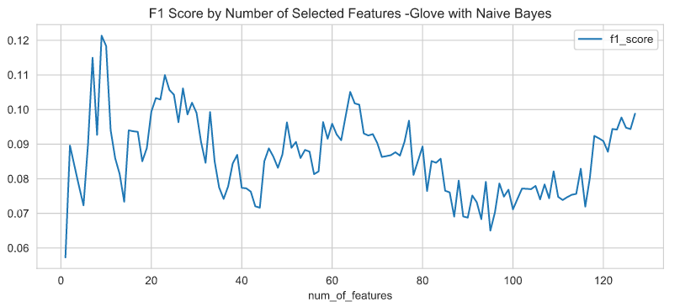

Glove from FLAIR
Feature Extraction
Feature Selection – Univariate with Chi²
Benchmarking

Slide 21
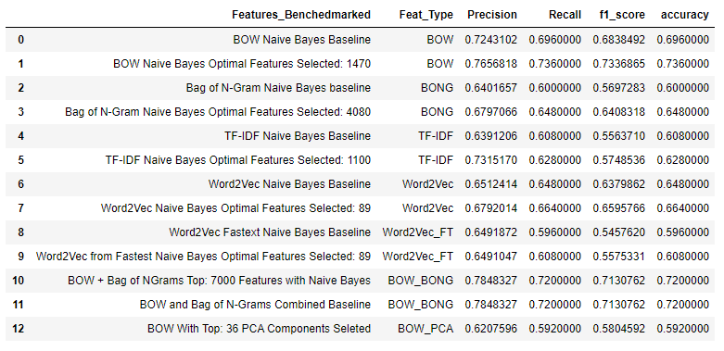
Feature Engineering, Extraction and Selection Final Results

Slide 22
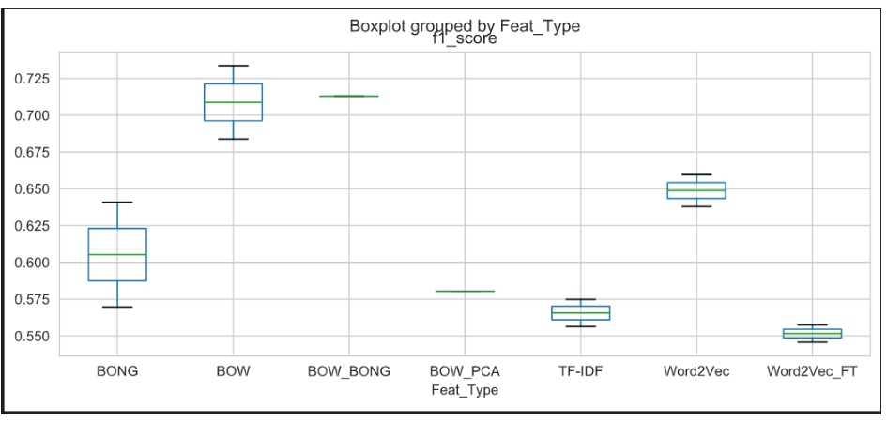
Final Results –Variance Between Baseline and Optimized Features

Slide 23
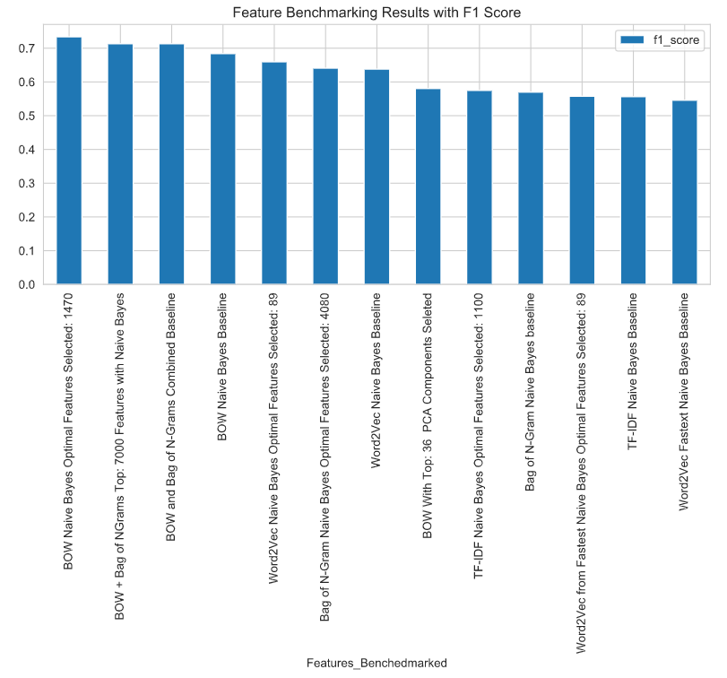
Feature Engineering, Extraction and Selection Final Results
Visualization of Benchmark
Results

Slide 24
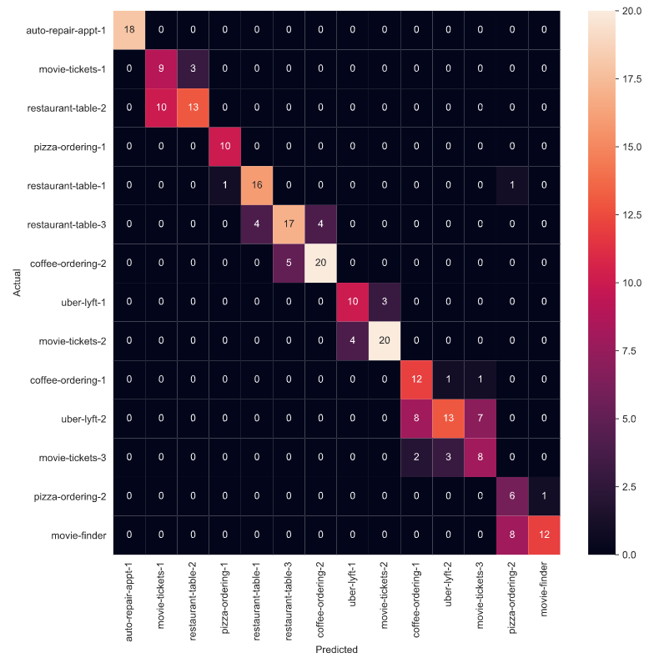
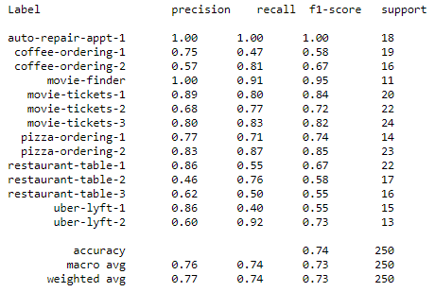
Feature Engineering, Extraction and Selection Final Results
Best results were produced from the following:
Extracted Feature | Bag of Words
Feature Selection Method | Univariate chi²
Reference Model | Naive Bayes Multinomial Variant
Confusion Matrix Heatmap

Slide 25
Next Steps
Feature Engineering
Review issue with Glove Feature in our notebook
Examine
Language Model (BERT and ELMO)
Topic Model
Feature Selection Methods
Examine
RFE
Feature Importance

