Slide 1
CSML1010 - Project Proposal Group 3: Jerry Khidaroo, Paul Doucet
Subject: NLP Text Classification
Dataset: Taskmaster-1 from Google

Slide 2
CSML1010 - Project Proposal
Dataset: Taskmaster-1 from Google
NLP Multi-Label Text Classification Problem
Data Preparation
Data Clean Up
Exploratory Data Analysis
Feature Extraction & Engineering
Feature Scaling & Selection
Modeling
Model Evaluation & Tuning

Slide 3
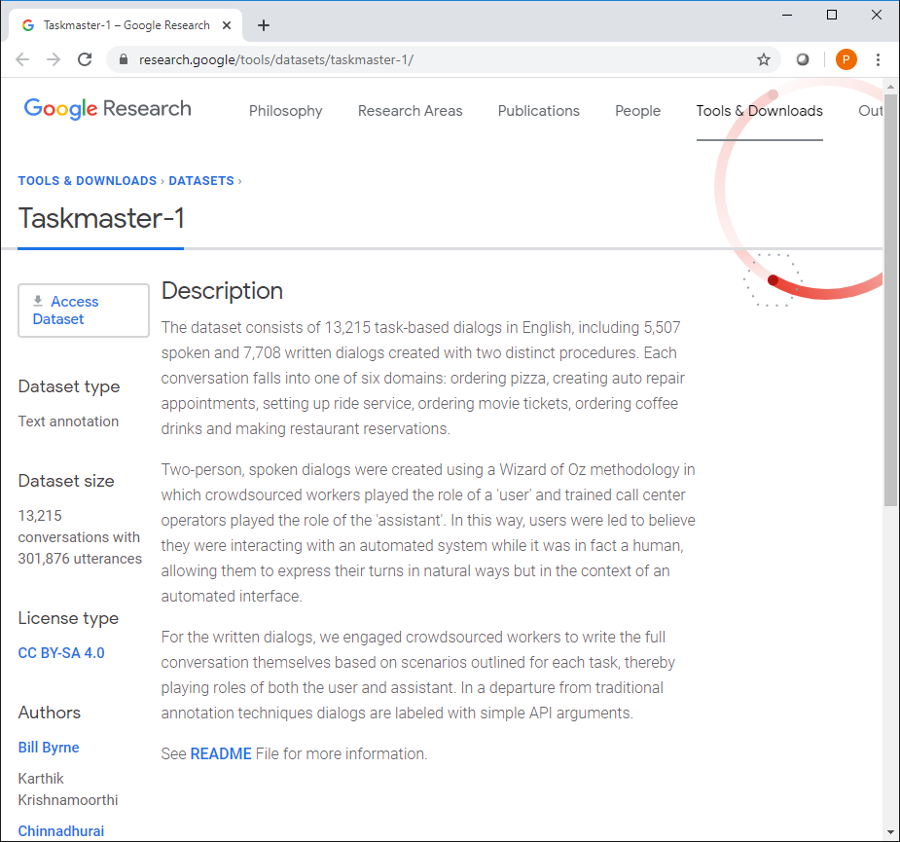
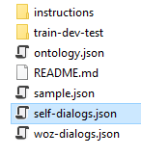
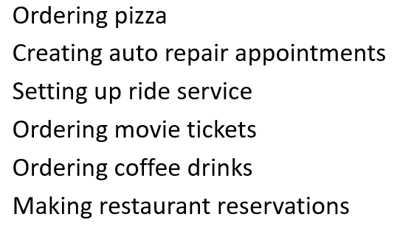
Dataset: Taskmaster-1 from Google https://research.google/tools/datasets/taskmaster-1/
The dataset selected is the Taskmaster-1 from Google
The dataset consists of task-based dialogs falling into one of six domains
We will be using the self-dialogs file which contains 7,708 conversations
For our project, the ‘self-dialogs.json’ will be used

Slide 4
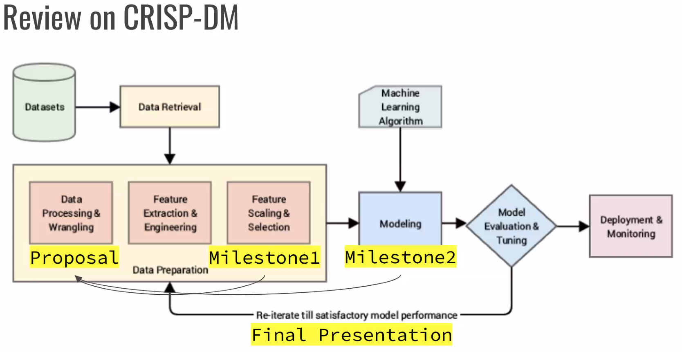
NLP Multi-Label Text Classification Problem
The problem we will examine is a supervised multi-label text classification problem.
The goal is to identify the machine learning method that best identifies the category for which the dialog conversation belongs
The input: will be the text elements of each conversation concatenated together
The output: will be the “instruction_id”, which is the type of conversation

Slide 5
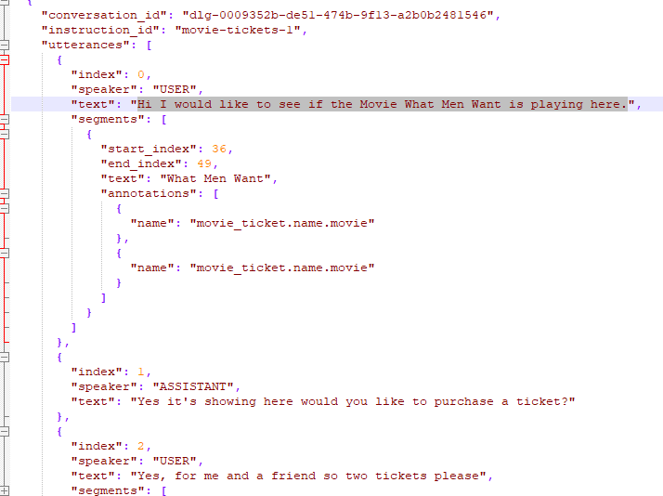
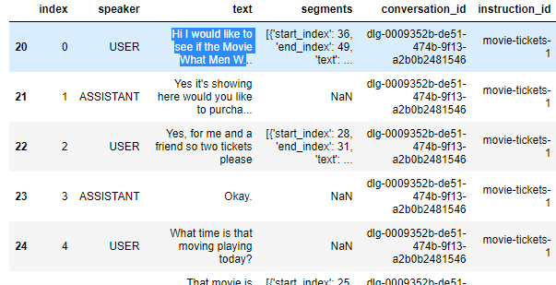
Sample Raw Conversation to Data Frame Example
Raw Conversation Data
Data Frame

Slide 6
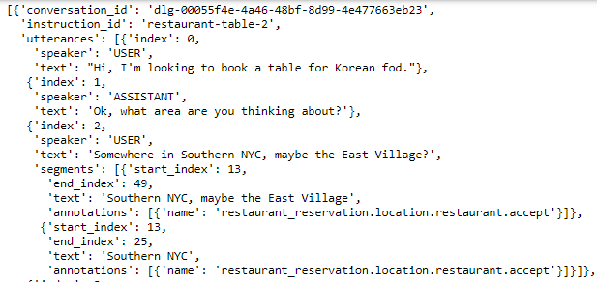
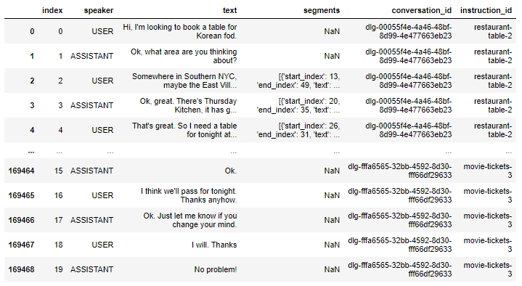
Data Preparation
Data Preparation Steps:
Import JSON file
Extract text and label columns
Cleaning the Conversation text column for NLP
Save cleaned data to a database file for easy retrieval

Slide 7
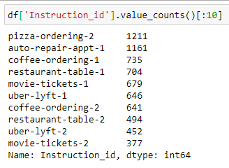
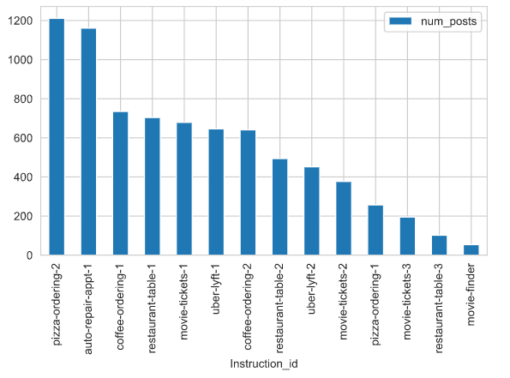
Exploratory Data Analysis – Categories
Label class counts
Shows our dataset is relatively balanced

Slide 8
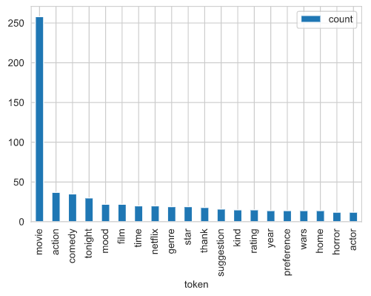
Exploratory Data Analysis – Word Exploration
Word review example:
Instruction_id = ‘movie-finder’

Slide 9
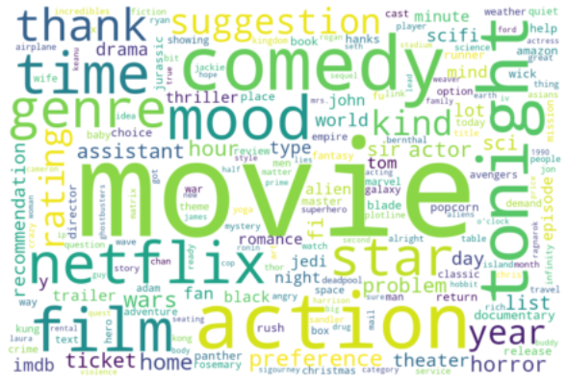
Exploratory Data Analysis – Word Clouds
Word cloud visualization example
Instruction_id = ‘movie-finder’

Slide 10
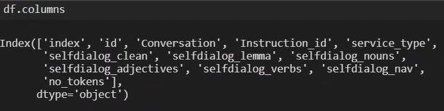
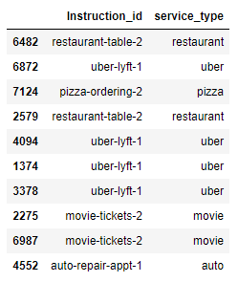
Feature Engineering
Count Vectors:
Bag-of-words
Bag of n-grams
TF-IDF Vectors:
Word level
N-gram level
Word Embeddings:
Word2vec
Glove
NLP Based:
Noun, Verb, Adjective, Adverb, Pronoun Counts
Language Models:
BERT
FLAIR

Slide 11
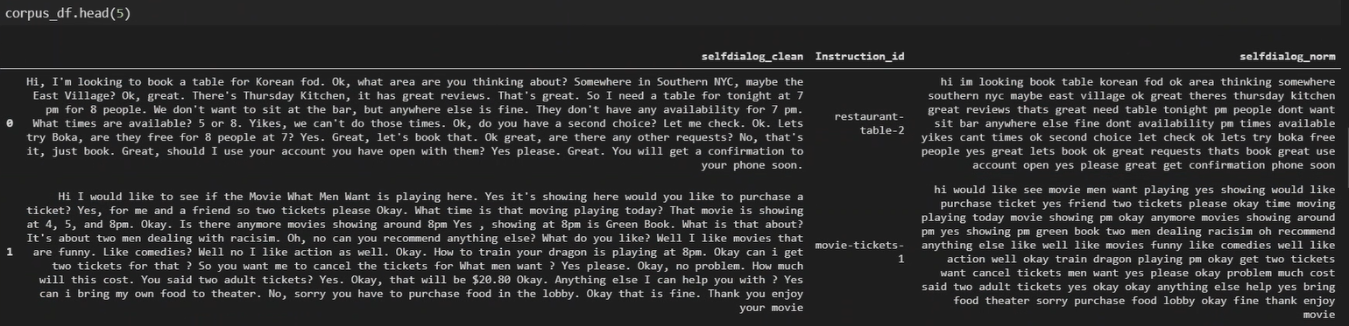
Feature Engineering

Slide 12
Feature Scaling & Selection
Feature selection will be based on benchmarking of features using a reference model
Feature Importance Analysis
PCA

Slide 13
Modeling
Splitting the Dataset
For Modeling we will split the dataset into train and test sets. The models will be built with the train set and evaluation with the test set.
Algorithms
Naive Bayes (multinomial):
Logistic regression.
Support vector machine.
Decision tree (random forest).
Ensemble: Bagging, Boosting

Slide 14
Model Evaluation, Tuning and Selection
Confusion Matrix
Metrics:
Accuracy
Precision
Recall
F1 Score
Relying on the F1 Score rather than accuracy
ROC
Area under ROC
Model Selection will be based on benchmarking of models based on the metrics identified during Model Evaluation (see items on the left)

