Slide 1
CSML1010 - Project Proposal Group 3: Jerry Khidaroo, Paul Doucet
Subject: NLP Text Classification
Dataset: Taskmaster-1 from Google

Slide 2
CSML1010 - Project Proposal
NLP Multi-Class Topic Classification Problem
Dataset: Taskmaster-1 from Google
Data Preparation
Data Clean Up
Exploratory Data Analysis

Slide 3
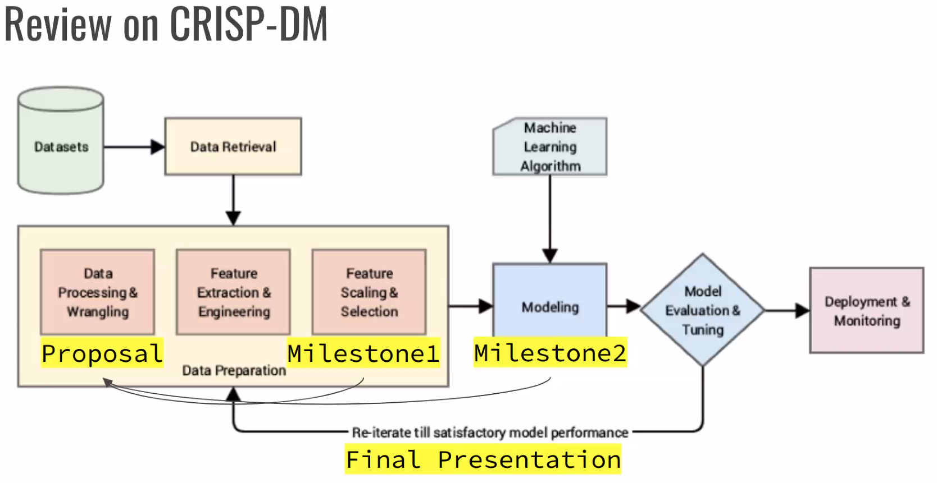
NLP Multi-Class Topic Classification Problem
The problem we will examine is a supervised text classification problem
The goal is to identify the machine learning method that best identifies the category for which the dialog conversation belongs
This is a multi-class topic classification problem

Slide 4
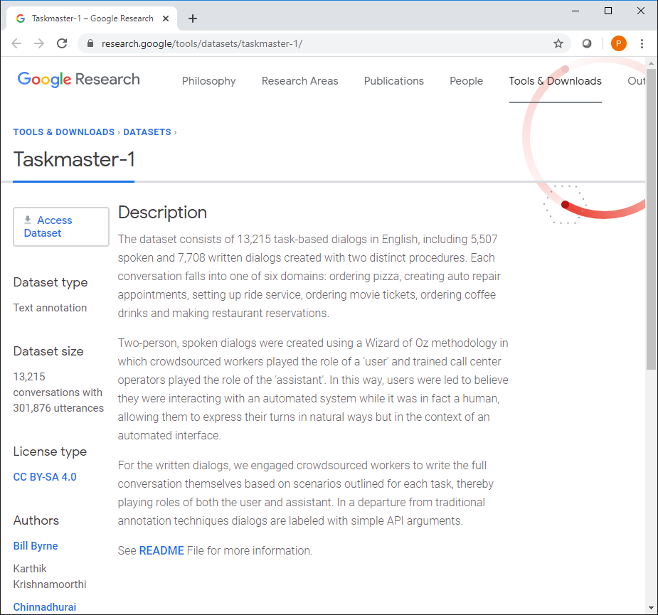
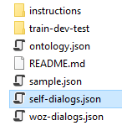
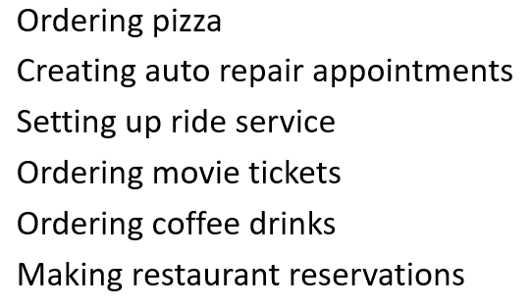
Dataset: Taskmaster-1 from Google https://research.google/tools/datasets/taskmaster-1/
The dataset selected is the Taskmaster-1 from Google
The dataset consists of task-based dialogs falling into one of six domains
We will be using the self-dialogs file which contains 7,708 conversations
For our project, the ‘self-dialogs.json’ will be used

Slide 5
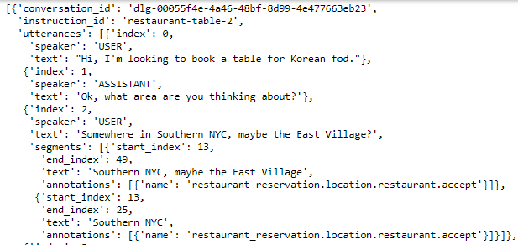
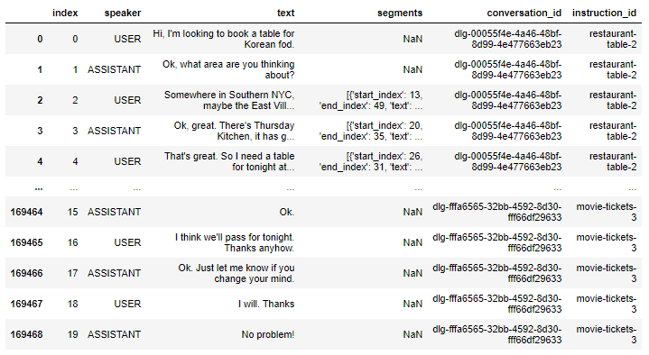
Data Preparation
Data Preparation Steps:
The dataset includes JSON files that needed to be imported
The data itself needs to be extracted into a data frame containing only the columns of interest for our project
Combining all dialog into one cell representing the conversation

Slide 6
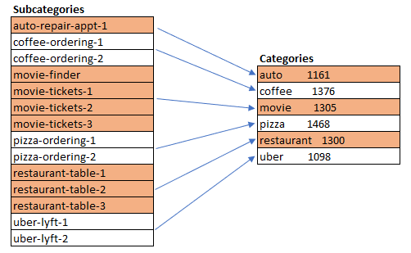
Data Clean Up
Categories
Cleaning the Dataset for NLP
Regular Expression to remove bad characters
NLP

Slide 7
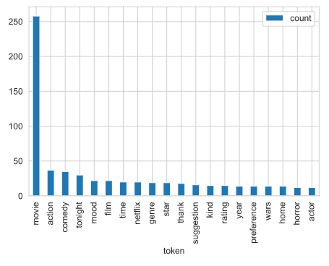
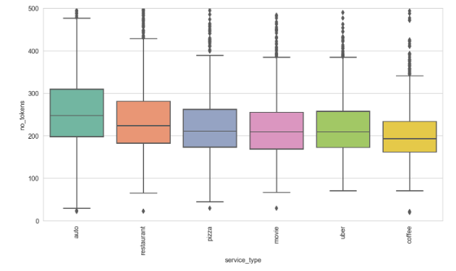
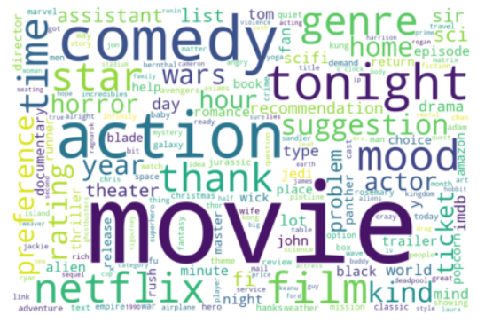
Exploratory Data Analysis

