Slide 1

Project: Conversation Dialogue Identification
York University – CSML1010 – Final Project – Group 3: Jerry Khidaroo, Paul Doucet
Instructor: Dr. Annie En-Shiun Lee

Slide 2
Questions
Feedback from Presentations
Project Proposal - both paul and jerry available 1. Problem Definition (3/5) - Can spend more time on clarifying your text classification problem (i.e. what are the classes) 2. Data Cleaning and balancing dataset (4/5) - great presentation of your code work 3. Data Exploration (4/5) - could have more visualizations and eda, but cover the major ones. 4. Others (presentation, graphs/charts/tables, code) (3.5/5) - Can be more fluent in the presentation. Lots of "um“ thank you for covering your plan
Milestone 1 - Jerry presented count methods first then Paul presented word embeddings. 1. Feature Extraction (4.5/5) - tfidf, bow, w2v, glove, fast text 2. Feature Selection (5/5) - minmax scaler, max abs scaler 3. Baseline and Benchmark of Features (5/5) - great summary with tables and graphs and heatmaps! Best so far 4. Others (presentation, graphs/charts/tables, code) (5/5) - very clear and precise results, good job comparing them on one page
Milestone 2 - Paul presented first; Jerry presented second 1. Benchmark Comparison (5/5) - great summaries and nice graphs; great job on hyperparameter optimizations as well! 2. Learning Curves (4/5) - good strategy for better convergence (good problem solving); 3. Ensemble Learning (4/5) - try all 4, great job 4. Others (presentation, graphs/charts/tables, code) (4.5/5) good detailed work ; try presenting f1 scores You might want to group your categorical variables into just a few, such as "auto, coffee, movie, pizza, restaurant, uber/lift", but you are already at 90+ f1 so it's good already Interestingly, why is there a drop at 800 features and another one at 840? your learning curves seem to be converging, good job. Perhaps try having a little bit more data? What is the difference between soft and hard voting? You might go with the voting. It maybe "slower" in real-time (production) but the results may be more robust (i.e. less variance) What is optimized/baseline and tuned/default? I assume the tuning is for hyperparameter and the optimized is for the features? Please conclude if optimized is always better, and how much better are the tuned models (typically). very nice graph for variance by model type, please spend more time describing this Please add a discussion section about the general trends you see in the different combination you tried.
Model interpretation: only certain models (answer Josue’s question on the LIME) Deliverables: Combine PDF files New Methods: What exactly is meant by this
Less is more, be clear with your presentation
Know the point we are trying to drive home

Slide 3
CSML1010 – Group 3
Final Project: Machine Learning Life-cycle
Introduction
Existing Work
Methodology
Results
Discussion
Conclusion
References/Bibliography

Slide 4
1. Introduction
Project Definition: Conversation Identification
The problem we will examine is a supervised multi-class text classification problem.
Goal: The goal is to investigate which supervised machine learning methods will give the best results in classifying the texts from our dataset into the pre-defined categories.
Input: conversation dialogue text and labels Output: model that predicts the “instruction_id” category correctly
Input
Conversation Dialogue text and labels
Machine Learning
Machine Learning Steps
Output
Model that predicts the “instruction_id” category
Notes:
TODO:
Look at getting a better diagram

Slide 5
2. Existing Work
Existing Work
1. Li, Susan, Feb 19, 2018, Multi-Class Text Classification with Scikit-Learn https://towardsdatascience.com/multi-class-text-classification-with-scikit-learn-12f1e60e0a9f | Gives some good examples of Data Exploration.
2. Bansal, Shivam, Jan. 12, 2017, Ultimate Guide to Understand and Implement Natural Language Processing (with codes in Python) https://www.analyticsvidhya.com/blog/2017/01/ultimate-guide-to-understand-implement-natural-language-processing-codes-in-python/ | Has a great overview of many of the steps involved in NLP.
3. Gupta, Shikhar, Jun 12, 2018, Machine Learning Model Evaluation & Selection, Validation strategies for your machine learning model https://heartbeat.fritz.ai/model-evaluation-selection-i-30d803a44ee | Provides a summary of Model Selection and Validation strategies.
4. scikit-learn 0.23.0, 3.2. Tuning the hyper-parameters of an estimator https://scikit-learn.org/stable/modules/grid_search.html#grid-search | Explains what is involved in Hyperparamet Tuning
5. scikit-learn 0.22.2, Receiver Operating Characteristic (ROC) https://scikit-learn.org/stable/auto_examples/model_selection/plot_roc.html | Provides examples of calculating and ploting ROC/AUC curves for Multi-Class Classification Models
6. Smolyakov, Vadim, Aug 22, 2017, Ensemble Learning to Improve Machine Learning Results, How ensemble methods work: bagging, boosting and stacking https://blog.statsbot.co/ensemble-learning-d1dcd548e936 | Discusses 3 types of Ensemble models: Bagging, Boosting and Stacking.
7. Koehrsen, Will, May 18, 2018, A Complete Machine Learning Walk-Through in Python: Part Three, Interpreting a machine learning model and presenting results https://towardsdatascience.com/a-complete-machine-learning-walk-through-in-python-part-three-388834e8804b https://github.com/WillKoehrsen/machine-learning-project-walkthrough/blob/master/Machine%20Learning%20Project%20Part%203.ipynb | Gives a good explanation of Model Interpretability.

Slide 6
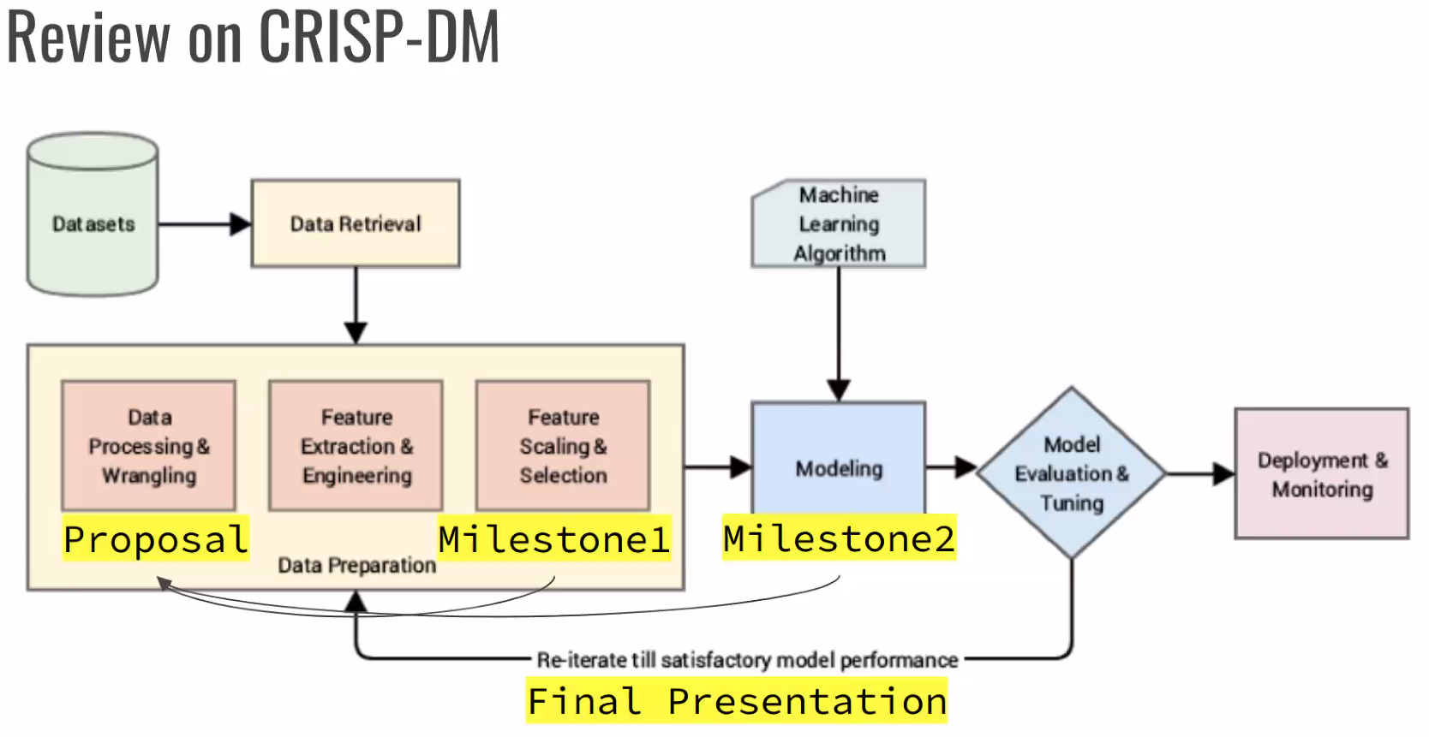
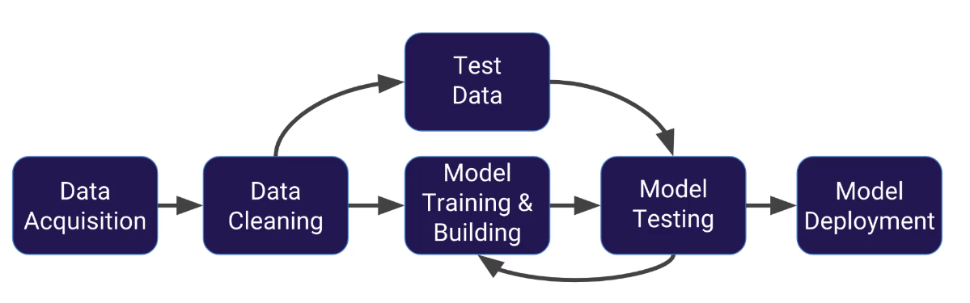
3. Methodology
3. Methodology
1. Data Preparation
2. Cleaning and NLP
3. Data Exploration
4. Feature Engineering and Selection
5. Model Evaluation and Ensemble
6. Model Interpretation
Data Preparation
Cleaning & NLP
Data Exploration
Feature Engineering & Selection
Model Evaluation and Ensemble
Model Interpretation
Notes:
TODO:
Clean up what diagram to keep

Slide 7
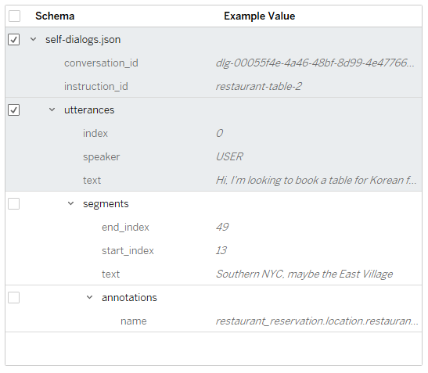
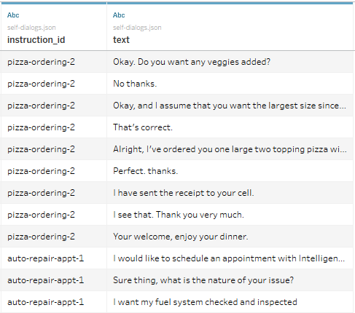
3.1 – Data Preparation
Convert the dataset for use in our project
Data Preparation
Cleaning & NLP
Data Exploration
Feature Engineering & Selection
Model Evaluation and Ensemble
Model Interpretation
Imports the dataset from the JSON file
Converts it to a cleaned-up dataset .CSV file for use with our project

Slide 8
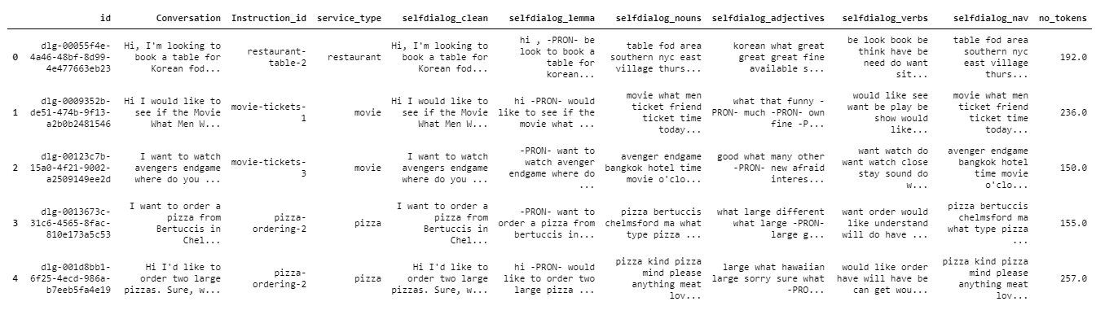
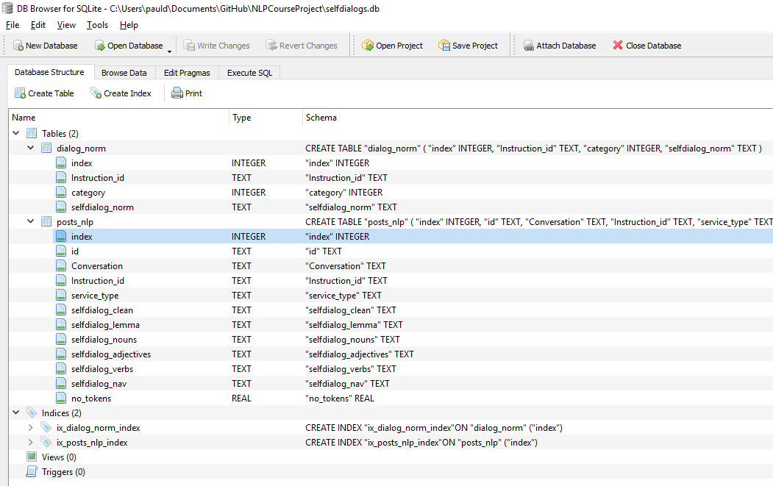
3.2 – Cleaning and NLP
Input | DF_selfDialogs.csv
Output | selfdialogs.db
Data Preparation
Cleaning & NLP
Data Exploration
Feature Engineering & Selection
Model Evaluation and Ensemble
Model Interpretation
Fixed Instruction_id values
Added ‘service_type’ column
Created a database ‘selfdialogs.db’
Cleaned the text using various functions: replace, regular expressions
Iterate and performed NLP on the dataset using ‘spacy’
Store results to database ‘sefldialogs.db’ in table ‘posts_nlp’

Slide 9
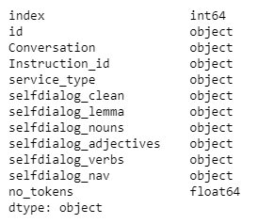
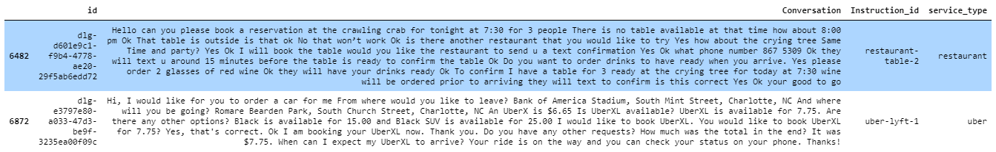
3.3 – Data Exploration
Input | selfdialogs.db
Output
Data Preparation
Cleaning & NLP
Data Exploration
Feature Engineering & Selection
Model Evaluation and Ensemble
Model Interpretation
View the columns of the imported dataframe
View two random rows showing the columns: ‘id’, ‘Conversation’, ‘Instruction_id’, ‘service_type’
Viewed the following parameters of the dataframe: length of dataframe; # of values per column; size info and memory usage;
Described the categorical columns
Described the numerical columns
Grouped by: ‘service_type’ in ‘cat_df’; ‘instruction_id’ in ‘cat_id_df’
Word Exploration
Reviewed the list of nouns stored in columns of the database and a certain ‘Instruction_id’ in ‘sub_df’

Slide 10
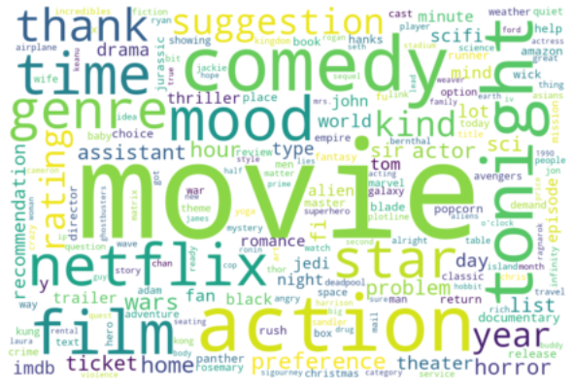
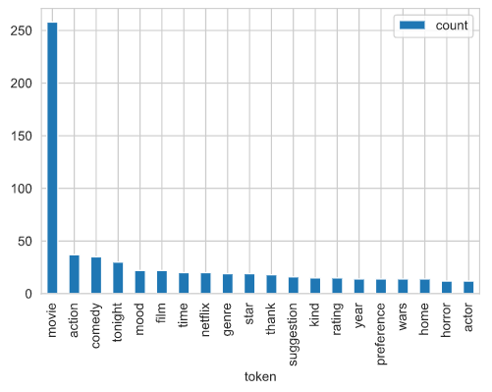
3.3 – Data Exploration
Input | selfdialogs.db
Output
Data Preparation
Cleaning & NLP
Data Exploration
Feature Engineering & Selection
Model Evaluation and Ensemble
Model Interpretation
Creating Token List
Create a token list from the ‘sub_df’
Review most common words
Removed stopwords
‘freq_df’ contains tokens and count
Exploring Word Clouds
Created and displayed word clouds using the tokens created above and a second one
Exploring Complexity
Reviewed for service type: average number of tokens; distribution of tokens; printed outliers; compared # of tokens per ‘instruction_id’

Slide 11
3.4 – Feature Engineering & Selection
Input | selfdialogs.db
Output | dialog_norm.csv
Data Preparation
Cleaning & NLP
Data Exploration
Feature Engineering & Selection
Model Evaluation and Ensemble
Model Interpretation
Merge some very similar ‘instruction_id’
Do some additional cleaning using ‘nltk’
Stored new file ‘dialog_norm.csv’ with the changes made above
Get a sample of records
Generate Corpus List: ‘doc_lst’
Build Vocabulary
Build pair generator (context_words, target words)
Setup dictionaries to cross reference ‘Instruction_id’ and ‘category’
Split data in Train and Test sets

Slide 12
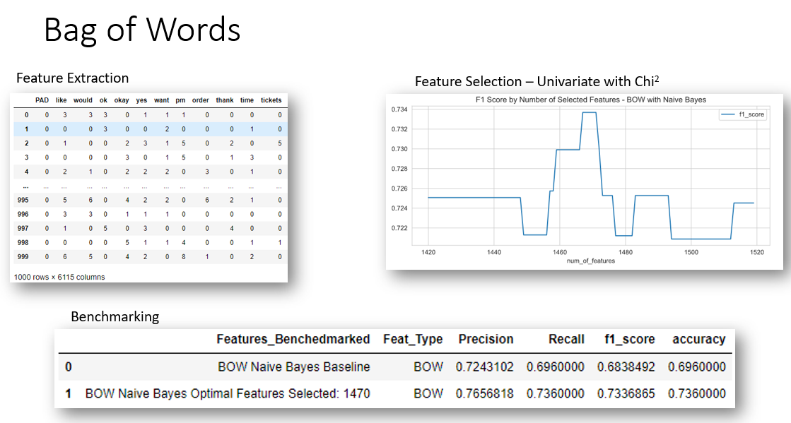
3.4 – Feature Engineering & Selection
Input | selfdialogs.db
Output | dialog_norm.csv
Data Preparation
Cleaning & NLP
Data Exploration
Feature Engineering & Selection
Model Evaluation and Ensemble
Model Interpretation
Feature Extraction:
Counting Methods
Bag of Words
Bag of N-Grams
TF-IDF
Word Embeddings
Word2Vec
FastText
Language Models
Topic Models – Used in Data Exploration during the final iteration as it is “unsupervised”
Notes:
TODO: Add some screen shots or diagrams of the different feature extractions

Slide 13
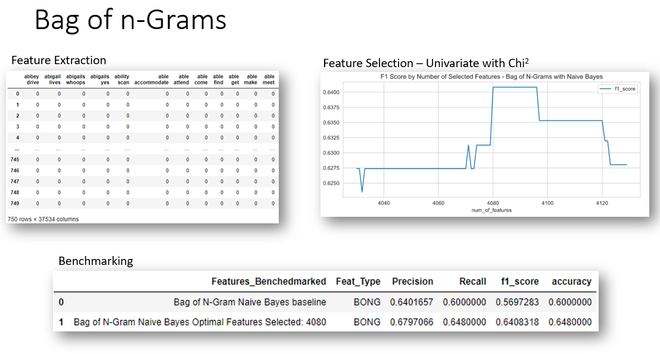
3.4 – Feature Engineering & Selection
Input | selfdialogs.db
Output | dialog_norm.csv
Data Preparation
Cleaning & NLP
Data Exploration
Feature Engineering & Selection
Model Evaluation and Ensemble
Model Interpretation
Feature Extraction:
Counting Methods
Bag of Words
Bag of N-Grams
TF-IDF
Word Embeddings
Word2Vec
FastText
Language Models
Topic Models – Used in Data Exploration during the final iteration as it is “unsupervised”
Notes:
TODO: Add some screen shots or diagrams of the different feature extractions

Slide 14
3.4 – Feature Engineering & Selection
Input | selfdialogs.db
Output | dialog_norm.csv
Data Preparation
Cleaning & NLP
Data Exploration
Feature Engineering & Selection
Model Evaluation and Ensemble
Model Interpretation
Feature Selection:
Univariate – SelectKBest “Chi2’
PCA
Optimal Number of Features Selected
Combined Features: BOW + Bag of N-Grams

Slide 15
3.5 – Model Evaluation & Ensemble
Input | selfdialogs.db
Output | dialog_norm.csv
Data Preparation
Cleaning & NLP
Data Exploration
Feature Engineering & Selection
Model Evaluation and Ensemble
Model Interpretation
Benchmark
Using Bag of Words Features
Feature Selection using chi2
Models
Logistic Regression
Multinomial Naïve Bayes
Random Forest Classifier
Linear SVC
Optimized Parameters
GridSearchCV
Learning Curves
Accuracy
Errors
ROC Curves
AUC
Ensemble Learning
Bagging
Boosting
Stacking
Voting

Slide 16
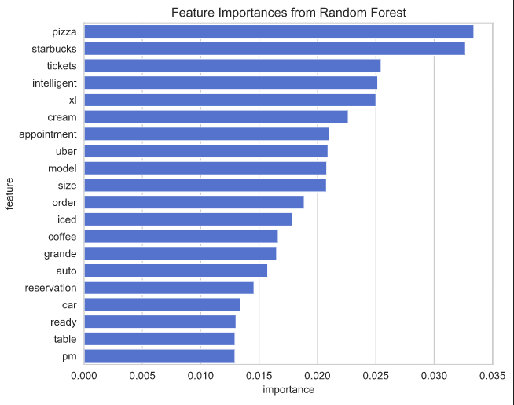
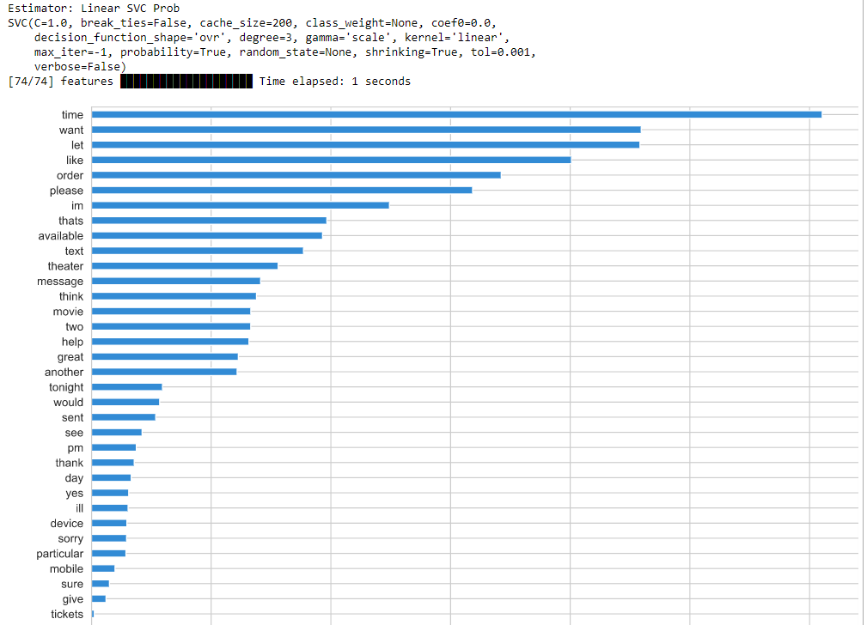
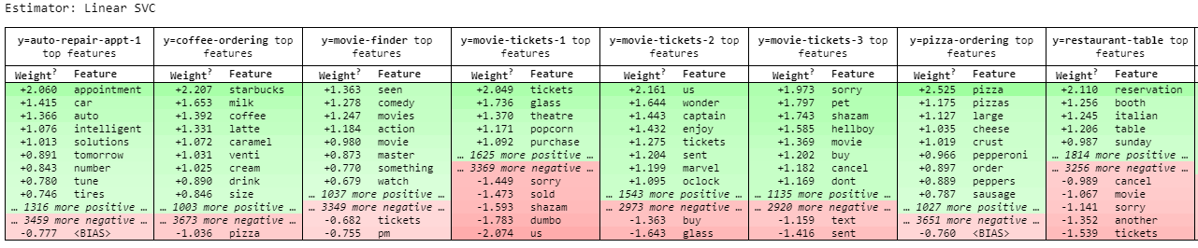
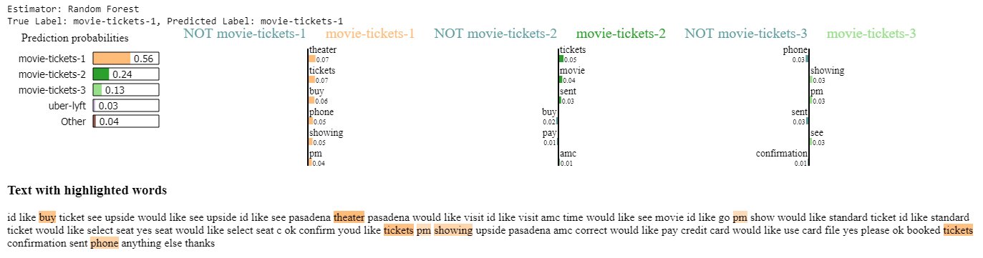
3.6 – Model Interpretation
Input | selfdialogs.db
Output | dialog_norm.csv
Data Preparation
Cleaning & NLP
Data Exploration
Feature Engineering & Selection
Model Evaluation and Ensemble
Model Interpretation
Interpretability
Feature Importance
ELI5
LIME
Skater

Slide 17
4. Results
4. Results
1. Feature Engineering
2. Model Evaluation
3. Learning Curves
4. Ensemble Learning
5. Model Selection

Slide 18
4.1 Feature Engineering
Input | selfdialogs.db
Output | dialog_norm.csv
Feature Engineering
Model Evaluation
Learning Curves
Ensemble Learning
Model Selection
Interpretability
Feature Importance
ELI5
LIME
Skater

Slide 19
4.2 Model Evaluation
Input | selfdialogs.db
Output | dialog_norm.csv
Feature Engineering
Model Evaluation
Learning Curves
Ensemble Learning
Model Selection
Interpretability
Feature Importance
ELI5
LIME
Skater

Slide 20
4.3 Learning Curves
Input | selfdialogs.db
Output | dialog_norm.csv
Feature Engineering
Model Evaluation
Learning Curves
Ensemble Learning
Model Selection
Interpretability
Feature Importance
ELI5
LIME
Skater

Slide 21
4.4 Ensemble Learning
Input | selfdialogs.db
Output | dialog_norm.csv
Feature Engineering
Model Evaluation
Learning Curves
Ensemble Learning
Model Selection
Interpretability
Feature Importance
ELI5
LIME
Skater

Slide 22
4.5 Model Selection
Input | selfdialogs.db
Output | dialog_norm.csv
Feature Engineering
Model Evaluation
Learning Curves
Ensemble Learning
Model Selection
Interpretability
Feature Importance
ELI5
LIME
Skater

Slide 23
5. Discussion
5. Discussion

Slide 24
6. Conclusion
6. Conclusion

Slide 25
References / Bibliography
Upasana, Mar. 17, 2017, Imbalanced Data : How to handle Imbalanced Classification Problems https://www.analyticsvidhya.com/blog/2017/03/imbalanced-data-classification/
Li, Susan, Feb 19, 2018, Multi-Class Text Classification with Scikit-Learn https://towardsdatascience.com/multi-class-text-classification-with-scikit-learn-12f1e60e0a9f
Sarkar, Dipanjan (DJ), Jan 6, 2018, Categorical Data, Strategies for working with discrete, categorical data https://towardsdatascience.com/understanding-feature-engineering-part-2-categorical-data-f54324193e63
Jaadi, Zakaria, September 4, 2019, Updated: February 24, 2020, A Step By Step Explanation Of Principal Component Analysis https://builtin.com/data-science/step-step-explanation-principal-component-analysis
Powell, Victor, Lehe, Lewis, Principal Component Analysis, Explained Visually https://setosa.io/ev/principal-component-analysis/
scikit-learn 0.22.2, Receiver Operating Characteristic (ROC) https://scikit-learn.org/stable/auto_examples/model_selection/plot_roc.html
Vallantin, Lima, Oct 9, 2018, Metrics to measure machine learning model performance https://medium.com/@limavallantin/metrics-to-measure-machine-learning-model-performance-e8c963665476
Borges, Diogo Menezes Jan. 2019, Ensemble Learning: 5 Main Approaches https://www.kdnuggets.com/2019/01/ensemble-learning-5-main-approaches.html
Smolyakov, Vadim, Aug. ,22, 2017, Ensemble Learning to Improve Machine Learning Results, https://blog.statsbot.co/ensemble-learning-d1dcd548e936
Koehrsen, Will, May 18, 2018, A Complete Machine Learning Walk-Through in Python: Part Three, Interpreting a machine learning model and presenting results https://towardsdatascience.com/a-complete-machine-learning-walk-through-in-python-part-three-388834e8804b
Hulstaert, Lars, Feb 20, 2018, Interpreting machine learning models https://towardsdatascience.com/interpretability-in-machine-learning-70c30694a05f

Slide 26
References / Bibliography
Ma, Edward, Jul 29, 2018, 3 ways to interpretate your NLP model to management and customer https://towardsdatascience.com/3-ways-to-interpretate-your-nlp-model-to-management-and-customer-5428bc07ce15
Li, Susan, Jul 3, 2019, Explain NLP models with LIME & SHAP, Interpretation for Text Classification https://towardsdatascience.com/explain-nlp-models-with-lime-shap-5c5a9f84d59b
scikit-learn 0.23.0, 3.2. Tuning the hyper-parameters of an estimator https://scikit-learn.org/stable/modules/grid_search.html#grid-search
NLP in Python - Quickstart Guide https://github.com/NirantK/nlp-python-deep-learning
Kessler, Jason, Beautiful visualizations of how language differs among document types. https://github.com/JasonKessler/scattertext
Seaborn, 0.10.1, Building structured multi-plot grids https://seaborn.pydata.org/tutorial/axis_grids.html
AlammarThe, Jay, Dec. 3, 2018, Illustrated BERT, ELMo, and co. (How NLP Cracked Transfer Learning) https://jalammar.github.io/illustrated-bert/
Brownlee, Jason, May 20, 2016, Feature Selection For Machine Learning in Python https://machinelearningmastery.com/feature-selection-machine-learning-python/
Brownlee, Jason, July 14, 2014, Feature Selection in Python with Scikit-Learn https://machinelearningmastery.com/feature-selection-in-python-with-scikit-learn/

Slide 27
Older Material For Reference
The following slides are from Milestone2
Need to be deleted before submission, but kept in to have reference when setting up the Final Project slides

Slide 28
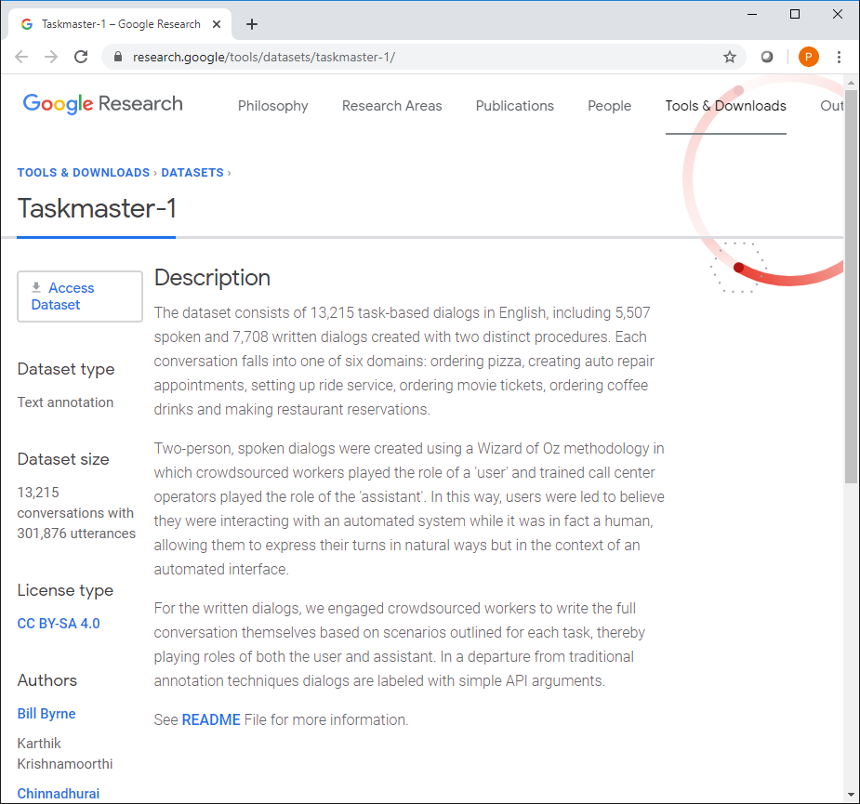
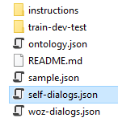
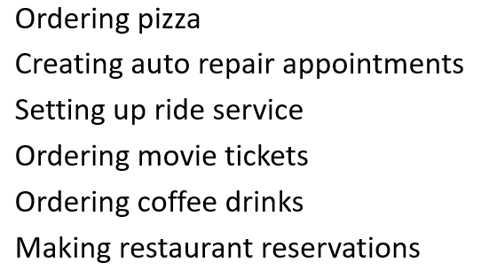
Dataset: Taskmaster-1 from Google https://research.google/tools/datasets/taskmaster-1/
The dataset selected is the Taskmaster-1 from Google
The dataset consists of task-based dialogs falling into one of six domains divided into 14 categories
We will be using the self-dialogs file which contains 7,708 conversations: ‘self-dialogs.json’

Slide 29
Description of Categorical Variable (Instruction_id)
Instruction_id | Conversation Dialogue Description
Auto-repair-appt-1 | Users will pretend they need to take their car to the mechanic, so they need to get an appointment scheduled
Coffee-ordering-1 | Users will pretend they’ve decided to order a coffee drink from a coffee shop
Coffee-ordering-2 | Users will pretend they’ve decided to order a coffee drink, and makes changes to the drink after the initial options have been requested
movie-finder | User is looking for a movie to see at home
movie-tickets-1 | User wants to see a movie playing now
movie-tickets-2 | User wants to see a movie playing now, settling for a second choice
movie-tickets-3 | User wants to see one of two movies
Pizza-Ordering-1 | User orders one pizza, and ask all relevant details
Pizza-Ordering-2 | User orders one pizza with two toppings, and ask all relevant details
restaurant-table-1 | Users will pretend they are searching for a restaurant and book a table
restaurant-table-2 | Users will pretend they are searching for a restaurant and book a table, and will need to find an alternative when choice is not available
restaurant-table-3 | Users will pretend they are searching for a restaurant and book a table, and will look at options at two restaurants
uber-lyft-1 | Users will pretend they need to order a car for a ride inside a city
uber-lyft-2 | Users will pretend they need to order a car for a ride inside a city, and looking for an alternative when choice is not available

Slide 30
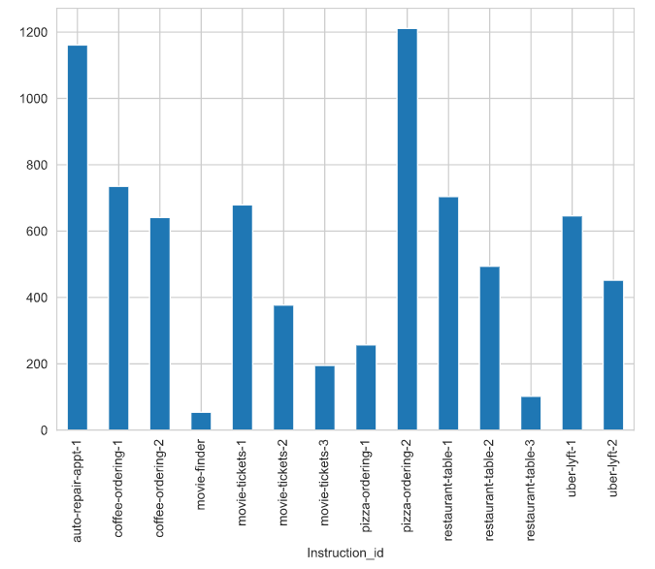
Distribution of Categorical Variable (Instruction_id)

Slide 31
Modeling, Model Evaluation & Tuning
Step | Description
1. Benchmark Using Bag of Words features Feature Selection using Chi² | Logistic Regression
 | Multinomial Naïve Bayes
 | Random Forest Classifier
 | Linear SVC
2. Optimized Hyperparameters | GridSearchCV
3. Learning Curves | Accuracy
 | Errors
4. ROC Curves | AUC
5. Ensemble Learning | Bagging
 | Boosting
 | Stacking
 | Voting

Slide 32
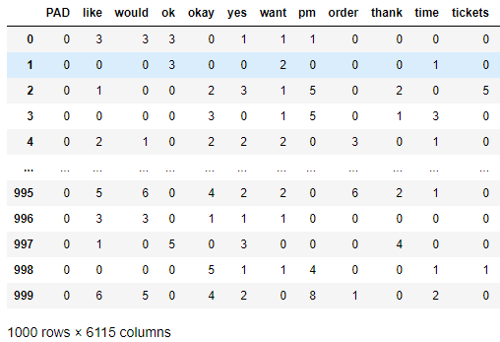
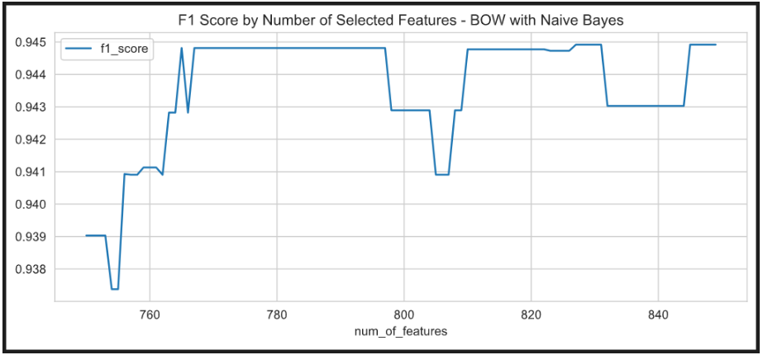

1a. Best Features Selected - Bag of Words
Feature Extraction
Feature Selection – Univariate with Chi²
Benchmarking

Slide 33
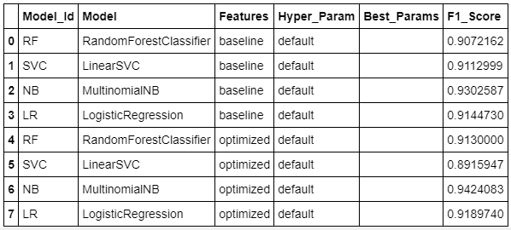
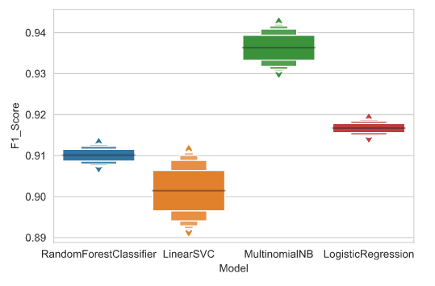
1b. Models Baseline Benchmark Comparison
Baseline: Bag of Words Features
Optimized: Bag of Words using Univariate Chi² feature selection method

Slide 34
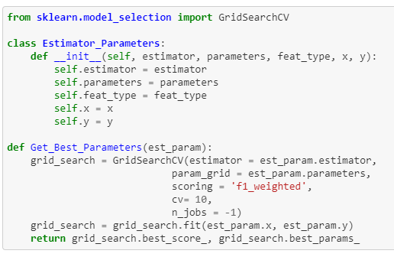
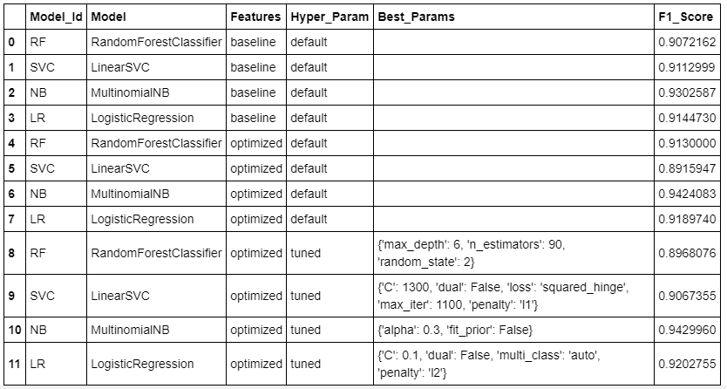
2. Optimized Hyperparameters Using GridSearchCV

Slide 35
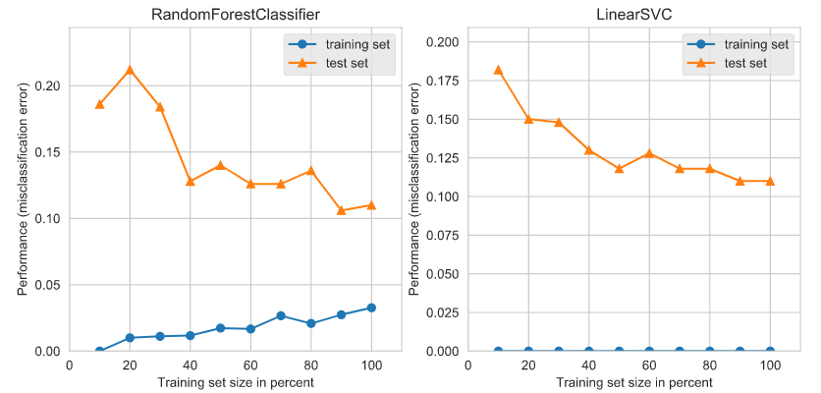
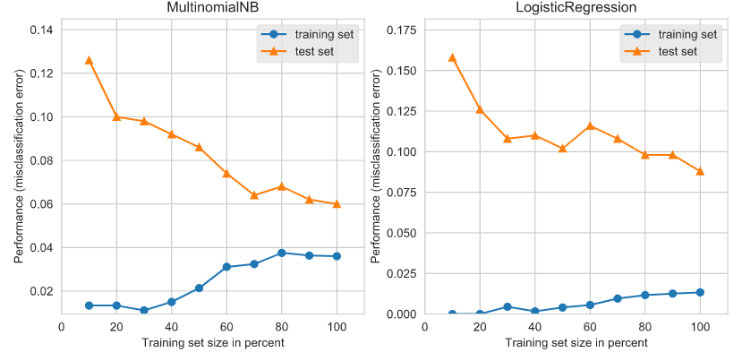
3a. Learning Curves – Training/Testing Errors
Random Forest Classifier:
Low Bias
Low Variance
Linear SVC:
Low Bias
High Variance
MultinomialNB:
Medium Bias
Low Variance
Logistic Regression:
Low Bias
Medium Variance

Slide 36
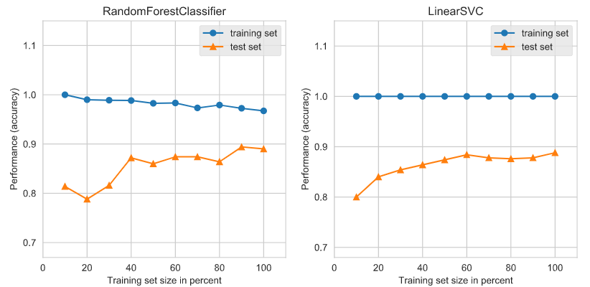
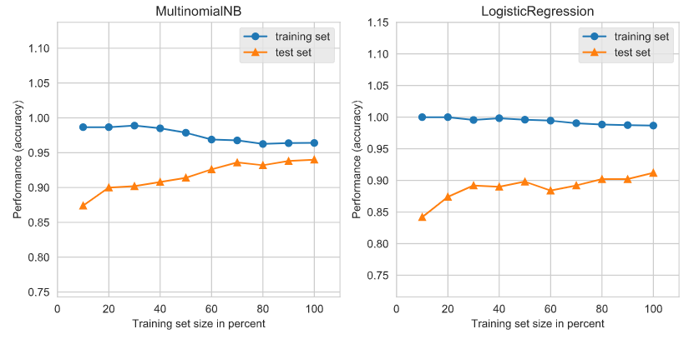
3b. Learning Curves – Training/Testing Accuracy
Random Forest Classifier:
Low Bias
Low Variance
Linear SVC:
Low Bias
High Variance
MultinomialNB:
Medium Bias
Low Variance
Logistic Regression:
Low Bias
Medium Variance
NOTE: The training and test curves are starting to converge after reducing the number of classes and modifying the weights of the samples taken on each class to balance the classes.

Slide 37
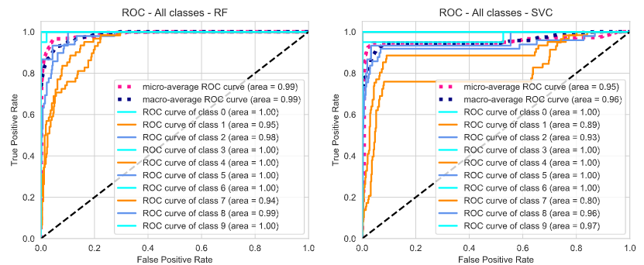
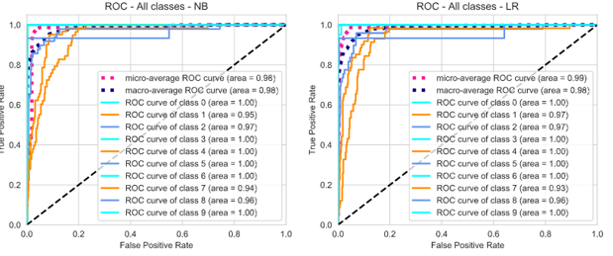
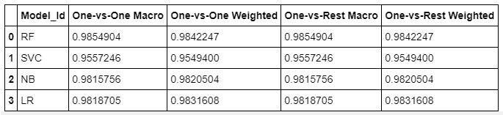
4. ROC – AUC Curves

Slide 38
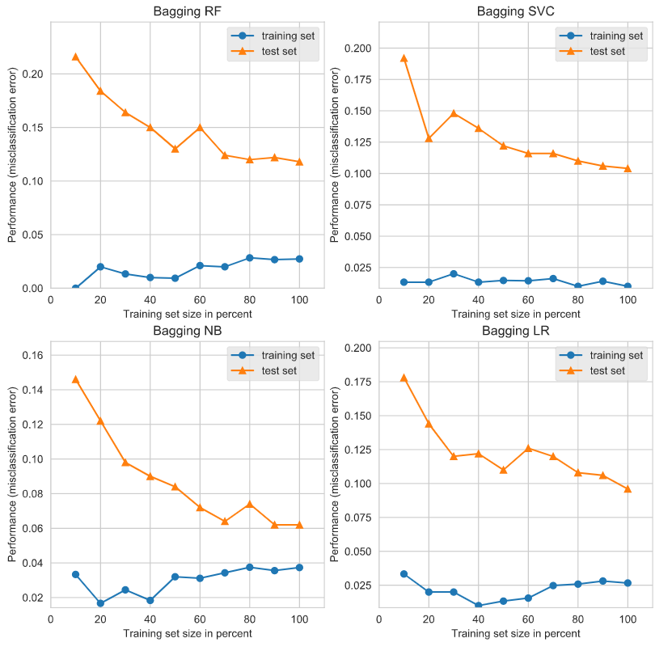
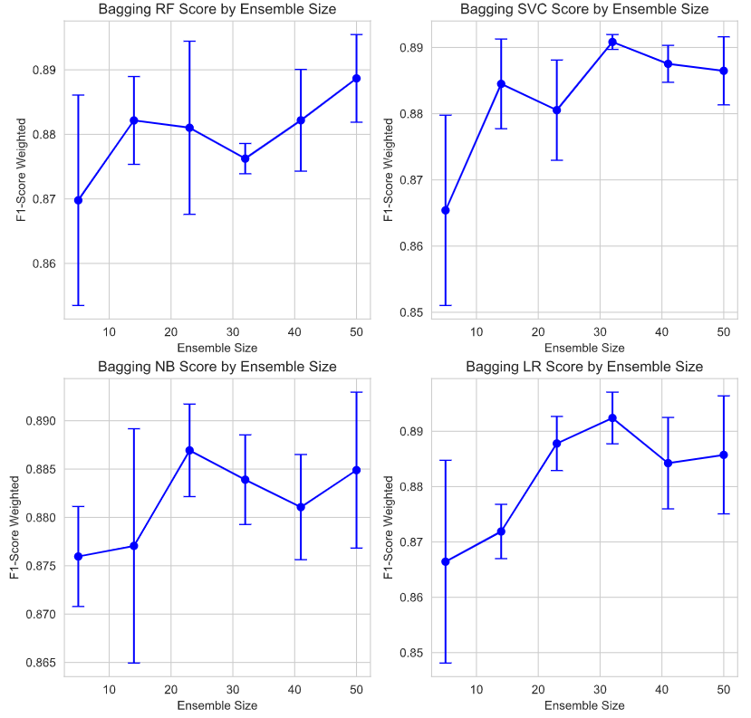

5a. Ensemble Learning – Bagging
Learning Curves Test/Train Errors
F1-Score Weighted by Ensemble Size

Slide 39
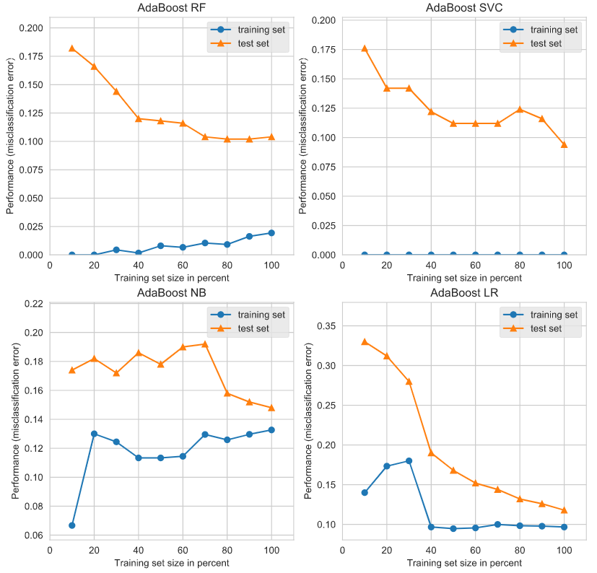
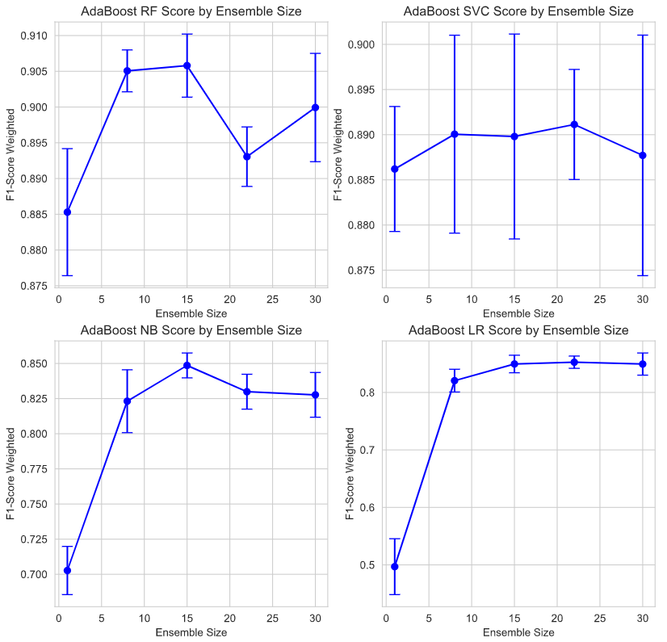

5b. Ensemble Learning – Boosting
Learning Curves Test/Train Errors
F1-Score Weighted by Ensemble Size

Slide 40
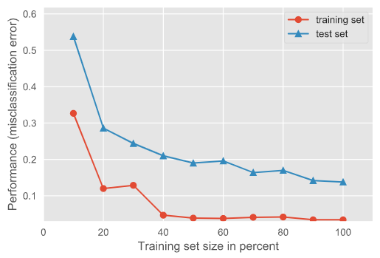
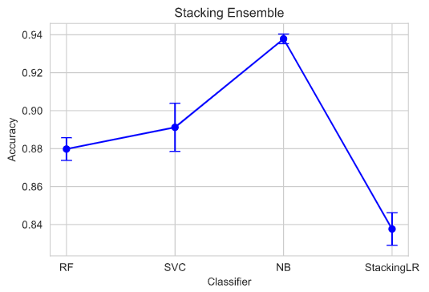
5c. Ensemble Learning – Stacking
Random Forest -> Linear SVC -> Multinomial Naïve Bayes -> Stacking Logistic Regression
Learning Curves Test/Train Errors
Stacking Ensemble Accuracy by Classifier

Slide 41
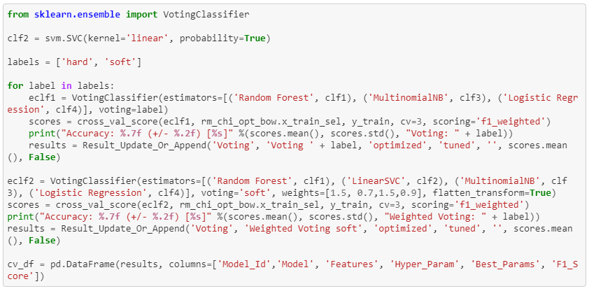
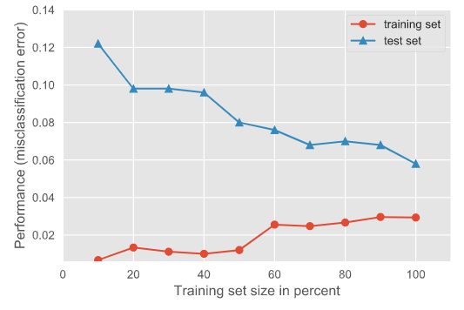

5d. Ensemble Learning - Voting

Slide 42
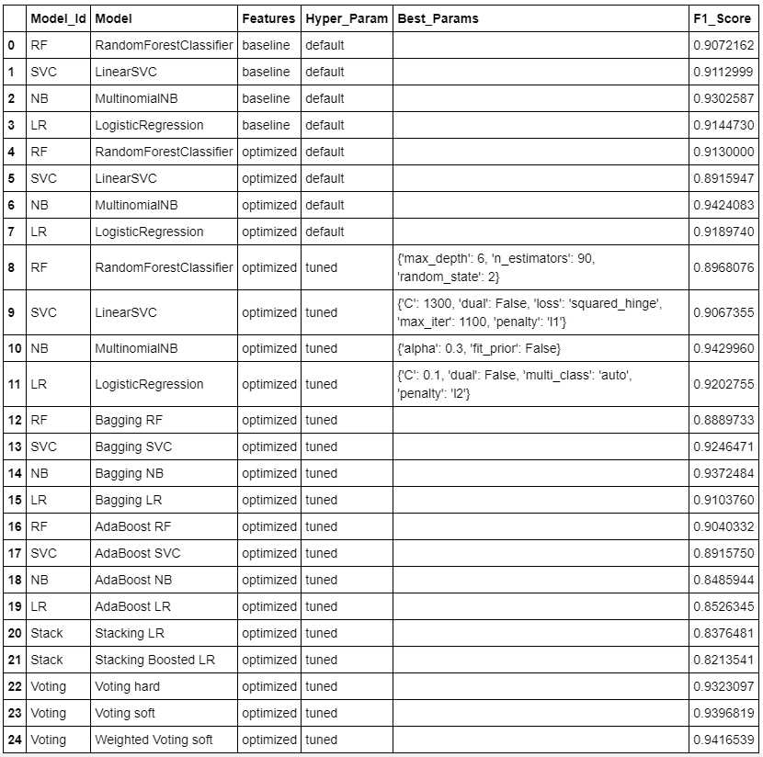
Summary Benchmark F1 Scores

Slide 43
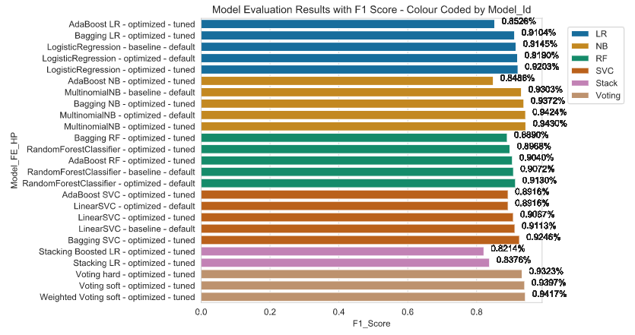
Visualization of Benchmark F1 Scores

Slide 44
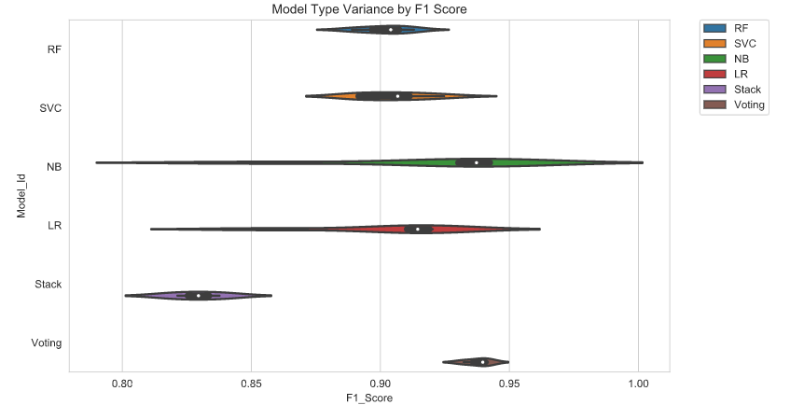
Visualization of F1 Score Variance by Model Type

Slide 45
Model Selection - Final Results
Best results were produced from the following:
Extracted Feature | Bag of Words
Model | Multinomial Naïve Bayes
Feature Selection Method | Univariate chi²
Hyperparameter Tuning | Optimized Hyperparameters Using GridSearchCV: Alpha = 0.3 Fit_prior = False
F1 Score | 0.9429960
Notes:
TODO:
Verify that the hyper parameters listed match the values from final run
Adjust the table

