Slide 1

Project: Conversation Dialogue Identification
York University – CSML1010 – Milestone 2 Group 3: Jerry Khidaroo, Paul Doucet
Instructor: Dr. Annie En-Shiun Lee

Slide 2
CSML1010 – Milestone 2
Dataset: Taskmaster-1 from Google
NLP Multi-Class Text Classification Problem
Data Preparation
Data Clean Up
Exploratory Data Analysis
Feature Extraction & Engineering
Feature Scaling & Selection
Modeling
Model Evaluation & Tuning

Slide 3
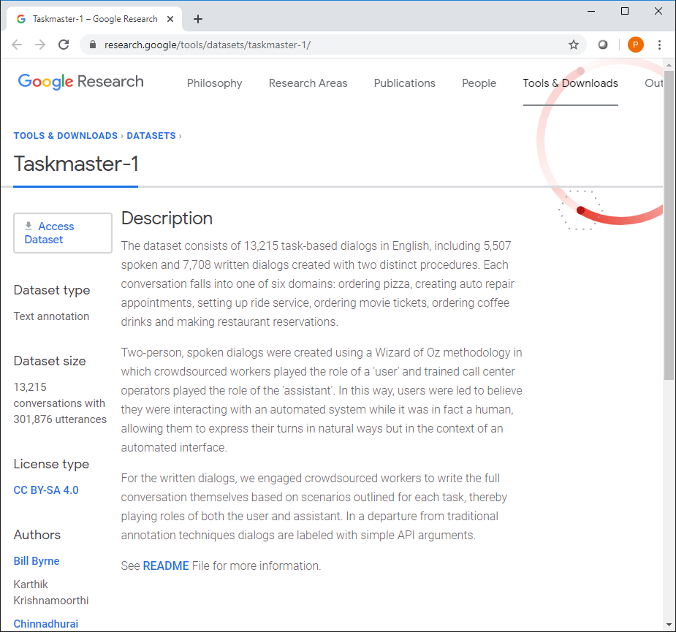
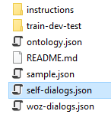
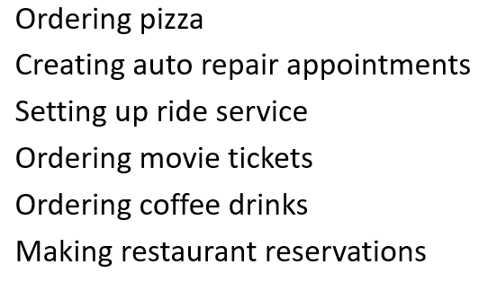
Dataset: Taskmaster-1 from Google https://research.google/tools/datasets/taskmaster-1/
The dataset selected is the Taskmaster-1 from Google
The dataset consists of task-based dialogs falling into one of six domains divided into 14 categories
We will be using the self-dialogs file which contains 7,708 conversations: ‘self-dialogs.json’

Slide 4
Description of Categorical Variable (Instruction_id)
Instruction_id | Conversation Dialogue Description
Auto-repair-appt-1 | Users will pretend they need to take their car to the mechanic, so they need to get an appointment scheduled
Coffee-ordering-1 | Users will pretend they’ve decided to order a coffee drink from a coffee shop
Coffee-ordering-2 | Users will pretend they’ve decided to order a coffee drink, and makes changes to the drink after the initial options have been requested
movie-finder | User is looking for a movie to see at home
movie-tickets-1 | User wants to see a movie playing now
movie-tickets-2 | User wants to see a movie playing now, settling for a second choice
movie-tickets-3 | User wants to see one of two movies
Pizza-Ordering-1 | User orders one pizza, and ask all relevant details
Pizza-Ordering-2 | User orders one pizza with two toppings, and ask all relevant details
restaurant-table-1 | Users will pretend they are searching for a restaurant and book a table
restaurant-table-2 | Users will pretend they are searching for a restaurant and book a table, and will need to find an alternative when choice is not available
restaurant-table-3 | Users will pretend they are searching for a restaurant and book a table, and will look at options at two restaurants
uber-lyft-1 | Users will pretend they need to order a car for a ride inside a city
uber-lyft-2 | Users will pretend they need to order a car for a ride inside a city, and looking for an alternative when choice is not available

Slide 5
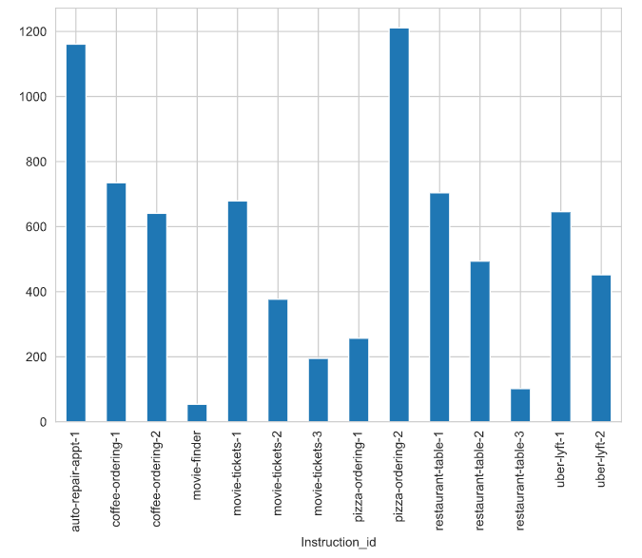
Distribution of Categorical Variable (Instruction_id)

Slide 6
Project: Conversation Identification
The problem we will examine is a supervised multi-class text classification problem.
Goal: Build a model that identifies the category for dialogue conversations
Input: conversation dialogue text and labels
Output: model that predicts the “instruction_id” category
Input
Conversation Dialogue text and labels
Machine Learning
Machine Learning Steps
Output
Model that predicts the “instruction_id” category

Slide 7
Modeling, Model Evaluation & Tuning
Step | Description
1. Benchmark Using Bag of Words features Feature Selection using Chi² | Logistic Regression
 | Multinomial Naïve Bayes
 | Random Forest Classifier
 | Linear SVC
2. Optimized Hyperparameters | GridSearchCV
3. Learning Curves | Accuracy
 | Errors
4. ROC Curves | AUC
5. Ensemble Learning | Bagging
 | Boosting
 | Stacking
 | Voting

Slide 8
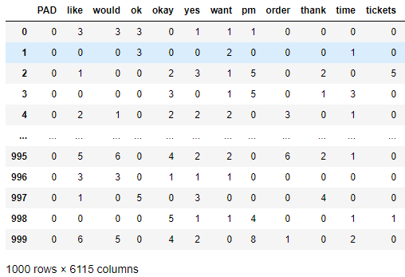
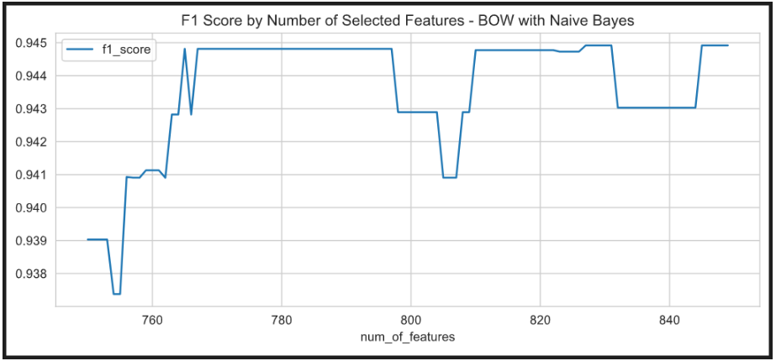

1a. Best Features Selected - Bag of Words
Feature Extraction
Feature Selection – Univariate with Chi²
Benchmarking

Slide 9
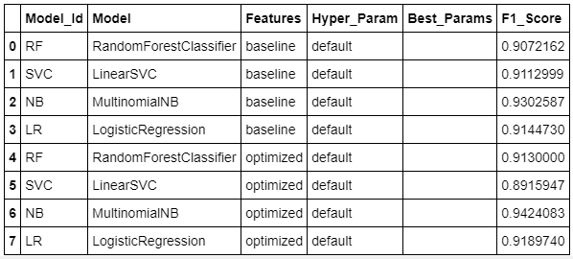
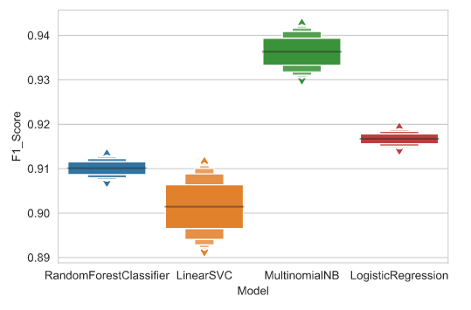
1b. Models Baseline Benchmark Comparison
Baseline: Bag of Words Features
Optimized: Bag of Words using Univariate Chi² feature selection method

Slide 10
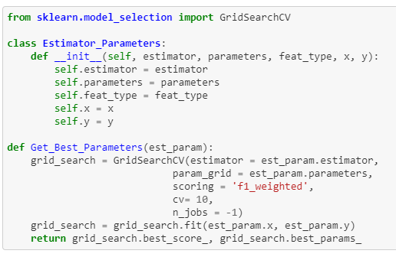
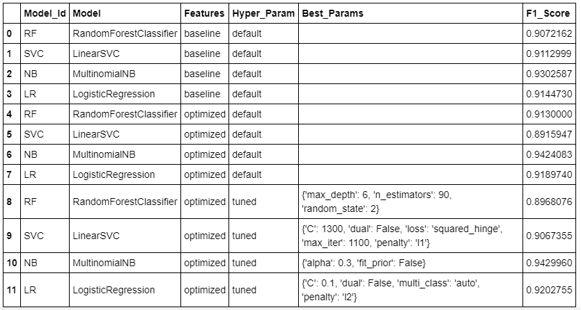
2. Optimized Hyperparameters Using GridSearchCV

Slide 11
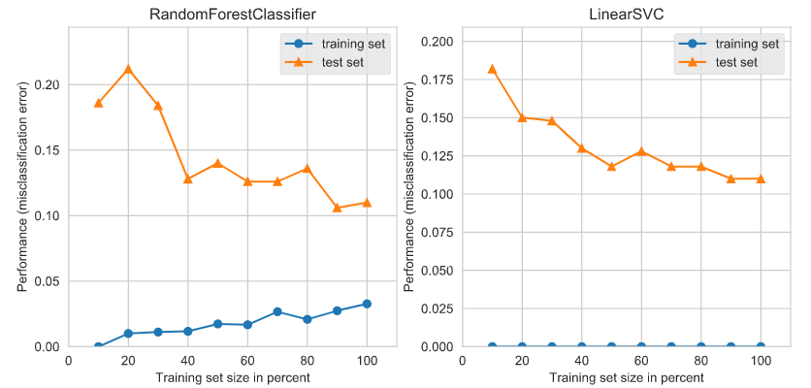
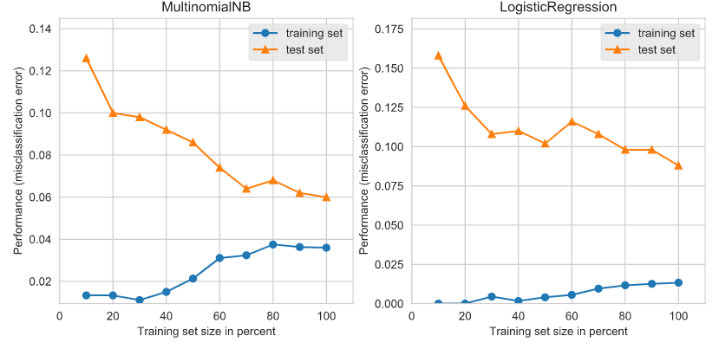
3a. Learning Curves – Training/Testing Errors
Random Forest Classifier:
Low Bias
Low Variance
Linear SVC:
Low Bias
High Variance
MultinomialNB:
Medium Bias
Low Variance
Logistic Regression:
Low Bias
Medium Variance

Slide 12
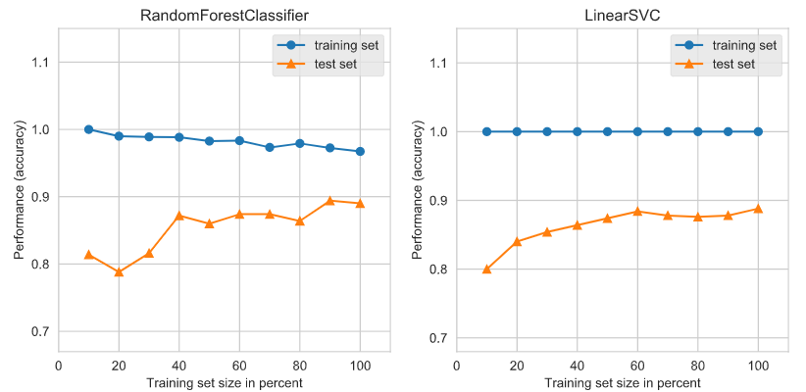
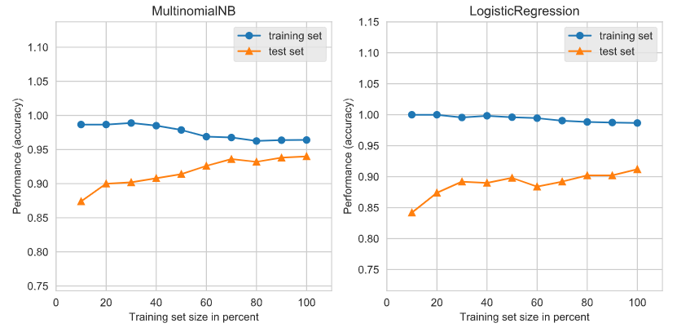
3b. Learning Curves – Training/Testing Accuracy
Random Forest Classifier:
Low Bias
Low Variance
Linear SVC:
Low Bias
High Variance
MultinomialNB:
Medium Bias
Low Variance
Logistic Regression:
Low Bias
Medium Variance
NOTE: The training and test curves are starting to converge after reducing the number of classes and modifying the weights of the samples taken on each class to balance the classes.

Slide 13
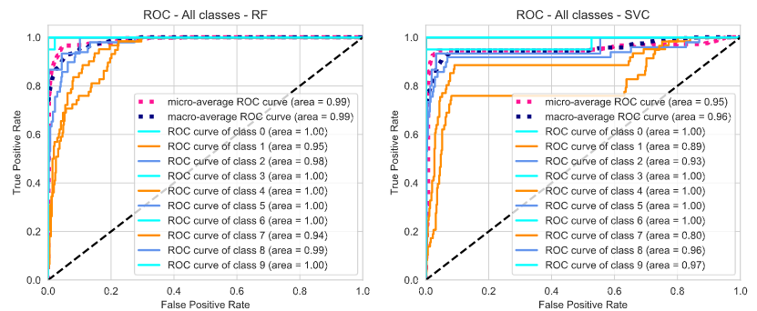
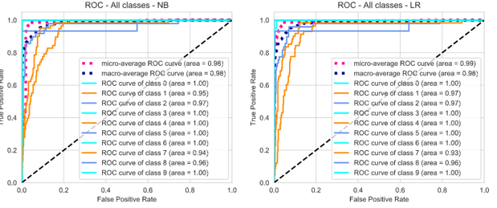
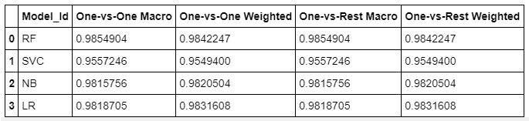
4. ROC – AUC Curves

Slide 14
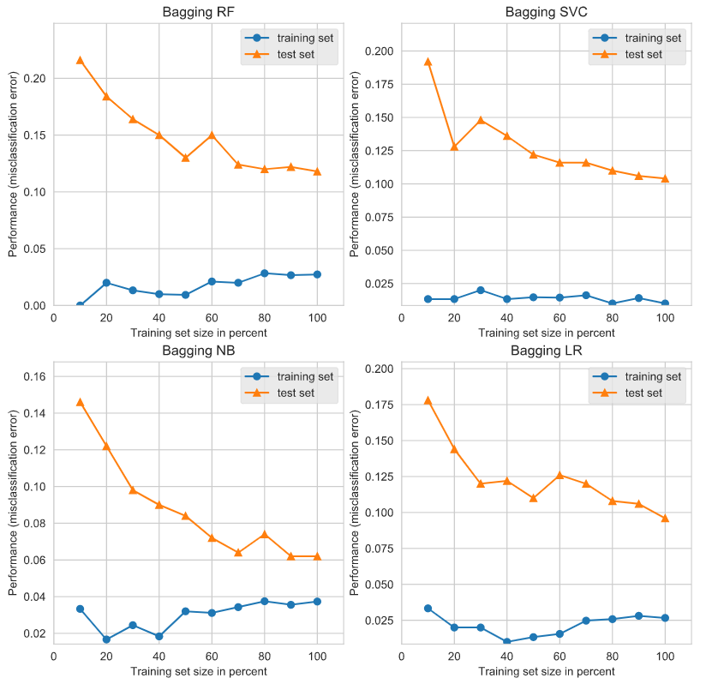
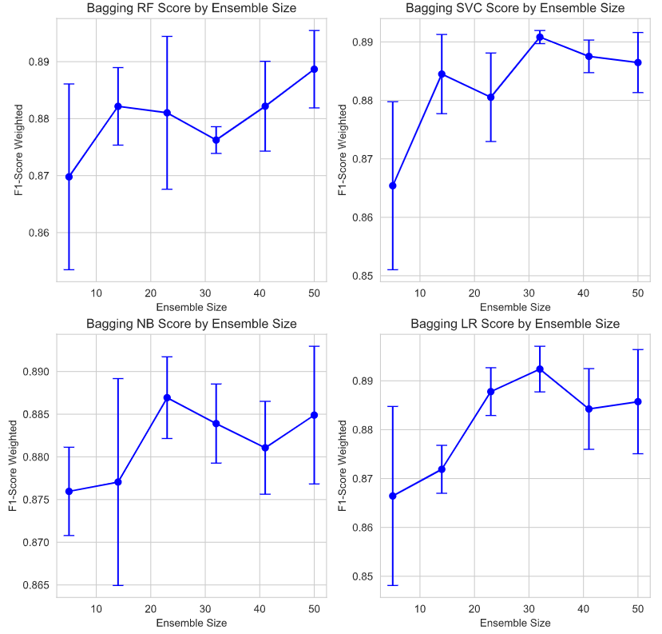

5a. Ensemble Learning – Bagging
Learning Curves Test/Train Errors
F1-Score Weighted by Ensemble Size

Slide 15
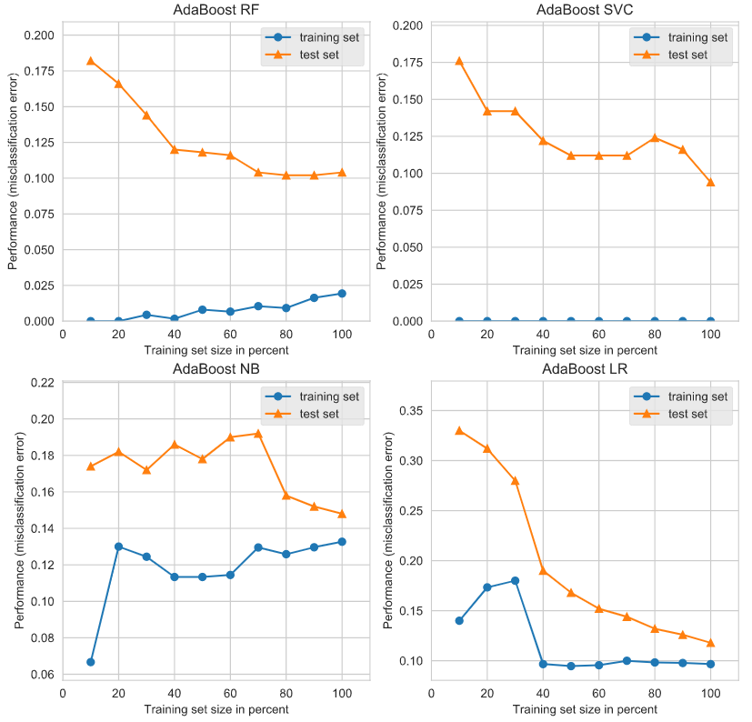
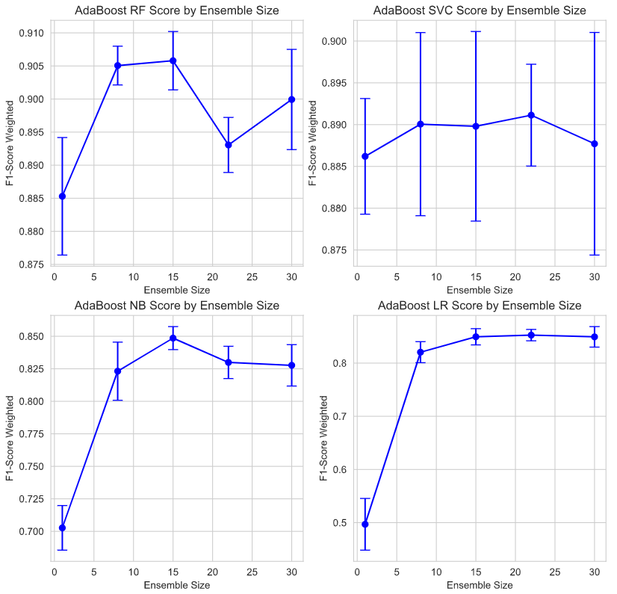

5b. Ensemble Learning – Boosting
Learning Curves Test/Train Errors
F1-Score Weighted by Ensemble Size

Slide 16
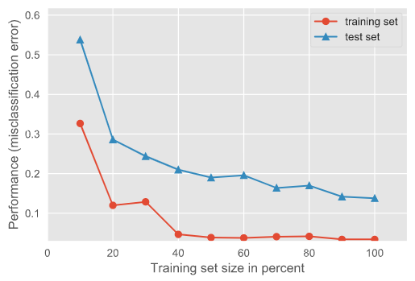
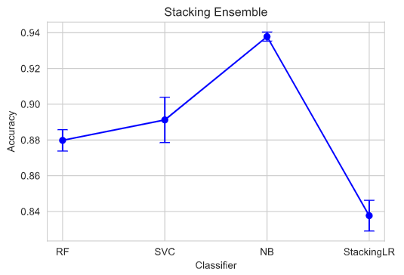
5c. Ensemble Learning – Stacking
Random Forest -> Linear SVC -> Multinomial Naïve Bayes -> Stacking Logistic Regression
Learning Curves Test/Train Errors
Stacking Ensemble Accuracy by Classifier

Slide 17
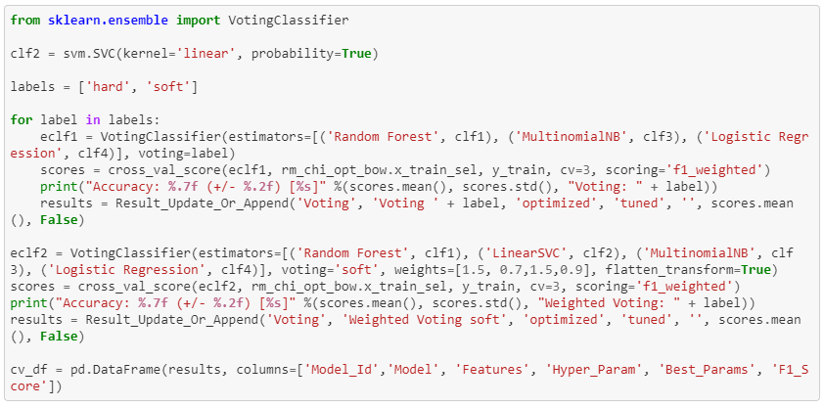
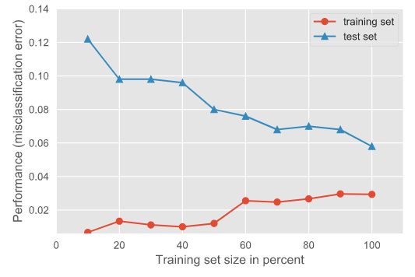

5d. Voting Classifier

Slide 18
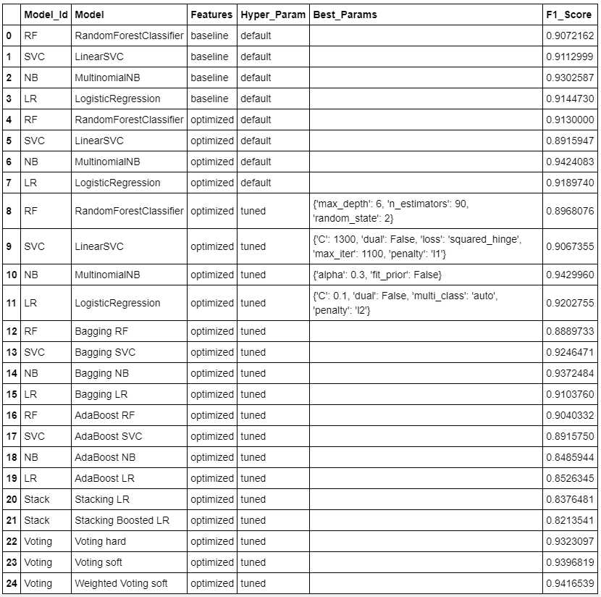
Summary Benchmark F1 Scores

Slide 19
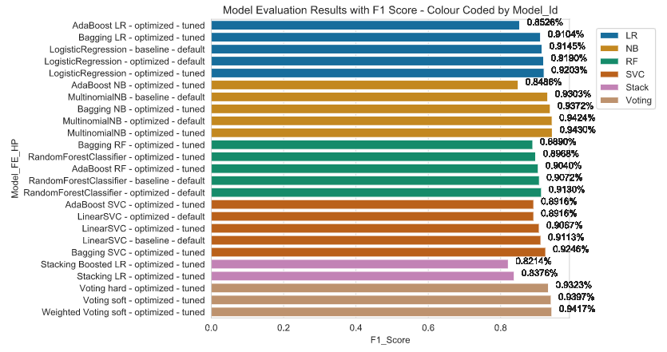
Visualization of Benchmark F1 Scores

Slide 20
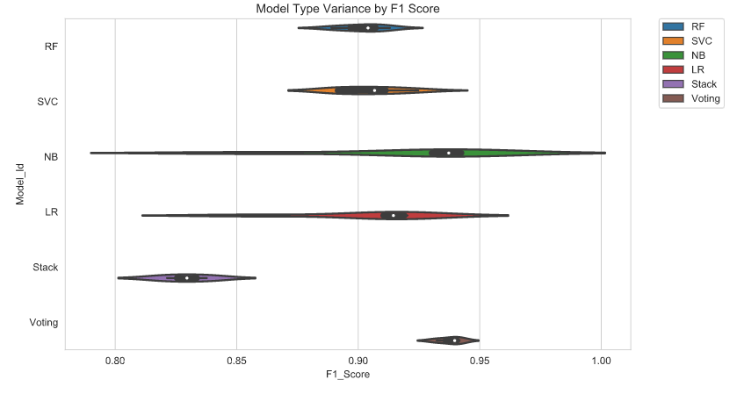
Visualization of F1 Score Variance by Model Type

Slide 21
Model Selection - Final Results
Best results were produced from the following:
Extracted Feature | Bag of Words
Model | Multinomial Naïve Bayes
Feature Selection Method | Univariate chi²
Hyperparameter Tuning | Optimized Hyperparameters Using GridSearchCV: Alpha = 0.3 Fit_prior = False
F1 Score | 0.9429960
Notes:
TODO:
Verify that the hyper parameters listed match the values from final run
Adjust the table

