Slide 1
Group Policy – Microsoft Edge ..and Legacy Edge
Chad Brower
@Brower_Chad
Sys Admin
Some Insurance Company

Slide 2
Chad Brower
@Brower_Chad
Microsoft Certified Professional
10 years..ish
I have kids...Racing

Slide 3
Agenda
Group Policy Basics
Demo
Legacy Edge
Demo
Security Baselines
Demo
Q & A
References

Slide 4
Group Policy Basics
Back to the basics

Slide 5

Group Policy Edge(s)
Legacy Edge is built into Windows 10 ADMX templates
Administrative Templates (.admx) for Windows 10 October 2020 Update (20H2) does not include Microsoft Edge policy files
Microsoft Edge (or Chromium Edge) you need to import them
Download from (https://aka.ms/EdgeEnterprise)
Import into local policy store or domain sysvol store

Slide 6
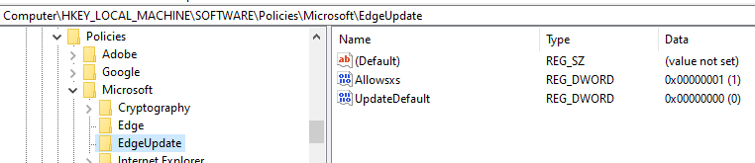
What might you want to set?
Disable Updates
Why?
Disable Password saving
Force or Disable Add-on
Set homepage

Slide 7
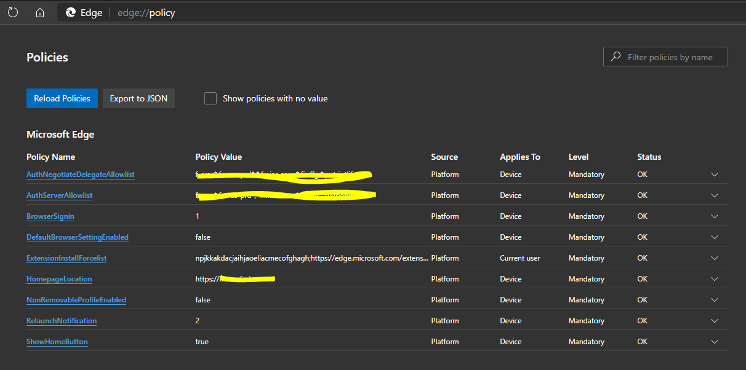
Edge://policy

Slide 8
Demo:
Notes:
2 demos
Kaido and Mike
DEMO: User-driven In-Place Upgrade - 10 minutes - Mike and Kaido

Slide 9
Do you still need Legacy Edge?
I hope not… but if you do.

Slide 10
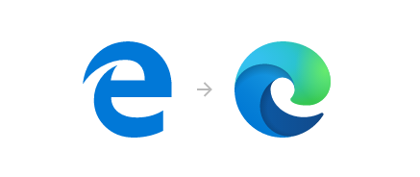
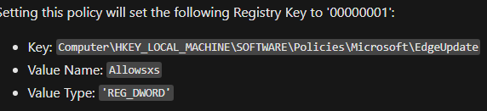
Side by Side (SxS)
WHY?
For ServiceDesk support that need to support both versions
For Devs who need to work with Legacy Edge and Microsoft Edge (This was my Org ^)
You must have Microsoft Edge policy templates to enable this
Or Registry Edit

Slide 11
Demo:
Notes:
2 demos
Kaido and Mike
DEMO: User-driven In-Place Upgrade - 10 minutes - Mike and Kaido

Slide 12
Security Baselines…
Easy and free solution

Slide 13
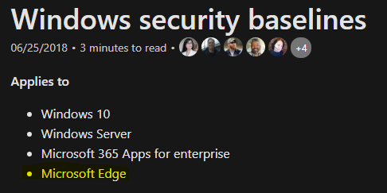
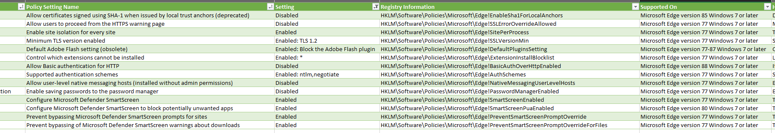
Security Compliance Toolkit (SCT)
Documentation
Easy to import
Follows CIS or meets other regulatory requirements
Backwards compatibility
Windows security baselines - Windows security | Microsoft Docs

Slide 14
Demo:
Notes:
2 demos
Kaido and Mike
DEMO: User-driven In-Place Upgrade - 10 minutes - Mike and Kaido

Slide 15
Q & A

Slide 16
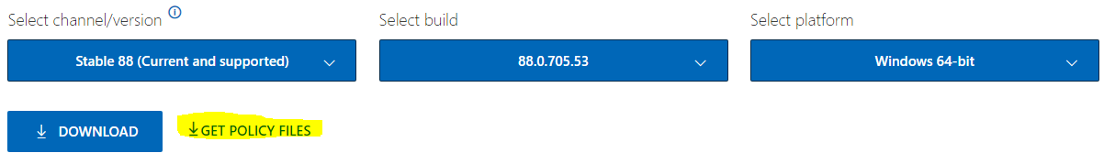
References
Download Windows 10 20H2 ADMX Templates
Download Administrative Templates (.admx) for Windows 10 October 2020 Update (20H2) from Official Microsoft Download Center
Configure Microsoft Edge
Configure Microsoft Edge for Windows | Microsoft Docs
See what's applied: edge://policy/
Get Microsoft Edge ADMX Templates
Download Microsoft Edge for Business - Microsoft
Access Legacy Edge with Microsoft Edge
Access the old version of Microsoft Edge | Microsoft Docs
Get Windows Baselines
Windows security baselines - Windows security | Microsoft Docs
Force Addons
Microsoft Edge Browser Policy Documentation | Microsoft Docs

Slide 17
Demo:
Notes:
2 demos
Kaido and Mike
DEMO: User-driven In-Place Upgrade - 10 minutes - Mike and Kaido

Slide 18
Section Header
This is the next section

Slide 19
Title
Line1
Bullet Level 1
Bullet Level 2
Bullet Level 3

Slide 20
Title
Code

Slide 21
Text Only with Border
Level 1
Level 2
Level 3

Slide 22
Text Only (Red)
Level 1
Level 2
Level 3

Slide 23
Title
Text 1
Level 1
Level 2
Level 3
Text 2
Level 1
Level 2
Level 3

Slide 24
Title
Section 1
Section 2
Text
Level 1
Level 2
Level 3
Text
Level 1
Level 2
Level 3

Slide 25
Demo Title

Slide 26





























Slide 27






























Slide 28




























Slide 29




























Slide 30




























Slide 31




























Slide 32




























Slide 33























Slide 34
















