Slide 1
Psychophysics
Psychometric functions and SDT
Filip Děchtěrenko, Jiří Lukavský
“It is more useful to study one animal for 1000 hours than to study 1000 animals for one hour” — B. F. Skinner

Slide 2
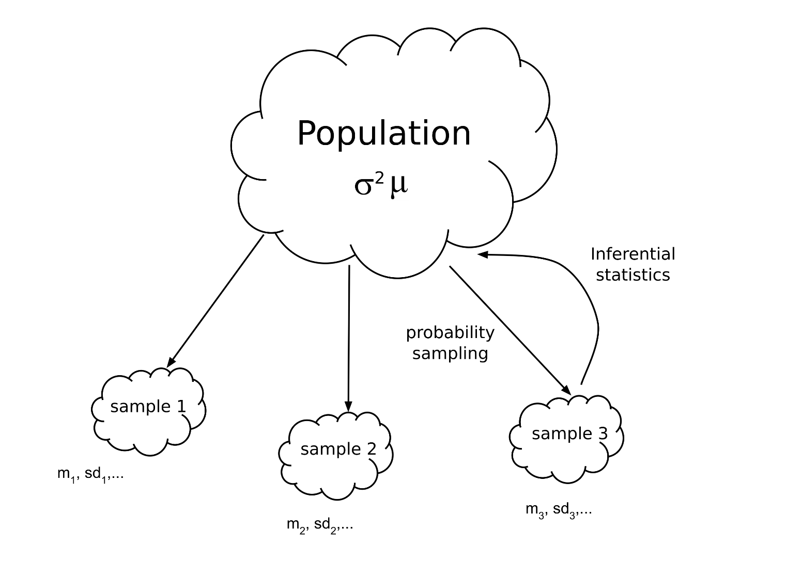
How statistics works?

Slide 3
Problem of large samples
Large samples should solve everything, right?
We have
Weak theories and models
Weak measurements
Poor experimental control of variance

Slide 4
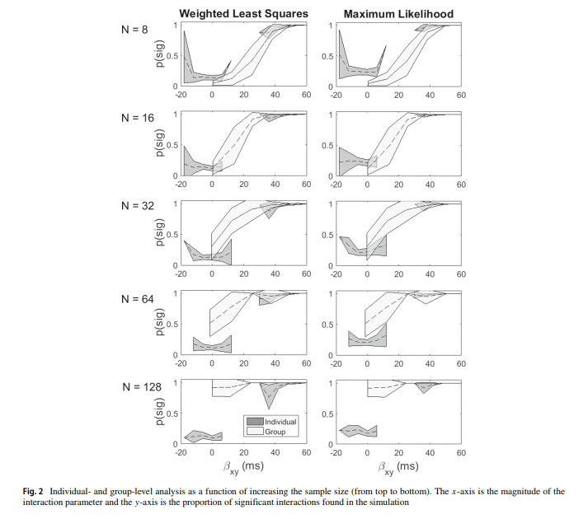
Simulation study
2x2 repeated measures ANOVA
Small-n group: interaction tested using additive method
Large-n group: interaction tested by collapsing RT per participant
http://www2.psychology.uiowa.edu/faculty/mordkoff/InfoProc/pdfs/Whitlow%20chptr7.pdf

Slide 5
Psychophysics can solve this!

Slide 6
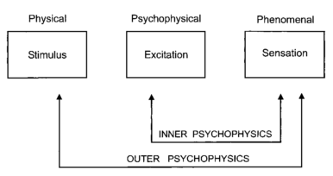
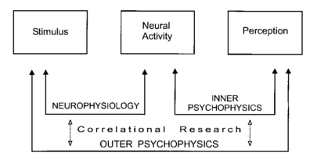
History
Fechner
Inner and outer psychophysics
Modern
Inner is not dependent on methodology

Slide 7

Weber’s law
Stimuli | Weber’s constant
Sound frequency | 0.003
Sound intensity | 0.15
Light intensity | 0.01
Smell concentration | 0.07
Taste concetration | 0.20
Pressure Intensity | 0.14

Slide 8
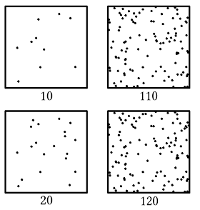
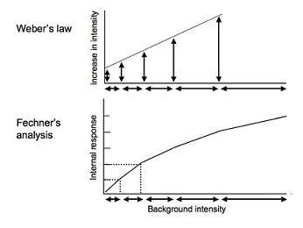
Weber-Fechner law
p = k ln (S/S₀)
p: Perceptual response
k: constant dependent on modality
S and S₀: Level of intensity and base intensity

Slide 9
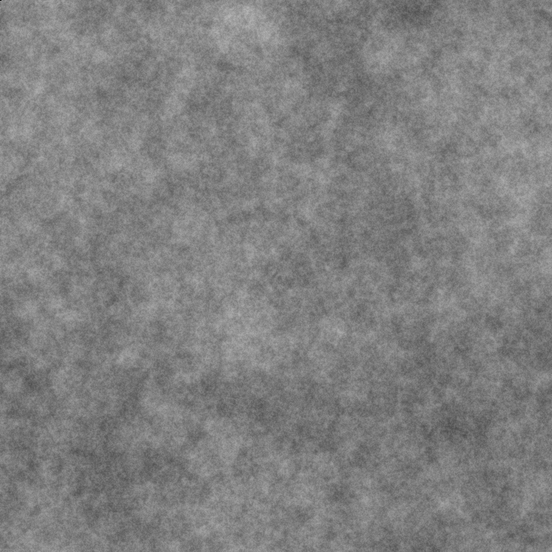




Psychometric funtion
We are showing Gabor patch in a noise
We are working with Gabor patches with very low detectability

Slide 10

Example of the task
1s
In the first
In the second
Empty noise
+
Noise with/without target
Empty noise till answer

Slide 11
Data
subject_id | trial_id | target contrast | target location | response | correct
1 | 1 | 0.04 | first | first | 1
1 | 2 | 0.02 | first | second | 0
1 | 3 | 0.08 | second | second | 1
1 | 4 | 0.02 | first | first | 1
1 | 5 | 0.16 | second | second | 1
1 | 6 | 0.08 | first | second | 0
1 | 7 | 0.16 | second | second | 1
1 | 8 | 0.04 | second | first | 0

Slide 12
Agreggated data
We need aggregated accuracies for individual target contrasts
subject_id | target contrast | accuracy
1 | 0.02 | 58%
1 | 0.04 | 63%
1 | 0.08 | 78%
1 | 0.16 | 85%
1 | 0.32 | 95%

Slide 13
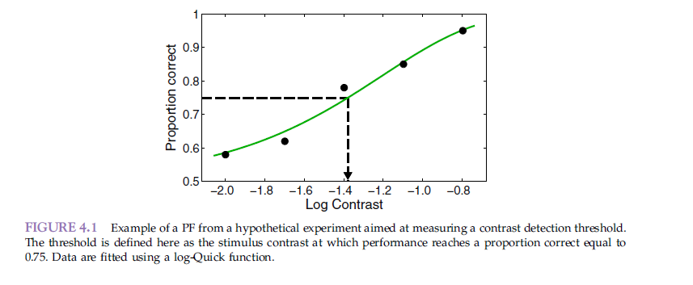
Visualization
We are usually interested in threshold, here stated as intesity for 75% accuracy

Slide 14
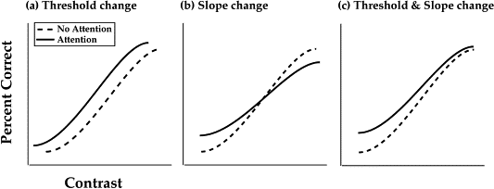

How to describe the curve
Usually 2 parameters
Threshold / PSE – stimulus intensity, when the state changes/when we subjectively think that the stimuli are the same
Slope – increase in steepness in certain point (typically in threshold)

Slide 15
What data do we want?
ideal

Slide 16
What data do we want?
ideal
fair enough

Slide 17
What data do we want?
ideal
fair enough
useless

Slide 18
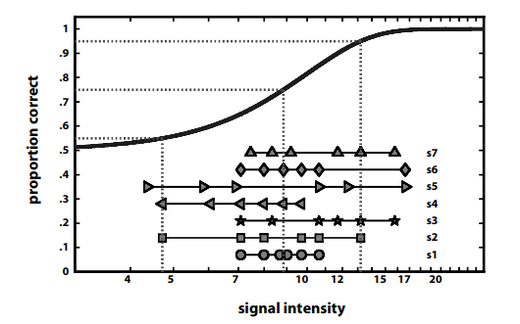
When evaluating fits in PF

Slide 19
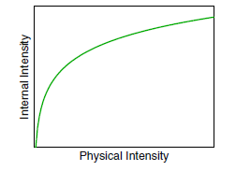

How many data points?
We usually want data around threshold
Cca 400 trials per subject
5 conditions
80 trials per condition
Transducer function
Transition between real intensity and subjective intensity
Usually logarithmic scale
Number of levels
Lower limit
Upper limit

Slide 20
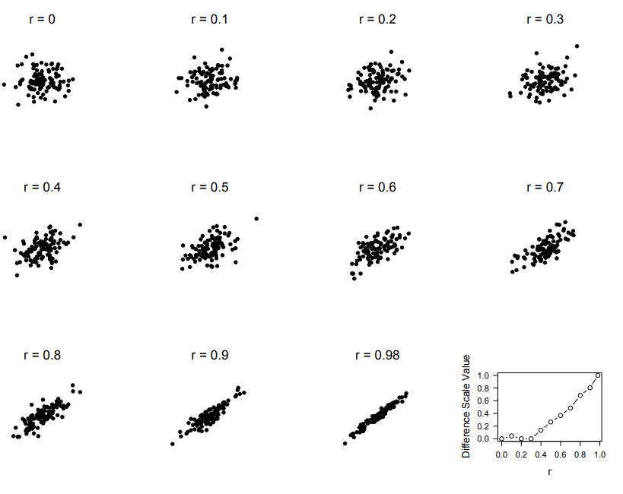
Transducer function

Slide 21
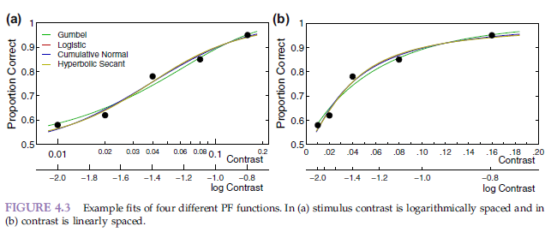
Type of functions
Many possible choices
Specific function is selected:
Theory-based
„fits data well“

Slide 22
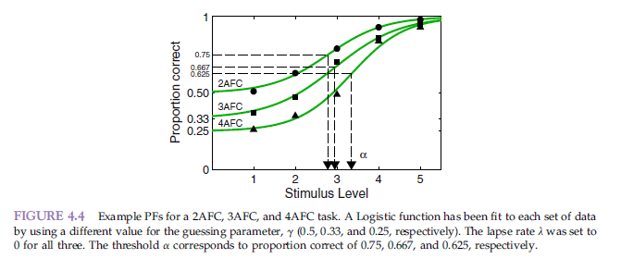
How to describe curve + human behaviour
Usually 4 parameters
Threshold / PSE – stimulus intensity, when the state changes/when we subjectively think that the stimuli are the same
Slope – increase in steepness in certain point (typically in threshold)
Guess rate – γ, what is the probability of correct answer when guessing?
Lapse rate – λ, percentage of trials, where participant gives incorrect answer

Slide 23
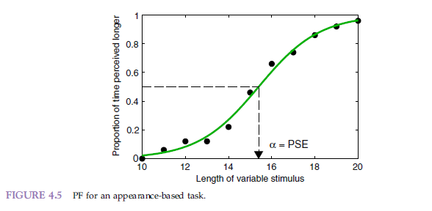
PF in appearence tasks
Guessing rate does not makes sense -> function goes to zero
There is no threshold but Point of subjective equivalence (PSE) – when both states seem equivalent
Sometimes is y scale displayed as -1 a 1 (0 is PSE), but we need to fit using data 0 to 1

Slide 24
Theory behond PF
If x is stimulus intensity, ψ(x) is performance for x
We are not interested that much in performance as in inner sensoric function F(x; θ), where θ are parameters of the function
F(x; θ) can’t be measured directly, only ψ(x)
Two theories HTT and SDT

Slide 25
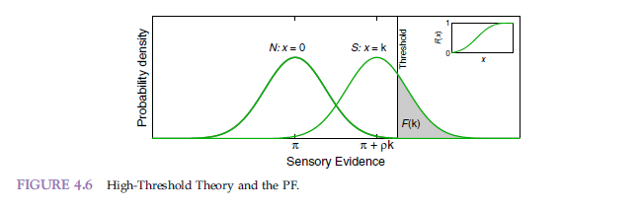
High threshold theory
2IFC experiment, Signal S a noise N
abstraction: we have neuron reacting on S (Gaussian-like)
N also produces signal, distance is linear with respect to intensity
We have inner threshold, and when the signal reaches above threshold, our mind will notice that
We do not know, how strong is the signal, if it does not reach over threshold

Slide 26
HTT – guessing rate and lapse rate
If I do not reach threshold, I need to guess (guessing rate)
Lapse rate – Probability of error (theoretically two types)
Sensoric error
Motoric error
Relationship between ψ(x; α,β,λ,γ) and F(x;α,β)

Slide 27

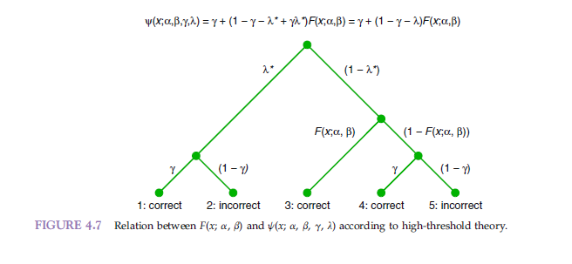
Types of answer

Slide 28

Commonly used form
Lapse can occur in guessing as well
We use λ = λ*(1 – γ)
λ – Probability that subject makes an error
λ*- motoric mistake
If participant would sneeze every 10th trial in 2AFC: λ = 0.1(1 – 0.5) = 0.05

Slide 29
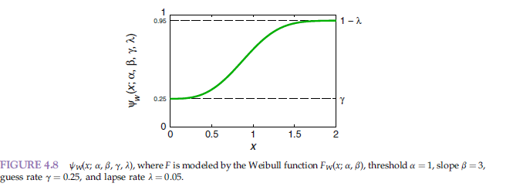
Fit PF with respect to the parameters
1-λ is upper asymptote, γ is lower asymptote

Slide 30
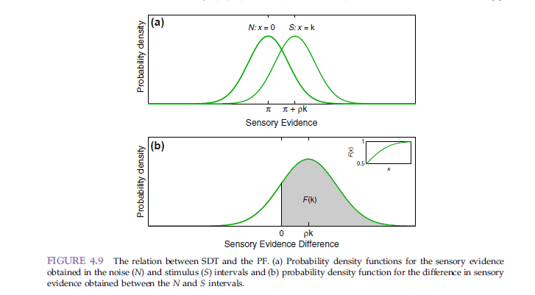
PF in Signal detection theory
There is no fixed threshold in SDT
Every repetition, we randomly select from N and S distribution and select the larger number
Difference is also normally distributed

Slide 31
PF in SDT
Observer never guesses!
Function formula makes sense in SDT but γ has different meaning
Nowadays, mainly SDT is used, but we use guessing rate from HTT
Thus the correct formulation would be: The amount of sensory evidence accumulated while sampling from the signal presentation happened to exceed the amount of sensory evidence accumulated while sampling from the noise presentation
But we say: Observer correctly guessed the answer.

Slide 32

Which function can we use
We can use multiple functions for F(x; α,β)
Cumulative normal function
Logistic function
Weibull function
Gumbel
Quick/Log-Quick
Hyperbolic Secant
Our own..

Slide 33

Cumulative normal function
Makes sense according to theory
α – corresponds to threshold (F_{N}(x = α; α, β) = 0.5
β – corresponds to slope
If x=0 would mean absence of the signal, we can use that, if x is log transformed
No closed form on integral

Slide 34

Logistic function
α – corresponds to threshold (F_{L}(x = α; α, β) = 0.5
β – corresponds to slope
Is an approximation of CNF (β_{L}≈ 1.7/β_{N})
There is closed form formula of the integral
Again problem with x=0

Slide 35
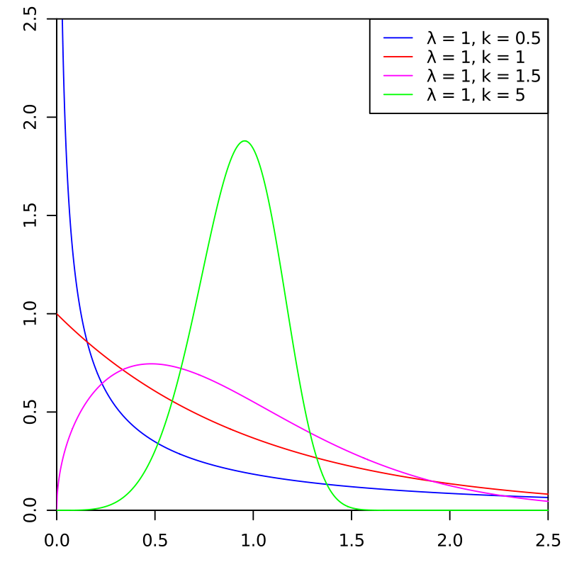


Weibullova a Gumbel funkce
Weibull
α – corresponds to threshold (F_{W}(x = α; α, β) = 1-exp(-1) ≈ 0.6321
β – corresponds to slope (but it also depends on α) changes in α lead to changes in slope, even when β is constant
Can’t be used for log scale (x ≥ 0)
Gumbel (log-Weibull)
Like weibull Weibull, but on log škále

Slide 36
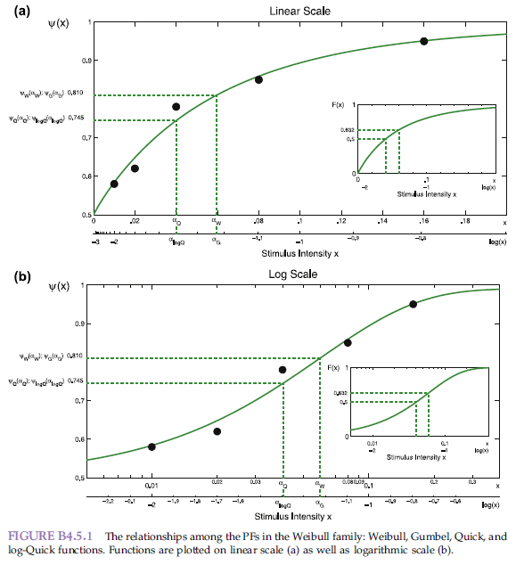


Quick a Log-Quick
Quick
Here is threshold=0.5
Log-Quick
Log version of quick function

Slide 37
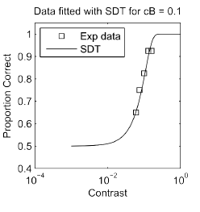

Own function
When we have correct theory, we do not need to approximate the relationship

Slide 38
PF and variance
Because β is not comparable between functions (β=2 in CNF means much steeper slope than β=2 in Logistic)
We take the range of data, where, defined data lives

Slide 39
How to fit data with curve?
Maximum likelihood estimate (MLE)
Likelihood: P(data|θ), where θ are free parameters
We are trying to explain data with appropriate model
Example:
We flipped a coind and we got a sequence of HTHHTTHTHHH
We are interested in P(H) or in another words P(X=0) = P(H) = a

Slide 40
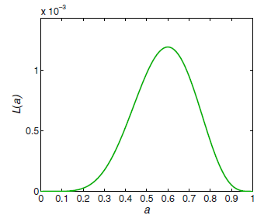

Example – cont’d
Likelihood in this case
Because p(y_{k}=H|a) = a, p(y_{k}=T|a) = 1 – a
For specific a=0.4 we get L(a|y) ≈ 0.0005
We compute that for all a, we get a distribution, from which we take the maximum
How should we do „ compute that for all a“

Slide 41
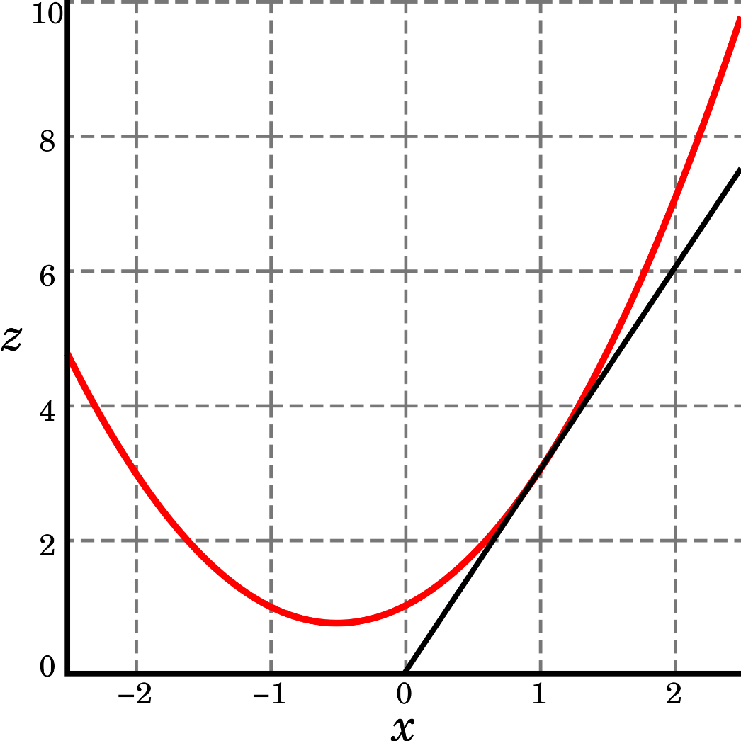


We use following trick
Likelihood uses multiplication
We can take logarithm, which uses addition instead
By taking a first derivative and solving an equation =0, we can get extreme analytically

Slide 42
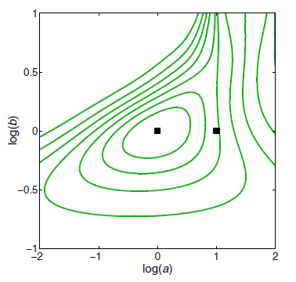
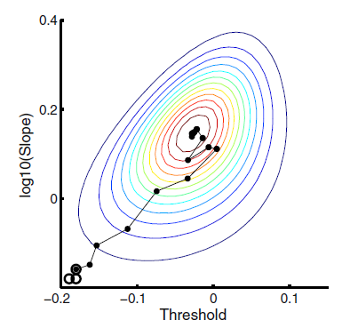
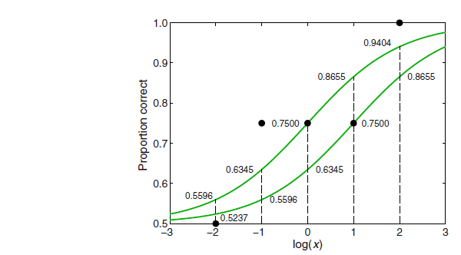
MLE using numeric optimalization
Unfortunately, most of the equations could not be solved analytically, so we use numerical approximation instead (as Nelder-Mead alg.)

Slide 43
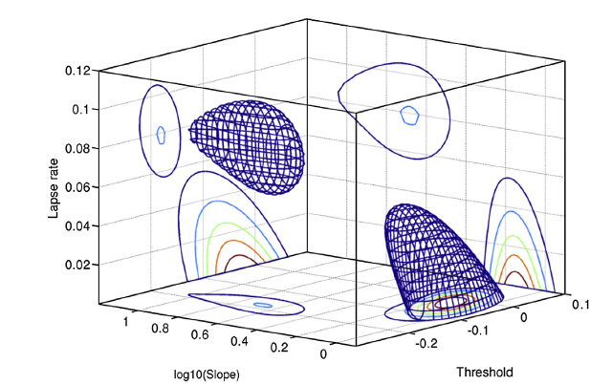
Lapse rate as free parameter
Guessing rate is not estimated (known from design)
Lapse rate can be fixed as well or it can be added as free parameter
It is an open question what is better

Slide 44
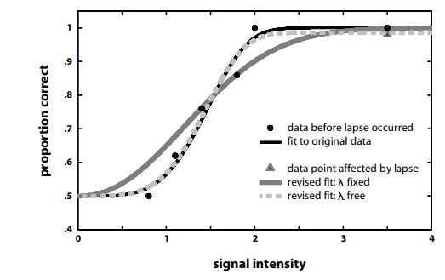

Effect of lapse rate on fit
Lapse rate changes data in asymptote
Alternative:

Slide 45
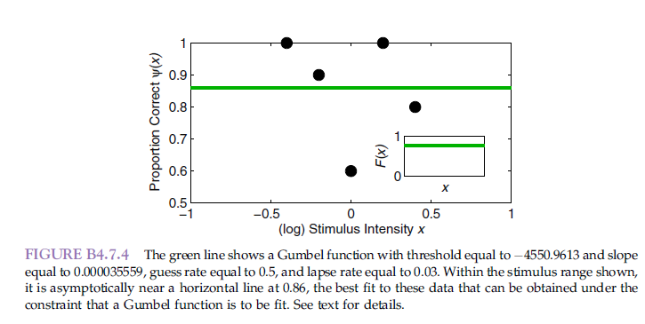
When fit breaks down
It is important to have properly selected levels of stimulus

