Slide 1
Data
Forward
y
Model
x
y'
計算 Loss
Backward

Slide 2
Data
Forward
Magic
Model
x
y'
Loss
Backward

Slide 7

y'
簡單、大量
Activation
Function
Linear Layer
x

Slide 8



CPU
GPU
VS

Slide 9
y'
Activation
Function
Linear Layer
x

Slide 10


y'
Activation
Function
Linear Layer
x

Slide 11

y'
y'
Layer
Deeper
$$⋮$$
x
x

Slide 12
y'
$$⋮$$
Better
Deeper
x

Slide 13
y'
？
$$⋮$$
Deeper
Better
x

Slide 15
Out channel=2
In channel=3

Slide 16
stride=1
stride=2

Slide 17
padding

Slide 18
1
2
0
3
5
1
0
4
1
2
1
0
3
1
7
0
2
0
7
5
8
1
4
2
3
1
8
9
6
0
2
7
9
2
1
3
4
2
0
4

Slide 19
Train
Z
G
Fake
D
Real Data
Real

Slide 20
Train
Real
Z
G
D
Fake

Slide 22
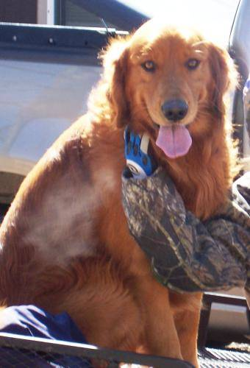
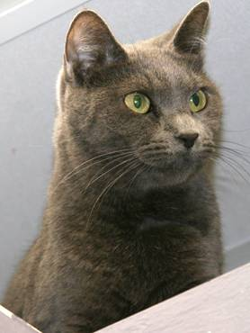
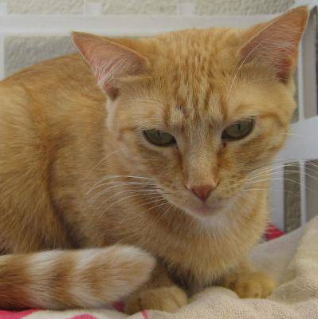
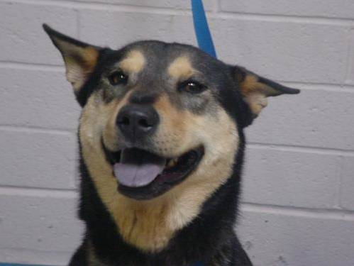
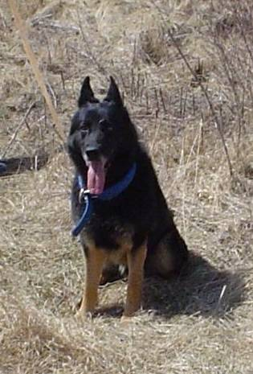
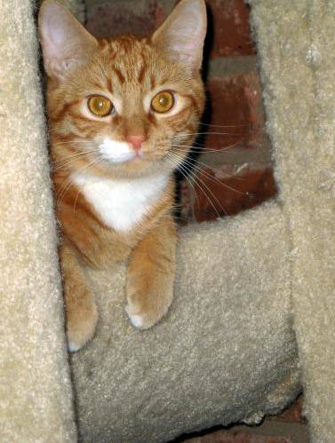
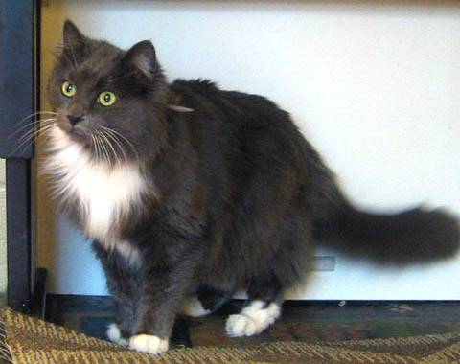
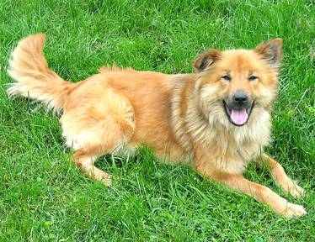
「Dog」
「 Cat 」

Slide 23
Group 1
Group 2

Slide 24
Group 1
Group 2

