Slide 1
Health & Emotion Tracker
CSPB 3308 Software Development Methods and Tools – Spring 2026 – Team 6
Carl Seaholm, Conner Mongoven, Ledy De La Rosa, Linda MacCagnan, Stephanie Gillihan

Slide 2
Project Overview
Background/Motivation
Architecture
Emotional well being is a vital component of overall health
The application allows users to easily track their mood and its intensity.
Tracking moods and mood intensities can promote self awareness and personal growth
Frontend: React, NextAuth, Mantine, Tailwind CSS, TypeScript
Backend: Next.js, Prisma
Database: PostgreSQL via Supabase
Deployment: Vercel
Documentation/Planning: GitHub

Slide 3
Team Responsibilities Overview
Carl: Responsible for overall app configuration, mobile/desktop optimization, hosting configuration, proxy setup, navigation and UI help, Repo and project board maintenance, running weekly meeting, general project organization
Connor: Responsible for the home page and the reports page. The home page supports site navigation and provides information about the app. The reports page allows a user to view mood trends over time.
Ledy: Responsible for user registration and the user profile page where users can view and edit aspects of their profile.
Linda: Responsible for the data fetching and passing components to ensure data flows correctly from the database to each page. Responsible for color scheme for the application.
Stephanie: Responsible for tracking page, where the user can create, edit, or delete a mood log, as well as view a list of all logged moods.

Slide 4
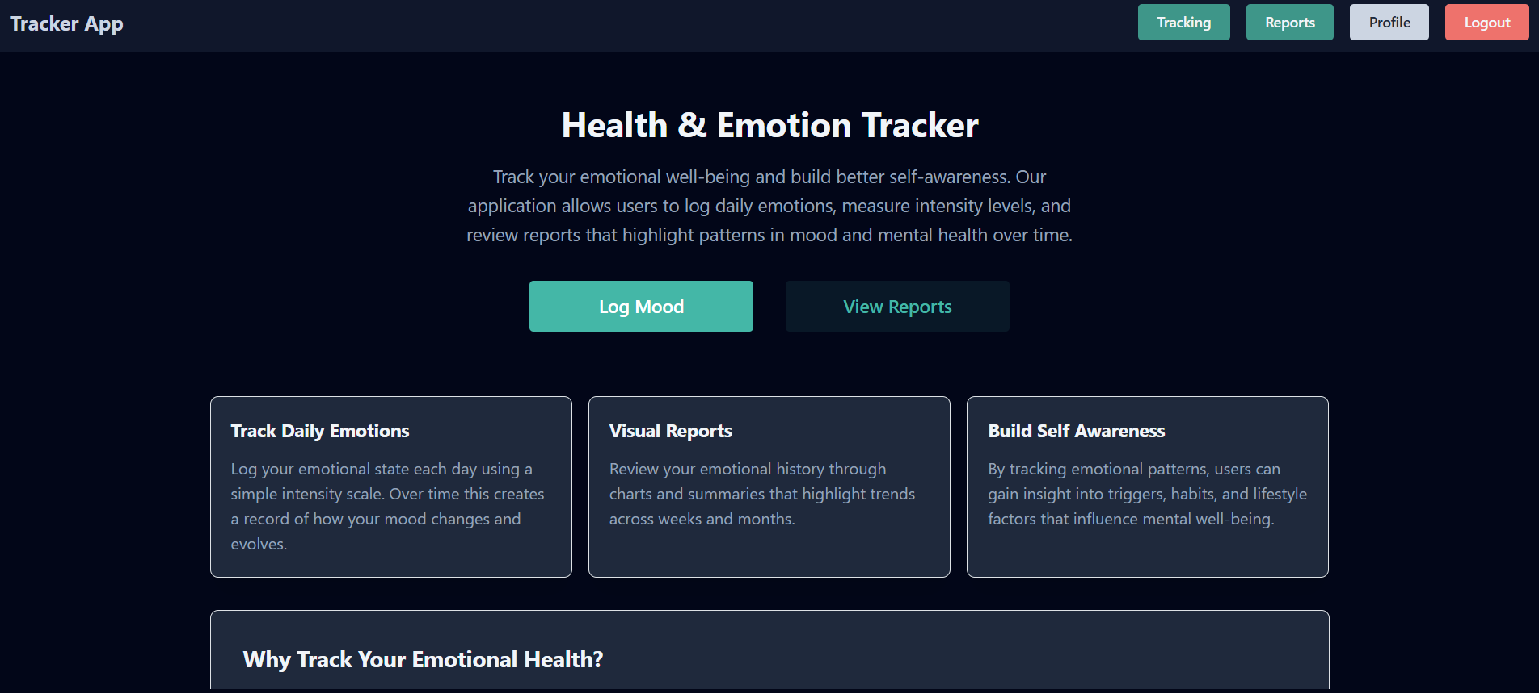
Home Page
The system checks whether a user is logged in and adjusts the UI accordingly
Logged in users can access mood tracking or reports. When no login is detected, the user is prompted to login or register
Aside from the mood logging modal window, the page is primarily informational, with static content designed to introduce the application

Slide 5
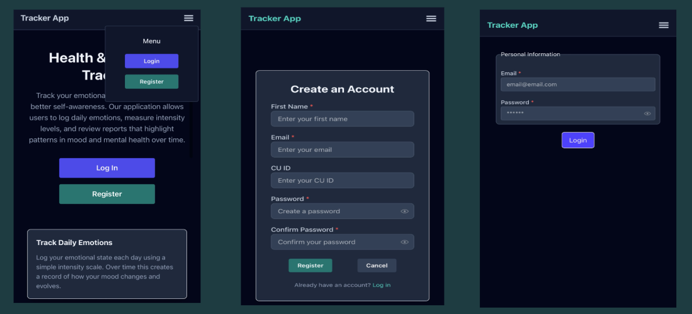
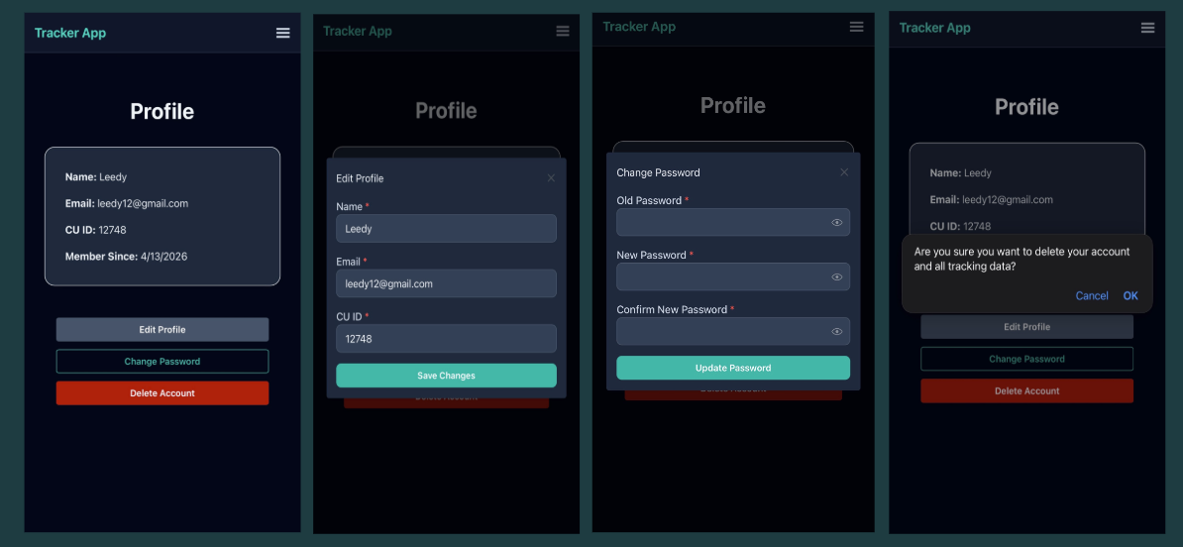
User Registration and Profile Page
The system securely verifies the user and loads all necessary data before displaying the profile. If anything fails, user is redirected to login
Account actions (edit, change password, delete) are located in a dedicated action panel
Updates are handled through modal workflows
Account deletion is comprehensive, ensuring all associated user data is fully removed

Slide 6
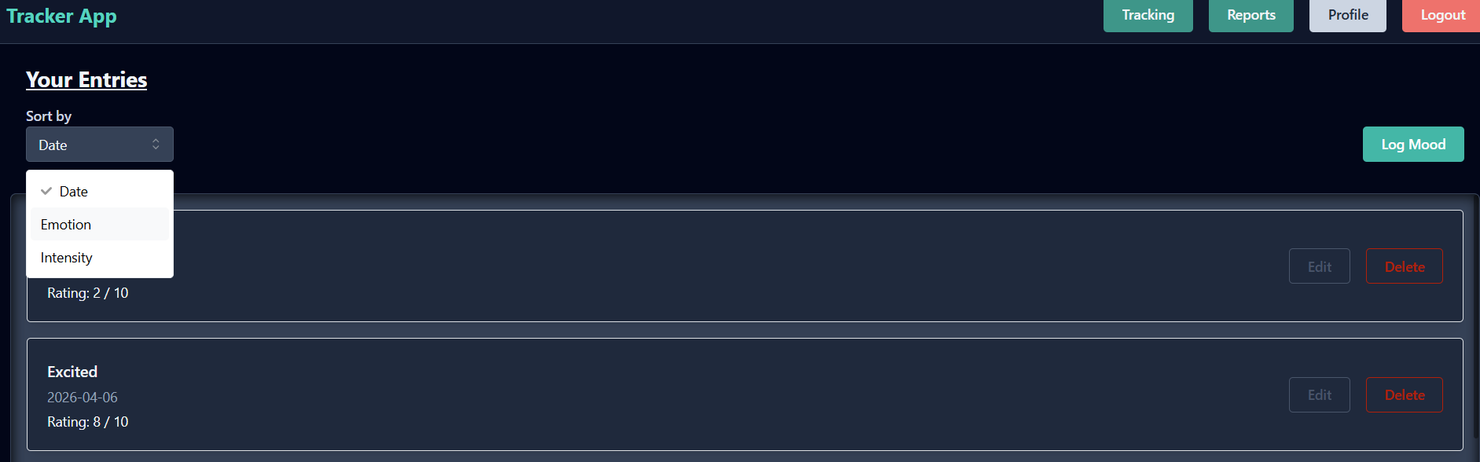
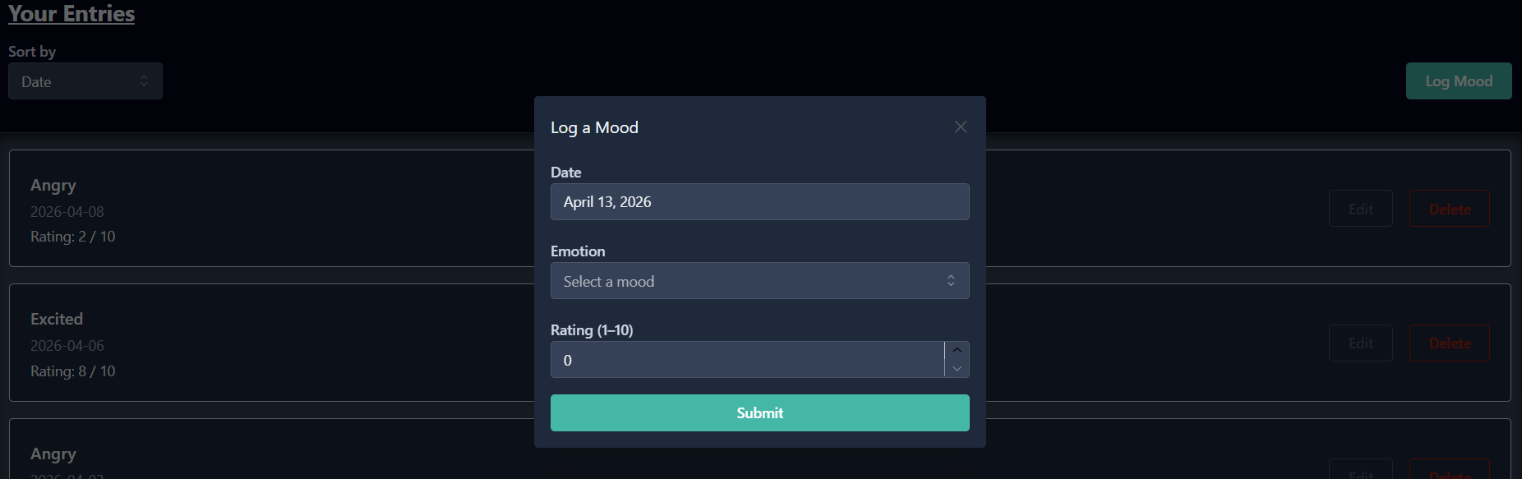
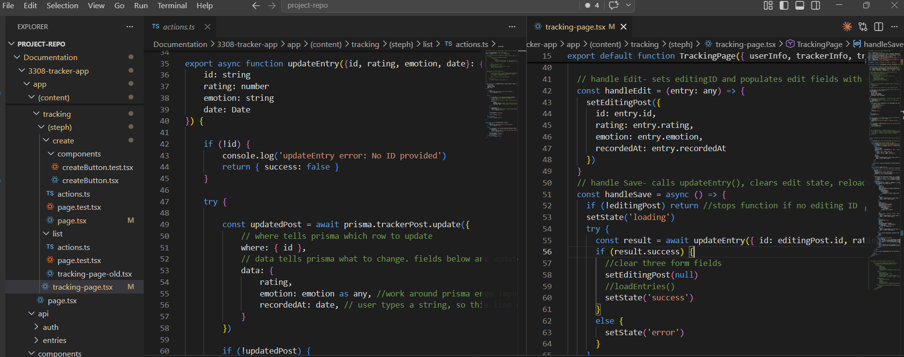
Mood Tracking Page
The system securely loads each user’s tracking data before displaying the page
Users can log new moods, editing existing entries, or delete entries
The interface supports new mood logging with a modal interface, and supports inline editing
The list of moods is sortable by date, mood, or intensity
Updates are processed in the background, with refreshed data on next page load

Slide 7
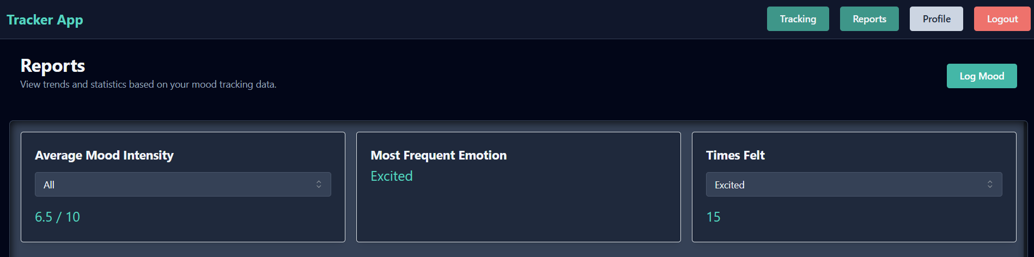
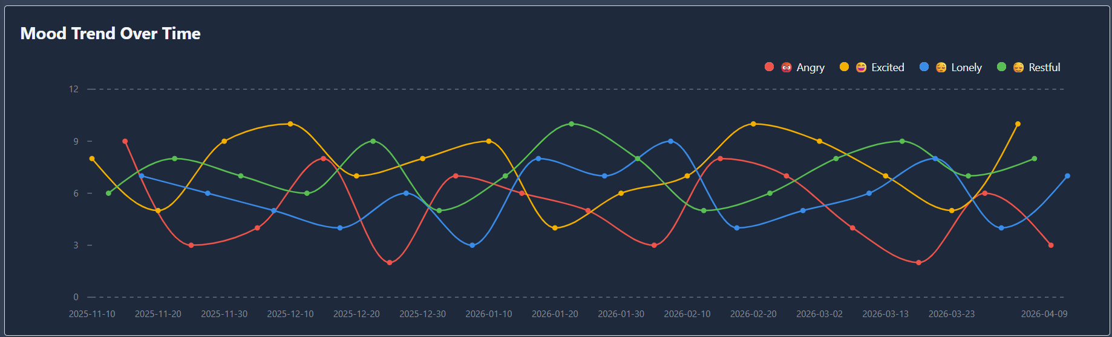
Reports Page
The system securely loads the user’s data to generate personalized insights and a graph
Key metrics (average intensity, most frequent emotion) provide quick insight
Data is visualized on a graph in clear chronological order, with different colors for each emotion
The page is primarily read-only, focused on user analysis

Slide 8
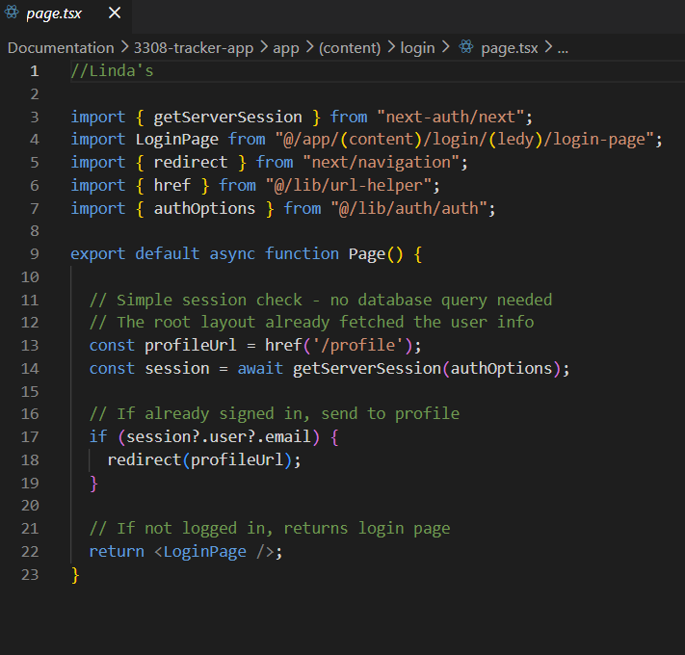
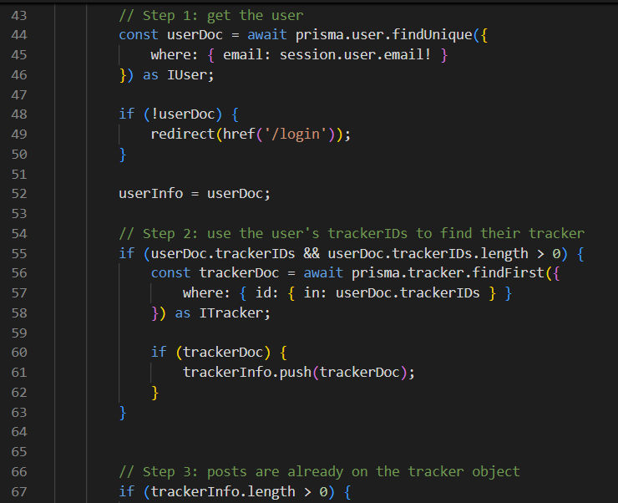
Data Fetching and Passing
All data is fetched securely on the server before the page loads
Consistent flow across pages: session → user → related data
Data is passed down to the UI as props
One way data flow keeps the system simple and predictable
Always-fresh data on each request (no caching)

Slide 9
Challenges Encountered
Honing in on the initial schemas for the app
Ensuring each piece expanded on chosen schemas and utilized the query structure to make sure schemas were used and robust as well as efficient
Time management
Coding and other technical aspects were challenging for beginners
Division of roles
Siloed folder structures

Slide 10
Team Dynamics
What went well:
What did not go well:
Variety of skill sets and strengths
Adding an additional team member after the project began
Everyone was willing to work together and help each other out
Everyone was willing to learn new things and tackle challenging tasks
All Milestones were turned in on time
Collaboration
In the beginning, ideas were closely aligned. Once implementation began, there were many subtle differences that needed to be worked out.
Team could have spent more time at the beginning clarifying vision, requirements, and outcomes
Feedback after a lot of work was already done was at times frustrating
Communication and planning in general

Slide 11
Evaluation of the application
Clean UI and has a lot of potential
Tools and stack used were very effective
Limited in current capacity, but potentially more useful if expanded to include additional moods and additional metrics

Slide 12
Future Direction of the Application
Add additional moods for more robust logging
Modify reports page to allow users to filter by time period (from date to date)
Add additional databases for tracking other health components: water consumption, nutrition, physical activity, and sleep.

Slide 13
Project Demonstration Flow
User login
Log a mood
View Profile page
View Tracking Page
Edit an entry
Delete an entry
View Reports page
Log out

