Slide 1



Slide 2
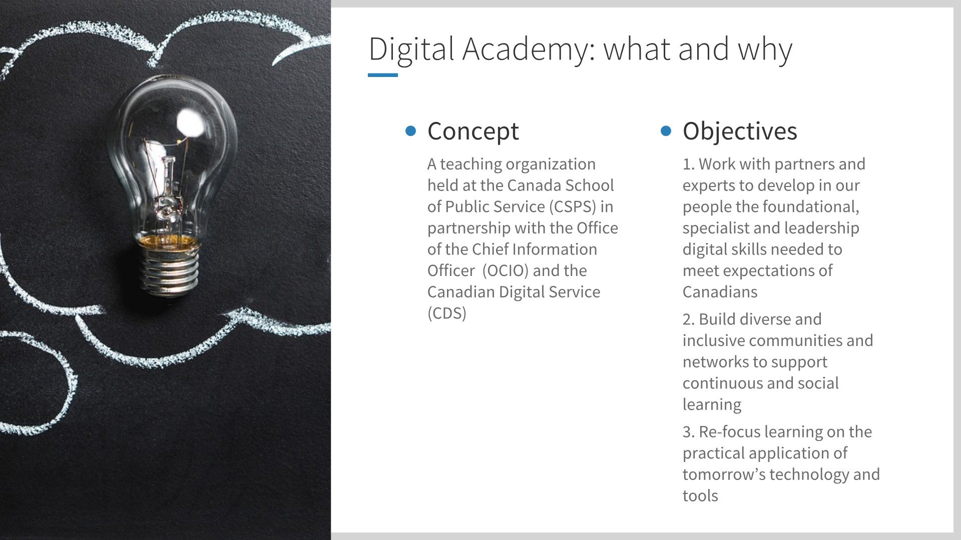
2

Slide 3





Digital academy: overview
Premium to build organizational capacity
Digital open learning
for any public servant
Leadership to lead and implement digital transformation
Digital Academy
Certification and aftercare to provide access to tools and communities
Practicum to connect leaders and practitioners around problems
3

Slide 4
Digital academy: update
Premium to build organizational capacity
Prototype AI, Data, and Design cohorts launched January/February
Prototype DevOps cohort launched in April
Digital open learning
for any public servant
Building to a critical mass throughout 2019
1,000+ reached through busrides.ca
Leadership to lead and implement digital transformation
Prototype Leadership cohort launched in March
Digital Academy
Certification and aftercare to provide access to tools and communities
Onboarding 5 external and 10 internal Fellows and building the team
Practicum to connect leaders and practitioners around problems
Scheduled for May 4-26
4

Slide 5
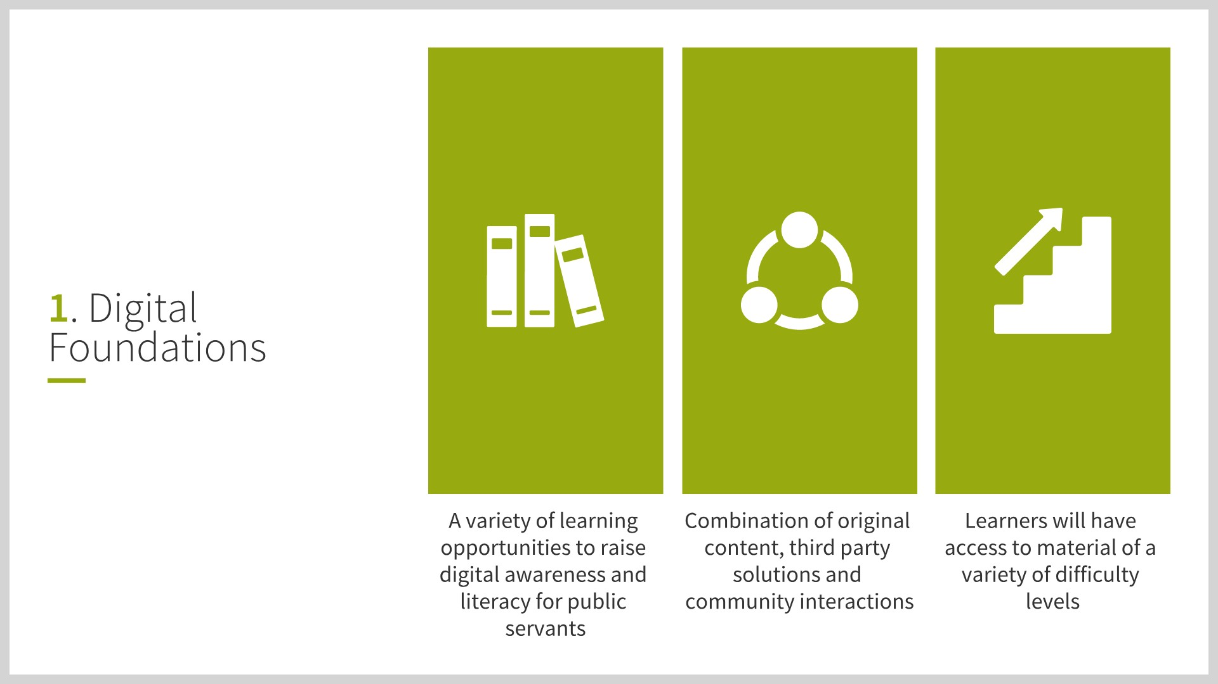
5

Slide 6
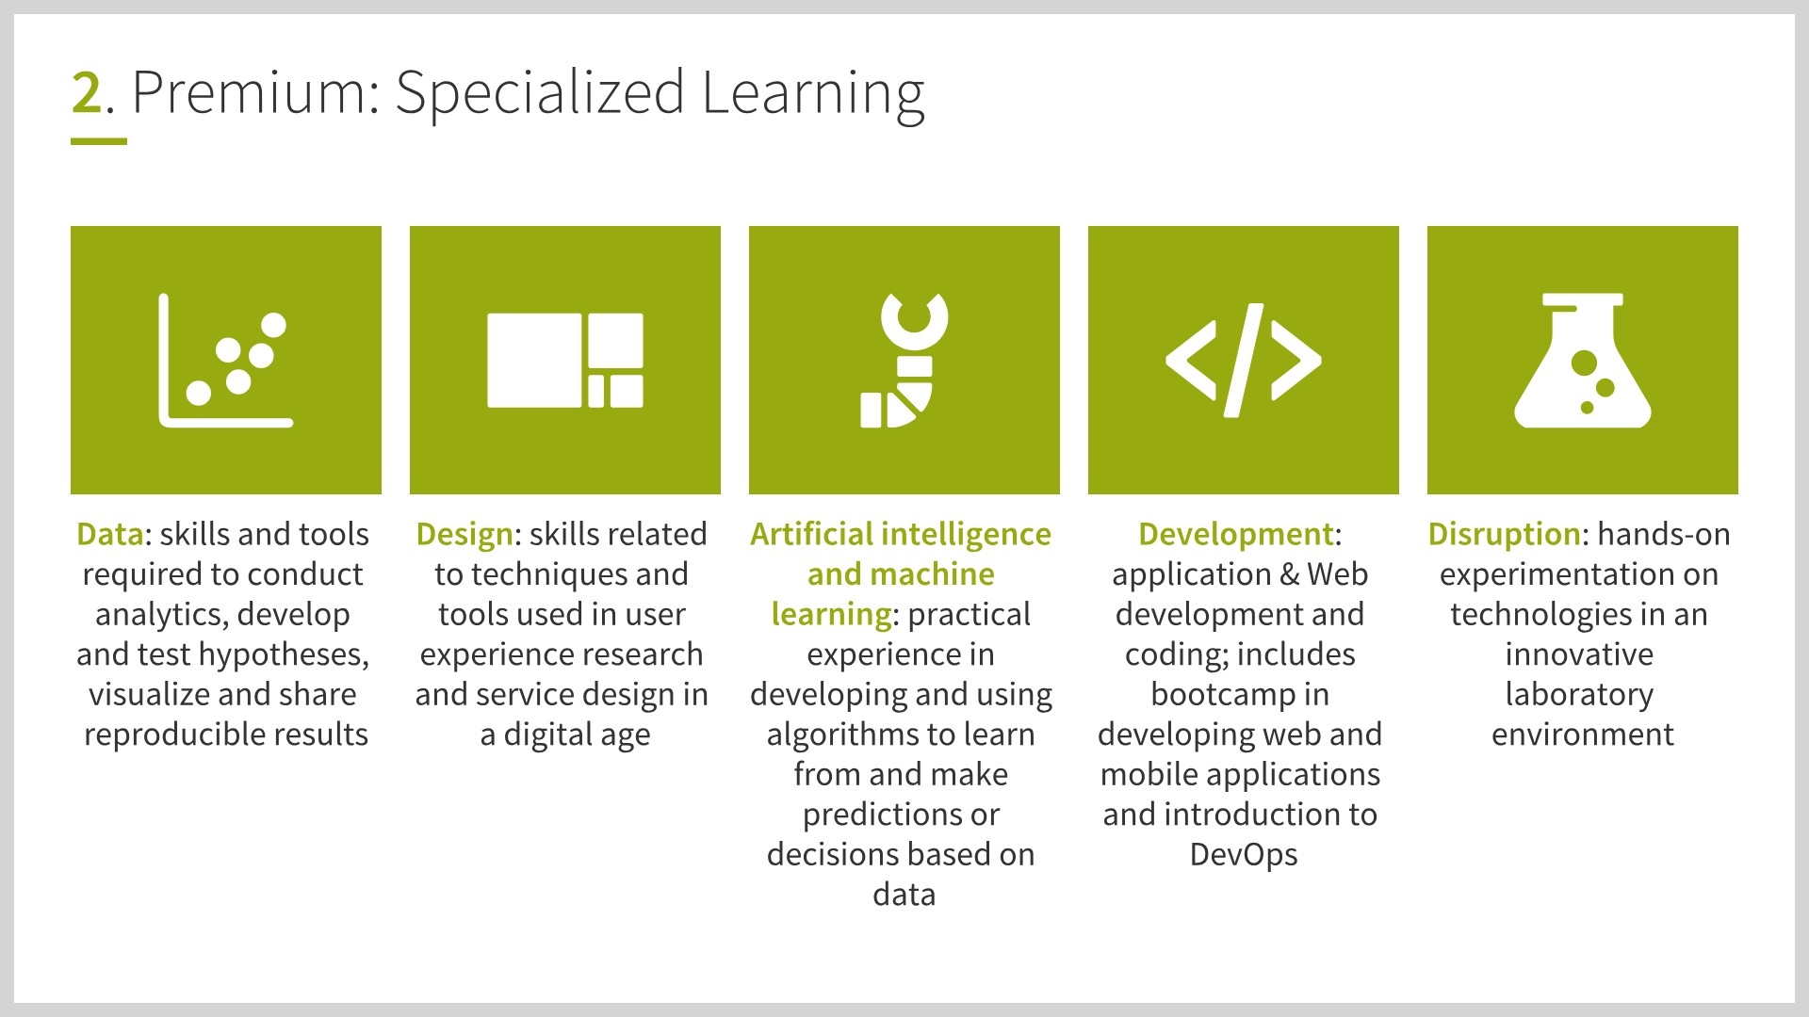
6

Slide 7
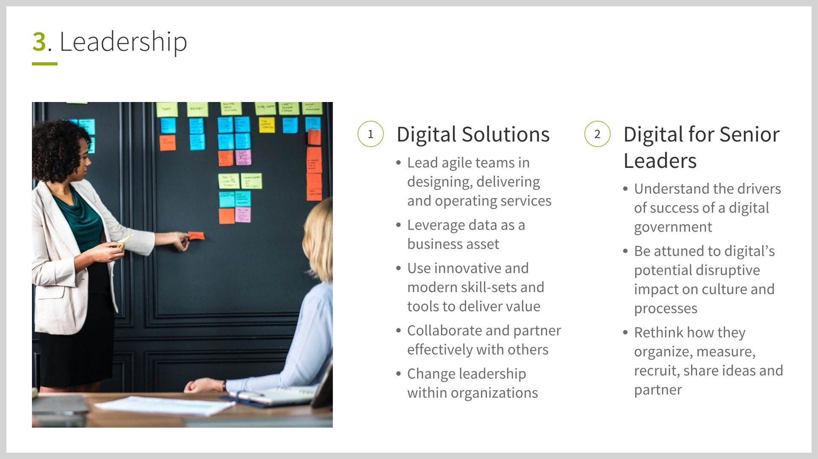
7

Slide 8
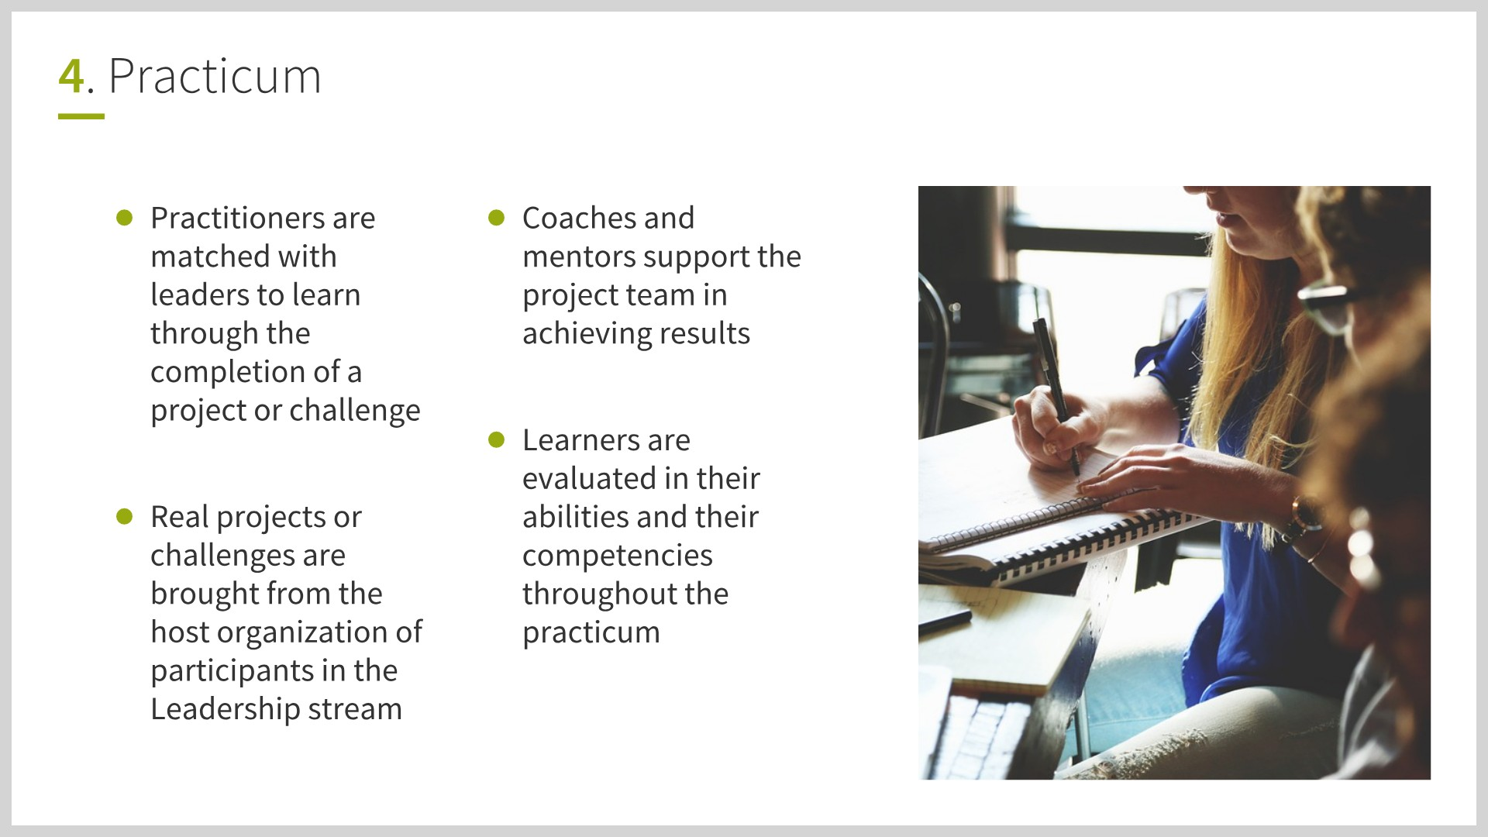
9

Slide 9
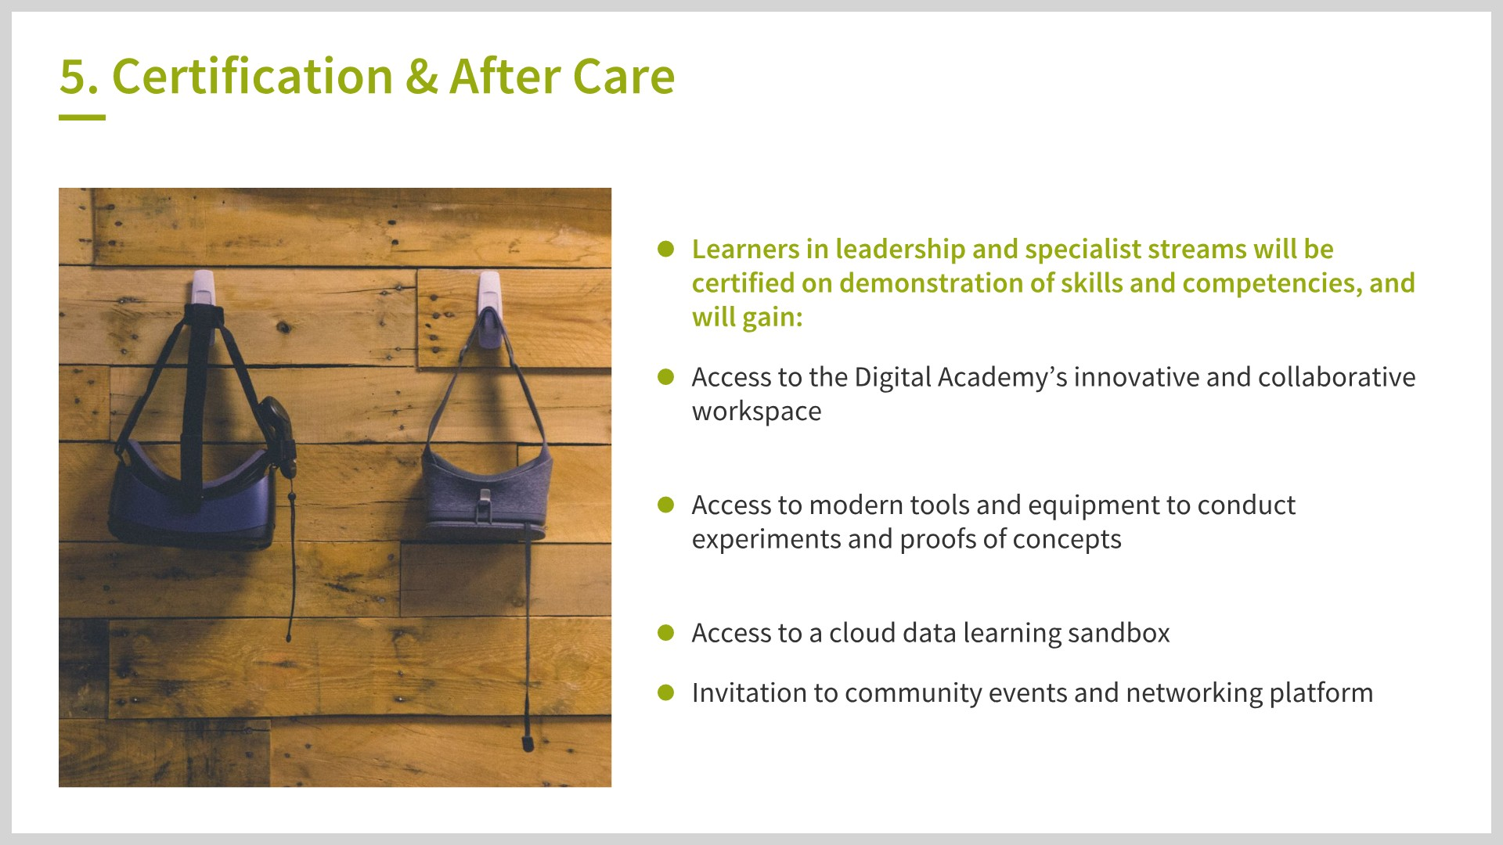
10

Slide 10
Digital academy: timeline
Leadership stream launch
March 28
Practicum starts
May 6
Digital Open Learning
Building to critical mass throughout 2019
Now
Summer
2019
DevOps stream launch
April 4
Evaluate, iterate, and launch second cohorts
June-July
Specialist and leadership capacity for 200-300 learners in 2019 (~15 per stream per cohort)
Scale through partnerships to reach up to 1,000+ in-depth learners per year
Reach through Digital Open Learning to reach 10k-100k+ public servants
11

Slide 11
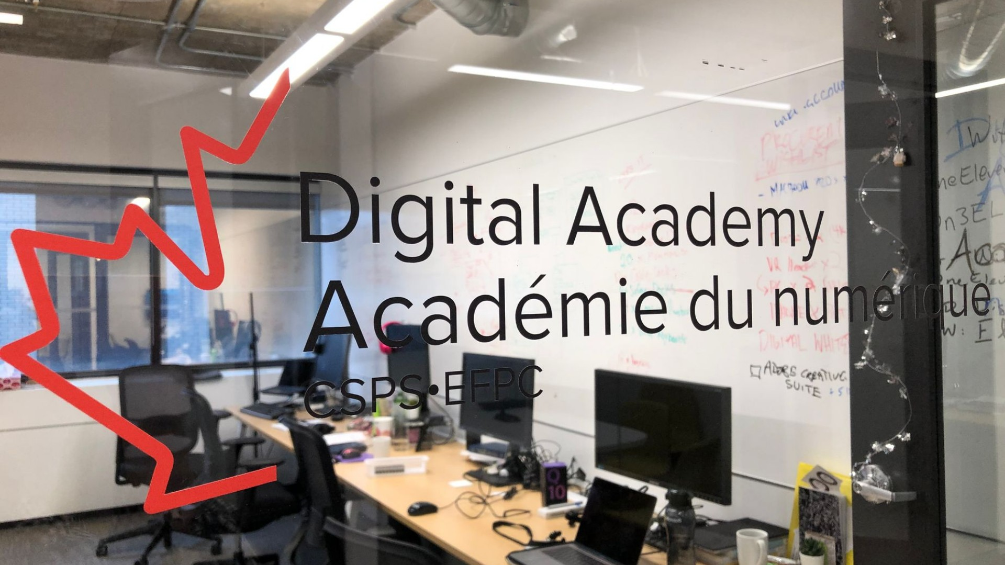

Slide 12
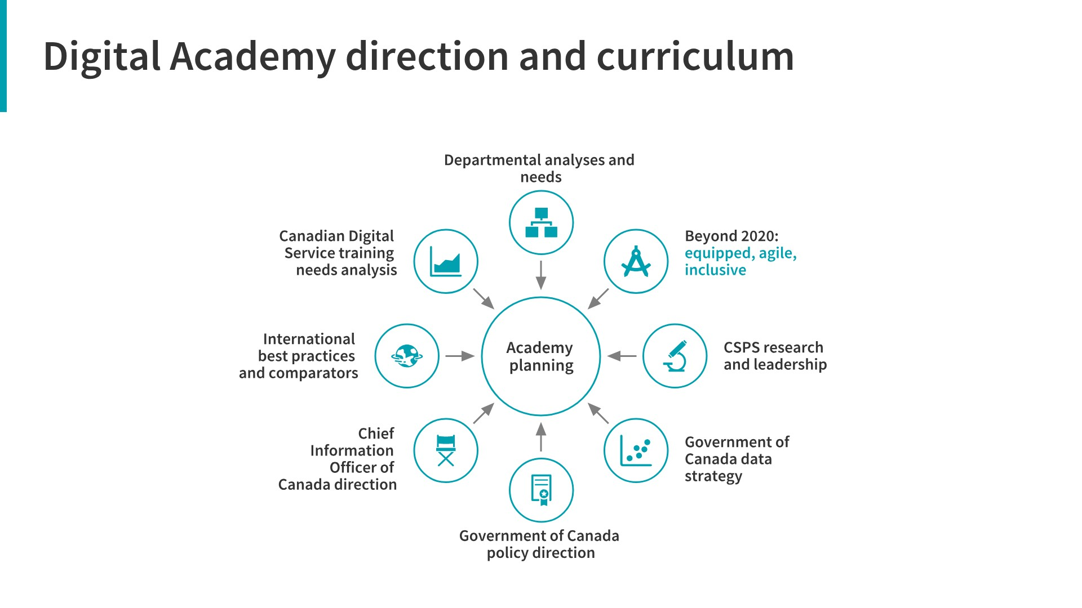

Slide 13
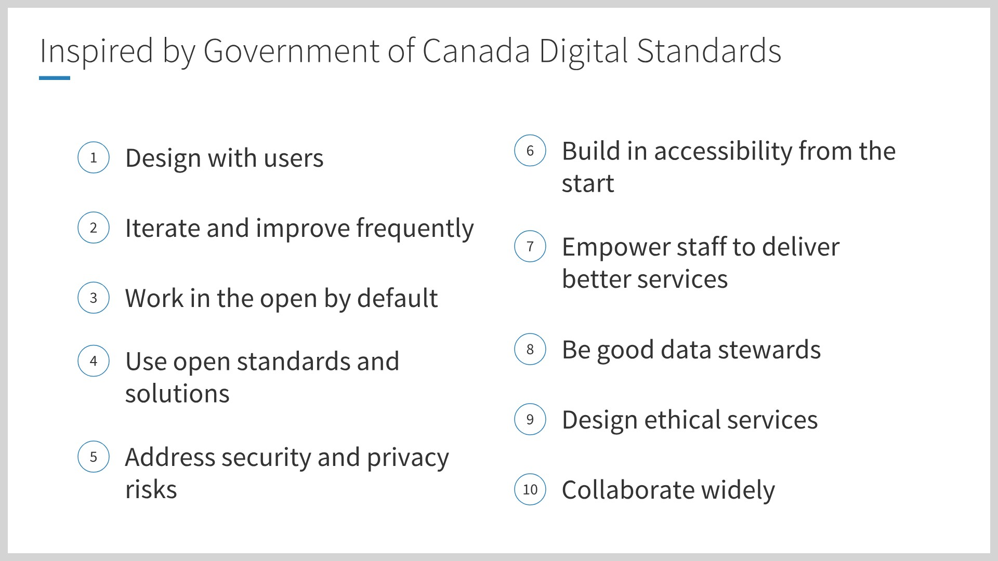

Slide 14
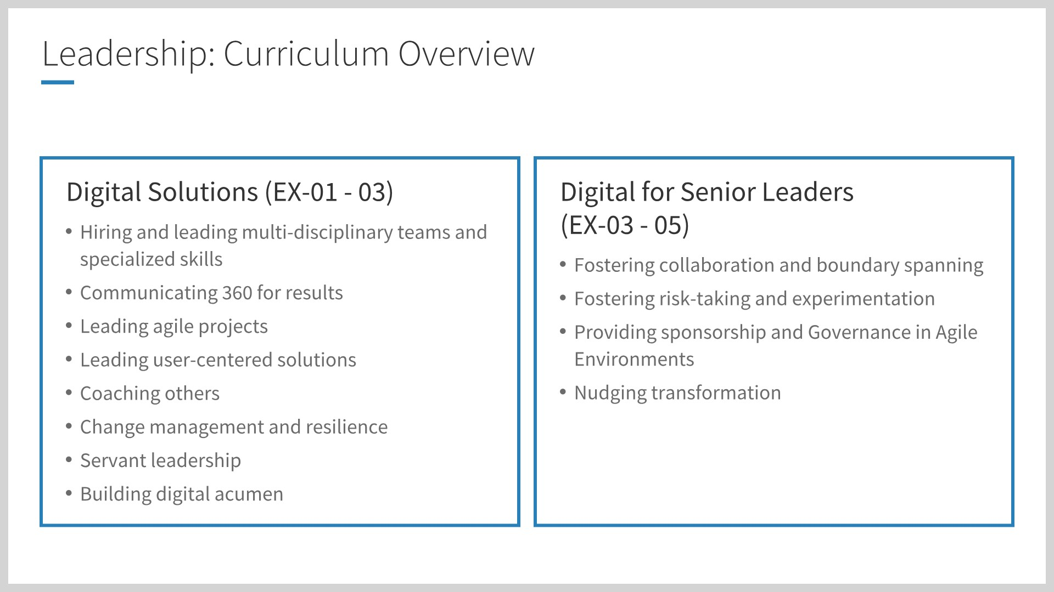
8

Slide 15
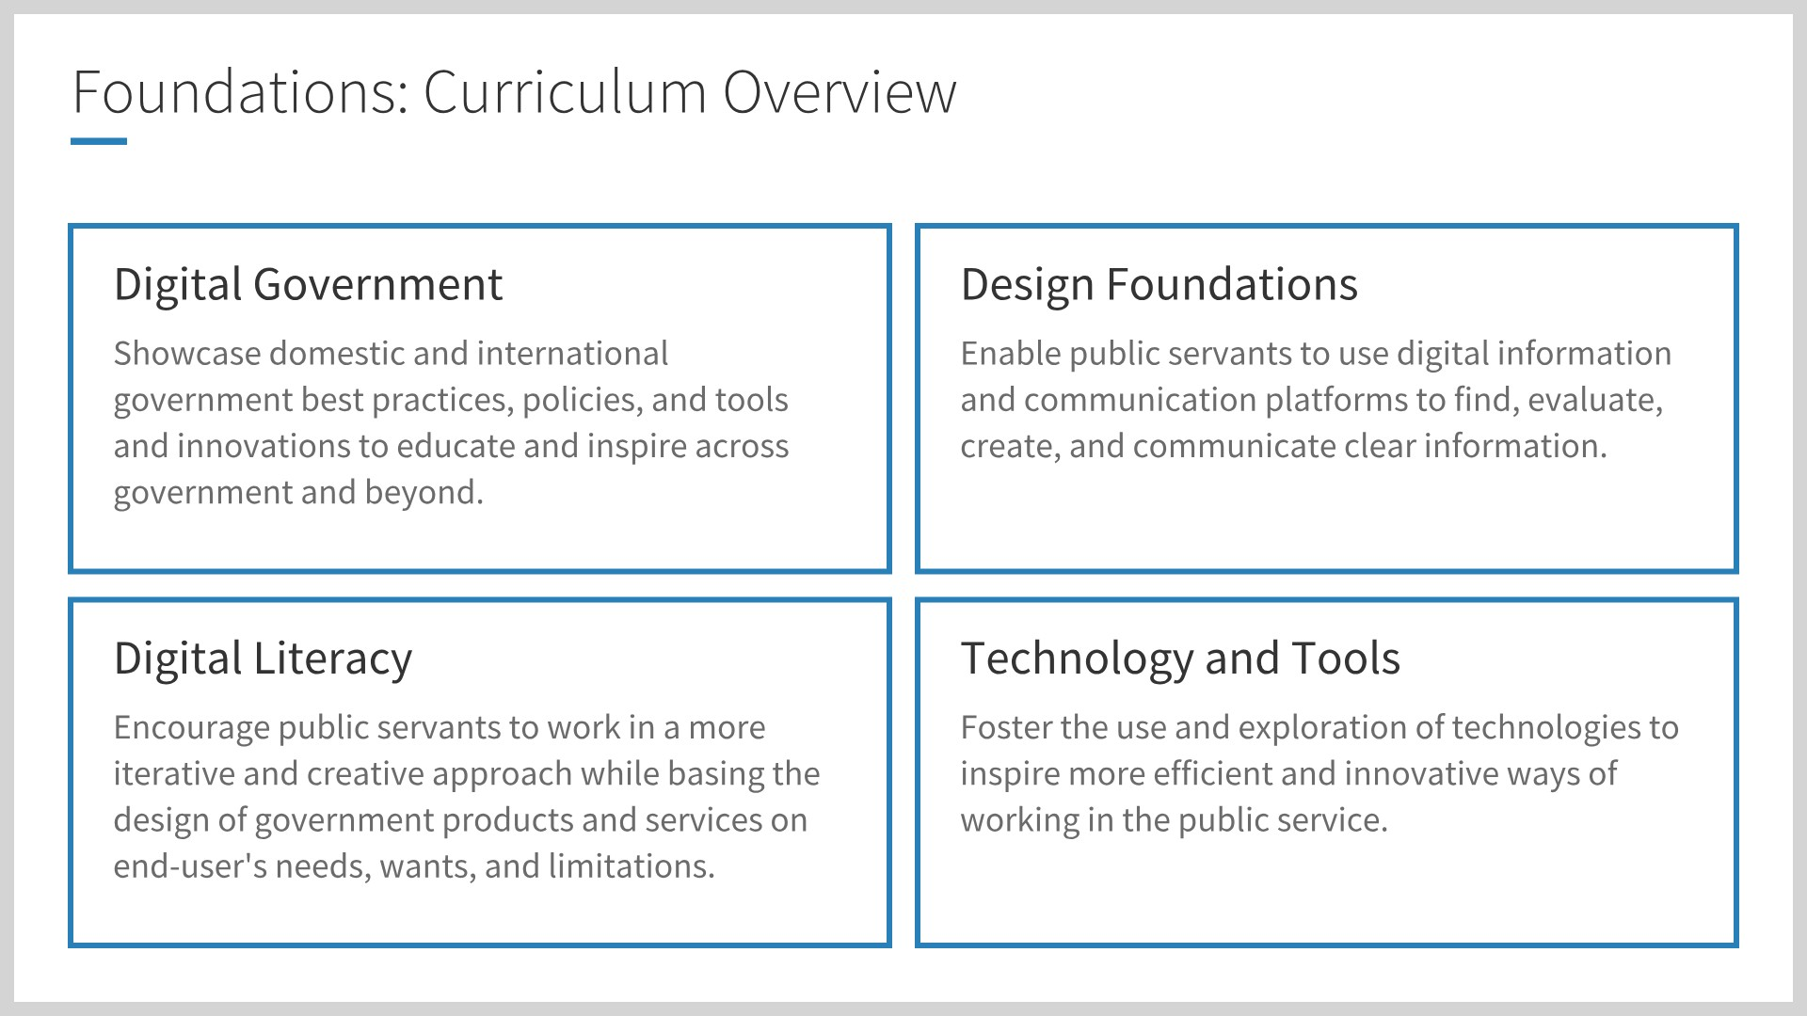

Slide 16
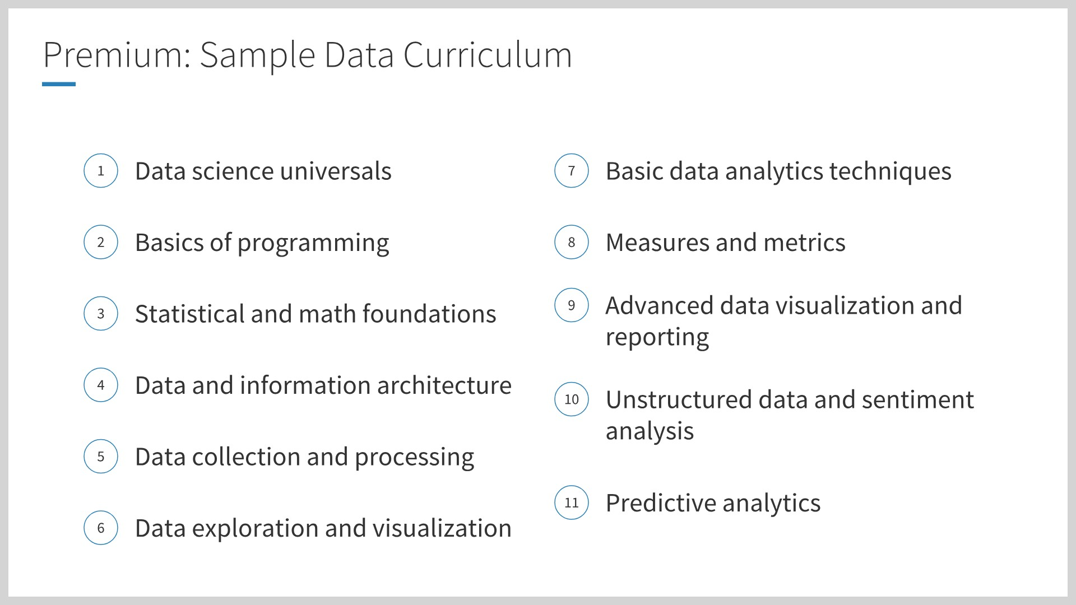

Slide 17
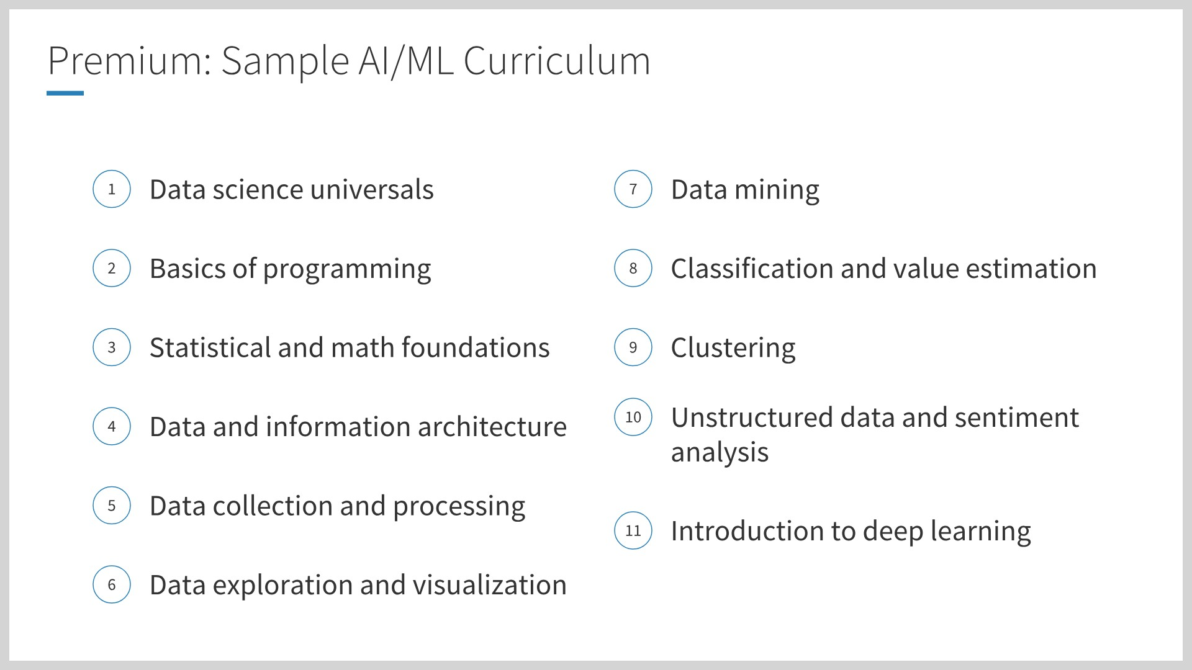

Slide 18
