Slide 1

Envisioning Review

Slide 2
Project Envisioning Report - Group 23
Andrew Sansum (ajs2g20@soton.ac.uk)
Patrik-Tibor Csanyi (ptc1g20@soton.ac.uk)
Guillaume Comet-Vernet (gcv1u20@soton.ac.uk)
Madhav Muralikrishnan (mkm1g20@soton.ac.uk)
Adam Clarke (ac4g20@soton.ac.uk)
David Stefanov (ds1u20@soton.ac.uk)

Slide 3
Stakeholder Analysis
Primary Stakeholders
Qualified Calculators
Secondary Stakeholders
Air Traffic Control
Airport Operations Manager
Civilian Aviation Authority
Pilots
Tertiary Stakeholders
Airline Companies
Passengers

Slide 4

Example: Qualified Calculators
Qualified Calculators
Description
Qualified calculators are members of Air Traffic Control that are qualified to recalculate the
declared distances of a runway in the event of an obstacle.
Reason for classification
These will be the primary users of the tool; they will use it to estimate the values so that airport
management can make a decision and ATC can inform pilots. They have the largest influence over
the design and will be the most affected by the final product.

Slide 5

Personas
2 Air Traffic Controllers
1 Qualified Calculator
1 Civil Aviation Authority Employee
1 Airport Operations Manager
1 Pilot

Slide 6

Example: Qualified Calculators
Gemma is a 55-year-old colour-blind woman who works as an independent calculator to verify the runway parameters specified by the Civil Aviation Authority (CAA). As a colour-blind woman, she often finds it difficult to see certain colours which results in her using certain applications wrong. She highly appreciates when an application considers colour-blindness. As a calculator, Gemma has very strong problem-solving skills and has been doing her job for a very long time. She is not very tech-savvy and her job doesn’t require the use of complicated technology. She has a good relationship with other calculators as she spends a lot of time working with them and has developed good communication skills. Gemma often finds herself wanting to double-check her answers so she is hoping for software in the future that can do this.

Slide 7
User Stories
Airport Operations Manager
Qualified Calculators
Air Traffic Control
Pilot
Civil Aviation Authority

Slide 8
Example: Qualified Calculators
I want to be able to visualise the obstacles from above and from the side So that I can check the accuracy of the obstacle shape compared to reality
I want the software to calculate the new runway length given 1 obstacle and parameters So that I do not have to have to manually calculate it every single time

Slide 9

Risk Analysis
Risk - A brief description of the risk
P - Probability of risk occurrence; rated from 1 (very unlikely) to 5
(almost certain)
S - Severity of risk occurrence in relation to project; rated from 1 (low
impact) to 5 (catastrophic)
RE - Overall risk value (Risk Exposure) where RE = P × S
Mitigation - Strategy to avoid or reduce the effect of the risk

Slide 10
Example: Risk Analysis
There is a change in requirements | 3 | 3 | 9 | Address the requirements change in the review meeting with the client and edit the user stories to match. These can then be planned into the next or future increments.

Slide 11
Burndown Chart
MoSCoW Prioritisation
Red: Must
Yellow: Should
Green: Could
Blue: Won’t

Slide 12
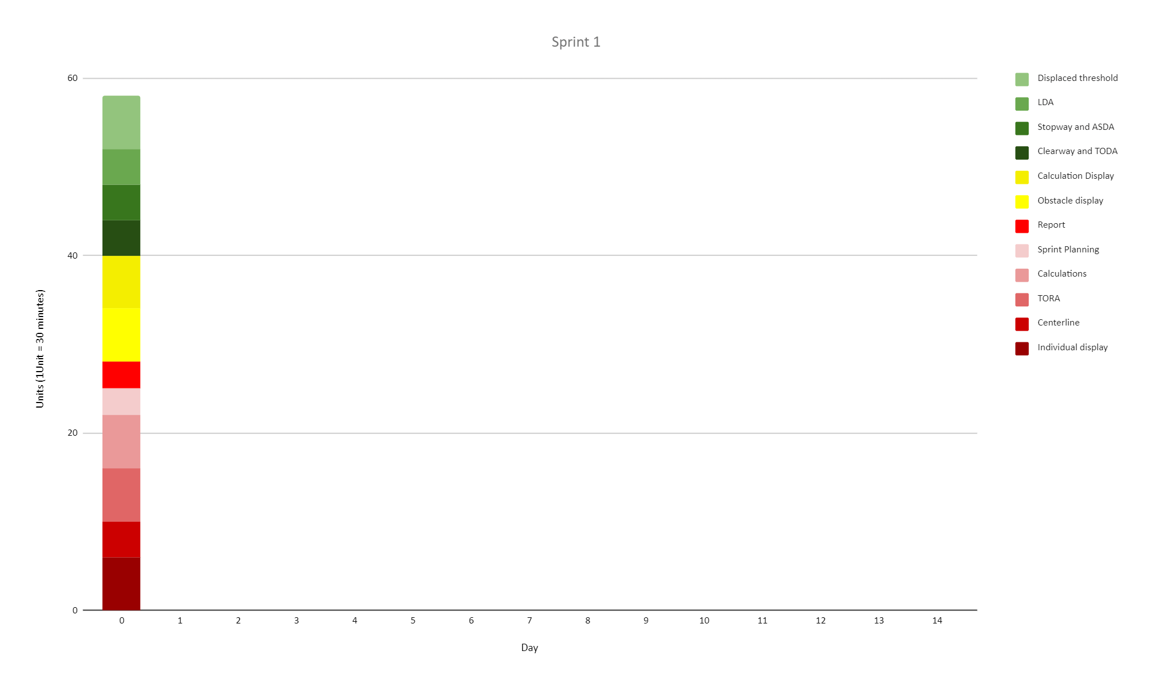
Example: Burndown Chart

Slide 13
Backlogs
Shared
Task ID
Name
Description
Estimated Difficulty
Actual Difficulty
Product Backlog
User Story
Increment
Sprint Backlog
Workforce
Date of finish

Slide 14
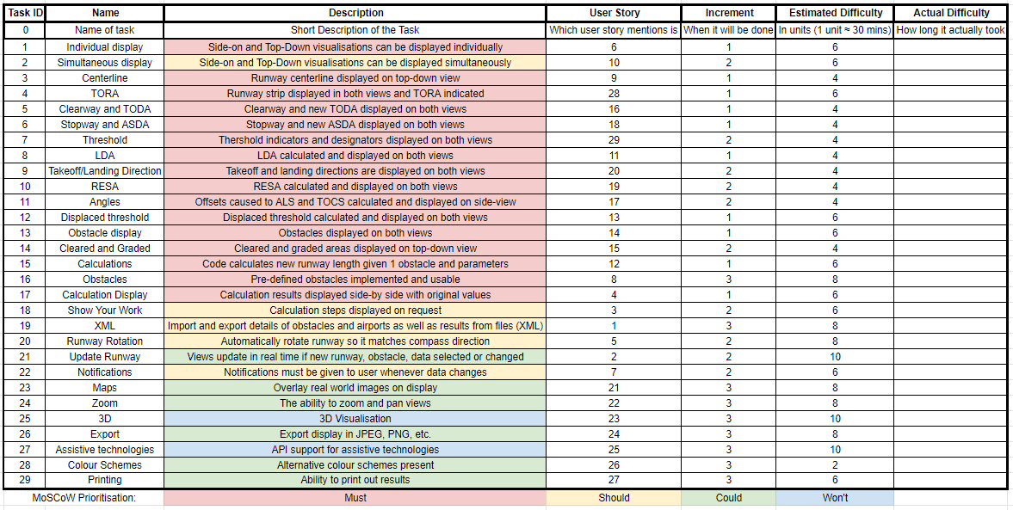
Example: Product Backlog

Slide 15
Tools Used
Communication
Discord
Planning
Google Drive
PlanningPoker.net
Trello
Programming
IDEs: IntelliJ, VSCode
GitLab
JavaFX
UML: LucidCharts
Maven

Slide 16

Thank You For Listening
Any Questions?

