Slide 1

Third Increment Review

Slide 2
Project Envisioning Report - Group 23
Andrew Sansum (ajs2g20@soton.ac.uk)
Patrik-Tibor Csanyi (ptc1g20@soton.ac.uk)
Guillaume Comet-Vernet (gcv1u20@soton.ac.uk)
Madhav Muralikrishnan (mkm1g20@soton.ac.uk)
Adam Clarke (ac4g20@soton.ac.uk)
David Stefanov (ds1u20@soton.ac.uk)

Slide 3
Diagrams
Class Diagram
Activity Diagram

Slide 4
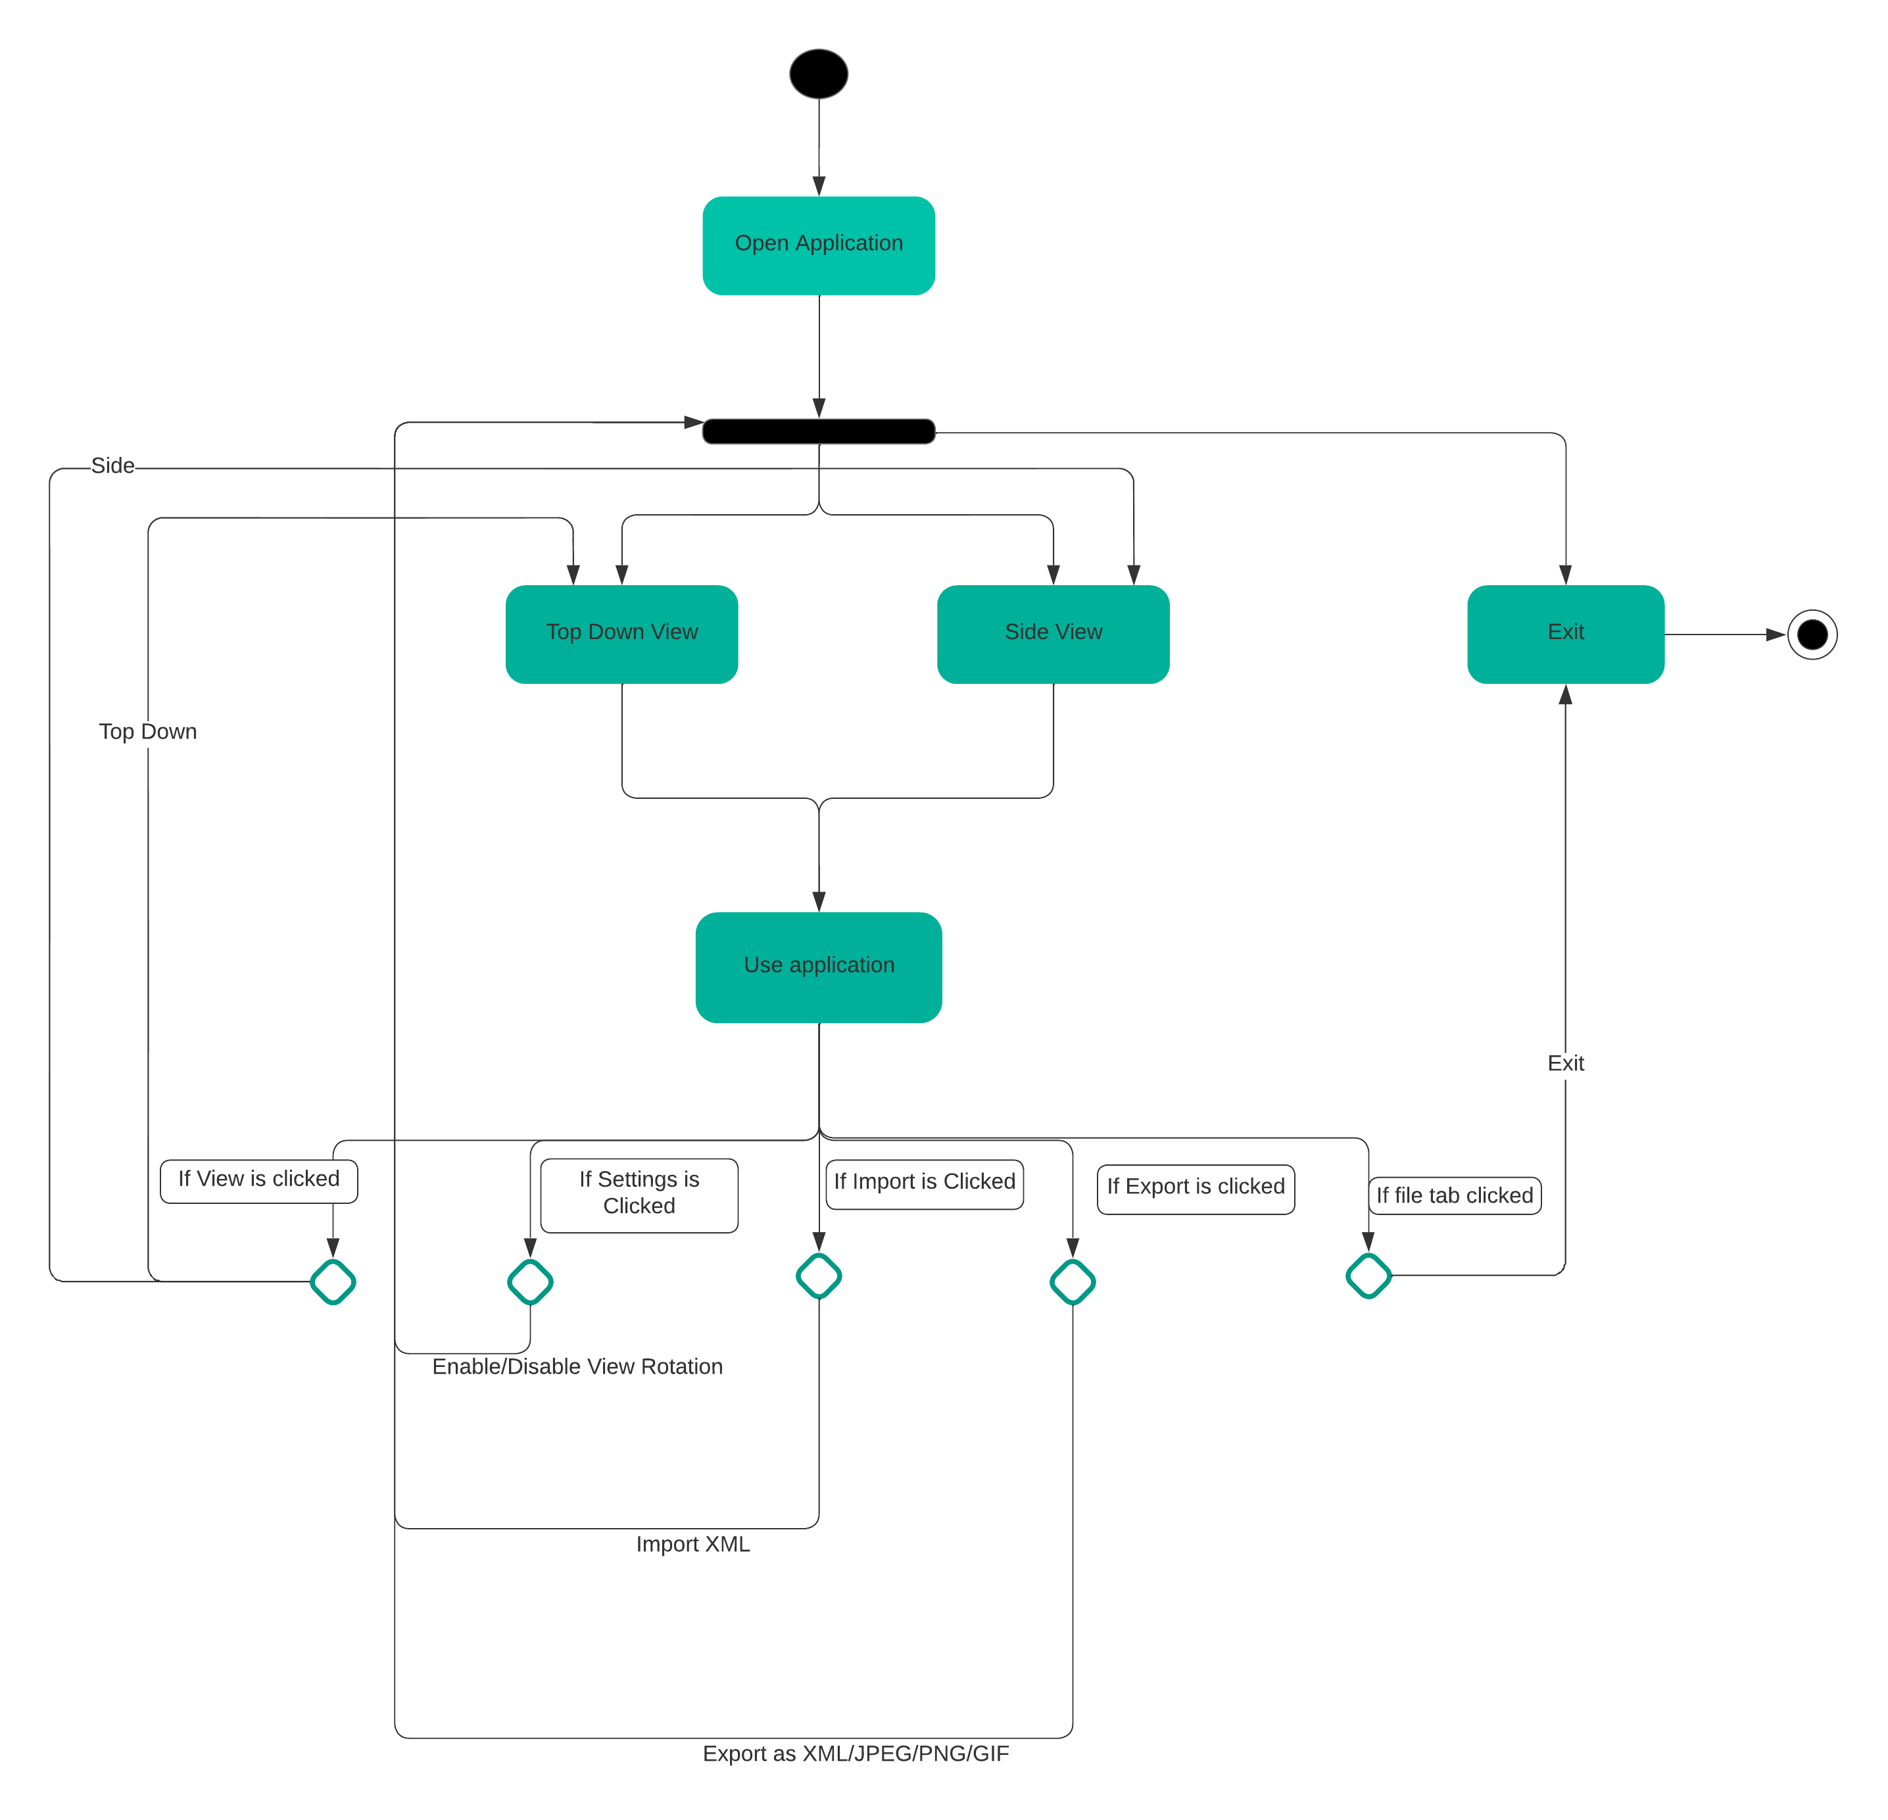
Example: Activity Diagram

Slide 5
Scenarios
Jaden - aerodrome controller
Jane - approach controller
Gemma - independent calculator

Slide 6
Example: Jane
Jane opens the runway redeclaration app
- Jane chooses the “Side View” from the “View” toolbar
- A side view page is displayed
- Jane clicks on the drop-down menu under “Colour Scheme” and chooses “Dark”
- The colour scheme of the application becomes dark
- Jane enters the values of a runway with an obstacle
- She presses the Calculate button
- Jane sees how much of the runway is usable and in what direction is the plane coming/going

Slide 7
Storyboards
10 Images. One of each configuration of the application

Slide 8
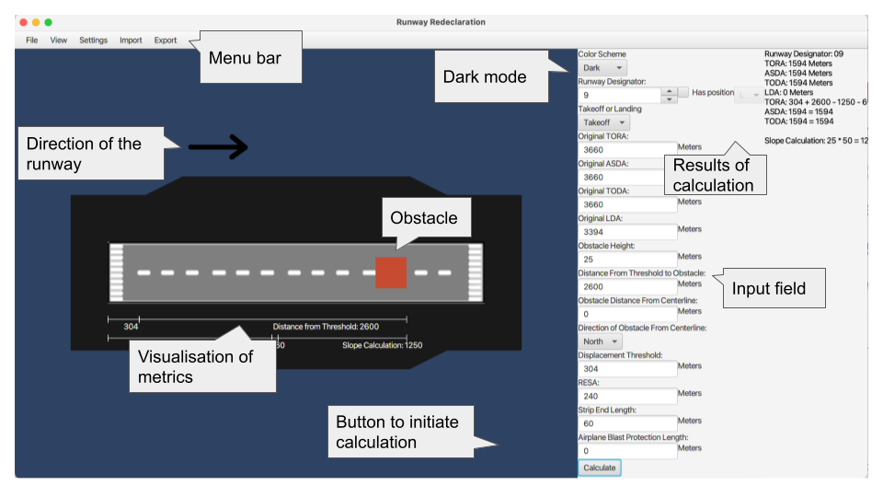
Example:

Slide 9
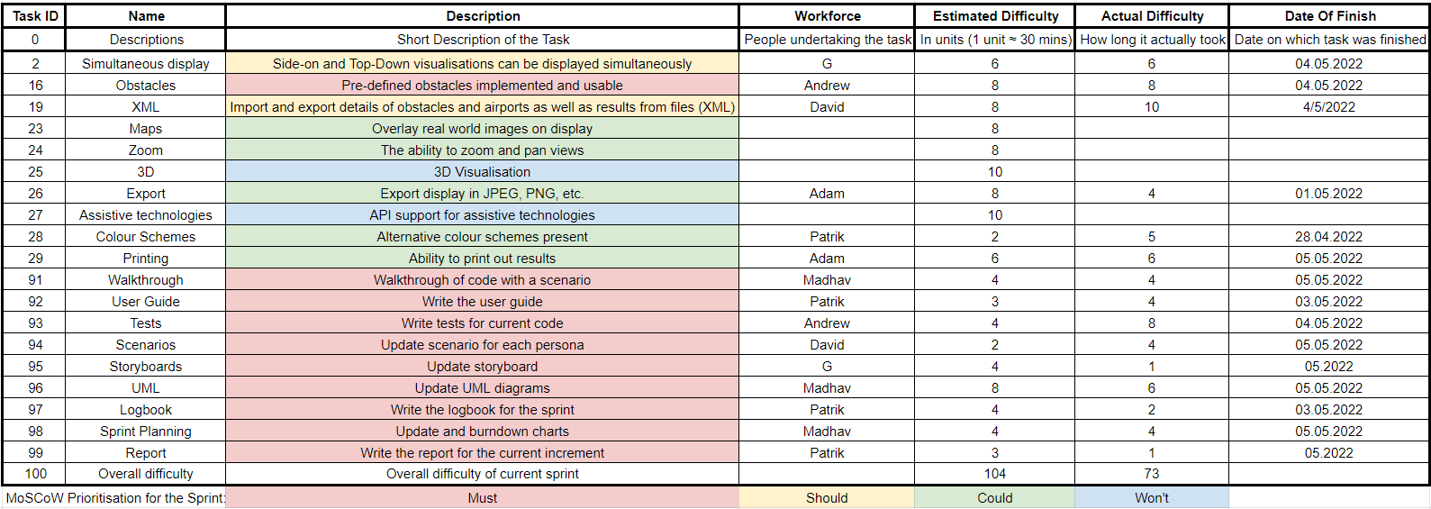
Backlog
Backlog for the third sprint

Slide 10
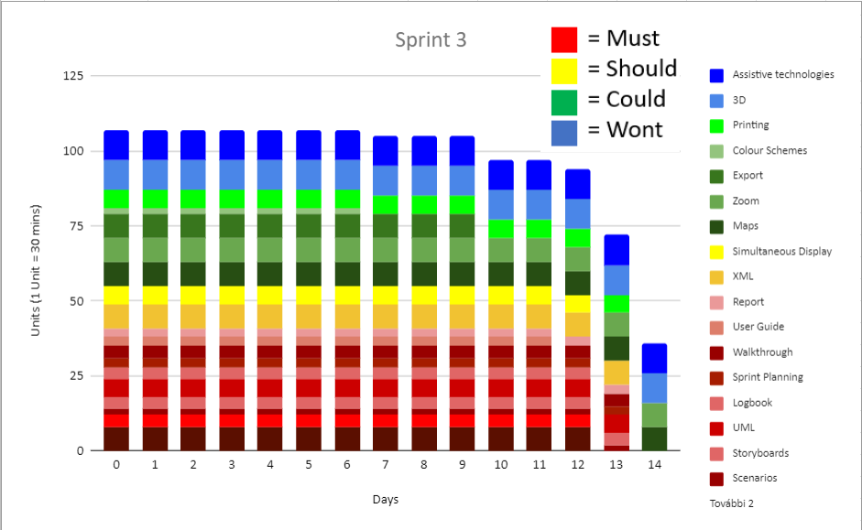
Burndown Chart
Burndown chart for the third sprint

Slide 11
Additional Chapters
Introduction
Logbook
On Testing

Slide 12

Thank You For Listening
Any Questions?

