Slide 1


Turtle Graphics with Python

Slide 2
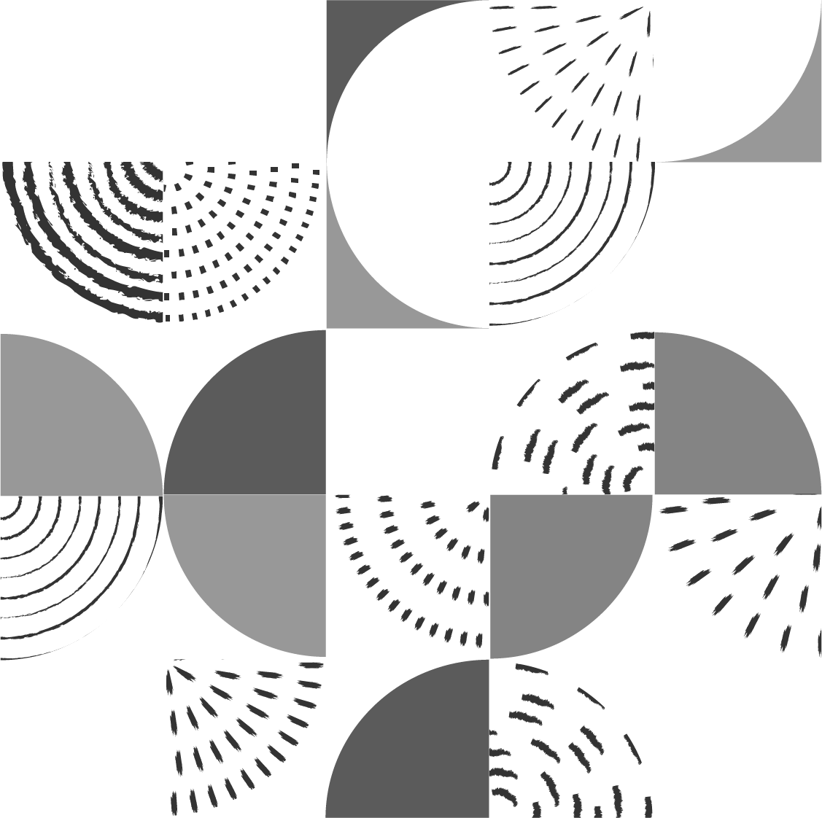
What Are Turtle Graphics?
Turtle Graphics are a popular way for introducing programming to kids and beginners
It uses a "turtle," which can move around the screen to draw shapes, lines, and more
This turtle obeys simple commands like moving forward, turning, or lifting the pen

Slide 3
Setting Up Turtle Graphics
Before we start, ensure you have Python installed
Let's start by creating a basic Turtle Graphics window
The turtle library is built into Python, no need to install anything else

Slide 4
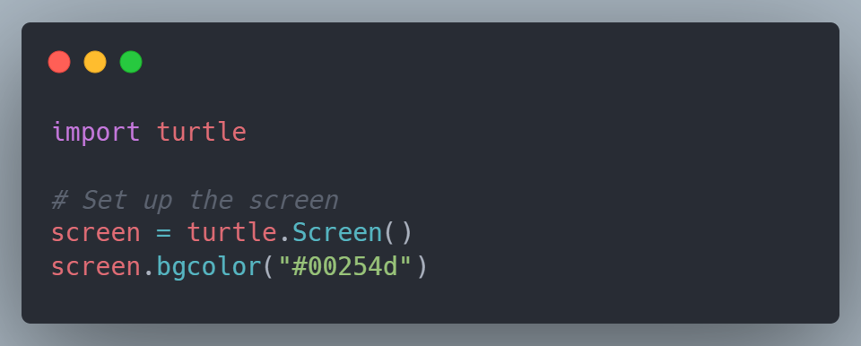
Setting Up Turtle Graphics
This creates a window where your turtle will draw

Slide 5
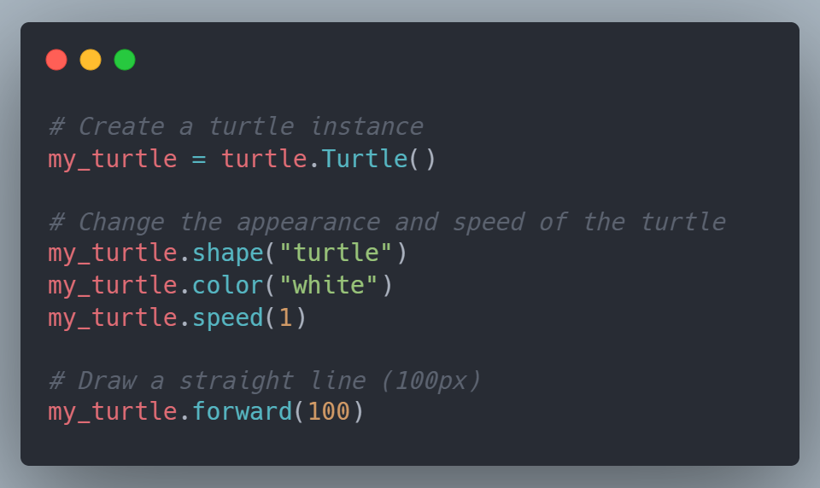
Drawing A Straight Line
The first thing we’ll do is draw a straight line
We need to create a turtle and give it some commands.

Slide 6
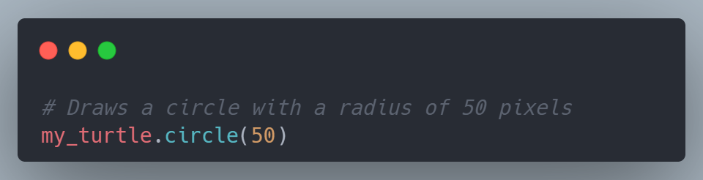
Drawing A Circle
Turtle Graphics provides an easy way to draw circles with just one command
This command tells the turtle to draw a circle of radius 50 pixels
Exercise: experiment with different values to see how the size changes

Slide 7

Full Turtle Drawing Tutorial
Now that we know how to move the turtle and draw basic shapes, let's use these concepts to draw a simple turtle figure

Slide 8

1. Move the Pen
Sometimes, we want the turtle to move to a new position without drawing anything
For that, we use the 'penup ' and 'pendown ' commands
The following function moves the turtle to the specified position without drawing

Slide 9
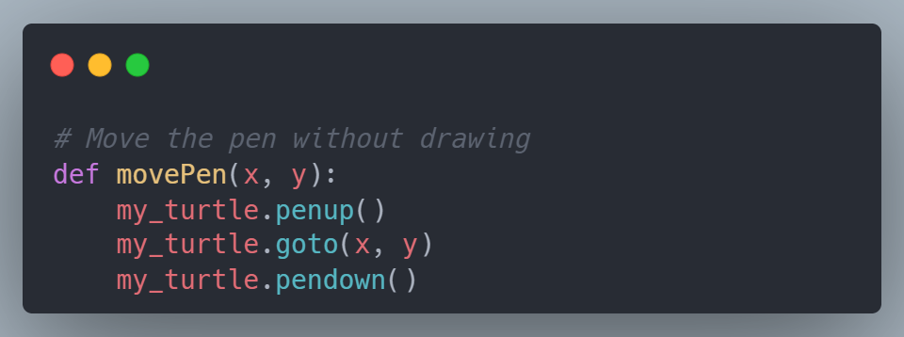
Moving the Pen (Without Drawing)
This function moves the turtle to the specified (x, y) position without drawing.

Slide 10

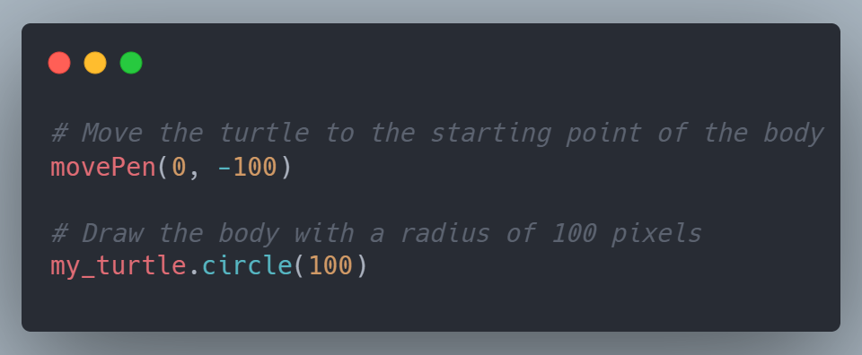
2. Draw the Turtle’s Body
We’ll start by drawing a circle for the turtle's body

Slide 11
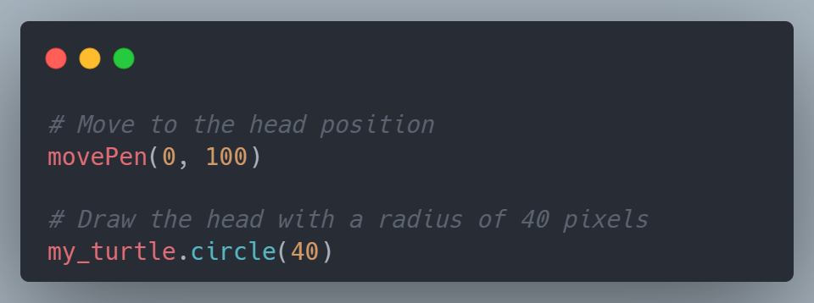
3. Draw the Turtle’s Head
Next, we move to the top of the body and draw a smaller circle for the turtle’s head

Slide 12
4. Draw the Turtle’s Limbs
The turtle has four limbs: two hands and two feet
Let’s draw each one

Slide 13

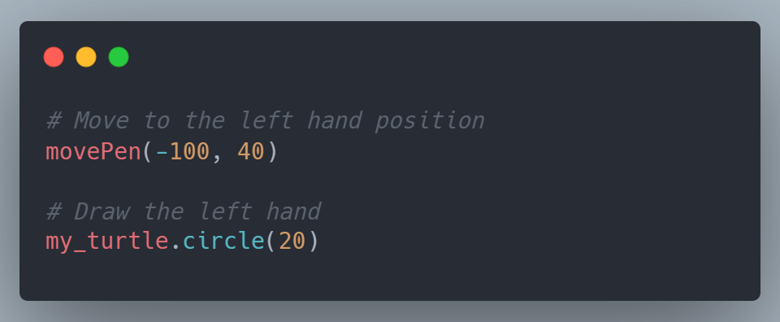
- Left Hand

Slide 14

- Right Hand

Slide 15


- Left Foot

Slide 16

- Right Foot

Slide 17
5. Draw the Tail
Finally, we’ll use the 'drawLine ' function to draw the tail as two lines
After drawing the turtle, you can hide the turtle itself from the screen to leave only the drawing
And finally, finish the drawing by calling turtle.done()

Slide 18
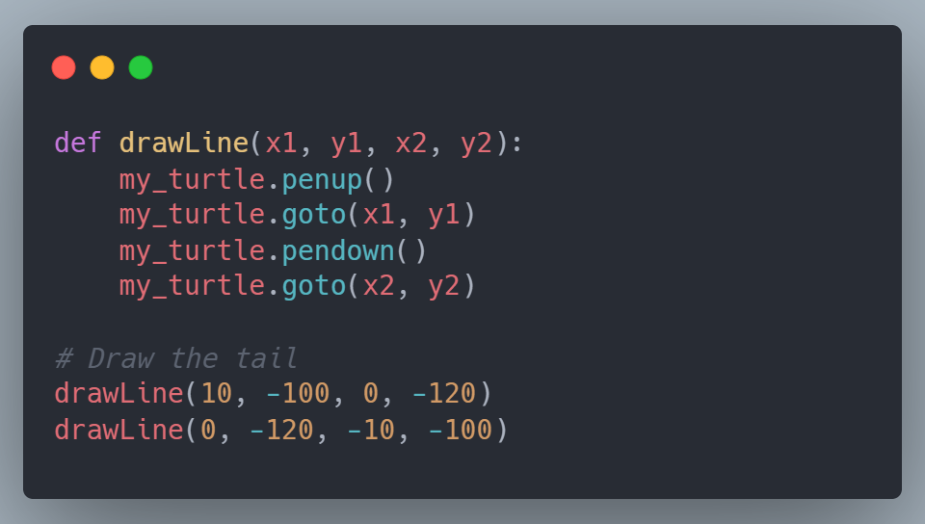
Drawing the Tail
Finally, we’ll use the `drawLine()` function to draw the tail as two lines.

Slide 19
Congratulations!
You've drawn your first turtle

Slide 20
Challenge
Challenge
Using what you've learned, draw a house with a square base and a triangle-shaped roof
Try
Try experimenting with the turtle commands to move the turtle to different parts of the house
Hint
Hint: You can use the 'goto ' method to move the turtle, and to draw the triangle roof, think about turning the turtle 120 degrees for each side
Come up with your own design! Best design will be announced next session
Advanced

