Slide 1
Students Presentation
CS21003 Algorithms – I
Instructors:
Prof. Palash Dey
Prof. Partha Pratim Chakraborty
Our Team
Team Member Name Roll Number
1)Cheruvu Surya Sai Ram 19EC30010
2)Giridhar Varuganti 19EC10070
3)Kalidindi M S Gowri Shankar 19EC10033
Video :
1)Kalidindi M S Gowri Shankar
2)Giridhar Varuganti
3)Cheruvu Surya Sai Ram

Slide 2
Formal Problem Statement
a) Our goal is to find all the partitions of a user input positive number N. A partition is a set of elements whose sum equals N. This presents the underlying idea that permuting the summands in a partition does not give a new partition. In other words, the order of elements in a partition is considered unimportant.
b) A non - repetitive partition is a partition in which each summand can occur only once. We also find the number of non - repetitive partitions of entered N. For instance, if the user inputs 5, Number of all partitions = 7 (1+1+1+1+1, 1+1+1+2, 1+1+3, 1+2+2, 1+4, 2+3, 5) Number of non - repetitive partitions = 3 (1+4, 2+3, 5) 2+2+1 and 1+2+2 are considered as the same partitions as already explained.

Slide 3
Input and Output Specification
Test case 1:
Enter a positive number : 15
Number of all partitions = 176
Number of non - repetitive partitions = 27
Test case 2:
Enter a positive number : 51
Number of all partitions = 239943
Number of non - repetitive partitions = 4097
Test case 3:
Enter a positive number : 80
Number of all partitions = 15796476
Number of non - repetitive partitions = 77312

Slide 4
Motivation : Why this problem?
In real life, we will be facing different situations where we are supposed to divide a number or a specific thing into different parts.The problem which we have chosen is the general one where we are supposed to distribute a number N into different parts such that their summation is equal to N. In part 1 repetitions are allowed but in part 2 repetitions are not allowed. Our algorithm gives the output of the number of partitions possible with and without repetition.
If we add specific conditions to this problem as required then it will have various applications in real life.
These include…
Dividing properties and assets
Budget Distribution
Vote Distribution
These tasks can be performed when we need to satisfy certain criterias which the user wants and our algorithms can be modified accordingly

Slide 5
What we would do?
a) Design an initial algorithm which computes the number of all partitions and also non - repetitive partitions of a positive number N.
b) Present the pseudo code of the initial algorithm. Prove its correctness. Analyze its time and space complexity. Work it out on an example.
c) Implement the initial solution in C language and run it on a few test cases.
d) Then we would refine our initial solution and make it efficient in terms of complexity.
e) Analyze the complexity of the refined solution.
f) Implement the refined solution in C language and run it on a few test cases.

Slide 6

Initial Solution

Slide 7
Tip
In the problem statement, we took an example of 5 and showed the count of all partitions and partitions without repetitions.
IMPORTANT : (2+2+1) and (1+2+2) are considered to be the same partition.
Tip :
In order to avoid such repetitions, we choose the summands in a non - decreasing order while countingi.e. if 1 and 2 are already chosen as the previous summands, the next summand cannot be less than 2.
In other words, we are fixing the permutation of a partition. This becomes clearer when we look at the pseudo code.
CONFUSION : (2+2+1) is not a partition without repetition because 2 is repeated. If any of the summands is repeated, then it is not considered as a partition without repetition. All the summands must be distinct in a partition without repetition.

Slide 8
Idea of our initial algorithm - Initial Solution
From this point, let’s say we have two problems : Part 1 and Part 2, Part 1 is to compute the total number of all partitions of a given positive number N whereas Part 2 is to compute the number of partitions without repetitions for the same.
Part 1 : For any number N, to compute the number of partitions, we add the number of partitions with starting summand as 1, 2, 3, ………., N. Computing the partitions with starting summand as i is nothing but computing the number of partitions with starting summand as i for a number N - i. After computing for each i, we add all of them from i = 1 to N to get the total number of all partitions. (Here partitions refer to all partitions).
Part 2 : For any number N, to compute the number of partitions, we add the number of partitions with starting summand as 1, 2, 3, ………., N. Computing the partitions with starting summand as i is nothing but computing the number of partitions with starting summand as i+1 for a number N - i. After computing for each i, we add all of them from i = 1 to N to get the total number of all partitions. (Here partitions refer to partitions without repetitions).
By looking at the above algorithm, we see that it can be implemented by recursion and the same is done in the following slides. We can see that Part 1 and Part 2 are almost the same but are variants of each other. In Part 2, we just eliminate the repetitions.

Slide 9
Pseudo Code (Part 1)
Part 1 :
partitions(int* arr, int* counter, int N ){
for i = 1 to N
count_allp(i, arr, counter, 0, N)
//summing all computations from 1 to N }
count_allp(int summand, int* arr, int* counter, int index, int N); //counts the number of all partitions (allp)
/*summand = starting summand,
arr = the values upto now in a partial particular partition,
counter = an array to store the count of partitions,
index = denotes the index in an array,
N = our number of interest i.e. user inputted number*/

Slide 10
Pseudo Code contd.
count_allp(int summand, int* arr, int* counter, int index, int N){
int sum; //a variable to check if sum reached N or not
/* Copy the values of arr into a new array _arr (so that the values of arr are undisturbed and preserved and counting is done by proceeding with _arr).*/
sum = sum of values in _arr
if (sum > N) return; //those values cannot form a partition anymore
else if (sum = N) { //a partition is formed
counter[0]++ //hence the counter variable is increased
return;
} else{ for i = summand to N // to ensure non - decreasing order (tip)
count_allp(i, _arr, counter, index+1, N)
//computing the number of partitions with starting summand as i for N - 1 while the starting summand for N is still summand
//here i starts from summand so that all partitions are counted
} }

Slide 11
Pseudo Code (Part 2)
Part 2 :
partitions(int* arr, int* counter, int N ){
for i = 1 to N
count_pwr(i, arr, counter, 0, N)
//summing all computations from 1 to N
}
count_pwr(int summand, int* arr, int* counter, int index, int N); //counts the number of partitions without repetitions (pwr)
/*summand = starting summand,
arr = the values upto now in a partial particular partition,
counter = an array to store the count of partitions,
index = denotes the index in an array, N = our number of interest i.e. user inputted number*/

Slide 12
Pseudo Code contd.
count_pwr(int summand, int* arr, int* counter, int index, int N){
int sum; //a variable to check if sum reached N or not
/*Copy the values of arr into a new array _arr (so that the values of arr are undisturbed and preserved and counting is done by proceeding with _arr).*/
sum = sum of values in _arr
if (sum > N) return; //those values cannot form a partition anymore
else if (sum = N) { //a partition is formed
counter[1]++ //hence the counter variable is increased
return;
} else{ for i = summand + 1 to N // to ensure non - decreasing order (tip)
count_pwr(i, _arr, counter, index+1, N)
//computing the number of partitions with starting summand as i for N - 1 while the starting summand for N is still summand
//here i starts from summand + 1 so that no repetition is ensured
} }

Slide 13
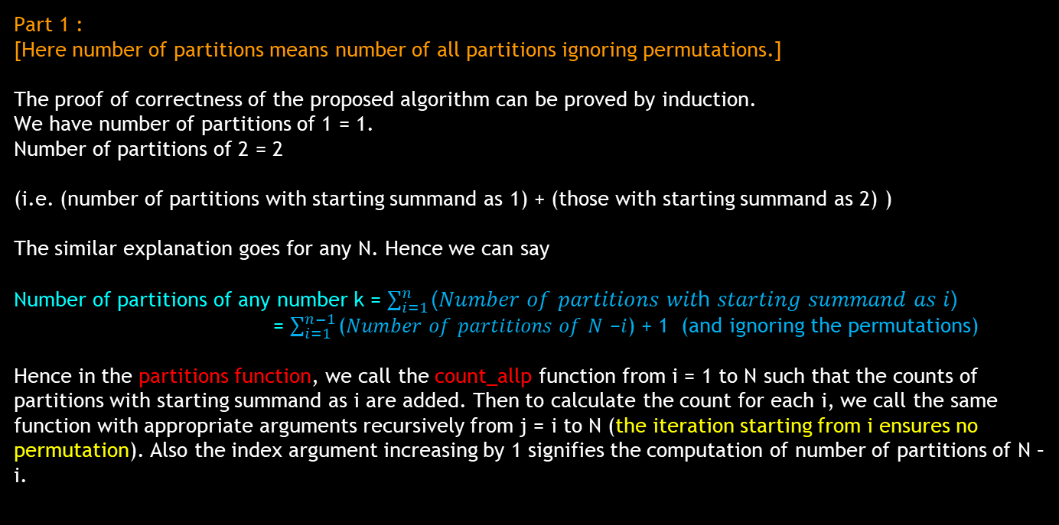
Proof of Correctness
Part 1 :
[Here number of partitions means number of all partitions ignoring permutations.]
The proof of correctness of the proposed algorithm can be proved by induction.
We have number of partitions of 1 = 1.
Number of partitions of 2 = 2
(i.e. (number of partitions with starting summand as 1) + (those with starting summand as 2) )
The similar explanation goes for any N. Hence we can say
Number of partitions of any number k = $\sum_{i=1}^{n}{\text{(}\text{Number} \text{of} \text{partitions} \text{wit}\text{h} \text{starting} \text{summand} \text{as} \text{i}\text{)}}$
= $\sum_{i=1}^{n−1}{\text{(}\text{Number} \text{of} \text{partitions} \text{of} \text{N} \text{−}\text{i}\text{) + }\text{1 }\text{(}\text{and} \text{ignoring} \text{the} \text{permutations}\text{)}}$
Hence in the partitions function, we call the count_allp function from i = 1 to N such that the counts of partitions with starting summand as i are added. Then to calculate the count for each i, we call the same function with appropriate arguments recursively from j = i to N (the iteration starting from i ensures no permutation). Also the index argument increasing by 1 signifies the computation of number of partitions of N – i.

Slide 14
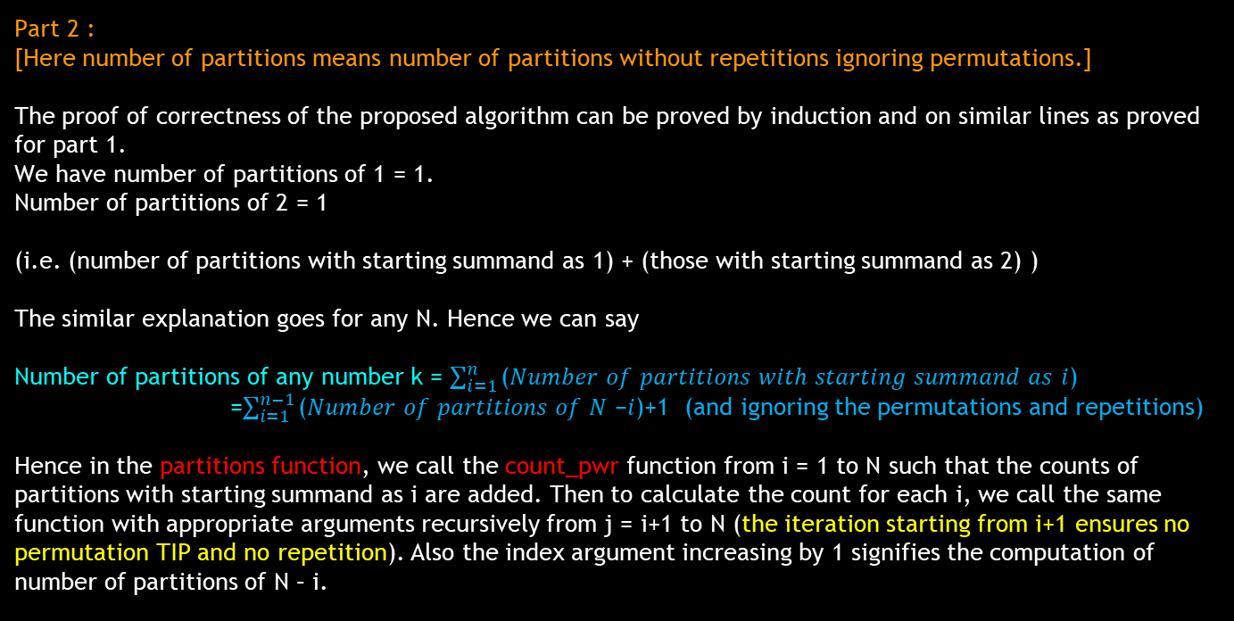
Proof of Correctness
Part 2 :
[Here number of partitions means number of partitions without repetitions ignoring permutations.]
The proof of correctness of the proposed algorithm can be proved by induction and on similar lines as proved for part 1.
We have number of partitions of 1 = 1.
Number of partitions of 2 = 1
(i.e. (number of partitions with starting summand as 1) + (those with starting summand as 2) )
The similar explanation goes for any N. Hence we can say
Number of partitions of any number k = $\sum_{i=1}^{n}{\text{(}\text{Number} \text{of} \text{partitions} \text{wit}\text{h} \text{starting} \text{summand} \text{as} \text{i}\text{) }}$
=$\sum_{i=1}^{n−1}{\text{(}\text{Number} \text{of} \text{partitions} \text{of} \text{N} \text{−}\text{i}\text{)}}$+1 (and ignoring the permutations and repetitions)
Hence in the partitions function, we call the count_pwr function from i = 1 to N such that the counts of partitions with starting summand as i are added. Then to calculate the count for each i, we call the same function with appropriate arguments recursively from j = i+1 to N (the iteration starting from i+1 ensures no permutation TIP and no repetition). Also the index argument increasing by 1 signifies the computation of number of partitions of N – i.

Slide 15
Complexity Analysis - Initial Solution
Time Complexity :
There are a huge number of recursive calls in both part 1 and part 2. The time complexity is nothing but the number of recursive calls since the remaining are of O(1) time. Due to such plenty number of recursive calls, the time complexity of both parts is very large and increases exponentially. It is of O(N^{N}).
THE TIME COMPLEXITY IS VERY LARGE.
HENCE WE NEED TO REFINE THIS INITIAL SOLUTION.
But before refining, let us look at an example and its implementation to gain more insight that time complexity is really large.
Space Complexity :
Part 1 : The space complexity is found to be O(N²). After the return of every recursive call, the memory is freed. The maximum memory existing at a time simultaneously is O(N²). Hence the space complexity is O(N²).
Part 2 : Even for part 2, with similar arguments we can say that space complexity is O(N²). But to be more precise, it is O(N√N) since we don’t take the same summand in the recursive call again.

Slide 16
Working on an example : Part 1
N=4
(1,a,c,0,4)
(2,a,c,0,4)
(3,a,c,0,4)
(4,a,c,0,4)
1
0
0
0
2
0
0
0
3
0
0
0
4
0
0
0
(+1)
(1,a,c,1,4)
(2,a,c,1,4)
(3,a,c,1,4)
(4,a,c,1,4)
(3,a,c,1,4) (4,a,c,1,4)
1
1
0
0
1
2
0
0
1
3
0
0
1
4
0
0
3
3
0
0
3
4
0
0
(+1)
(Return)
(Return) (Return)
(1,a,c,2,4) (2,a,c,2,4) (3,a,c,2,4) (2,a,c,2,4) (3,a,c,2,4) (4,a,c,2,4)
1
1
1
0
1
1
2
0
1
1
3
0
1
2
2
0
1
2
3
0
1
2
4
0
(+1)
(Return)
(Return)
(Return)
(Return)
(2,a,c,1,4)
(3,a,c,1,4)
(4,a,c,1,4)
2
2
0
0
2
3
0
0
2
4
0
0
(1,a,c,3,4) (2,a,c,3,4) (3,a,c,3,4) (4,a,c,3,4)
(+1) (Return) (Return)
1
1
1
1
1
1
1
2
1
1
1
3
1
1
1
4
(+1) (Return) (Return) (Return)

Slide 17



Easy understanding of the above
4
1
2
3
4
1+1
1+2
1+3
1+4
3+3
3+4
1+1+1
1+1+2
1+1+3
1+1+4
2+2
2+3
2+4
1+1+1+1
1+1+1+2
1+1+1+3
1+1+1+4
1+2+3
1+2+4

Slide 18
Working on an example : Part 2
N=5
(1,a,c,0,5) (2,a,c,0,5) (3,a,c,0,5) (4,a,c,0,5) (5,a,c,0,5)
1
0
0
0
0
2
0
0
0
0
3
0
0
0
0
4
0
0
0
0
5
0
0
0
0
(+1)
(2,a,c,1,5) (3,a,c,1,5) (4,a,c,1,5) (5,a,c,1,5)
(4,a,c,1,5) (5,a,c,1,5) (5,a,c,1,5)
1
2
0
0
0
1
3
0
0
0
1
4
0
0
0
1
5
0
0
0
3
4
0
0
0
3
5
0
0
0
4
5
0
0
0
(+1)
(Return)
(Return) (Return) (Return)
(3,a,c,2,5) (4,a,c,2,5) (5,a,c,2,5)
(3,a,c,1,5) (4,a,c,1,5) (5,a,c,1,5)
1
2
3
0
0
1
2
4
0
0
1
2
5
0
0
2
3
0
0
0
2
4
0
0
0
2
5
0
0
0
(Return) (Return) (Return)
(+1)
(Return) (Return)
(4,a,c,2,5) (5,a,c,2,5)
1
3
4
0
0
1
3
5
0
0
(Return) (Return)

Slide 19


Easy understanding of the above
5
1
2
3
4
5
1+2
1+3
1+4
1+5
3+4
3+5
4+5
2+3
2+4
2+5
1+2+3
1+2+4
1+2+5
1+3+4
1+3+5

Slide 20
Implementation of Initial Solution - in C language
#include <stdio.h>
//declaring the required functions
void partitions(int arr[], int arr1[], int counter[], int N);
void count_allp(int a, int arr[], int counter[], int index, int N);
void count_pwr(int a, int arr[], int counter[], int index, int N);

Slide 21
Implementation(cont.)
int main()
{
//Taking input from user
int N;
printf("Enter the Number: ");
scanf("%d", &N);
//Declaring and Initializing the required array elements to 0
int counter[2] = {0};
int arr[N], arr1[N];
for (int i = 0; i < N; i++)
{
arr[i] = 0;
arr1[i] = 0;
}
//calling the function which does the job of partitioning
partitions(arr,arr1,counter,N);
// giving the output
printf("Count of All Partitions = %d\n", counter[0]);
printf("Count of Partitions without Repetitions = %d\n", counter[1]);
}

Slide 22
Implementation(cont.)
void partitions(int arr[], int arr1[], int counter[], int N )
{
//we will be adding all the computations from 1 to N when repetitions are allowed
for (int i = 1 ; i <= N; i++)
count_allp(i, arr, counter, 0, N);
// we will do the same procedure but here repetitions are not allowed
for (int i = 1 ; i <= N; i++)
count_pwr(i, arr1, counter, 0, N);
}

Slide 23
Implementation(cont.)
void count_allp(int summand, int arr[], int counter[], int index, int N)
{
/*summand = starting summand,
arr = the values up to now in a partial particular partition,
counter = an array to store the count of partitions,
index = denotes the index in an array,
N = our number of interest i.e. user inputted number*/
//using a new array named arr_new to store the values of arr
//This is done to preserve the values of arr and we will start counting with arr_new
int arr_new[N];
for (int i = 0; i < N; i++)
{
arr_new[i] = arr[i];
}
arr_new[index] = summand;
//using a variable sum which stores the sum of all the elements in arr_new
//will be useful to terminate the function call when sum reaches N
int sum = 0;
for (int i = 0; i < N; i++)
{
sum += arr_new[i];
}

Slide 24
Implementation(cont.)
//partitioning is no longer possible as sum crosses N
if (sum > N)
return;
//If sum=N then a partition is obtained
else if (sum == N)
{
//we will increment counter value by 1
counter[0]++;
return;
}
/*computing the number of partitions with starting summand as i for N-1 while the
starting summand for N is still summand
here i starts from summand so that all partitions are counted*/
else
{
for (int i = summand; i <= N; i++)
{
count_allp(i, arr_new, counter, index + 1, N);
}
}
}

Slide 25
Implementation(cont.)
void count_pwr(int summand, int arr[], int counter[], int index, int N)
{
/*summand = starting summand,
arr = the values upto now in a partial particular partition,
counter = an array to store the count of partitions,
index = denotes the index in an array,
N = our number of interest i.e. user inputted number*/
//using a new array named _arr to store the values of arr
//This is done to preserve the values of arr and we will start counting with _arr
int _arr[N];
for (int i = 0; i < N; i++)
{
_arr[i] = arr[i];
}
_arr[index] = summand;
//using a variable sum which stores the sum of all the elements in _arr
//will be useful to terminate the function call when sum reaches N
int sum = 0;
for (int i = 0; i < N; i++)
{
sum += _arr[i];
}

Slide 26
Implementation(cont.)
//partitioning is no longer possible as sum crosses N
if (sum > N)
return;
//If sum=N then a partition is obtained
else if (sum == N)
{
//we will increment counter value by 1
counter[1]++;
return;
}
/*computing the number of partitions with starting summand as i for N-1 while the
starting summand for N is still summand, here i starts from summand + 1 so that no
repetition is ensured*/
else
{
for (int i = summand + 1; i <= N; i++)
{
count_pwr(i, _arr, counter, index + 1, N);
}
}
}

Slide 27
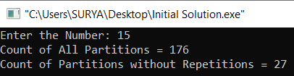
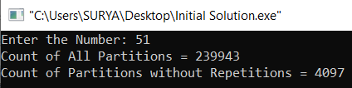
Output of C program
We get the following outputs for the test cases when the above code for initial solution is run.

Slide 28

Refined Solution

Slide 29
Algorithmic Methodology and Data Structures
From the recursion tree of initial solution, we are able to find out that large number of identical subproblems are being generated. Due to this, the complexity is very high.
Dynamic Programming :
The common algorithmic paradigm to solve identical subproblems is the Dynamic Programming method. We memoize the required values and whenever the value to the same subproblem is needed, we retrieve it from the set of memoized values.
If the value to a new subproblem is needed, we compute and memoize it.
Let’s try to implement our algorithm using dynamic programming and see how it affects the complexity. We observe that time complexity would be drastically reduced.
Data Structures :
Space Complexity arises due to the memoized space. For memoization, we use a three - dimensional (3D) array. This would become clearer when we look at the algorithm and its implementation.

Slide 30
Pseudo Code (Part 1)
In main, we call count_allp for m = 1 to n.
dp[][][] //a 3D array for memoization
int count_allp(int n, int m){
Initialize all the elements of 3D dp array to -1.
return compute(0,1,n,m)
}
int compute(int index, int num, int rem, int i){
//Base Condition
if(index=i){
if(rem=0)
return 1
else
return 0
}
//If N is partitioned as a sum of less than i numbers
if(rem=0)
return 0
//Using the memoized value for the same subproblem occurring again
if(dp[index][num][rem] is not equal to -1)
return dp[index][num][rem];
dp_value = 0;
for(j=num;j<=rem;j++) {
dp_value+=compute(index+1,j,rem-j,i); //recursive call of the function
}
dp[index][num][rem]=dp_value;
return dp[index][num][rem];
}

Slide 31
Pseudo Code (Part 2)
//Memoizing the already computed results
done[][][]
pwr[][][]
count_pwr(int n,int m,int pre)
{
//the partitioning is done and we have obtained the solution
if(n=0) return 1;
//partitioning is not possible
else if (n > 0 and m = 0) return 0;
//If the result is already computed, we will simply return it
else if (done[n][m][pre] = 1) return pwr[n][m][pre];
//Start computation if required to
//We will use Memoization here
else
{
done[n][m][pre] = 1;
for i=0 to n,
{
//we need to proceed if the current value is lower than the previous one
if(i < pre)
pwr[n][m][pre] += count_pwr(n-i,m-1,i);
}
return pwr[n][m][pre];
}
}

Slide 32
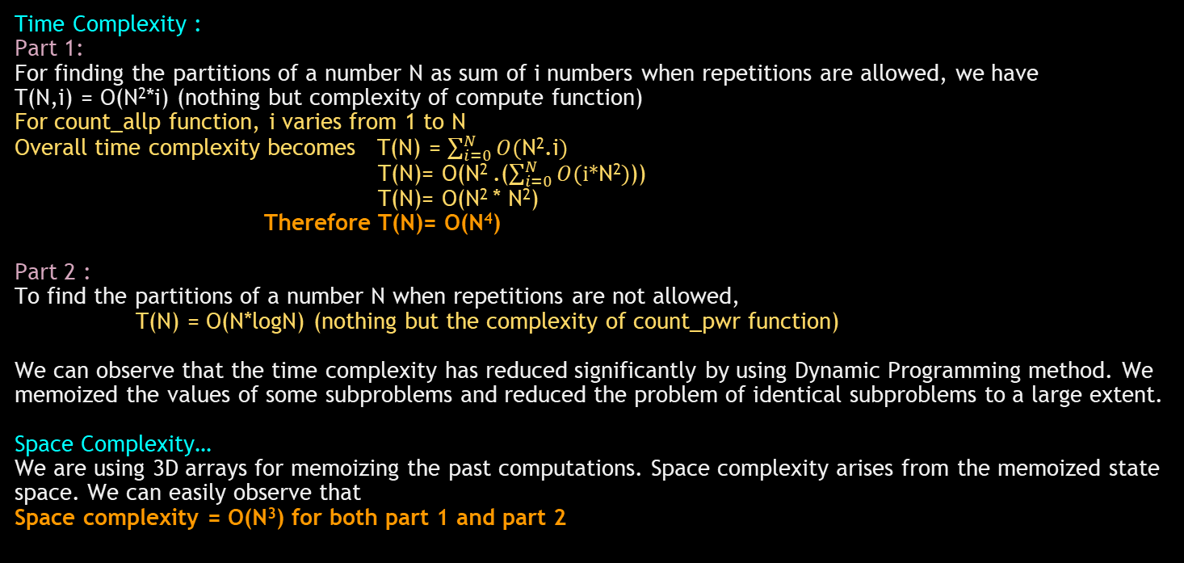
Complexity Analysis - Refined Solution
Time Complexity :
Part 1:
For finding the partitions of a number N as sum of i numbers when repetitions are allowed, we have
T(N,i) = O(N²*i) (nothing but complexity of compute function)
For count_allp function, i varies from 1 to N
Overall time complexity becomes T(N) = $\sum_{i=0}^{N}{O(\text{N}\text{2}\text{.}\text{i})}$
T(N)= O(N² .($\sum_{i=0}^{N}{O(\text{i}\text{∗}\text{N}\text{2})}$))
T(N)= O(N² * N²)
Therefore T(N)= O(N⁴)
Part 2 :
To find the partitions of a number N when repetitions are not allowed,
T(N) = O(N*logN) (nothing but the complexity of count_pwr function)
We can observe that the time complexity has reduced significantly by using Dynamic Programming method. We memoized the values of some subproblems and reduced the problem of identical subproblems to a large extent.
Space Complexity… We are using 3D arrays for memoizing the past computations. Space complexity arises from the memoized state space. We can easily observe that
Space complexity = O(N³) for both part 1 and part 2

Slide 33
Implementation of Refined Solution - in C language
//Implementation of refined solution in C language
#include<stdio.h>
int dp[500][500][500]; //3D dp array for part 1; dp = dynamic programming
int done[500][500][500]; //Done array
int pwr[500][500][500]; //3D dp array for part 2
int count_allp(int n, int m);
int compute(int index, int num, int rem, int i);
int count_pwr(int n,int m,int pre);

Slide 34
Implementation(cont.)
//Main function
int main()
{
int i,N,c1,c2;
//User Input
printf("Enter a number : ");
scanf("%d", &N);
//c1 stores the count of all partitions
//c2 stores the count of partitions without repetitions
c1=0;
for(i=1;i<=N;i++){
c1 += count_allp(N,i); //calling the corresponding function
}
c2=count_pwr(N,N,10000); //we need to pass a large number as the third argument
printf("\nCount of all partitions : %d\nCount of non - repetitive partitions : %d",c1,c2);
}

Slide 35
Implementation(cont.)
//The below function returns the number of ways in which n can be partitioned as a sum of m numbers
int count_allp(int n, int m)
{
int i,j,k,result;
//Initialization of each element in 3D dp array to -1
for(i=0;i<500;i++){
for(j=0;j<500;j++){
for(k=0;k<500;k++){
dp[i][j][k]=-1;
}
}
}
result=compute(0,1,n,m); //calling compute function
return result;
}

Slide 36
Implementation(cont.)
int compute(int index, int num, int rem, int i) //The below function makes use of the dp array in solving identical subproblems
{
int j,dp_value;
//Base Condition
if(index==i){
if(rem==0)
return 1;
else
return 0;
}
//If N is partitioned as a sum of less than i numbers
if(rem==0)
return 0;
//Using the memoized value if a subproblem has already been solved
if(dp[index][num][rem]!=-1)
return dp[index][num][rem];
dp_value = 0;
for(j=num;j<=rem;j++) {
dp_value+=compute(index+1,j,rem-j,i); //recursive call
}
dp[index][num][rem]=dp_value;
return dp[index][num][rem];
}

Slide 37
Implementation(cont.)
//The below function returns the number of partitions without repetitions
int count_pwr(int n,int m,int pre)
{
//the partitioning is done and we have obtained the solution
if(n==0)
return 1;
//partitioning is not possible
else if(n>0&&m==0)
return 0;
//If the result is already computed we will simply return it
else if(done[n][m][pre]==1)
return pwr[n][m][pre];
//Start computation if required to
//We will use Memoization here
else
{
done[n][m][pre]=1;
for (int i=0;i<=n;i++)
{
if(i<pre) //we need to proceed if the current value is lower than the previous one
pwr[n][m][pre]+=count_pwr(n-i,m-1,i);
}
return pwr[n][m][pre];
}
}

Slide 38
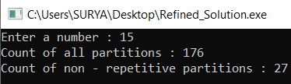
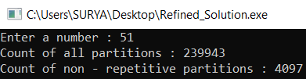
Output of C program
We get the following outputs for the test cases when the above code for initial solution is run.

Slide 39
--Conclusion--
We see that our problem has many real world applications. Slight variants of this problem can be applied frequently in our daily life. So the algorithmic implementation, analysis and refinement of such problems is really essential.
Also designing an efficient algorithm for a given problem statement involves three steps :
Initial solution using recursive definitions
Analysis of initial solution
Solution refinement and final algorithm
We followed the above steps and arrived at an algorithm that is very efficient.
Also we used the concept of DYNAMIC PROGRAMMING. It is one of the most widely used algorithmic paradigms to tackle identical subproblems.
In our case, a really large number of identical subproblems are being generated and hence the time complexity is too large.
We got rid of these identical subproblems using Dynamic Programming and developed an EFFICIENT FINAL algorithm.
The time complexity is reduced to a large extent as already seen.
Efficient algorithmic design is very important in our life. To do that, we follow some strategies and in this case, we used Dynamic Programming.
~~~THANK YOU~~~

