Slide 1
Lifestyle Management
Project Members:
Gagneet Sachdeva
Purva Avinash Patil
Greeshma Sree Parimi

Slide 2
Description :
Our target demographic includes adults from age group 18 to 60 and have a very hectic schedule. So, this application reminds the users to take short breaks between their daily personal and professional events with reminder / alerts. It helps users to maintain healthy lifestyle by reducing their stress and increasing productivity. Also, this design is very simple and clear that can be used by people of any age groups.
Success Criteria :
Number of people actively using the app, for Eg. people customizing their schedule in the app
Number of downloads from the app store
Reviews and Ratings of the application

Slide 3
Login Page
Create Account Page
Skip
Username
Username
Username
Email Id
Password
Password
Sign In
Create Account
Confirm Password
Create Account
Submit

Slide 4
User Landing Page
Happy Path
User opens the application
User selects to view the schedule
User selects the breaks to add/edit breaks
User selects daily routine to add schedule
User will be reminded with a notification/alerts based on the breaks set.
Current Date
Breaks
Daily Routine

Slide 5
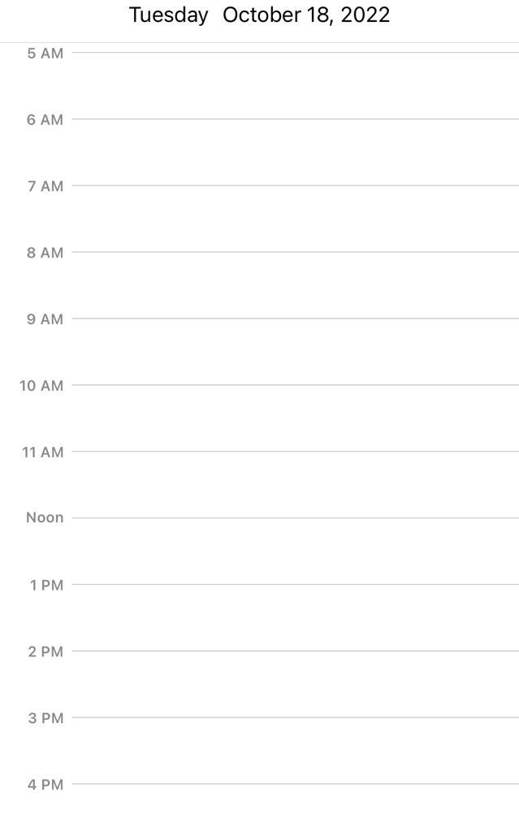
User Current day Schedule
Gym Time
Work starts
Work break
Lunch Break
Break

Slide 6



Adding Breaks or Events
Enabling Alerts
Work Break
System Generated Break
User Generated Break
Gym Time
Lunch Break
Breaks
Drink Water
……..Break
Break Title
Start Time
Add Breaks
End Time
Submit

Slide 7
Add Daily Routine
Wake Up Time
Morning Exercise
Breakfast
Daily Routine
Work Start/End Time
Lunch Time
Event Title
Start Time
Add Event
End Time
Submit

Slide 8
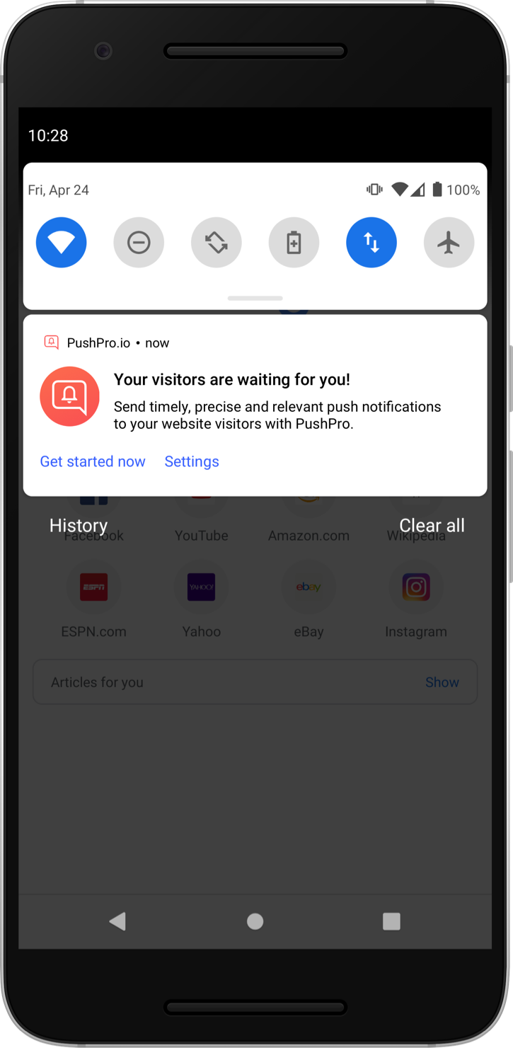
Notification / Alert
Its time to take a break !

