Slide 1

CJ Miller, Trent Punt, Steven Trotta

Slide 2
Features
Fully networked
Randomized Board
2-4 Players
Time limit on turn
Can trade with other people or bank
Wave Game Engine

Slide 3
Testing Strategies
Unit Tests
Integration Tests
System Tests
Acceptance Tests
Mocking

Slide 4
Testing Statistics
 | Branch Coverage | Statement Coverage | Maintainability Index | Cyclomatic Complexity
Cataners | 64.48% | 77.52% | 72 | 525
CatanersShared | 98.51% | 100% | 87 | 125
CatanersServer | 82.12% | 88.83% | 88 | 368

Slide 5
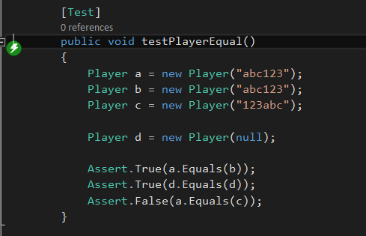
Unit testing

Slide 6
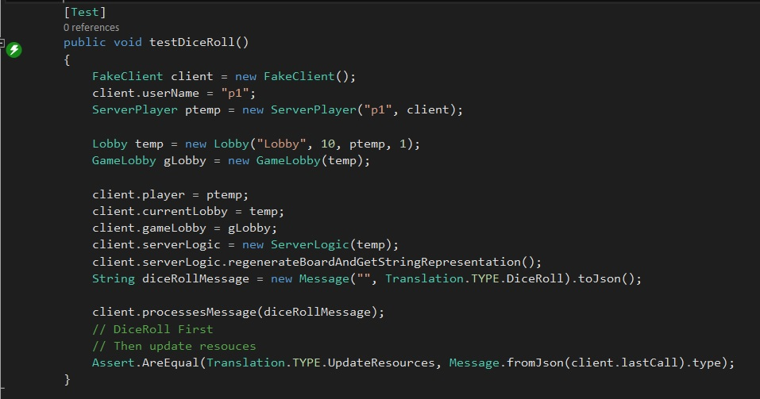
Integration Tests

Slide 7
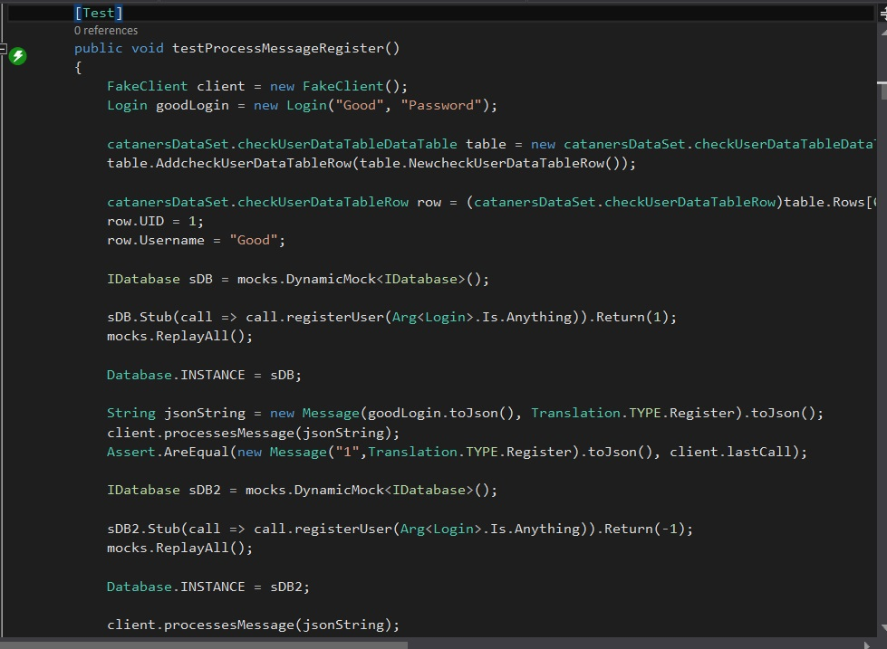
Mocking

