Slide 1
Understanding Human-Chosen PINs:
Characteristics, Distribution and Security
Ding Wang, Qianchen Gu, Xinyi Huang and Ping Wang
School of EECS, Peking University, Beijing, China
ASIACCS 2017
April 5th, Abu Dhabi, UAE
() wangdingg@mail.nankai.edu.cn
Tel: +86 18511345776
Notes:
Good morning everyone.
My name is。。。

Slide 2
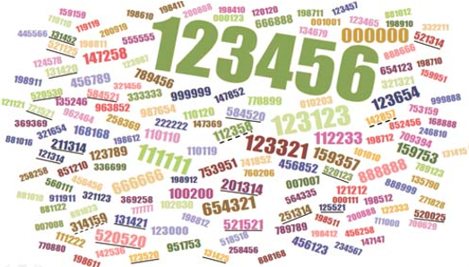
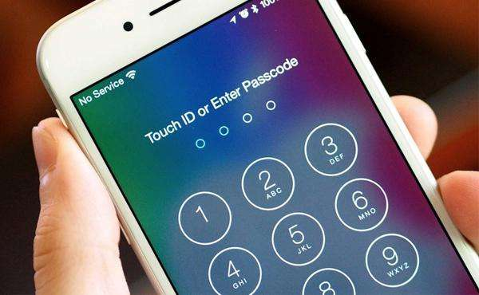
Outline
Introduction
  PIN Usage
  Motivation
PIN datasets
Characteristics of PINs
PIN distribution
PIN strength
Conclusion
Notes:
So this is the outline of today’s presentation, they are: Introduction, datasets, characteristic, distribution, strength and conclusion. The introduction part is mainly include PIN usage and motivation.

Slide 3
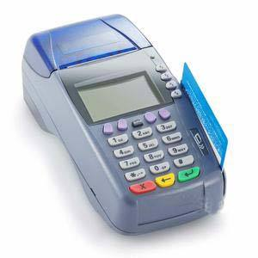
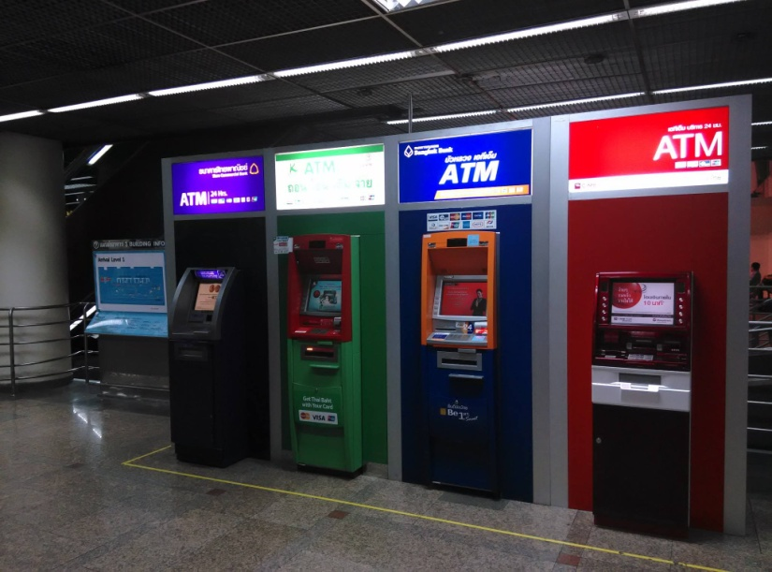
Introduction
PIN
  Personal Identiﬁcation Numbers
  Fixed-length of digits
  suitable for resource-constrained environments
Notes:
First of all, PIN stands for personal identification number. It is a special kind of password. It is typically composed of fixed-length of digit and do not entail any letters or symbols. This makes PINs suitable for resource-constrained environments where users are only offered a numpad, not a full keyboard, such as embedded system, ATMs, POS terminals and mobile phones.

Slide 4
PIN Usages
Mobile devices | 4-digit PINs
Most banks in Europe | 4-digit PINs
Banks in North America countries | Mainly 4-digit PINs, some up to 12-digit PINs
Banks in South America countries | Mainly 4-digit PINs, some up to 6-digit PINs
Banks in Australia and New Zealand | Mainly 4-digit PINs, some up to 12-digit PINs
Bank of Singapore | 5-digit PINs
Banks in Japan, South Korea, Thailand and Oman | 4-digit PINs
Banks in East and South Asia countries(e.g., China, Singapore, India, Indonesia and Malaysia) | 6-digit PINs
Notes:
So let’s see the PIN usage around the world. Mobile devices use 4-digit PINs. Most banks in Europe, America and Oceania use 4-digit PINs. In Asia, most countries are currently using (or are going to migrate to) 6-digit PINs. So in this work, we focus on 4-digit PINs and 6-digit PINs.

Slide 5
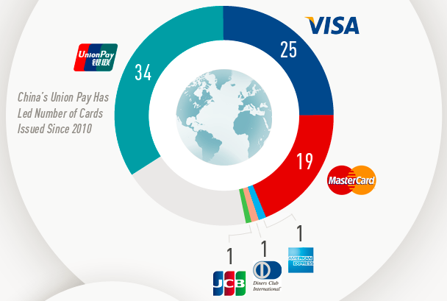
PIN Usages
Chinese users account for the world’s largest Internet population and largest consumer group of bank cards.
Great differences in selecting passwords between Chinese and English users. What about PINs?
Notes:
In the recent year, bank cards with UnionPay has become the biggest user group, more than visa and mastercard. That is to say, Chinese users account for the world’s largest Internet population and largest consumer group of bank cards. So we take Chinese users and English users as our user groups in this work. Since there are great differences in selecting passwords between Chinese and English users. We wonder what about PINs?

Slide 6

Motivation
PIN standard
  ISO 9564 and the EMV standard
  “select a PIN that cannot be easily guessed”
  never tell common users what constitute good PINs
Notes:
The security of PINs are also unsolved. There have been a number of standards that provide various security guidelines about PIN selection and management, such as ISO 9564 and the EMV standard. There are typical advice such as “select a PIN that cannot be easily guessed”. This might fail to be effective in practice, for they only enumerate some kinds of bad practice and never tell common users what constitute good PINs.

Slide 7
Motivation
Lack of concern
  ﬁrst academic research on human-chosen PINs in 2012 by Bonneau et al
  Focus on 4-digit PINs
No real-life datasets of banking PINs
  Approximate by password
Notes:
Despite the ubiquity of PINs, PIN security is lack of concern. It was not until 2012 that the first academic research on human-chosen PINs was conducted by Bonneau et al. They focus on 4-digit PINs that are used in American and Europe. One biggest problem in researching PINs is that, there are no real-life datasets of banking PINs. Therefore, most of research had to approximate PINs by passwords. And we did it as well.

Slide 8
Motivation
Issues unsolved
  What’s the distribution of human-chosen PINs?
  Do longer PINs generally ensure more security?
  6-digit PINs are widely used in Asia. What is the characteristics of 6-digit PINs and how is their security as compared to that of 4-digit ones?
Notes:
Though there are some useful studies about PINs security, there are many issues unsolved. For example, What’s the distribution of human-chosen PINs? Do longer PINs generally ensure more security? 6-digit PINs are widely used in Asia. What is the characteristics of 6-digit PINs and how is their security as compared to that of 4-digit ones?

Slide 9
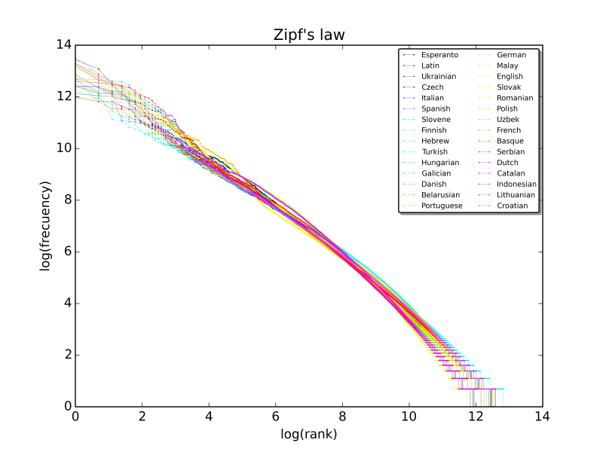
Motivation
“Our models are correct under our assumption of uniformly distributed PINs.”
Some PINs occur much more frequently than others.
Passwords have been found to follow the Zipf’s law.
Notes:
Particularly, some studies assumed that PINs are uniformly distributed, like “Our models are correct under our assumption of uniformly distributed PINs.”, or “we assume a uniform probability distribution in our experiments”. However, we will show that in reality some PINs occur much more frequently than others. Moreover, these overly popular PINs are statistically significant in every PIN dataset. Passwords have been found to follow the Zipf’s law. Then, there comes the question, PINs are of a fixed length and with a much smaller character space, does Human-chosen PINs also follow this kind of distribution?

Slide 10
Contributions of this paper
We compare the selection strategies of 4-digit PINs between English users and Chinese users, and initiate the study of 6-digit PINs
We show underlying distributions of user-chosen PINs by using NLP techniques.
We employ leading metrics to measure PIN strength. Longer PINs essentially attain marginally improved security.
Notes:
Then, in this paper, we have make these contribution. We compare the selection strategies of 4-digit PINs between English users and Chinese users, and initiate the study of 6-digit PINs. We show underlying distributions of user-chosen PINs by using NLP techniques. We employ leading metrics to measure PIN strength. We found longer PINs essentially attain marginally improved security.

Slide 11
Outline
Introduction
PIN datasets
Characteristics of PINs
PIN distribution
PIN strength
Conclusion
Notes:
In the next part, we are going to talk about PIN dataset.

Slide 12


PIN datasets
No database of real-world banking PINs has leaked
  User survey?
Dozens of high-proﬁle web services have recently been hacked
  Approximate by password
  Why? How?
Notes:
As mentioned before, No database of real-world banking PINs has leaked. Online user surveys might be conducted to collect some PINs, in this way even a large number of participants can be recruited. However, survey on sensitive topics like passwords is inherently subject to the ecological validity issue.
[click] Fortunately, Dozens of high-profile web services have recently been hacked. So we can approximate PINs by passwords. But why and how can we do this kind of approximation?

Slide 13
Why?
digits and texts in a password are generally semantically independent
  PCFG
User cognition capacity is rather limited
  probably reuse PIN sequences as building blocks for their passwords
our survey reveals that 14.03% Chinese users re-use their banking PINs in web passwords
Notes:
There are mainly three reasons we can do this approximation. Firstly, it is reasonable to assume that digits and texts in a password are semantically independent. This assumption serves the foundation for the PCFG-based password cracking technique, and has been shown a great success. Secondly, user cognition capacity is rather limited. a user’s working memory can only manage a total of 5 to 7 chunks of independent information, so they probably reuse PIN sequences as building blocks for their passwords. Thirdly, our survey reveals that 14.03% Chinese users re-use their banking PINs in web passwords. That is not a small ratio, since some users may not use digit in their password.

Slide 14
How?
4+ different ways
 | 1234 | 12345 | a1234 | a1234bc5678
Way 1 | 1234 | - | - | -
Way 2 | 1234 | - | 1234 | 1234, 5678
Way 3 | 1234 | 1234 | 1234 | 1234
Way 4 | 1234 | 1234, 2345 | 1234 | 1234, 5678
Notes:
Then how can we extract PINs from password? There are more than four different ways. The first one is to only select passwords consist of 4-digit. The second one is select passwords contain digits and the exact length of consecutive digits is four. The third way is to choose the passwords containing digits and the length of consecutive digits is no shorter than 4, and only the ﬁrst 4 digits are used. The fourth one is similar to the third one, but all 4-length digit will be selected.
[click] In our work, we decide to choose the second way mainly for two reasons. First, we believe people will not use such short digits as their passwords without any alternation. Secondly, it is still an open question whether there is any relationship between different length of digits. So the third way and the fourth way may largely underestimate or overestimate PIN usage in passwords.

Slide 15

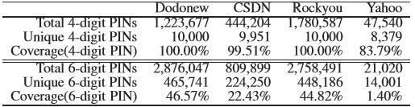
PIN datasets
Notes:
We extract all 4-digit and 6-digit PINs from these four datasets, dodonew, CSDN, Rockyou and Yahoo. The table shows the size of the PIN dataset, and the coverage of PINs. We leave the interesting question to future research whether our created PIN datasets are comparable to the real corpus of PINs.

Slide 16
Outline
Introduction
PIN datasets
Characteristics of PINs
  4-digit PINs
  6-digit PINs
PIN distribution
PIN strength
Conclusion
Notes:
Then let’s see the characteristic of 4-digit and 6-digit PINs.

Slide 17
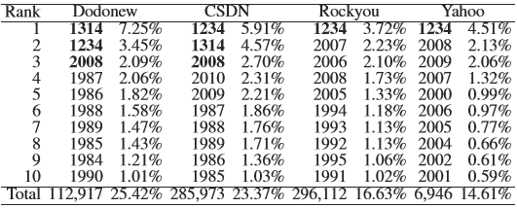
4-digit PINs
Top 10 4-digit PINs
Notes:
The table lists the top ten 4-digit PINs in our datasets. It is not a surprise to see 1234 being among the most popular PINs. The difference between Chinese and English datasets is that, for the two Chinese datasets, 1314, 2008 occupy the second and third positions. 1314 means “forever and ever” in Chinese, and 2008 is the year China held the Summer Olympic Games. The rest PINs in top 10 are the years range from 1991 to 2010, covering 15% to 23% of the whole datasets.

Slide 18
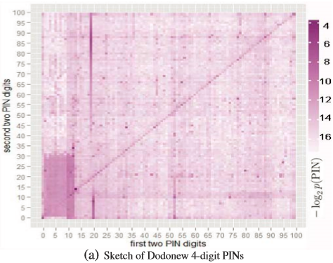
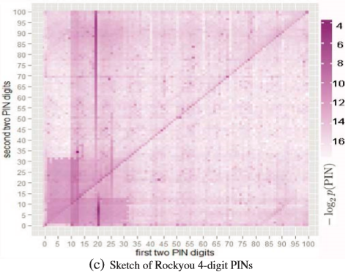
4-digit PINs
Observe distribution by heatmaps
Notes:
To observe 4-digit PIN distribution, we use a 2-dimensional grid. Each grid uses the ﬁrst two PIN digits as the x-axis and the second two PIN digits as the y axis, and color is employed to represent frequency: the higher the frequency of a PIN is, the darker the color in a cell will be. We can see the dark part on the grid. The bottom left corner can be understood as date, the vertical line can be understood as year, and the diagonal is the repeated values.

Slide 19
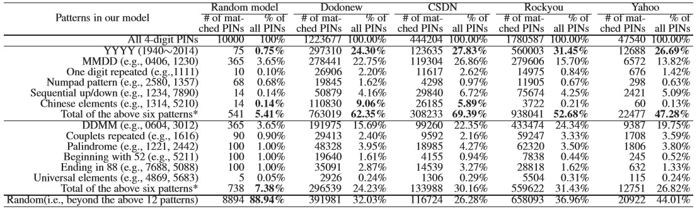
4-digit PINs
Patterns in datasets
Notes:
To measure the influencing factors that dominate the user selection of 4-digit PINs, we devise a model that contains 12 patterns observed above. Patterns include the year, the date, the repeated digits, the numpad patterns, sequential up/down, Chinese elements and so on. If one PIN matches two pattern, it will be counted for only once.
[click] We compared the dataset with the random model. The result of the coverage shows that, about 70% PINs in the dataset have been included while 10% PINs in the random model are covered.

Slide 20
4-digit PINs
Summary
  Different choice, Similar frequency between Chinese and English users
  Identified patterns account for a large proportion
Notes:
To make a summary of 4-digit PINs, Chinese users and English users have different choices on PINs, but the frequency of popular PINs are similar. Our identified patterns account for a large proportion of the PIN datasets.

Slide 21
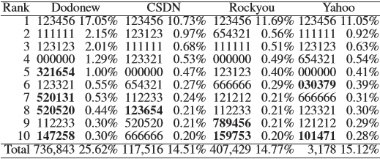
6-digit PINs
Top 10 6-digit PINs
Notes:
Then the table shows the top 10 of 6-digit PINs. Surprisingly, the top-3 PINs can occupy from 12% to 21% of our PIN datasets, much more than the 4-digit PINs. It is largely true that “the greater the number of digits required, the more predictable PIN selections become”.

Slide 22
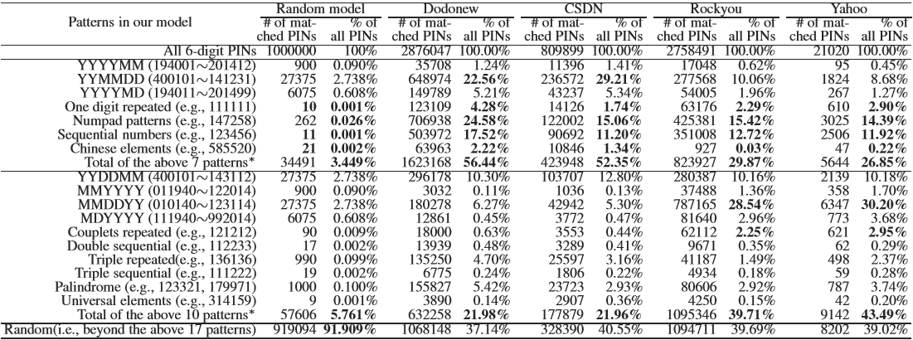
6-digit PINs
Patterns in datasets
Notes:
We also identify some patterns to understand 6-digit PINs. The detail of pattern can be found in the paper. The result of the coverage shows that, about 60% PINs in the dataset have been included while less than 10% PINs in the random model are covered. The coverage of 6-digit PINs is less than 4-digit PINs.

Slide 23
6-digit PINs
Summary
  more likely to be of numpad-based patterns, language-based speciﬁc elements and sequential numbers
  popular 6-digit PINs are more concentrated than 4-digit ones
  a larger fraction of 6-digit PINs do not follow any obvious pattern
Notes:
To make a summary of the characteristic of 6-digit PINs, 6-digit PINs are more likely to be of numpad-based patterns, language-based specific elements and sequential numbers. Popular 6-digit PINs are more concentrated than 4-digit ones, a larger fraction of 6-digit PINs do not follow any obvious pattern.

Slide 24
6-digit PINs
More prone to small number of guessing attempts(online guessing)
More secure against larger numbers of guessing attempts(ofﬂine guessing).
Necessity of migration to longer PINs?
Notes:
Moreover, there comes the real-world implications. 6-digit PINs are more prone to small number of guessing attempts, that’s we called online guessing. And it’s more secure against larger numbers of guessing attempts, that’s we called ofﬂine guessing. So, is it necessary to migrate to longer PINs?

Slide 25
Outline
Introduction
PIN datasets
Characteristics of PINs
PIN distribution
PIN strength
Conclusion
Notes:
In the following part, let’s see the PIN distribution.

Slide 26
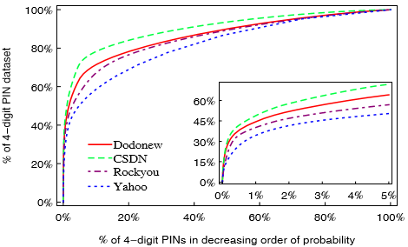
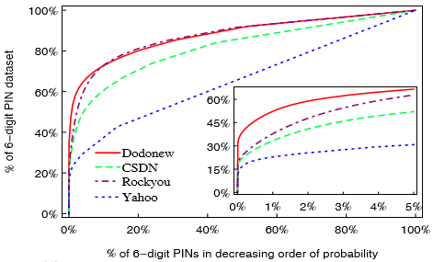
PIN distribution
Cumulative frequency distribution graph for 4-digit/6-digit PINs
Notes:
To observe the distribution of PIN datasets, we present a cumulative frequency distribution graph for 4-digit/6-digit PINs. the x-axis is the top x% of PINs and the y-axis is the percentage of coverage. And the different color stands for different datasets. CDF graphs show that both these popular PINs and unpopular PINs are statistically significant in every PIN dataset.

Slide 27


PIN distribution
Similar to Zipf’s law in password
p_{r} is the relative frequency (probability of occurrence)
Notes:
Fortunately, we observe that CDF graph is much similar to the Zipf’s law in password. Initially, this law was used to describe that the frequency of any word in a natural language corpus is inversely proportional to its rank in the frequency table arranged in decreasing order. Formally, it is formulated as f r equals C divide r to the s. f r stands for the frequency, r stands for the rank, s is the real number and close to 1. It can be equally expressed by pr. pr is the relative frequency, means probability of occurrence. Generally, for better comprehension, we can present the formula by a log-log format.

Slide 28
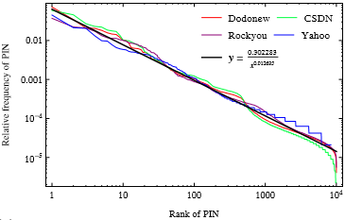
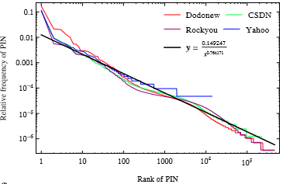
PIN distribution
probability vs. rank on a log-log scale
Notes:
We plot the probability and rank of PINs on a log-log scale, the left graph shows 4-digit PINs, the right one shows 6-digit PINs. It is worth noting that the relative frequency of each PIN in all our datasets drops polynomially as its rank becomes lower. An exception is that the probability of very few PINs at the tail of the rank lists drop much more sharply than polynomially. This strongly indicates that majority of PINs well follow a Zipf distribution.

Slide 29
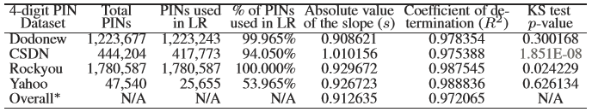
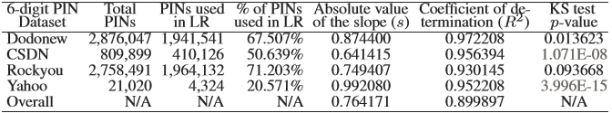
PIN distribution
low frequency PINs are unlikely to exhibit their true probability distribution according to the law of large numbers
Notes:
There are several approaches to determine the parameters of a Zipf distribution when given empirical data. least-squares linear regression is widely used and we adopt it for its simplicity. The Coefficient of Determination is used as an indicator of the quality of the fitting. Besides coefficient, we also employ the KS test to evaluate the goodness-of-fit. It is worth noting that, low frequency PINs are unlikely to exhibit their true probability distribution according to the law of large numbers, so we don’t include these low frequency PINs when doing the KS test.

Slide 30
PIN distribution
A natural question arises: Do digit sequences of other length (e.g., 3, 5, 7, 8, 9, 10) extracted from passwords also follow the Zipf’s law?
Only digit sequences of length 3, 4 and 6 follow this law.
A plausible reason: users love to use digit chunks of length 3, 4 and 6 as their secrets
Notes:
Then a natural question arises: Do digit sequences of other length like 3, 5, 7 extracted from passwords also follow the Zipf’s law? The answer is only digit sequences of length 3, 4 and 6 follow this law. A plausible reason: users love to use digit chunks of length 3, 4 and 6 as their secrets.

Slide 31
Outline
Introduction
PIN datasets
Characteristics of PINs
PIN distribution
PIN strength
Conclusion
Notes:
Then let’s see the PIN strength.

Slide 32


PIN strength
Questions:
  How much security can PINs provide?
  Between these two user groups, whose PINs are generally more secure?
Two kinds of security threat
  Online guessing
  Offline guessing
shoulder surfing
malware
Notes:
Considering PIN strength, the questions come up: How much security can PINs provide? Between these two user groups, whose PINs are generally more secure?
[click] There are two kinds of security threats against PINs: online guessing and offline guessing. Online guessing is where allowed guess number is limited. Offline guessing is where guess number can be very large. Other attacks like malware and shoulder surfing also exists.
[click] However, they are largely unrelated to PIN strength. So we will not consider them.

Slide 33
PIN strength
Two broad approaches to measure PIN strength
  statistic-based
    against the optimal attacker
  cracking-based
    against the real attacker
Notes:
To measure PIN strength, there are two broad approaches available, statistic-based and cracking-based. The statistic-based approach measures resistance against the optimal attacker. The cracking-based approach is against real attackers. To be robust, we will employ both.

Slide 34
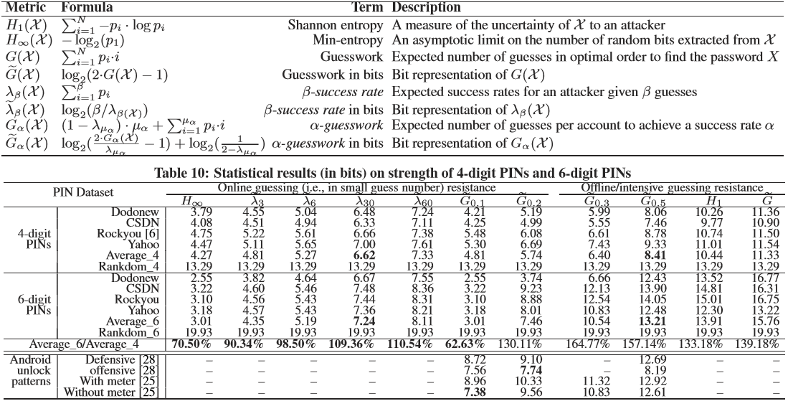

Statistic-based approach
Notes:
In statistic-based approach, we mainly adopt the five metrics. shannon entropy , min-entropy, guesswork, β success-rate and α-guesswork. They have been widely utilized. The first two metrics are used for measuring online guessing, the next two are for offline guessing and the last one is multi-purpose.
[click] Here, “Average” stands for the average metric results of above PIN datasets; “Random” stands for the dataset consisting of all distinct PINs.
The table shows that, both types of PINs offer less than 50% of security as compared to random PINs of the same length.
The table also shows that, 4-digit PINs of Chinese users are less secure than English users against both online guessing and offline guessing

Slide 35
Statistic results
6-digit PINs
  expected increase against ofﬂine guessing (i.e.,from 133.18% to 164.77%)
  Not significant increase against online guessing (i.e., 0.62 bit)
As online guessing is the primary threat, the additional security gained by enforcing a longer PIN requirement would not outweigh the increased costs in deployment and usability
Notes:
Moreover, 6-digit PINs has expected increase against offline guessing, but has not significant increase in security against online guessing . As online guessing is the primary threat, the additional security gained by enforcing a longer PIN requirement would not outweigh the increased costs in deployment and usability.

Slide 36
Cracking-based approach
PCFG-based, Not suitable
  PINs only contain fixed-length digit
Markov-Chain-based
  no normalization problem
  smoothing techniques to deal with the data sparsity problem: Laplace / Good Turing
Notes:
In cracking-based approach, the state-of-the-art password cracking algorithms include PCFG-based and Markov-Chain-based.
PCFG-based is not suitable, for PINs only contain fixed-length digit.
So we use Markov-Chain-based approach. PINs have the same length, there is no normalization problem. And we use smoothing techniques to deal with the data sparsity problem, such as Laplace and Good Turing. They are both effective.

Slide 37
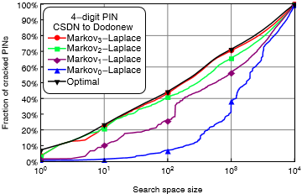
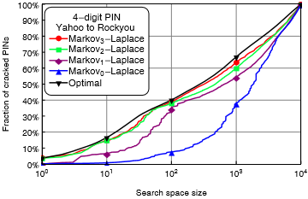
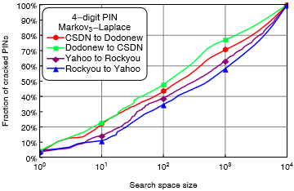
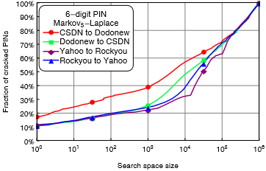
Cracking results
Notes:
In each attack, we use PINs from one source as training sets and generate PIN guesses in decreasing order of probability. Then, we try these guesses sequentially to attack PINs from another source. The x axis is the guess number, and the y axis is the crack ratio of dataset.
The upper two figures illustrate the cracking results about 4-digit PINs. We try different orders of Markov, and found the largest order gain the best effect, which is nearest from the optimal curve. So we use the largest order on all datasets. From the cracking, we found it very close to the optimal result. This highly indicates the potential that distribution of PINs from one source can be well predicted by using PINs from another source.

Slide 38
Outline
Introduction
PIN datasets
Characteristics of PINs
PIN distribution
PIN strength
Conclusion
Notes:
The last part comes the conclusion.

Slide 39
Conclusion
a systematic investigation into the characteristics, distribution and security of PINs chosen by English and Chinese users
  identiﬁed various differences in patterns
  revealed that PINs follow Zipf’s law
  highlighted that 6-digit PINs essentially offer marginally improved security over 4-digit PINs
Notes:
In this paper, we have conducted a systematic investigation into the characteristics, distribution and security of PINs chosen by English and Chinese users. Specifically, we identified various differences in patterns,
revealed that PINs follow Zipf’s law, and highlighted that 6-digit PINs essentially offer marginally improved security over 4-digit PINs.

Slide 40

THANK YOU & QUESTIONS
Notes:
Thank you for your attention.

