Slide 1

On the Implications of Zipf's Law in Passwords
Ding Wang， Ping Wang
School of EECS, Peking University, Beijing, China
In Proc. ESORICS 2016
() pwang@pku.edu.cn
Tel: +86 135 0110 7470
Notes:
hank you, chairs.
Good morning everyone.
Today, on behalf of our team, I am honored to have the opportunity to present our recent work, called “On the Implications of Zipf’s Law in Passwords”, a study on the security and usablity issues in password-based authentication.

Slide 2


Password authentication is everywhere
Notes:
Password authentication is the most previlant authentication method and secures our various digital assets. It has been widely accepted that password authentication is likely to keep its place in the foreseeable future.

Slide 3
A long-standing problem
How to quantify the advantages of
guessing attackers against
Password-based authentication protocols？
Involves a more
fundametnal question
What’s the distribution
of user-chosen passwords?
Notes:
However, it has been a long-standing problem as to how to quantify the advantages of guessing attackers against password-based authentication protocols. The resolution of this question involves a more fundametnal question: what’s the distribution of user-chosen passwords?
In this work, we aim to answer these two questions.

Slide 4
Outline
Introduction
Password distribution model
  Descriptions of our password datasets
  Review of the PDF-Zipf password distribution model
  Our CDF-Zipf password distribution model
Implications for password-based protocols
Implications for password creation policies
Implications for password strength metric
Conclusion
Notes:
So this is the outline of today’s presentation, they are: Introduction, Preliminaries; and the three implications of Zipf’s law in passwords.

Slide 5
Outline
Introduction
Password distribution model
  Descriptions of our password datasets
  Review of the PDF-Zipf password distribution model
  Our CDF-Zipf password distribution model
Implications for password-based protocols
Implications for password creation policies
Implications for password strength metric
Conclusion
Notes:
Now let us see the Introduction.

Slide 6
User-chosen passwords
Password creation
  User-chosen (99%)
  System assinged （very rare)
Due to inherent cognitive constraints, users love to save efforts, they
  Use popular passwords
  Ceate passwords containing personal information
  Reuse passwords
User-chosen passwords are highly skewed
Notes:
In our daily lives, almost every system allows users to choose password on themselves. However, due to inherent cognitive constraints, users love to save efforts, and they
1) Use popular passwords
2) Ceate passwords containing personal information
3) Reuse passwords
4) etc.
Such behaviors lead to a highly skrewed password distribution.

Slide 7
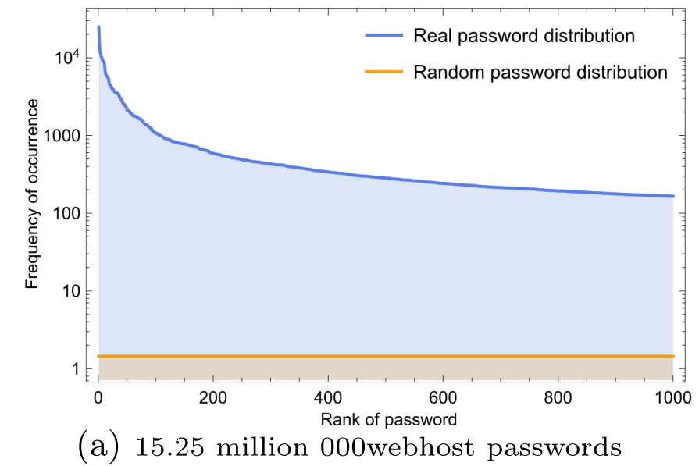
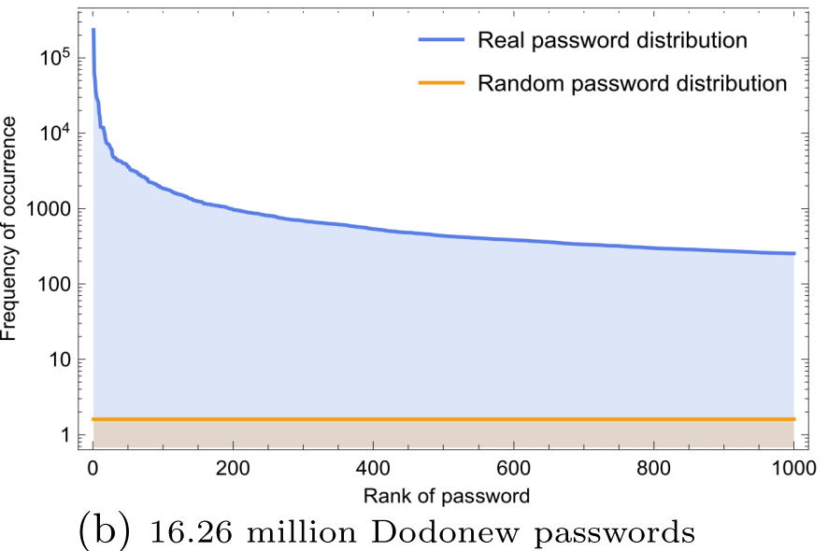
User-chosen passwords are highly skewed
Far from a uniform-distribution
    15.25 million www.000webhost.com passwords
    16.26 million www.dodonew.com passwords
Notes:
Here we use two large-scale password datasets as concrete example to show that human-chosen passwords are far from uniform. The first dataset is from 000webhost, the world’s largest free webhosting website.
In the picture, the x-axis is “Rank of passowrd” and the y-axis is “the frequency of occurrence”. We can see that, the most popular password occurs over 100,000 times, while the 200th password only occurrs about 1000 times. As shown in the picture, the real distribution curve of passwords is far from a random distribution curve.
Similar results can be seen in the 16 million Dodonoew passwords.

Slide 8
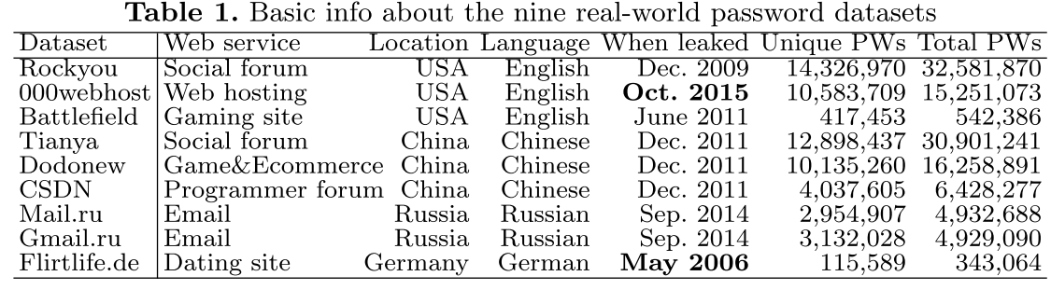
User-chosen passwords are highly skewed (2)
More examples
  All of them are highly skewed.
Notes:
In all the nine real-world passowrd datasets, the real distribution curve is far from a random distribution curve. All of these password distributions are highly skewed.

Slide 9
Existing problems
When an explicit assumption about password-distribution is needed, most works assume that passwords are uniformly distributed.
    This assumption is not realistic, and gives rise to serious security and usability issues.
When an explicit assumption about password-distribution is not needed, most works simply
avoid making an assumption.
    This may miss the discovery/examination of important properties/goals.
Notes:
There are two major undersiable situations in existing password research.
First, when an explicit assumption about password-distribution is needed, most works assume that passwords are uniformly distributed. As we have shown, this assumption is not realistic, and will significantly underestimate the system’s risk.
Second, when an explicit assumption about password-distribution is not needed, most password-related works simply avoid making an assumption about password distribution. As a result, many important properties or goals that actually rely on an assumption about password distribution are left undiscussed.

Slide 10
The underlying reason for the issues
If we do not assume the uniform
distribution of passwords, then no one knows what is their exact distribution.
    Lack of real-world passowrd data
    Involve some recent advancements in the inter-discipline knowledge (e.g., Statistics, NLP)
Notes:
The essential reason for the aforementioned two undesirable situations is that, if we do not assume the uniform distribution of passwords, then no one knows what is their exact distribution. This is attributed to two facts:
First, in the past, there is lack of real-world passowrd data;
Second, figuring out the password distribution would involve some recent advancements in the inter-discipline knowledge (e.g., Statistics, NLP). These two reasons make the study of password distribution a challenging task.

Slide 11
Our contributions
We propose CDF-Zipf, an imporved password distribution model over the existing PDF-Zipf.
We show how to 2~4 orders of magnitude more accurately capture an attacker’s guessing advantages against password protocols.
We present a series of prediction models to facilitate the choices of parameters for the popularity-based password creation policies.
We, for the ﬁrst time, reveal that the widely used password strength metric α-guesswork is actually non-parametric in two of four cases.
Notes:
In this work, we first propose the CDF-Zipf model, an imporved password distribution model over the existing PDF-Zipf model.
With our CDF-Zipf model, we demonstrate three important implications:
First, we show how to 2~4 orders of magnitude more accurately capture an attacker’s guessing advantages against password protocols.
Second, we present a series of prediction models to facilitate the choices of parameters for the popularity-based password creation policies.
Third, we, for the ﬁrst time, reveal that the widely used password strength metric α-guesswork is actually non-parametric in two of four cases.

Slide 12
Outline
Introduction
Password distribution model
  Descriptions of our password datasets
  Review of the PDF-Zipf password distribution model
  Our CDF-Zipf password distribution model
Implications for password-based protocols
Implications for password creation policies
Implications for password strength metric
Conclusion
Notes:
Now we discuss the password distribution model.

Slide 13
Password datasets we used
From various high-profile websites
In three kinds of languages
A time span of ten years
A total of 112 million
    Conclusion: our datasets are representative.
Notes:
In this work, we employ nine password datasets, a total of 112 million real-world passwords.
They are from various high-profile websites, such as Rockyou, Tianya, Gmail. Our datasets are in three different kinds of languages, and in a time span of ten years.
In a nutshell, our datasets are of good representative.

Slide 14
Outline
Introduction
Password distribution model
  Descriptions of our password datasets
  Review of the PDF-Zipf password distribution model
  Our CDF-Zipf password distribution model
Implications for password-based protocols
Implications for password creation policies
Implications for password strength metric
Conclusion
Notes:
In the following, we provide a review of the PDF-Zipf password distribution model proposed by Wang et al. in 2014.

Slide 15


Zipf’s law
Zipf’s law (Zipf 1949)：a rank-frequency relationship to quantify the relative commonness of words in natural languages.
This law implies that the frequency fr of passwords decreases polynomially with the increase of their rank r.
where C and s are constants depending on the corpus.
Notes:
First of all, let us see the definiton of Zipf’s law. This law was originally discovered and name after Zipf in 1949. He used this law to characterizes a rank-frequency relationship to quantify the relative commonness of words in natural languages.
As we have mentioned earlier, the Zipf’s law suggests that the frequency of words in a textbook decreases polynomially with the increase of their rank r:
f_r=C/r^s
where C and s are constants depending on the password dataset and can be calculated using methods like least squares or maximum likelihood estimation (MLE).

Slide 16
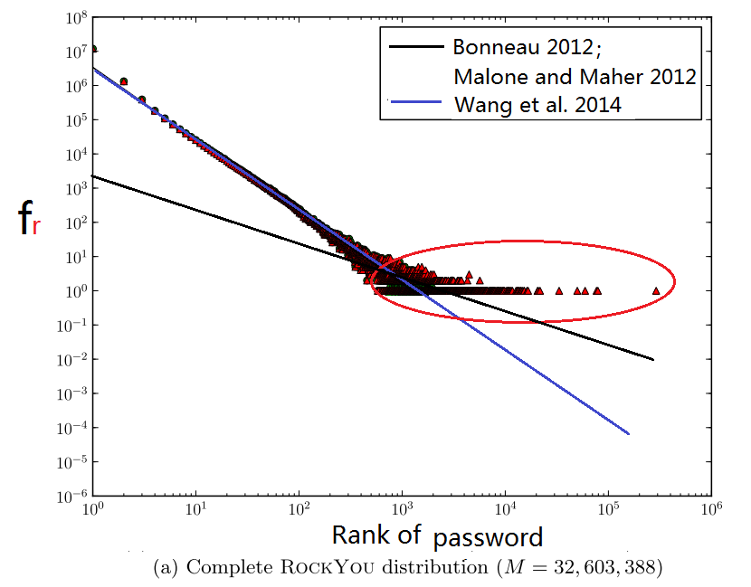
Earlier investigation attempts
In 2012, Bonneau (IEEE S&P’12) and
Malone and Maher (WWW’12) investigated
whether passwords follow a Zipf’s law.
  Their conclusion: passwords do not follow
  a Zipf’s law.
In 2014, Wang et al. found that after
eliminating these least frequent passwords,
passwords do follow a Zipf’s law.
  Eliminate these passwords with frequency f <4.
Notes:
Since human-spoken language follow the Zipf’s law, it is natural to test whether human-chosen password also follow the Zipf’s law.
At IEEE S&P’12, Bonneau investigated whether passwords follow a Zipf’s law. Almost at the same time, at WWW’12, Malone and Maher investigated this same question. They fitted the entire password dataset into the Zipf model, and see whther the fitted model well describe the real data. Their conclusion is that passwords do not follow the Zipf’s law.
In 2014, Wang et al. found that, after eliminating these least frequent passwords, passwords do follow a Zipf’s law. Wang et al. eliminated the passwords with frequency f <4, and their rationale is that the frequency of these unpopular passwords cannot reflect their probability because of the law of large numbers (大数定律).
As shown in the picture, when the unpopular passwords, as shown in the red circle, are eliminated, the remaining passwords well follow the Zipf’s law.

Slide 17
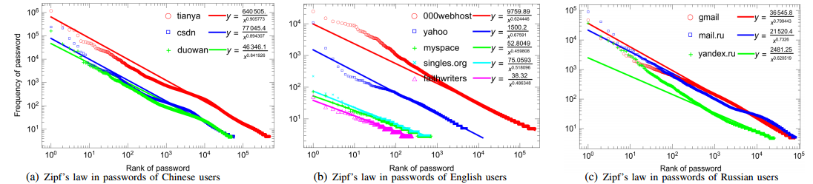
Wang et al.’s PDF-Zipf model
Wang et al.’s approach
  Eliminate these unpopular passwords (e.g., fr<4)
  Characterize the PDF graphs of popular passwords
  Linear regression based on least sequares
  Kolmogorov-Smirnov (KS) tests
Notes:
Wang et al.’s approach has four features:
First, it eliminates the unpopular passwords (e.g., fr<4)
Second, it characterizes the probability distribution function (PDF) graphs of popular passwords
Third, its linear regression is based on least sequares
Fourth, it uses the Kolmogorov-Smirnov (KS) tests
As shown in the picture, Wang et al.’s use 9 real-world datasets to show that their model are acceptable. We call Wang et al.’s model the PDF-Zipf model, because they try to characterize the PDF graphs of passwords.
An undersirable feature is that, the PDF-Zipf model can only describes the popular portion of passwords.

Slide 18
Outline
Introduction
Password distribution model
  Descriptions of our password datasets
  Review of the PDF-Zipf password distribution model
  Our CDF-Zipf password distribution model
Implications for password-based protocols
Implications for password creation policies
Implications for password strength metric
Conclusion
Notes:
To overcome this issue, we propose the CDF-Zipf model.

Slide 19


Our new model: CDF-Zipf
Our approach
  Model the entire password dataset
  Characterize the CDF graphs of entire passwords (because CDF and PDF are interdeducible)
  Linear regression based on the golden-section-search method
  Kolmogorov-Smirnov (KS) tests
Results
  This law implies that the cumulative frequency of passwords up to rank r increases polynomially with the increase of their rank r.
where C’ and s’ are constants depending on the corpus.
Notes:
In our new model, there are three differences:
Frist, we describe the entire password dataset
Second, we characterize the CDF graphs of entire passwords (because CDF and PDF are interdeducible)
Third, the linear regression is based on the golden-section-search method
Our CDF-Zipf model shows that the cumulative frequency (CDF) of passwords up to rank r increases polynomially with the increase of their rank r:
F_r=C’\cdot r^s’
where C’ and s’ are constants depending on the password corpus.

Slide 20
Our new model: CDF-Zipf
Our CDF-Zipf model implies that
  Fr(.) is a step function, because r = 1, 2, 3, · · · . Thus, we have
  The PDF graph of passwords follows a Zipf’s law
where C’ and s’ are constants.
Notes:
Our CDF-Zipf model implies that the PDF graph of passwords follows a Zipf’s law. See the bottom-right of the picuture.

Slide 21
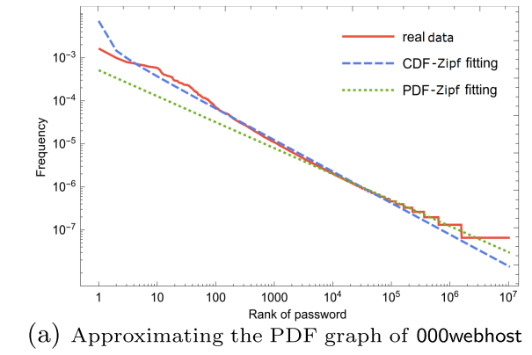
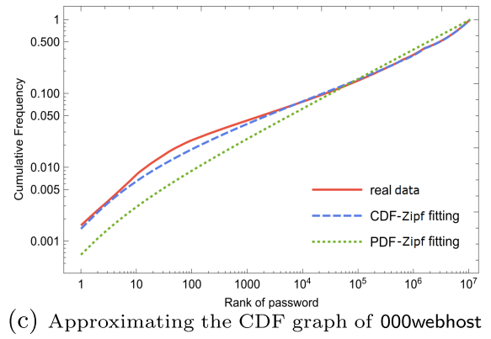
Comparing the CDF-Zipf model with the PDF-Zipf model
Notes:
Now let us compare the PDF-Zipf model with our CDF-Zipf model.
In the left picture, we plot the PDF graph of the 000webhost passowrds. One can see that, our CDF-Zipf model performs better: the red line stands for the PDF curve of real data, and the blue line stands for our CDF-Zipf model. In the right picture, we plot the CDF graph of the 000webhost passowrds. One can see that, our CDF-Zipf model also performs better.
Similar results can be found in all the other password datasets.

Slide 22
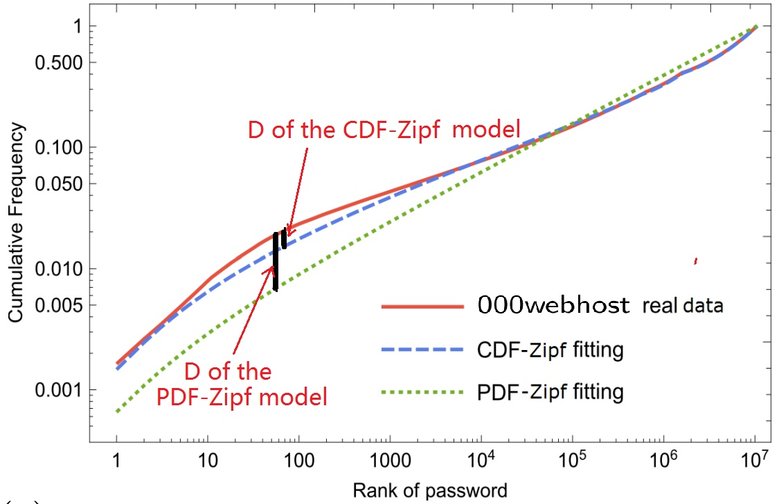

Comparing the CDF-Zipf model with the PDF-Zipf model
Quntify the difference of these two models
  metric: KS statistic D
D quantiﬁes the max distance between the CDF of an empirical distribution, namely Fn(x), and the CDF of the theoretic distribution, namely F(x).
the smaller the D, the better the model.
Notes:
Now we use the Statistic D to quatify the quantiﬁes the max distance between the CDF of an empirical distribution, namely Fn(x), and the CDF of the theoretic distribution, namely F(x).
As shown in the piciture, the smaller the D, the better the model will be.

Slide 23
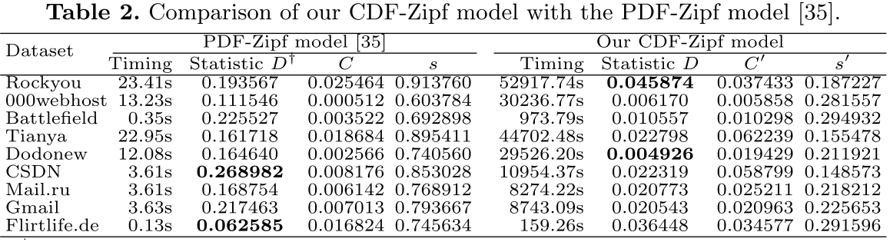
Comparing the CDF-Zipf model with the PDF-Zipf model (2)
In all cases, our CDF-Zipf model produces smaller D, which implies that it performs better than the PDF-Zipf model.
Notes:
As shown in the table, in all cases, our CDF-Zipf model produces smaller D, which implies that it performs better than the PDF-Zipf model.

Slide 24
Outline
Introduction
Password distribution model
  Descriptions of our password datasets
  Review of the PDF-Zipf password distribution model
  Our CDF-Zipf password distribution model
Implications for password-based protocols
Implications for password creation policies
Implications for password strength metric
Conclusion
Notes:
Next we show the implications for password-based protocols

Slide 25
Password-based protocols
The most widely used cryptographic protocols
  Simplicity, low-cost, scalability
Classification
  Password-based authentication
  Password-based encryption
  Password-based secret share
  Password-based signature
(for example)
Notes:
Password-based protocols are the most widely used cryptographic protocols because of their simplicity, low-cost and scalability.
According to their functions, password-based protocols can be classified into:
Password-based authentication;
Password-based encryption;
Password-based secret share;
Password-based signature;
Here we take password-based authentication as an example.

Slide 26







Existing formulations of attacker advantage
Generally, it is assumed that passwords are
drawn uniformly at random from a dictionary
of size , and with Q(k) online guesses,
where is the advantage of in attacking the password-based protocol , k is the system parameter, and is a negligiable function.
    Generally, |D|≈10⁶, and Q(k)<10⁴.
Notes:
In most of existing password-based authentication protocols, it is generally assumed that passwords are drawn uniformly at random from a dictionary D of size |D|, and with Q(k) online guesses, the attacker A’s advantages can captured in this formulation:
(see the ppt)
Where P stands for the password-based protocol, k is the system parameter, and ᵋ is a negligiable function.
Generally, the size of D roughly equals on million, and Q(k) is smaller than ten thousand.

Slide 27
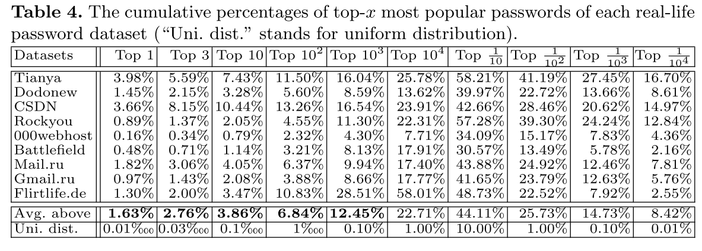
Issues in the existing formulation
The real advantage of the attacker is largely
underestimated
2~4 orders of magnitude under- estimation.
Notes:
In this kind of formulation, the advantage of the real attacker is largely underestimated. As shown in the table, there are 2~4 orders of magnitude of under-estimation.
(这个2~4 数量级是这样计算得到的：1.63/0.001=1630; 2.76/0.003=920; 3.86/0.1=38.6; … 预防有听众提问“这个2~4 数量级是怎样计算的”？）

Slide 28

Abdalla et al.’s formulation
In IEEE S&P’15, Abdalla et al. abandoned the tradition formulation (but did no explain why), and proposed to use the following formulation
As we will show later, this formulation greatly
overestimates the attacker’s advantage.
where m is the min-entropy of a password distribution.
Notes:
At IEEE S&P’15, Abdalla et al. abandoned the tradition formulation (but did no explain why), and proposed to use the following formulation:
where m is the min-entropy of a password distribution.
As we will show later, this formulation greatly overestimates the attacker’s advantage.

Slide 29
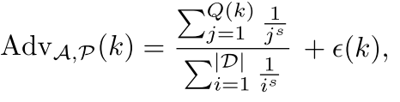

Our new formulations
Based on the PDF-Zipf model, we have
Based on the CDF-Zipf model, we have
Notes:
With the knowledge of the exact distribution of passwords, we propose two new formulations.

Slide 30
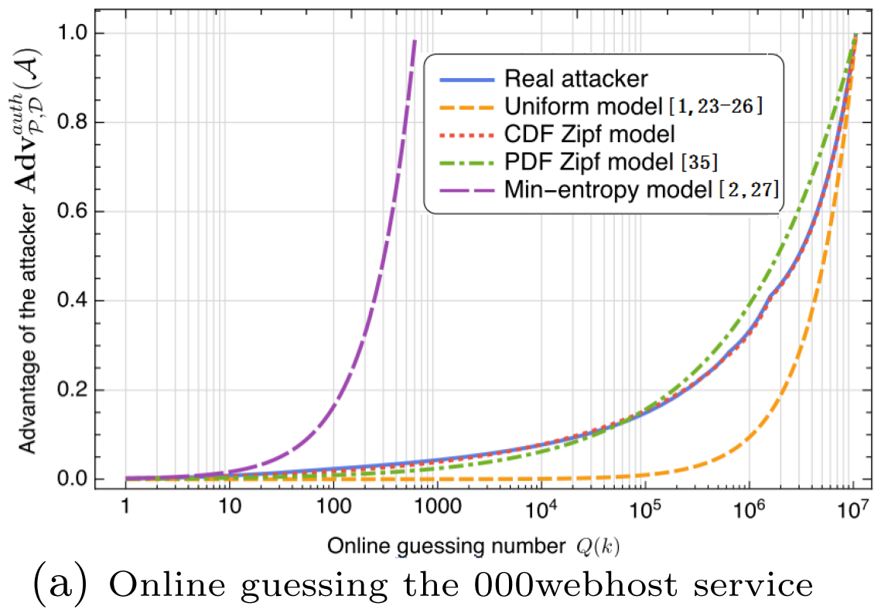
Comparison of various formulations
Our CDF-Zipf-based fourmation performs
the best.
This assertion holds in all our datasets.
Our CDF-Zipf model almost overlaps with the real attacker.
Notes:
Among the four fourmations, our CDF-Zipf-based formations performs the best. This assertion holds in all our datasets.
Interestingly, our CDF-Zipf model almost overlaps with the real attacker. See the blue solid line and the read dotted line.

Slide 31
Outline
Introduction
Password distribution model
  Descriptions of our password datasets
  Review of the PDF-Zipf model
  Our CDF-Zipf model
Implications for password-based protocols
Implications for password creation policies
Implications for password strength metric
Conclusion
Notes:
We now show implications for password creation policies.

Slide 32
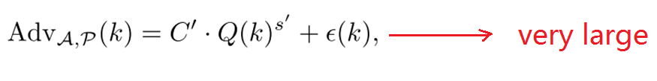

Popularity-based password policy
Users love to choose riskly popular passwords
To confine the attacker’s advantage, researchers
propose to disallow users from choosing
passwords that are popular than a threshold
.
    Question: How to choose this threshold T ?
Notes:
Since users love to choose riskly popular passwords, thus the advantages of guessing attackers will be very large.
To confine the attacker’s advantage, researchers propose to disallow users from choosing passwords that are popular than a threshold T.
How to choose this threshold T ?

Slide 33
How to set the popularity threshold T
Security vs. Usability
  Security---→ T as small as poaaible
  Usability---→ T shall not be too small, otherwise
  losts of users will be annoyed to
  choose a new password.
We can propose theoretical models to predict
what fraction of users will be anonyed.
  Thanks to the knowledge of the exact distribution
  function of passwords.
Notes:
We find that there is an conflict between Security and Usability:
On the ond hand, security requires that T as small as poaaible
On the other hand, usability requires that T shall not be too small, otherwise losts of users will be annoyed to choose a new password.
Fortunately, with the knowledge of the exact distribution of passwords, we can propose theoretical models to predict what fraction of users will be anonyed and set an appropriate T accordingly.

Slide 34


Our theoretical models
Given the threshold T, we can predict the fractons of passwords that will be potentially
affected:
where
Given the threshold T, we can predict the fractons of passwords that will be actually
affected:
Notes:
Given the threshold T, we can predict the fractons of passwords that will be potentially and actually affected.

Slide 35



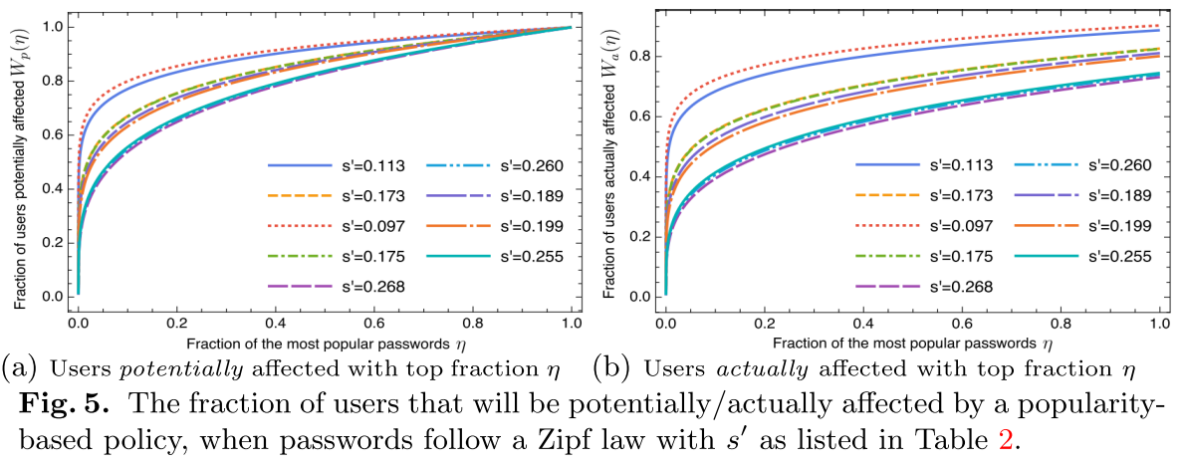
Our theoretical models (2)
Large fraction of users will be annoyed even if
is small, e.g., T =1/16384,
= 0.0022%, 11.64%.
Notes:
Based on our prediction models and the Zipf parameters, we can find that very large fraction of users will be annoyed if the threshold T is small.

Slide 36
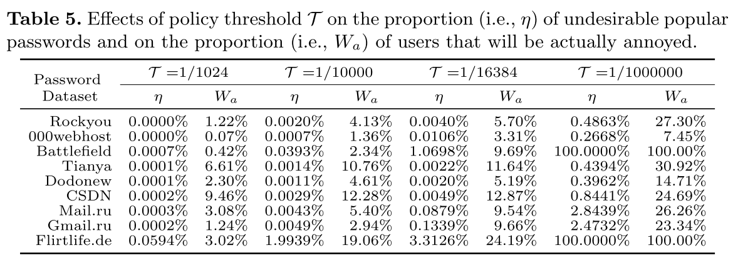
Our suggestions
T=1/16384 is better than T=1/10⁶ (widely recommented).
  If T=1/16384, then about 10% of users are annoyed.
  If T=1/10⁶, then about 25% of users are annoyed.
Notes:
Based on our prediction models, we find that T=1/16384 is more practical than T=1/1000000.

Slide 37
Outline
Introduction
Password distribution model
  Descriptions of our password datasets
  Review of the PDF-Zipf password distribution model
  Our CDF-Zipf password distribution model
Implications for password-based protocols
Implications for password creation policies
Implications for password strength metric
Conclusion
Notes:
In the following, we show the Implications for password strength metric α-guesswork. .

Slide 38






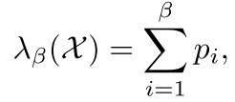
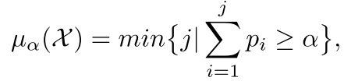
Review of password strength metric
Preliminary definitions
  stands for the password distribution, and each password is randomly drawn from with a probability , where
  Without loss of generality, suppose
  where N is the total number of possible individual passwords in .
  β-success-rate
  α-work-factor
Notes:
First of all, we give some preliminary defintions. Time is limited, I skip these details.

Slide 39
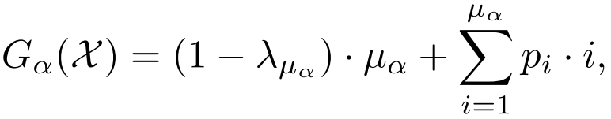


Review of password strength metric
α-guesswork
  It is a widely used statistical password strength metric.
  It won the 2013 NSA best paper award.
  It is believed to be non-deterministic——
  it is believed to be always parameterized on the success rate α .
(e.g., a relationship of can
never guarantee that )
Notes:
α-guesswork has won the 2013 NSA best paper award, and widely used.
It is believed to be always parameterized on the success rate α.

Slide 40
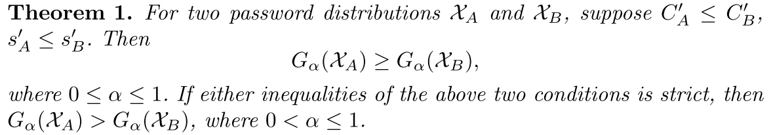
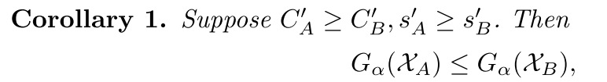
Determinism of α-guesswork
  We find α-guesswork is actually deterministic
  in two out of four cases.
Notes:
We find α-guesswork is actually deterministic in two out of four cases. We have one theorem and one corollary.

Slide 41
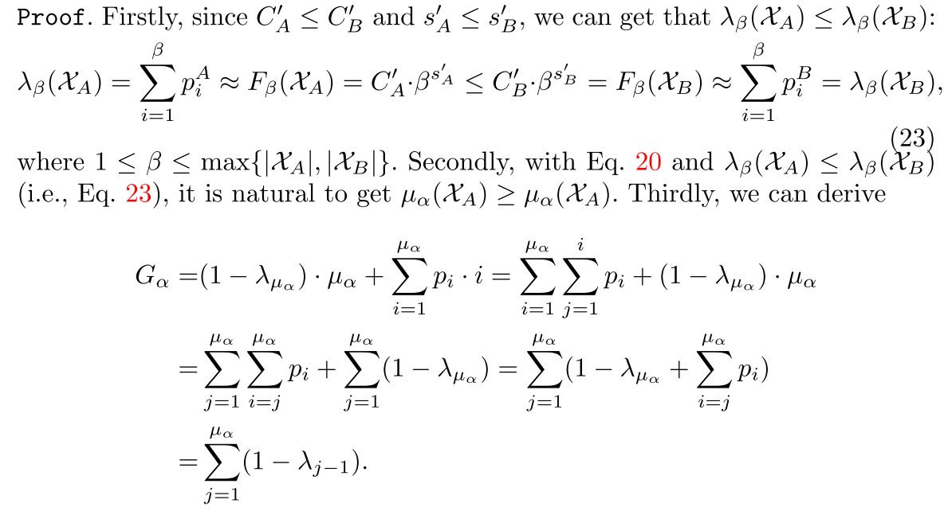
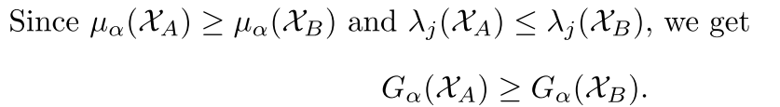
Proof for theorem 1
Notes:
This is the formal proof of theorem 1. Time is limited and we omit the details.

Slide 42
Outline
Introduction
Password distribution model
  Descriptions of our password datasets
  Review of the PDF-Zipf password distribution model
  Our CDF-Zipf password distribution model
Implications for password-based protocols
Implications for password creation policies
Implications for password strength metric
Conclusion
Notes:
Now we come the conclusion.

Slide 43
Conclusion
We propose a new password distribution model CDF-Zipf.
We propose to use to
capture the attacker’s advantage.
We suggest a series of theoretical models for predicting user annoyance, and show that
setting T=1/16384 is better than 1/1000000.
We formally prove that α-guesswork is deterministic in two out of four cases.
Notes:
To summarize, we
We proposed a new password distribution model CDF-Zipf.
Based on this new password distribution model, we have explored three interesting implications.

Slide 44
Future work
Investigate what is the underlying mechanism that leads to the emergence of Zipf’s law in passwords.
Explore how Zipf’s law can be applied into other situations
  honeywords generation
  password hash
  user studies
  etc.
Notes:
For the future work, we plan to ……(just read the ppt words)

Slide 45

THANK YOU & QUESTIONS
Notes:
Thank you.

