Slide 1
Fundamentals of Git
By Vibhore Kapoor
31 August, 2016

Slide 2
Command line basics
Work without a GUI

Slide 3
Simple command line
Open Git Bash terminal
Where am I??
  pwd – print working directory
How do I move around??
  cd – change directory
  cd c:/target_folder – change to a specific path
  cd .. – change to parent directory.
What files are there?
  ls – list
  ls - l – list with details

Slide 4
More command line
Use up/down arrow to select/repeat commands
Click on icon in top left corner to change properties of the command window OR edit (e.g., copy, paste)
May be able to use tab completion

Slide 5
Git Basics

Slide 6
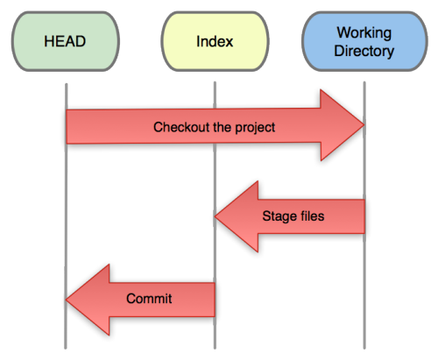
Getting Started
Three trees of Git
  The HEAD
    last commit snapshot, next parent
  Index
    Proposed next commit snapshot
  Working directory
    Sandbox

Slide 7
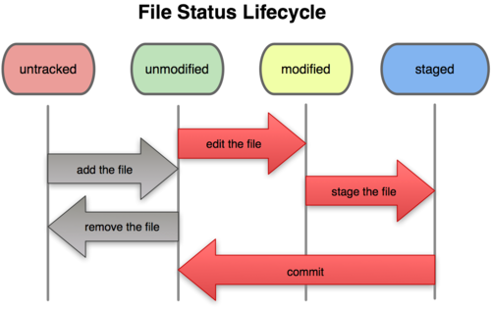
Git file lifecycle

Slide 8
Getting Started
A basic workflow
  (Possible init or clone) Initialise a repo
  Edit files
  Stage the changes
  Review your changes
  Commit the changes

Slide 9
Getting Started
Git init
This creates a new subdirectory named ‘.git’ that contains necessary repository files.
Git clone
This creates a copy of a remote repository on our local machine, and is automatically initiated.

Slide 10
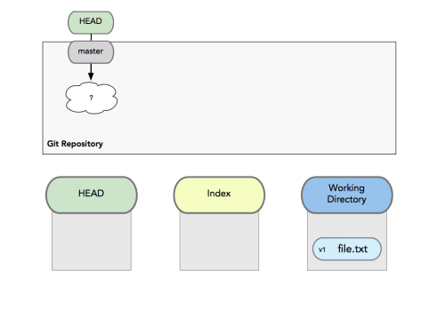
Getting Started
A basic workflow
  Edit files
  Stage the changes
  Review your changes
  Commit the changes

Slide 11
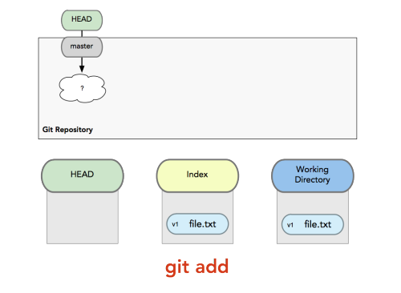
Getting Started
A basic workflow
  Edit files
  Stage the changes
  Review your changes
  Commit the changes
Git add filename

Slide 12
Getting Started
A basic workflow
  Edit files
  Stage the changes
  Review your changes
  Commit the changes
Git status

Slide 13
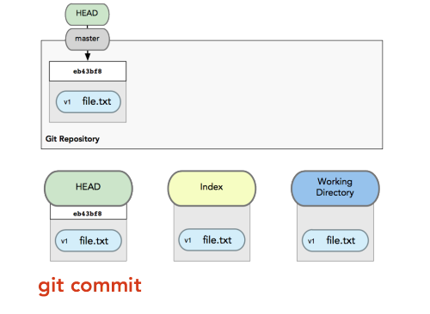
Getting Started
A basic workflow
  Edit files
  Stage the changes
  Review your changes
  Commit the changes
Git commit

Slide 14
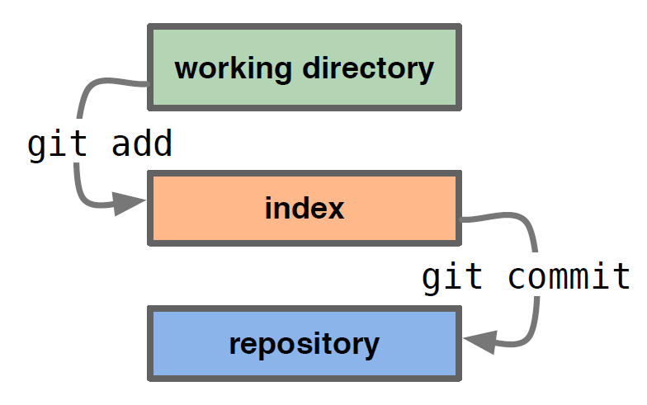
Getting Started
A basic workflow
  Edit files
  Stage the changes
  Review your changes
  Commit the changes

Slide 15
View Changes
Git diff
  Show the difference between working directory and staged
Git diff --cached
  Show the difference between staged and the HEAD
Git log
View history

Slide 16
Undoing Things
git revert
This command creates a new commit that undoes the changes from a previous commit. This command adds new history to the project (it doesn't modify existing history).
git checkout
This command checks-out content from the repository and puts it in your work tree. It can also have other effects, depending on how the command was invoked. For instance, it can also change which branch you are currently working on. This command doesn't make any changes to the history.
git reset
This command is a little more complicated. It actually does a couple of different things depending on how it is invoked. It modifies the index (the so-called "staging area"). Or it changes which commit a branch head is currently pointing at. This command may alter existing history (by changing the commit that a branch references). For more info, visit https://git-scm.com/blog .

Slide 17
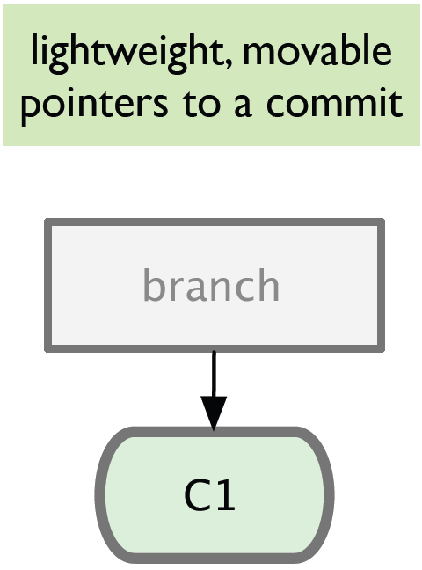
Branching
Branching means you diverge from the main line of development and continue to do work without messing with that main line.

Slide 18
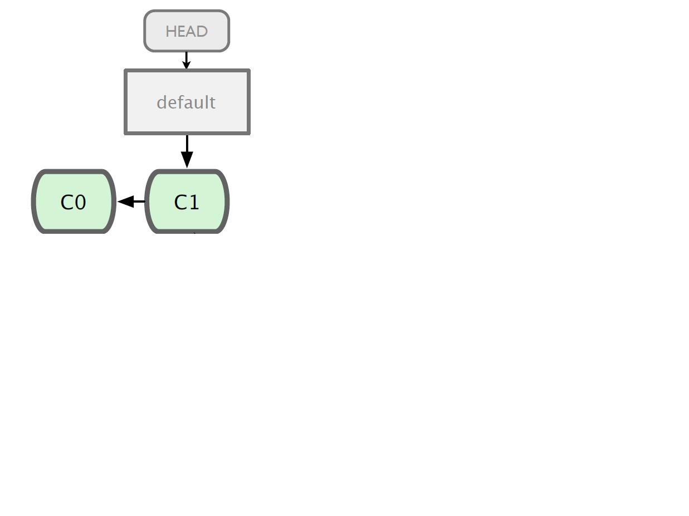
Branching

Slide 19
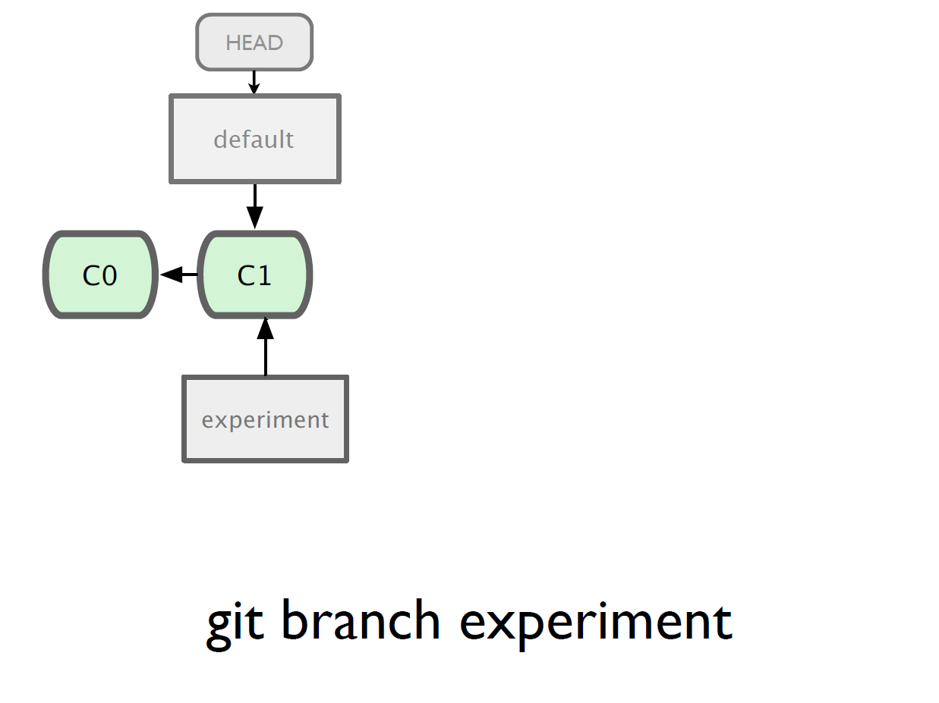

Slide 20
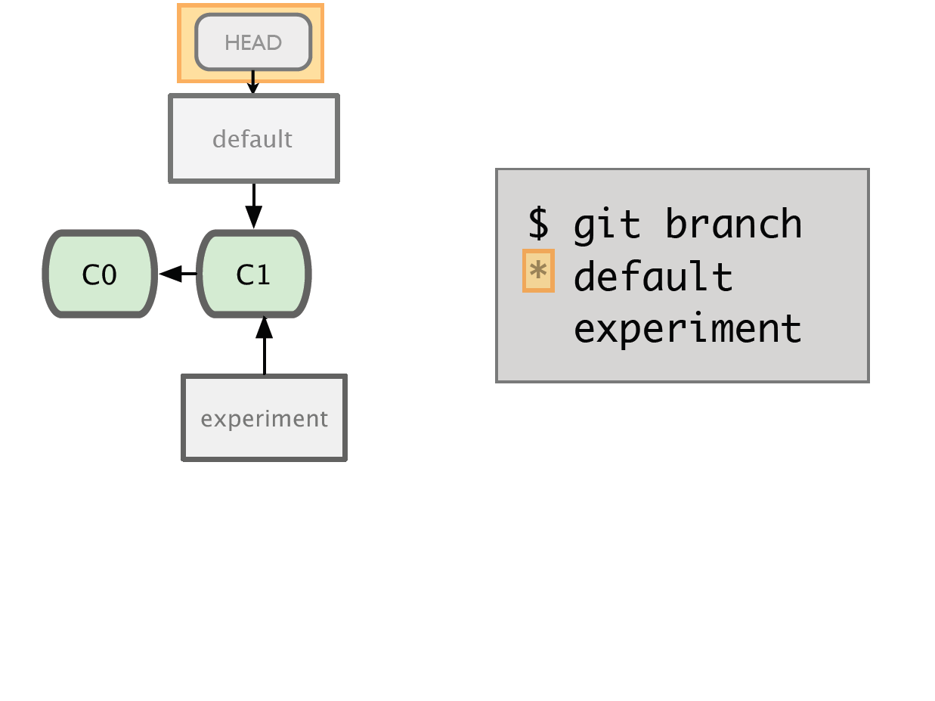

Slide 21
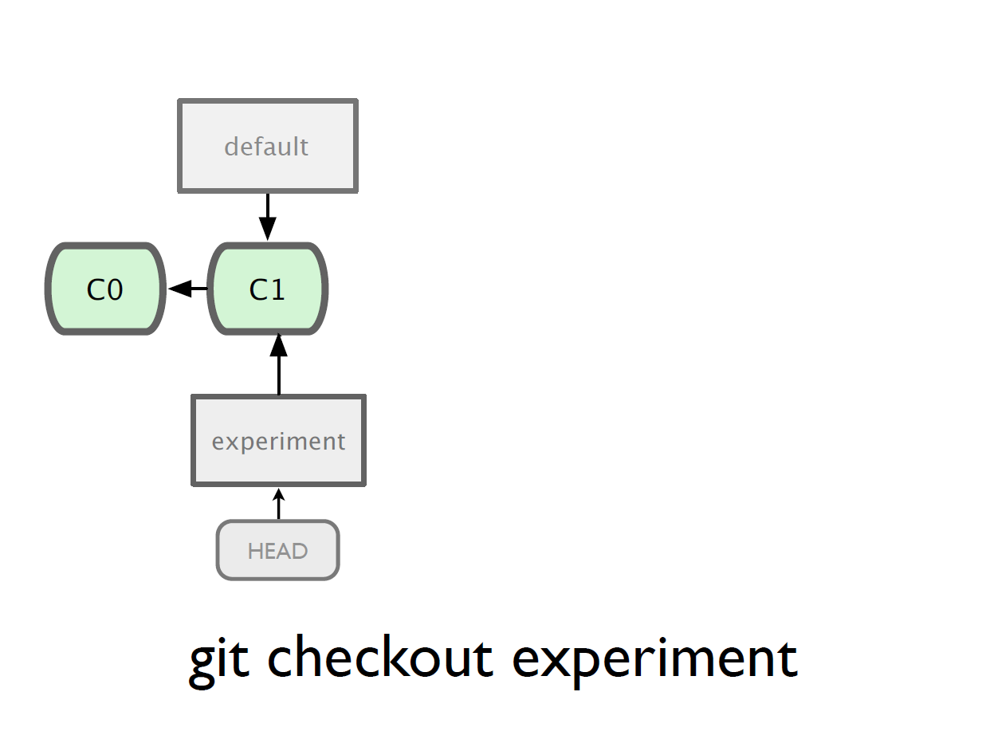

Slide 22
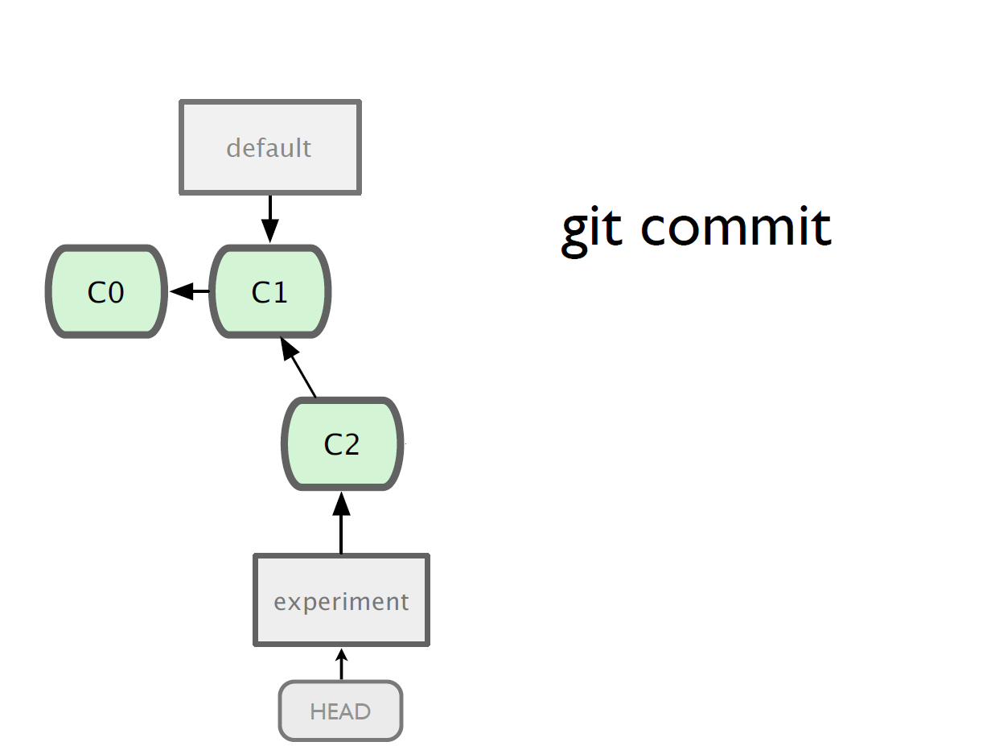

Slide 23
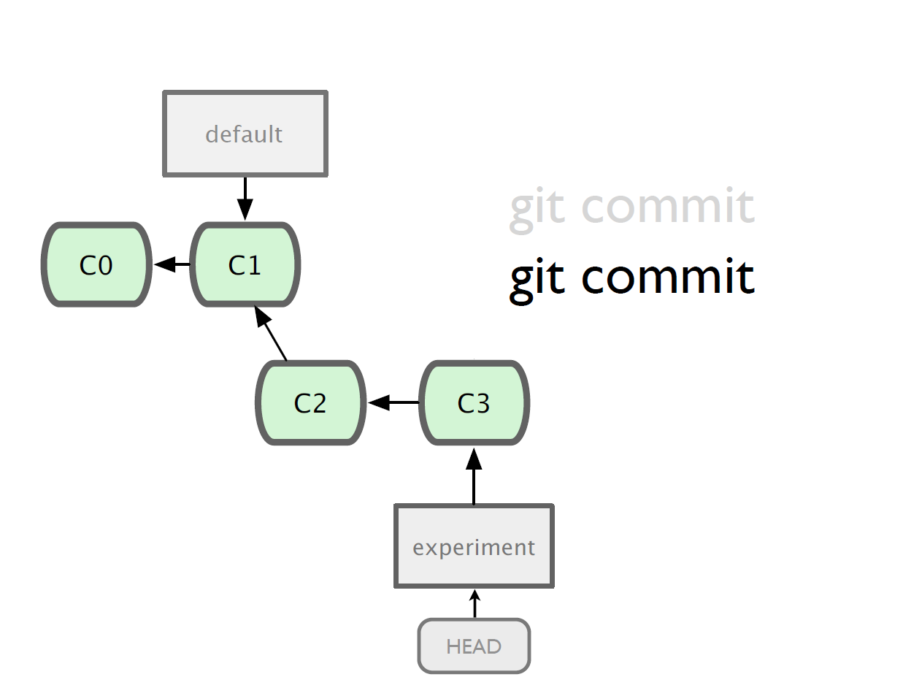

Slide 24
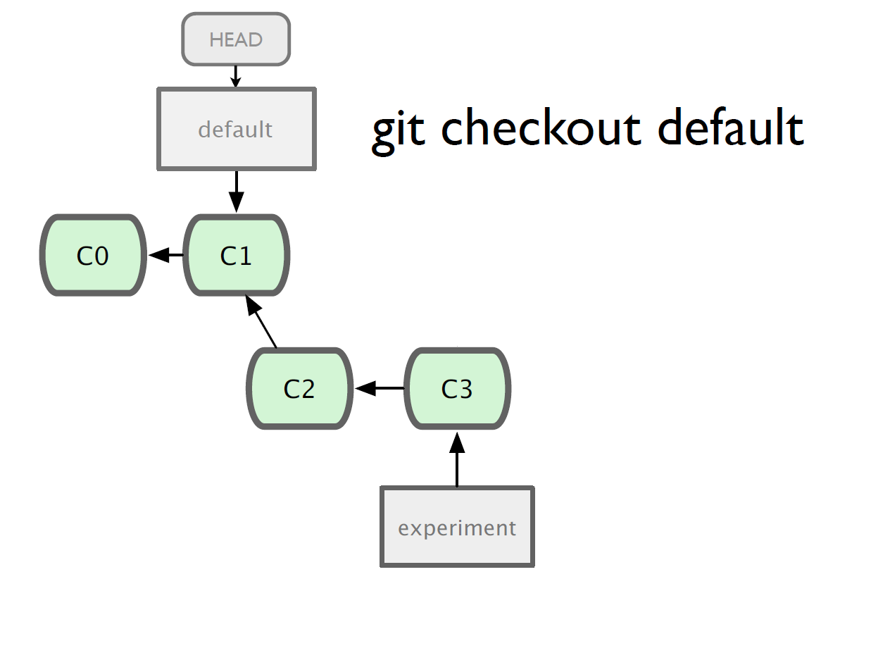

Slide 25
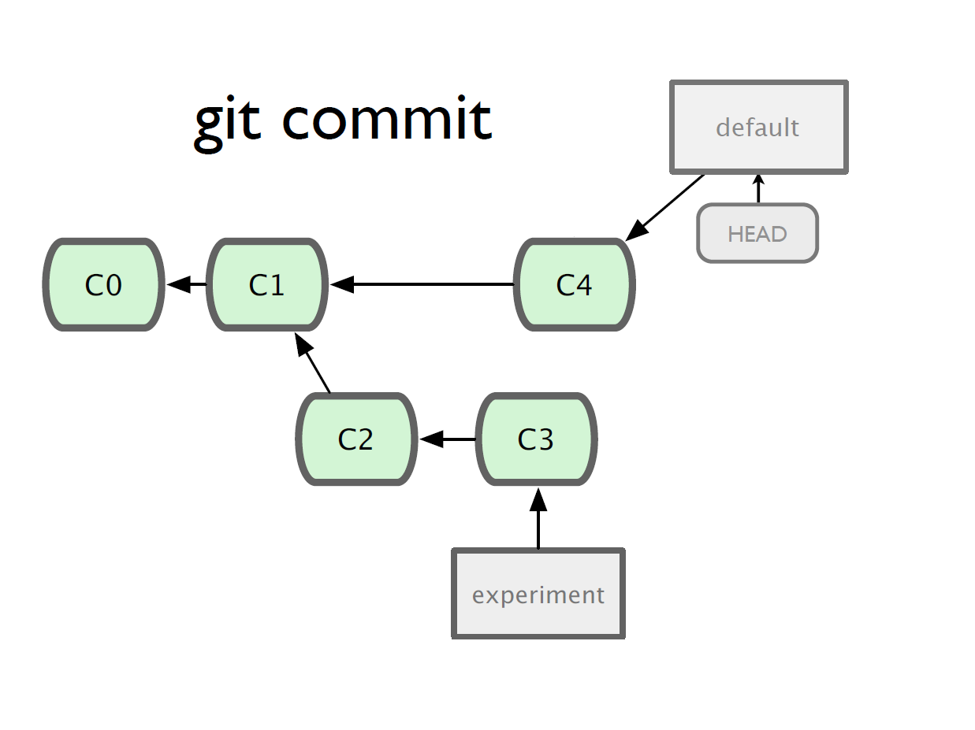

Slide 26
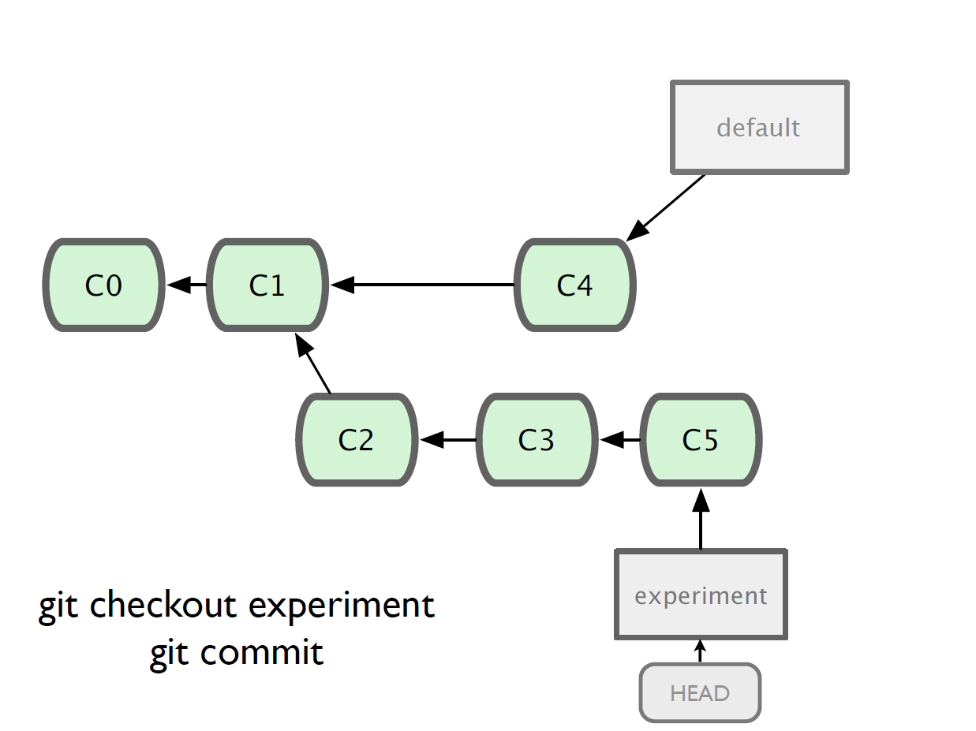

Slide 27
Merging
What do we do with this mess?
  Merge them

Slide 28
Merging
Steps to merge two branch
  Checkout the branch you want to merge onto
  Merge the branch you want to merge

Slide 29
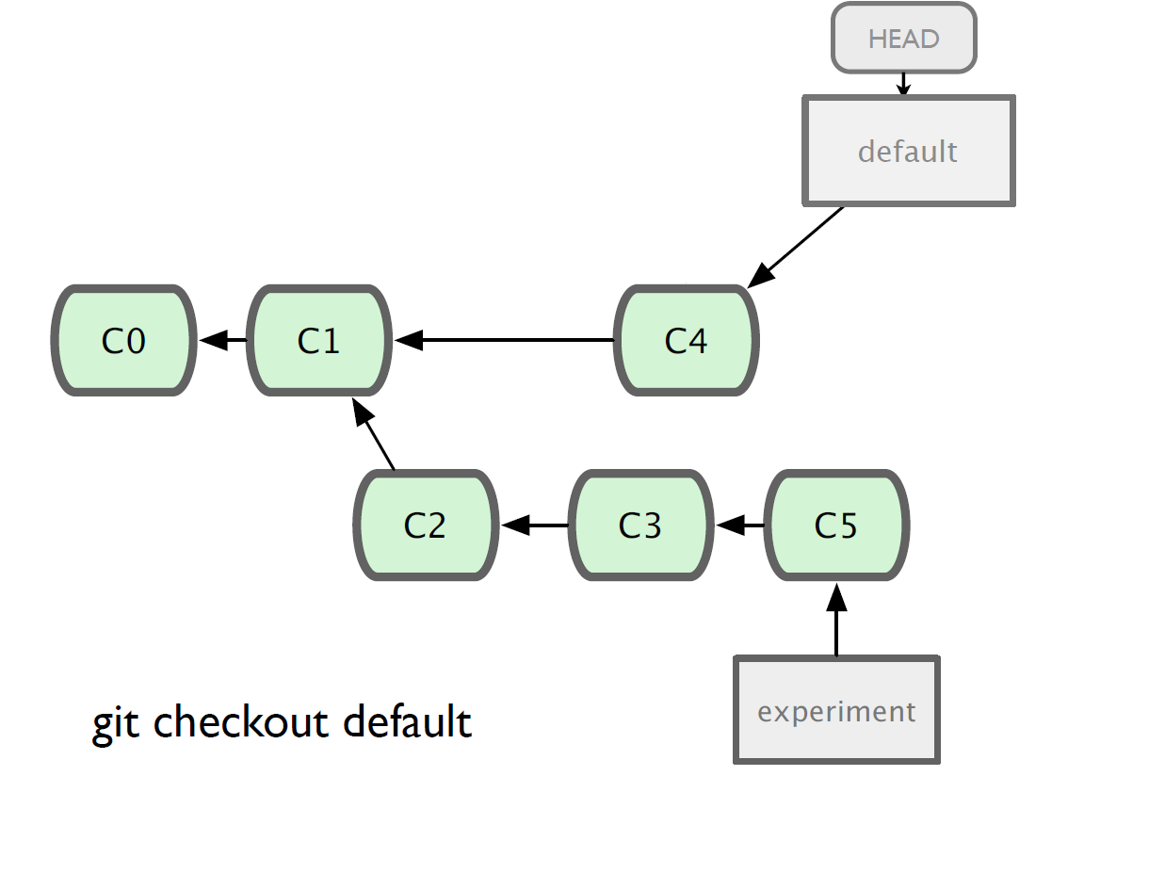

Slide 30
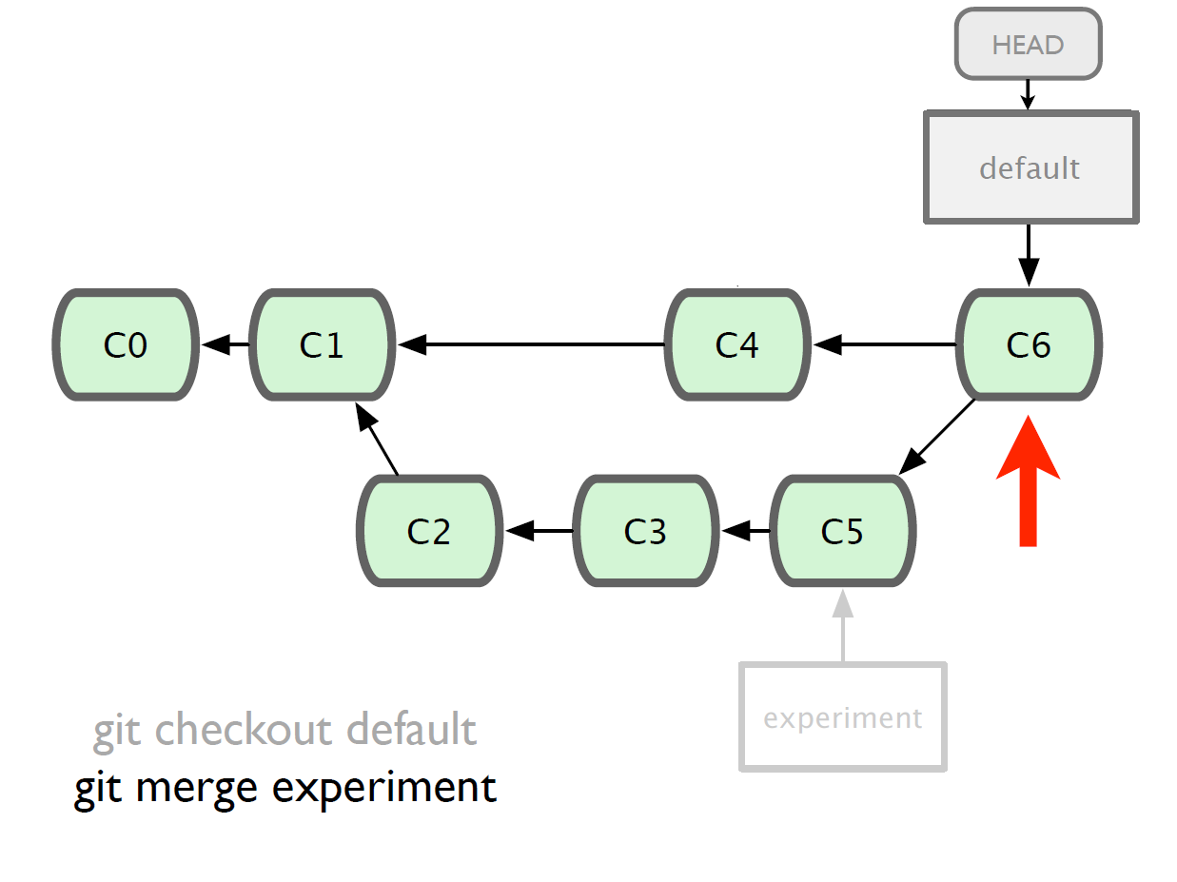

Slide 31
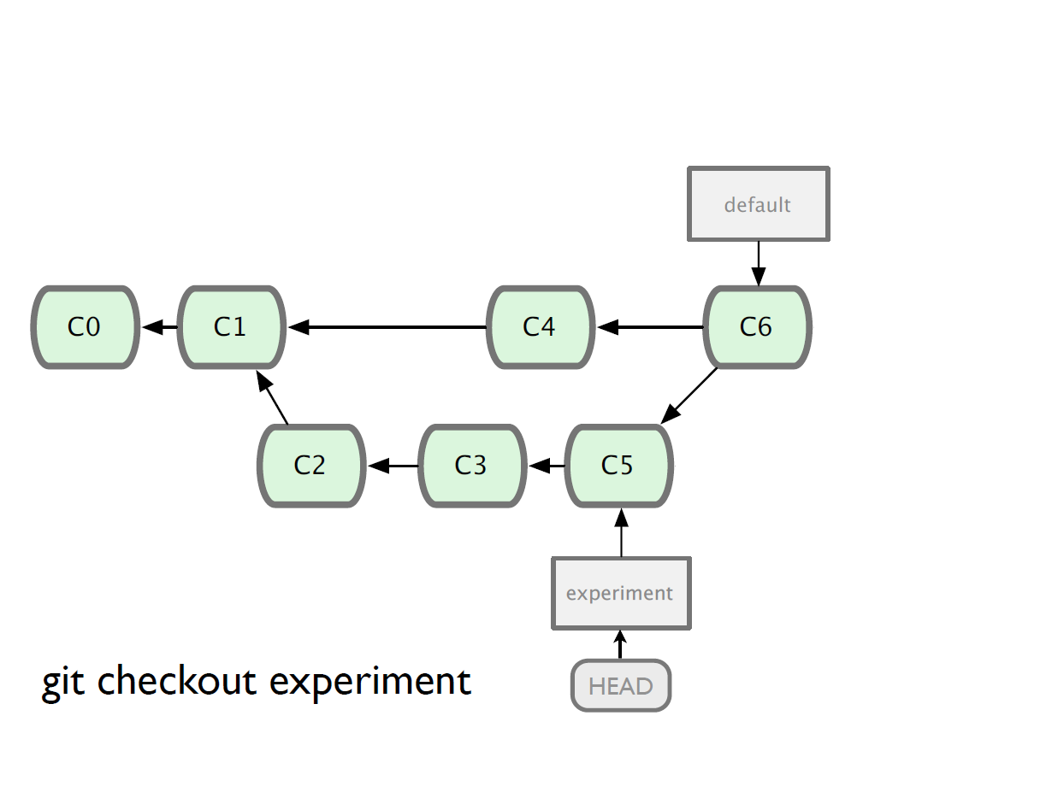

Slide 32
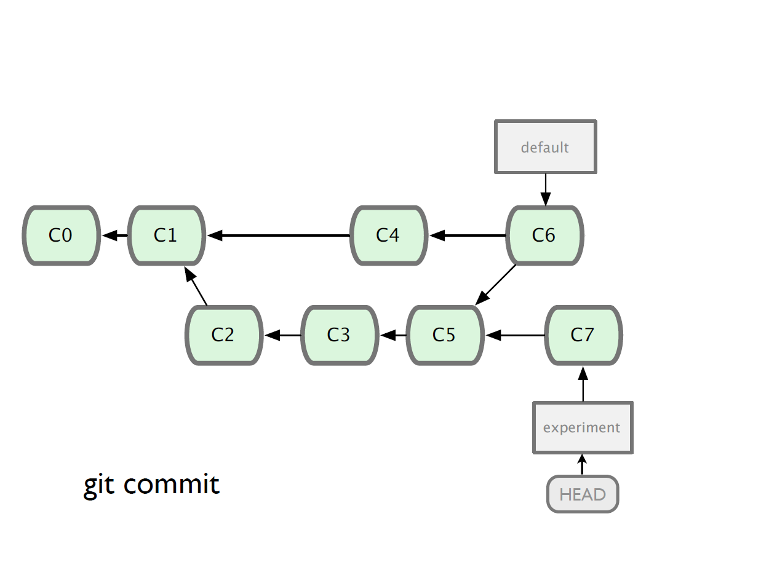

Slide 33
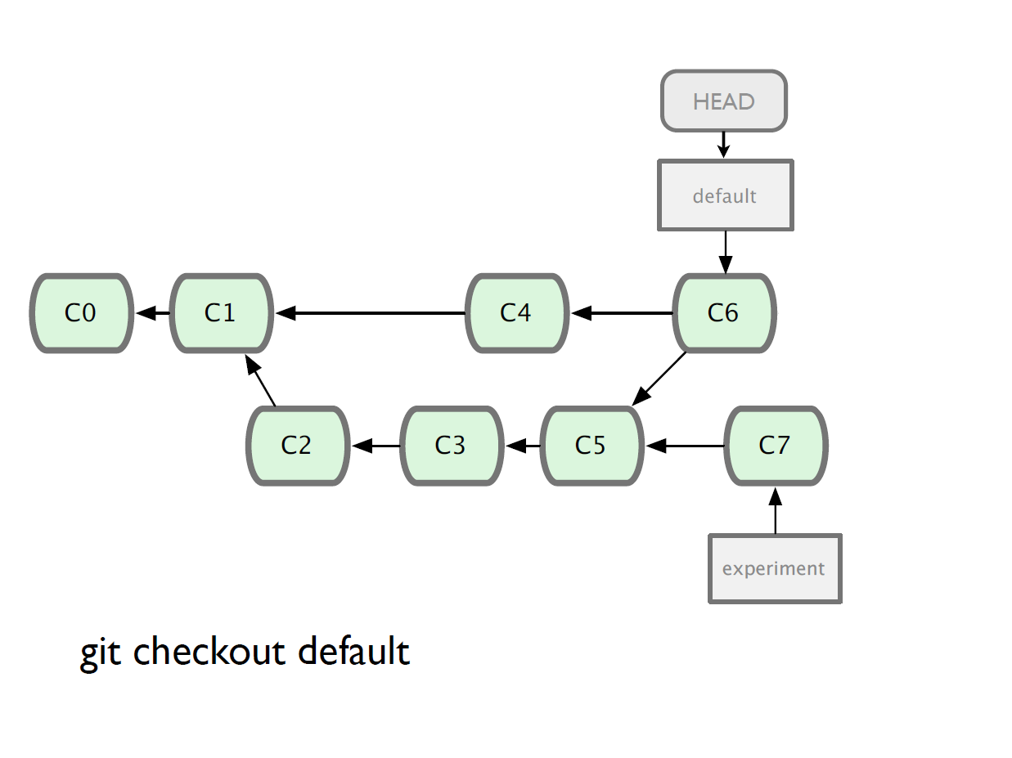

Slide 34
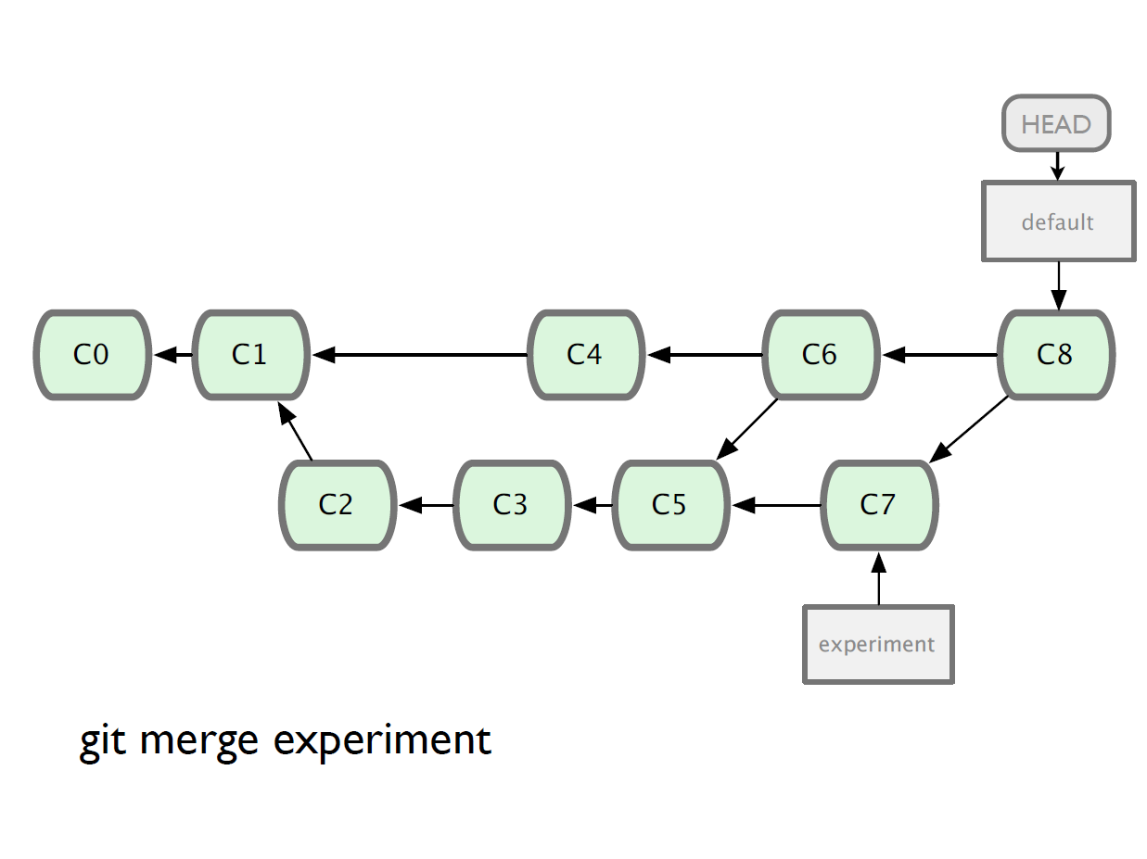

Slide 35
Working with remote
Use git clone to replicate repository
Get changes with
  git fetch
  git pull (fetches and merges)
Propagate changes with
  git push
Protocols
  Local filesystem (file://)
  SSH (ssh://)
  HTTP (http:// https://)
  Git protocol (git://)

Slide 36
Pulling and Pushing
Good practice:
Add and Commit your changes to your local repo
Pull from remote repo to get most recent changes (fix conflicts if necessary, add and commit them to your local repo)
Push your changes to the remote repo
To fetch the most recent updates from the remote repo into your local repo, and put them into your working directory:
$ git pull origin master
To push your changes from your local repo to the remote repo:
$ git push origin master
Notes: origin = an alias for the URL you cloned from
master = the remote branch you are pulling from/pushing to,
(the local branch you are pulling to/pushing from is your current branch)
Notes:
$ git remote -v
origin https://github.com/rea2000/santalist.git (fetch)
origin https://github.com/rea2000/santalist.git (push)

Slide 37
.gitignore
It’s important to tell Git what files you do not want to track
Temp files, executable files, etc. do not need version control (and can cause major issues when merging!)
https://help.github.com/articles/ignoring-files
Example (place in root of repo):
  *.class
  .project
  .classpath
  .settings/
repo
ignore
eclipse
exec
What is a hidden file?

Slide 38
Tell Git who you are
Update your config, one time only
  git config --global user.name “Vibhore Kapoor”
  git config --global user.email myemail@gmail.com
  git config --list (or git config –l)

Slide 39
So what is github?
GitHub.com is a site for online storage of Git repositories.
Many open source projects use it, such as the Linux kernel.
You can get free space for open source projects or you can pay for private projects.
Question: Do I have to use github to use Git?
Answer: No!
you can use Git completely locally for your own purposes, or
you or someone else could set up a server to share files, or
you could share a repo with users on the same file system.

Slide 40
Q&A
Any questions?

