Slide 1
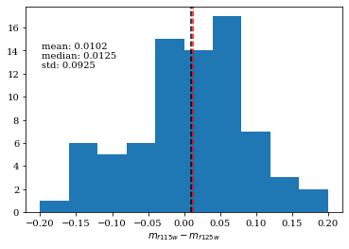
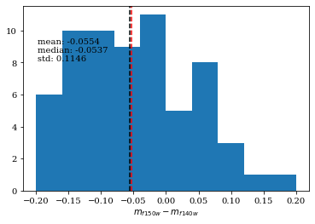
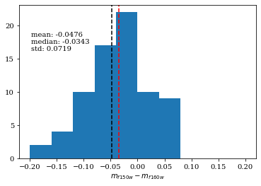
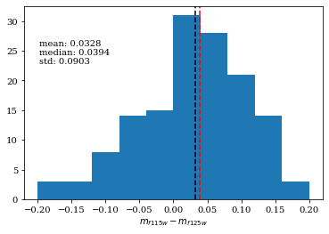
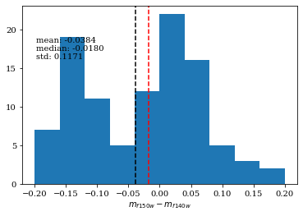
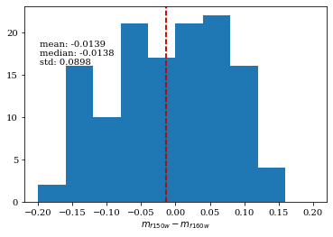
If significant magnitude offset in CEERS photometry?
JWST pipeline version 1.5.3: need add +0.05 mag to photometry for F115W and +0.15 mag for F150W
CEERS data release 0.5: Pipeline version 1.7.2
Magnitude offset is smaller than 0.06, which may caused by difference in filters.
Masafusa Onoue + 2023

Slide 2
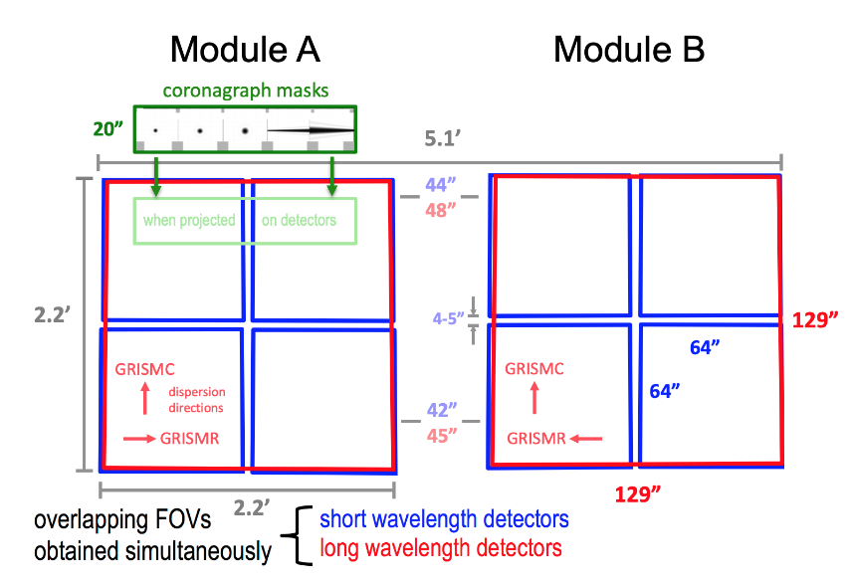
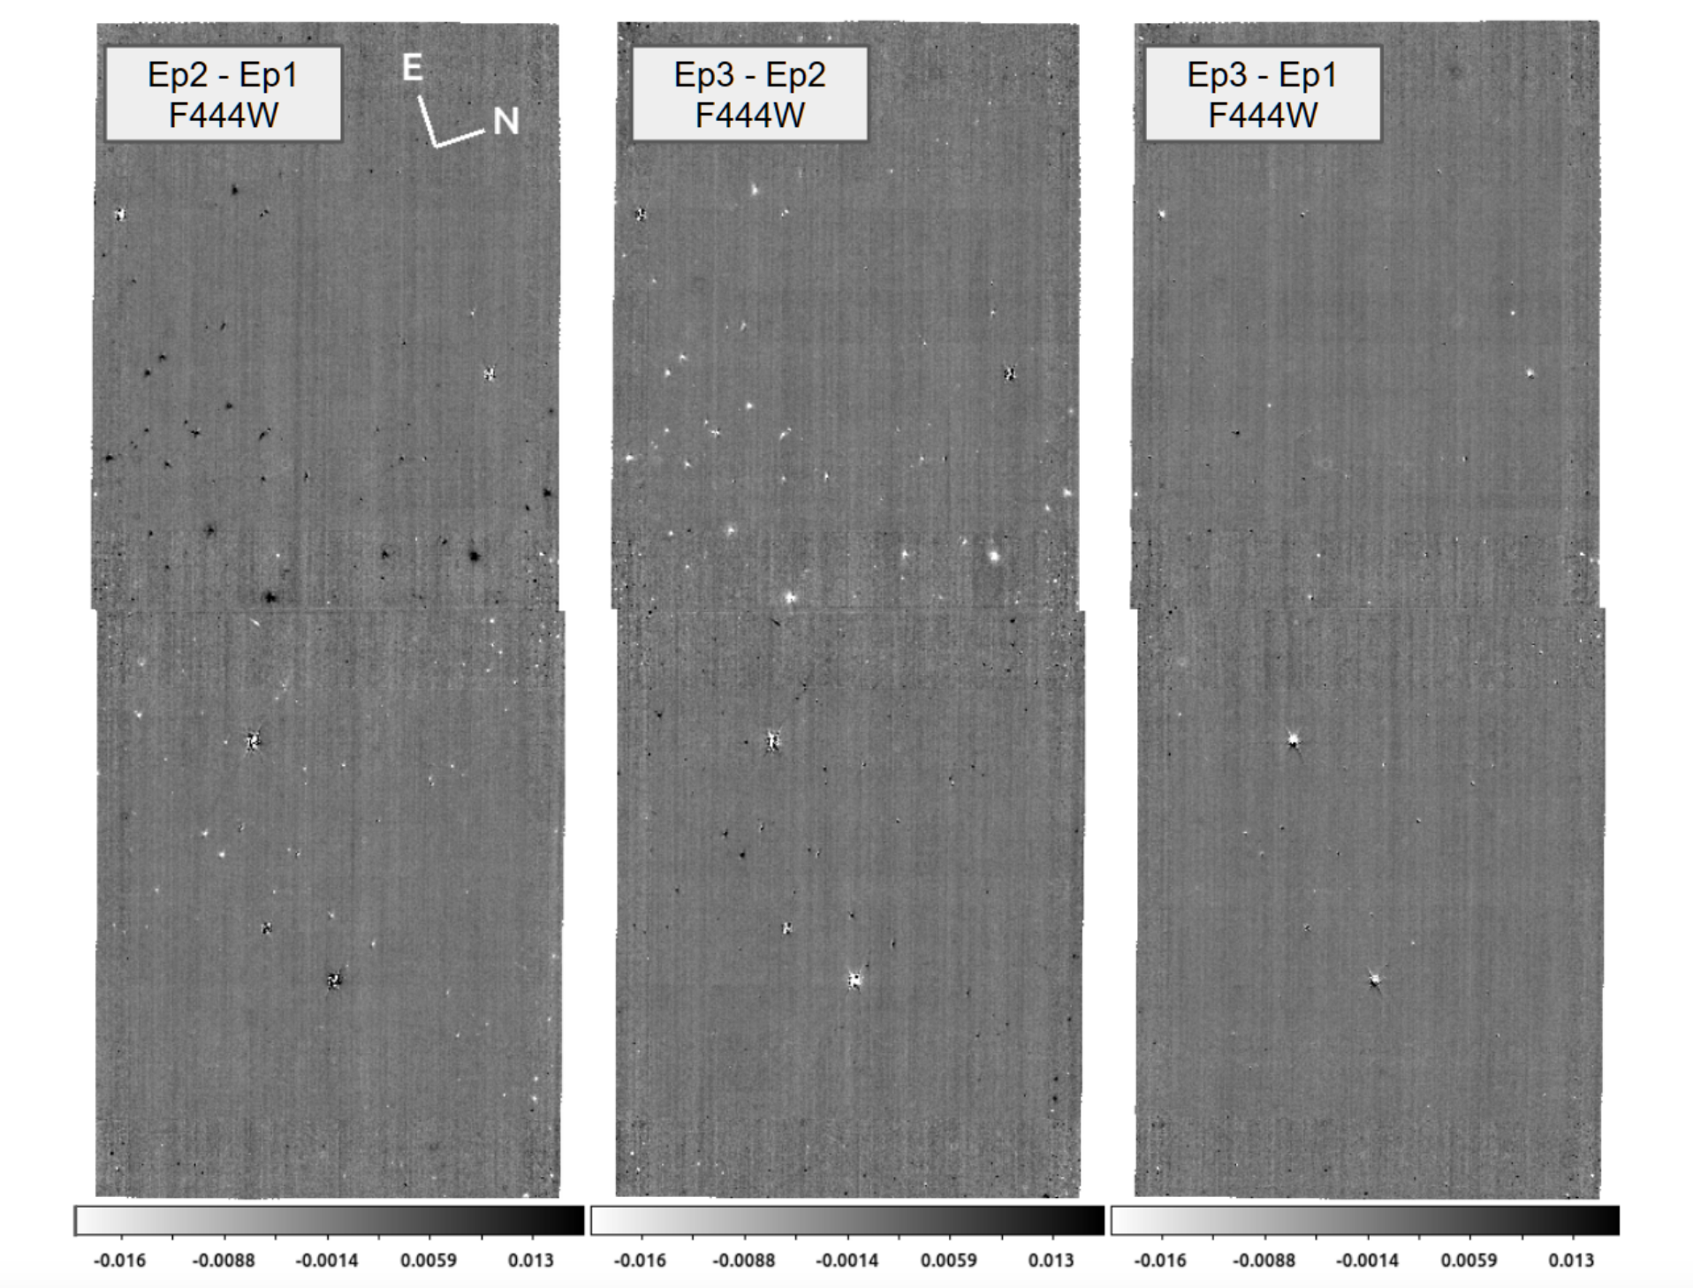
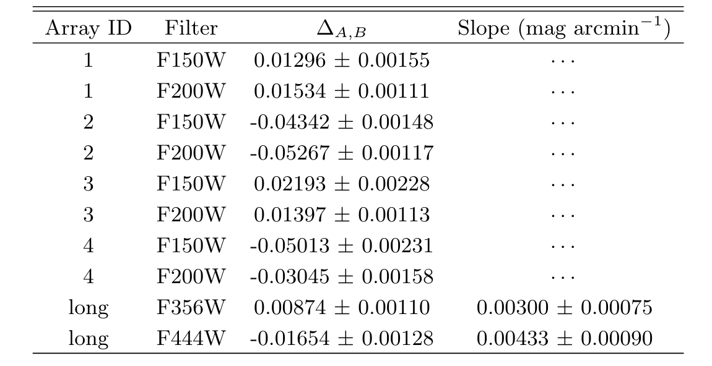
Magnitude offset in module A&B

Slide 3
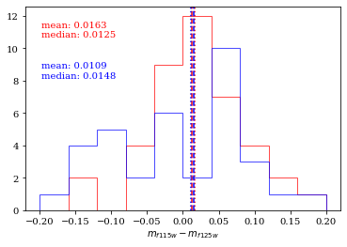
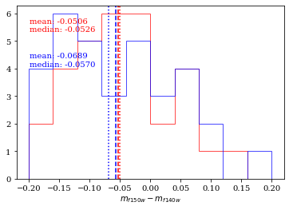
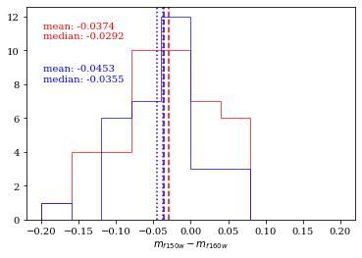
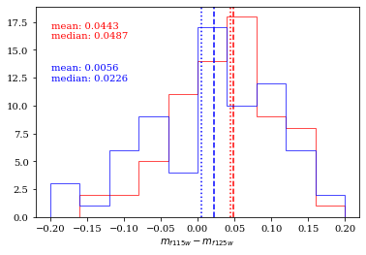
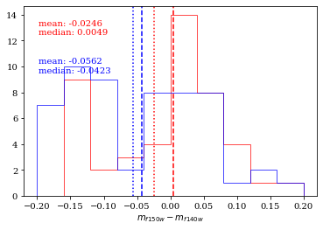
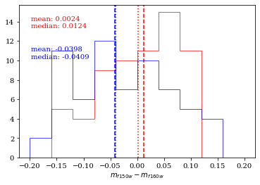
Module A v.s. Module B
Data release 0.5 (pipeline 1.7.2): no significant offset
Data release 0.6 (pipeline 1.8.5): offset ~0.03mag

Slide 4
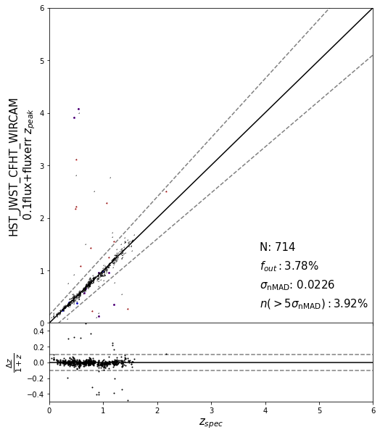
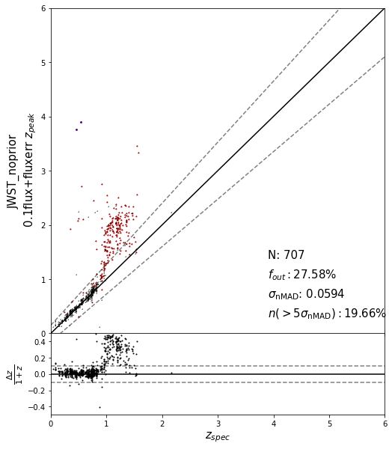
CEERS uncertainty: 0.1*flux + fluxerr
Compare with 3.53%
Compare with 4.53%

Slide 5
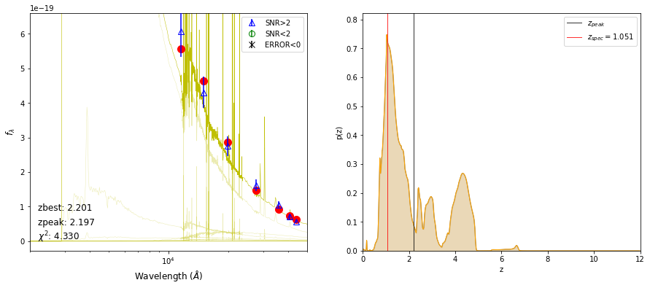
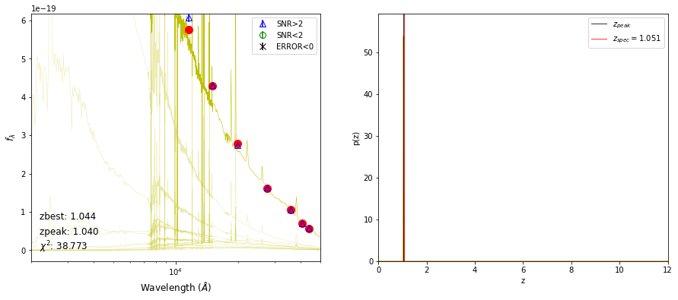
Fluxerr = 0.1*flux + origin error

Slide 6
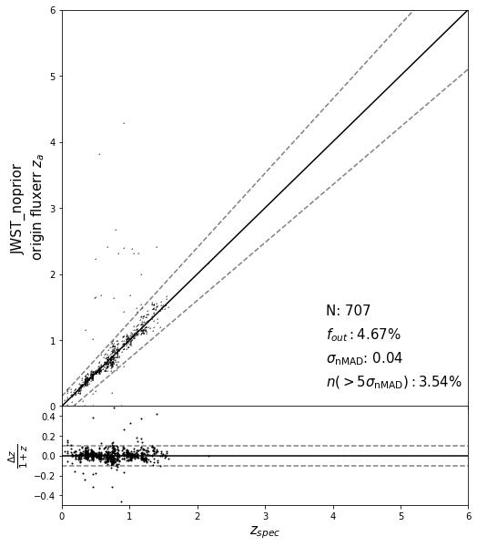

Compare z_peak 4.53%

Slide 7
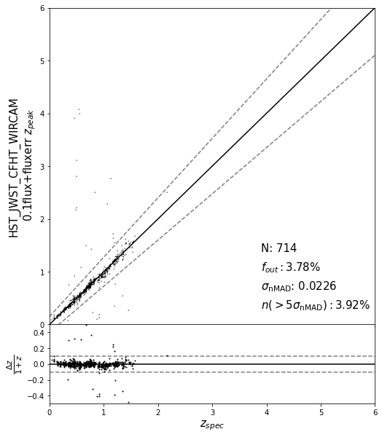
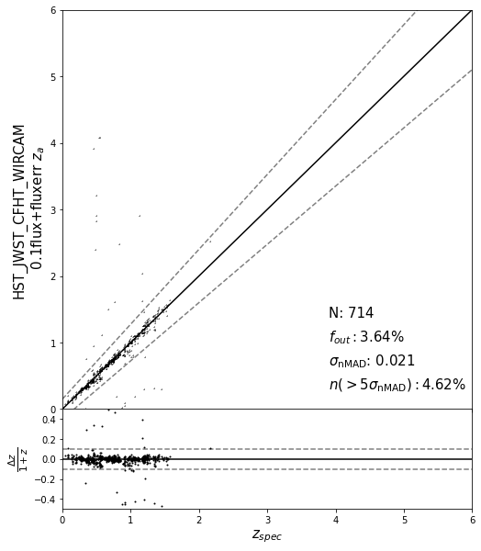
Z_a get better outlier fraction and scatter

Slide 8
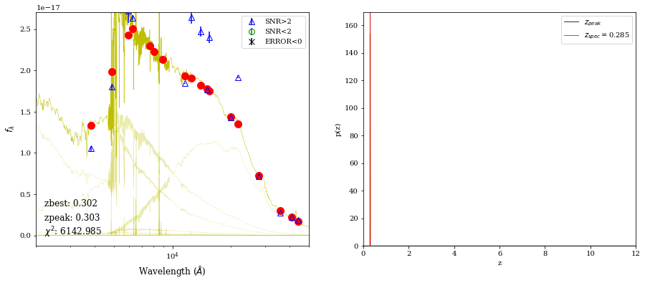
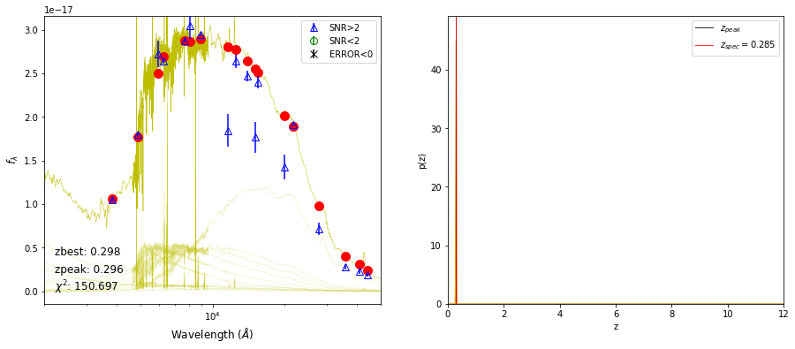
Origin fluxerr
0.1*flux+origin fluxerr

Slide 9
Conclusion
It is advisable not to modify the flux values, but the flux error can be adjusted appropriately;
For JWST photometry, z_a in Eazy is a better choice;

