Slide 1


Deepika Suberi Karma Dorji Tek Nath Acharya Karma Tshewang Guide: Mr. Parshu Ram Dhungyel
Smart Campus
Mobile Application

Slide 2
Outline
Pilot Study
Problem Statement
Introduction
Aims and Objectives
Scope
Literature Review
Methodology
Risk Analysis and Challenges
Project Millstones
Expected Outcome
Conclusion
References

Slide 3

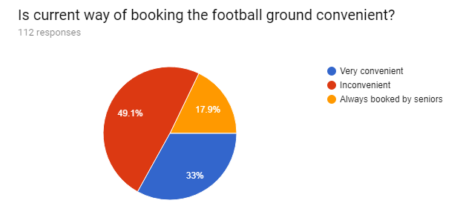
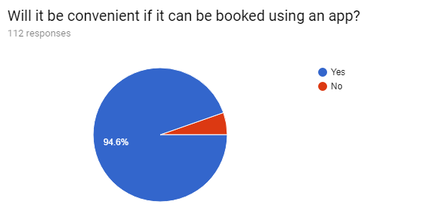

Pilot Study
3

Slide 4
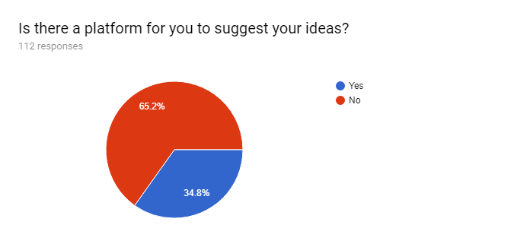
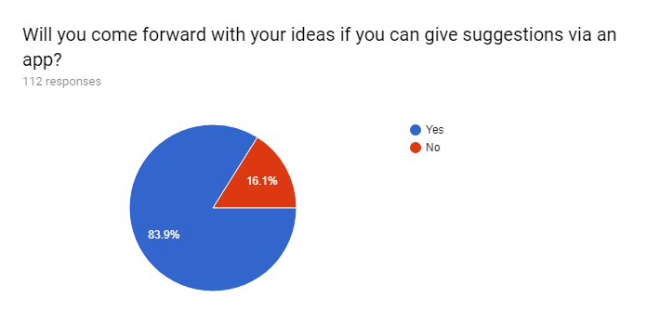
Pilot Study
8/25/2018
4

Slide 5
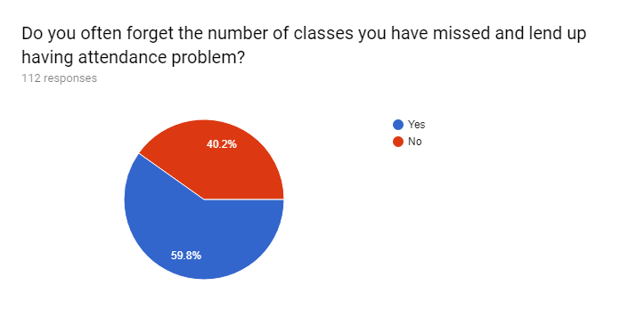
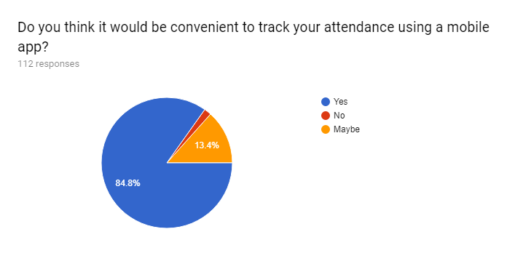
Pilot Study
8/25/2018
5

Slide 6
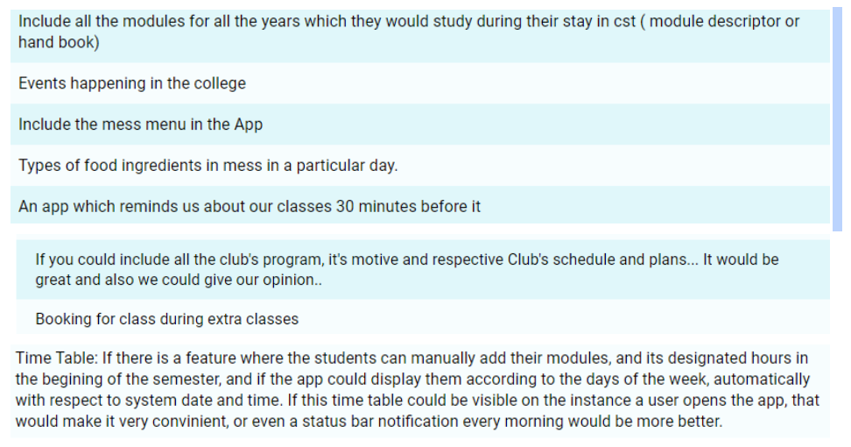
Pilot Study
8/25/2018
6

Slide 7
Problem Statement
Booking football ground and Teamwork hall is time consuming, inconvenient and is priority based.
Number of classes missed by students is not known and end up having attendance problem.
There is no proper platform for giving suggestions or feedback regarding college issues.
Registration for maintenance work is very inconvenient and time consuming.
8/25/2018
7

Slide 8
Introduction
Wide popularity of smartphones.
Giving suggestions or feedback electronically is more convenient.
Booking system would make existing system fair and convenient.
Making CST friendlier environment for new students.
8/25/2018
8

Slide 9
Aims
“To develop and deploy Smart Campus mobile application for College of Science and Technology.”
8/25/2018
9

Slide 10
Objectives
To develop Android and iOS (future) mobile app and deploy for use in CST.
To study the privacy issues due to mobile apps in Bhutan and publish findings as a research paper.
To implement e-suggestions in CST for improvement of college.
To reduce student attendance shortages by introducing self-attendance tracking.
8/25/2018
10

Slide 11
Objectives Cont’d
To implement online football ground booking and make ground booking fair for all.
To make maintenance registration more systematic and easy for all students in the college.
To review documents related to the topic.
To learn development of Android and iOS mobile apps and integrating mobile apps to a database.
8/25/2018
11

Slide 12
Scope
User registration
User login
Football ground booking
Maintenance registration
Time table display
Self-attendance tracking
Feedback and suggestions
8/25/2018
12

Slide 13
Scope cont’d
Future Scope
College Handbook
Staff details
Club/college activity details and calendar
Class, teamwork hall and lecture theater booking
Development of iOS Smart Campus app
8/25/2018
13

Slide 14
Literature Review
In the paper, an online booking facility system for sports was developed that will facilitate fast and accurate booking of the different types of sports including football, squash, tennis, spinning, racquetball, treadmills and arc trainers (Carnegie Mellon University, 2010) .
In this research(Sultana, Enayet, & Mouri, February 2015), considering the wide popularity of smartphones among any age group, the attendance tracking system was proposed as mobile application using a smartphone.
8/25/2018
14

Slide 15
Literature Review
This paper(Spear, Lock, & McCulloch, 2006). focuses on the methodology of giving feedbacks of teaching lessons from teachers to the students and students categorized under different field of their interest were in turn asked to give feedbacks of way teachers were performing.
The paper (Alqahtani & Mohammad, 2015) discuses about the mobile application that is basically develop for the education purpose which is for learning the right way to read
8/25/2018
15

Slide 16
Literature Review
This paper (Hoff, 2015) discuses mobile technology that is develop for student so that they can engage before joining the campus so that their first-year experiment can have reminder of their educational careers.
This paper(Lu & Law,2011) reports on the effects of different types of peer assessment on student learning. Assessment has a great influence in the outcomes of a student.
8/25/2018
16

Slide 17
Methodology (Agile)
8/25/2018
17

Slide 19
Project Milestones
8/25/2018
19

Slide 20
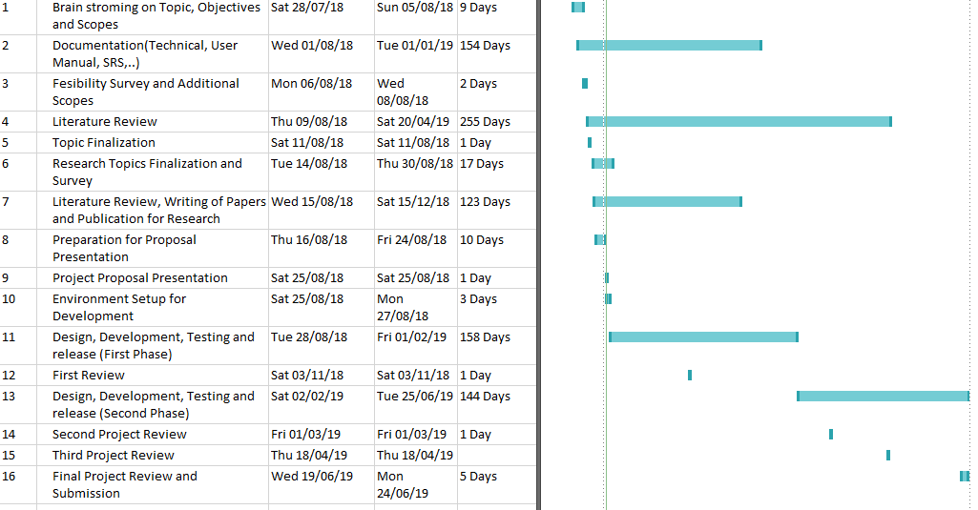

Slide 21
Expected Outcome
Learn Android development.
Learn through literature review about feedback systems and booking engines.
Learn about technical paper writing and survey data collection skills.
Learn about mobile database tools.
Learn about database integration with mobile apps.
To deploy Smart Campus app.
8/25/2018

Slide 22
Risk Analysis
8/25/2018
22

Slide 23
Type of Risk | Risk Level |  |  | Description | How to solve
 | Low | Medium | High
Technical |  | ✓ |  | Flaw in the design of the app or in coding of app. Connectivity issues with server | Always work on Git branches Seek expert help and advice.
Timing |  | ✓ |  | Not being able to finish all features according to the plan | Following work schedule strictly and working during holidays and vacations.
Budget | ✓ |  |  | Budget may incur during research survey. | Opting online surveys and other electronic measures.

Slide 24
Tools
Software
Android studio 3.1
JDK v8 and above
WAMP v2.4
Hardware
Android mobile (testing)
Laptop (development and backend)
8/25/2018
24

Slide 25
Conclusion
We will deploy an app consisting of features that will help manage CST in a smarter way.
The app will help students save time for other precious activities.
This app will also help students in tracking their attendance for self use.
8/25/2018
25

Slide 26
References
(2010, October). Retrieved from Carnegie Mellon University: https://www.enrollment.cmu.edu/reservesport/index.jsp
Alqahtani, M., & Mohammad, H. (2015). Mobile applications' impact on student performance and satisfaction. Tojet: The Turkish Online Jornal of Educational Technology, vol. 14 issue 4.
Brindley, C., & Scoffield, S. (1998). Peer assessment in undergraduate programmes. . Teaching in Higher Education, 79-90.
Butler, D. L., & Winne, P. H. (1995). Feedback and self-regulated learning: A theoretical synthesis. . Review of educational research, 245-281.
Crooks, T. J. (1988). The impact of classroom evaluation practices on students. . Review of Educational Research, 438.
Falchikov, N. (1986). Product comparisons and process benefits of collaborative peer group and self assessments. Assessment & Evaluation in higher education, 146-166.
Falchikov, N., & Blythman, M. (2001). Learning together: Peer tutoring in higher education.
Falchikov, N., & Goldfinch, J. (2000). Student peer assessment in higher education: A meta-analysis comparing peer and teacher marks. Review of educational research, 287.
Hoff, J. (2015). Engaging students with a mobile app. Educause.
Li, L., Liu, X., & Steckelberg, A. L. (2010). Assessor or assessee: How student learning improves by giving and receiving peer feedback. British Journal of Educatioin Technology, 525-536.
8/25/2018
26

Slide 27
References Cont’d
Liu, E. Z., Lin, S. S., Chiu, C. H., & Yuan, S. M. (2001). Web-based peer review: The learner as both adapter and reviewer. IEEE Transaction on Education (pp. 246-251). IEEE.
Nelson, M. M., & Schunn, C. D. (2009). How different types of peer feedback affect.
NIST. (1993, April 19). ELECTRONIC DATA INTERCHANGE (EDI). Retrieved from http://web.archive.org/web/20080511043940/https://www.itl.nist.gov/fipspubs/fip161-2.htm
Pankanti, S., Prabhakar, S., & Jain, A. K. (2002). On the individuality of fingerprints. IEEE Transactions (pp. 1010-1025). IEEE.
Rowntree, D. (1987). Assessing students: How shall we know them? London: Kogan Page.
Spear, M., Lock, N. D., & McCulloch, M. (2006). The written feedback mentors give to student. Teacher Development, 13.
Strijbos, J.-W., Narciss, S., & Du nnebier, K. (2010). Peer feedback content and sender’s competence level in academic writing revision tasks: Are they critical for feedback perceptions and efficiency? . Learning and Instruction, 291-303.
Sultana, S., Enayet, A., & Mouri, I. J. (February 2015). A smart location based time and attendance tracking system using android application. ijcseit, Vol. 5, No. 1.
Topping, K. J. (1998). Peer assessment between students in colleges and universities. Review of Educational Research, 249-277.
Topping, K. J., Smith, E. F., Swanson, I., & Elliot, A. (2000). Formative peer assessment of academic writing between postgraduate student. Assessment & Evaluation in Higher education , 149-169.
van Gennip, N. A., Segers, M. S., & Tillema, H. H. (2010). Peer assessment as a collaborative learning activities: The role of interpersonal variables and conceptions. Learning and Instructions, 280-290.
8/25/2018
27

Slide 28
THANK YOU
?
8/25/2018
28

