Slide 1
You are being tracked!
Discussion: What are some of your favorite memes? Why? How many are ones you forward on facebook or instagram?

Slide 2
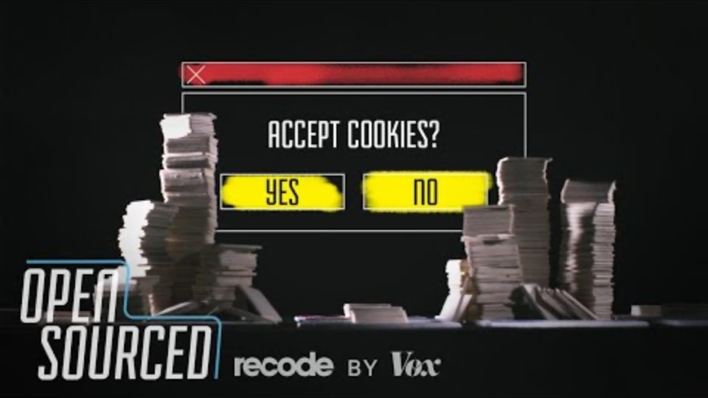
How ads follow you around the internet

Slide 3
Take Away
Cookies are files stored on your computer
Benefits
provide “State” to your websites
Remembering that you are there, information about you, etc
Issues
Are being used to track you for advertising
Can also be used to track you for other purposes
Discussion:
What are some ways to prevent ads from tracking you?
Look some up, discuss together
Pros and Cons!
Really, no exact answer yet!
Why for every benefit, there is a con. Ad blockers may also block site content for example.
Open your discussion to another group / report what you put together

Slide 4
File Handling In Java
The TA will SSH into a CS machine
You can attempt to follow on your own computer
Or even SSH into a CS machine if you have it setup
Work in pairs!
Common Linux Commands
ls
cd
mkdir
pwd
nano/pico – two command line editors for linux

Slide 5
Java Program
nano/pico – Names.txt
create a list of names (give the TA a theme). Names.txt
nano/pico – Session10.java
create Session10.java
use this class, to read through the list of names! (calling nextLine()), and prints them out as is to the screen.
to run the program
javac Session10.java – compiles the java file
java Session – runs the program
You essentially wrote “cat”
another linux command!
Yes, Java is just a series of files!

Slide 6
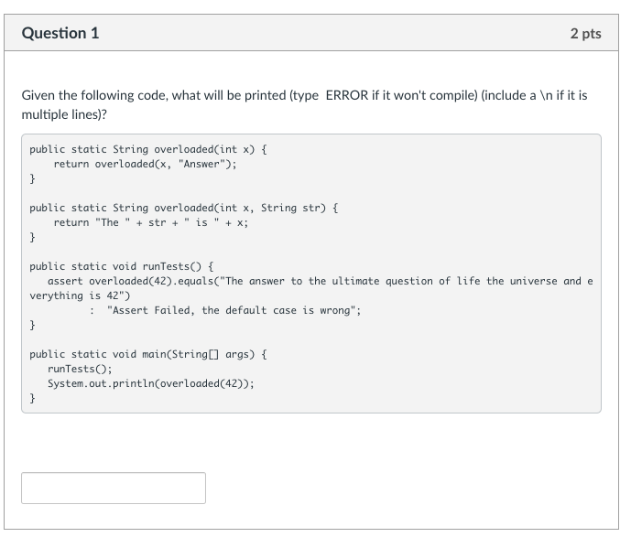
Knowledge Check - Methods

Slide 7
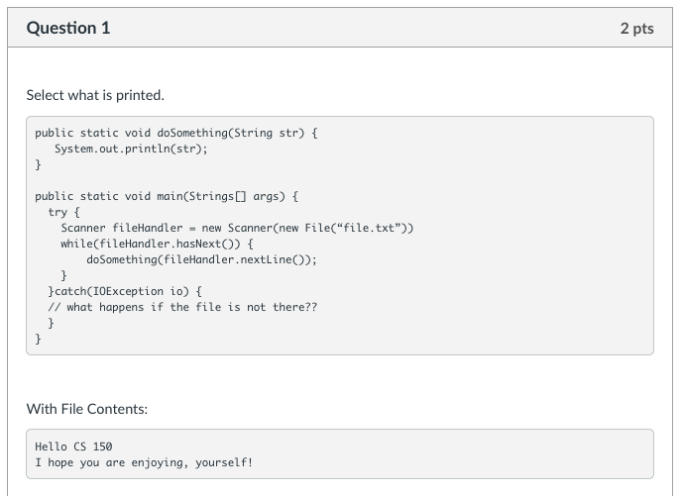
Knowledge Check Files

Slide 8
Knowledge Checks?
Dealing with files, is the heart of most programs.
You can follow along yourself!
After we work on the webpage, make sure to ask the TAs to walk you through any knowledge checks or lab methods!

