Slide 1
Hacking 101
Discussion: Now that you have been learning about the internet, have you thought more about the websites you have been visiting? How has that view changed?

Slide 2
Paper Due This Thursday!
Explain an issue
related to internet or digital security / data privacy
Must include two sides to the issue
However – have fun!
Pick something you are interested in learning more about
Something you like to argue about
This is about providing you with more data on issues that directly influence your life!
Max of 3 pages (we stop reading after that)
Use references

Slide 3
Review
Internet is made up of layers
Security is a layer on top of the HTTP layer
we will go more into security after the exam
However, besides our data, what do we have to worry about?
For the next video – take notes, mark which “question” seemed to interest you the most

Slide 4
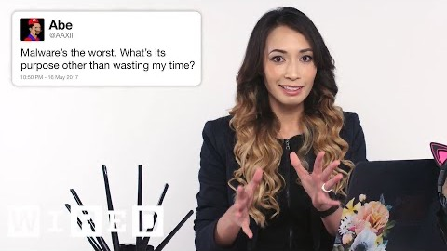
Wide range of questions, but which interest you?

Slide 5
Hacking!!
Red Team / Blue Team
White Hat / Black Hat
note: red hat is actually a Linux distribution, nothing related to hacking
CS 456 – you are actually playing red team / blue team style games against other students.
Since the internet is about sharing files
Really, writing programs to…
access data on a system
data is stored as files!
You are learning to use files in java right now!
Discussion Question:
Talk about some of these situations. What are some changes you are thinking in your daily work habits?

Slide 6
Knowledge Checks?
TAs will go over Lab 17 with you!
You can follow along yourself!
After we work on the webpage, make sure to ask the TAs to walk you through any knowledge checks or lab methods!

