Slide 1
Methods and Strings
Warm up question – favorite board game?

Slide 2
Can Machines Think
What defines thinking?
How did Alan Turing address this question?
John Searle’s Chinese Room
Contradiction to Alan Turing
Let’s watch a video on it!

Slide 3

Chinese Room – Discussion – Can machines think
Notes:
STOP before ‘Responses’

Slide 4
An Easier Question - Why Board Games?
Games are
A series of rules
These rules must be done in a specific pattern
Code is like board games
specific rules and patterns
Games were often the first tests of intelligence
Still very hard to solve for some games!
Not a board game – but Crossword Puzzles
String as a collection of ordered characters
Your job - build a crossword puzzle – using terms in this class
or
Play hangman with terms in this class
number the dashes for hangman – but start at 0
i
n
S
y
s
t
e
m
t
r
i
n
g
Notes:
This is how we represent

Slide 5
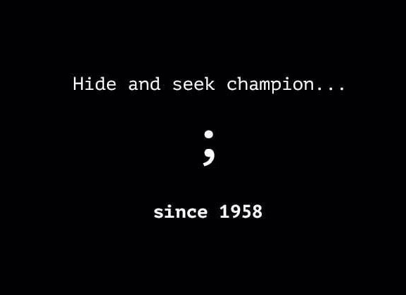
Debugging Code
Compile Errors
bad syntax
missing semicolon (bane of all coders)
missing curly brackets
Runtime Errors
Poor logic
Works, but not as intended
Solution
code only a few lines at a time
run after a few lines – even if running doesn’t do much!
Let’s look at some examples

