Slide 1
Week 3: What’s the Method With You?
Warm up question: What are some of your study techniques?
What are some you want to try?
Note: next week, a lot of classes have exams (including this one)

Slide 2
Warm Up Problem
A farmer with a pet fox goes to the market and buys, a bag of grain and a chicken.
On the way, home she comes to a river, and a boat where she can only put one in at a time.
HOWEVER:
If left alone, the chicken will eat the bag of grain
If left alone, the fox will eat the chicken.
Think-pair-share
How can she get all three items over the river, without loosing any
She has to use the boat, and she has to row it – so what she doesn’t take is alone on the rivers edge.
Part 1: Think About it
Part 2: with a partner(s) attempt to solve it
Part 3: write it down – in a step, by step series of instructions others can follow!
Part 4: share with the class different ideas

Slide 3
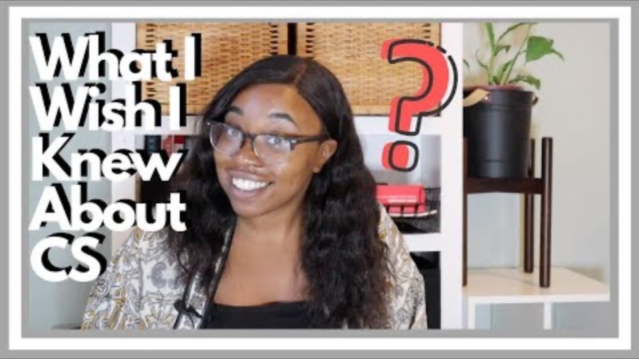
Words From a CS Major - Sosa

Slide 4
Review
Imposter Syndrome
Very real, we all deal with it.
It is OK to ask for help!
Help Sessions (Plan ahead, reach out ahead)
Help Desk (3-8 PM, M-Th)
It is OK to be frustrated!
Walk away, and then come back
But if you get joy when you are done, you are in the right place!
Reinforce Outside The Classroom!
Build something for fun, for yourself
Join clubs (ACM, ACM-W, AR/VR, Hash Dump)
Prepare for Internships or Job Searches
Career Center Helps
Clubs Help!

Slide 5
The Method To Our Madness
Divide-Conquer-Glue
Solving problems, takes looking at them different
Take a problem, break it into smaller parts.
Methods
Methods are meant to focus on
ONE idea, one task, one thing!
Designing Methods
Pre-condition – what can you assume going into the method
Post-condition – what will the method produce
When Coding Methods
Focus on the one task (biggest mistake is looking at the entire program)
TEST every method, before coding other methods!
Let’s look at code

