Slide 1
CS 150 – Inclusive Design Part 2
Warm up question: Can you think of fields outside of “traditional technology” and STEM (for example archeology, art, english, etc) – what are some ways computer science can be used in those fields? (either known, or ones you just imagine)

Slide 2
Technology Everywhere, but for everyone?
Given your warm up question
What did you come up with (share with the group)
Was there something your partner mentioned, that you never thought about before?
When looking at these ideas…
How do you take into account the variety of audiences?
Who are the expected clients/audiences?
Is that expectation correct?

Slide 3
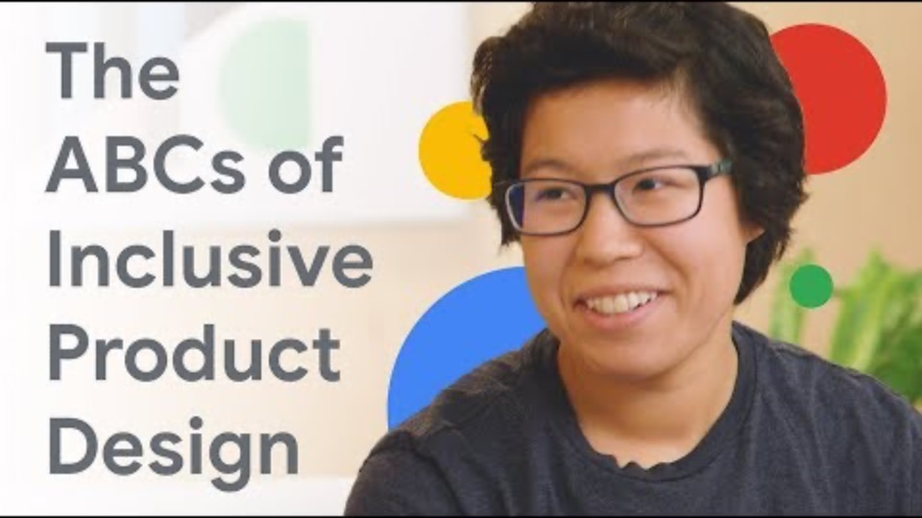
How might we?

Slide 4
ABC of Inclusive Design (by google)
A – Address diverse needs of current and future users.
you have a target, but who else could be using your application?
what countries?
what educational background?
access to technology?
B – Build for everyone, with everyone
do development teams reflect that diversity?
you are bound to have blind spots
C – Continuously Test and Improve
iteration and debugging
on all improvements, let inclusive design drive changes
Further thought: how does this relate to the five parts of design thinking?
HMW
How might we?

Slide 5
Research Paper
Due end of week 7! (next week)

Slide 6
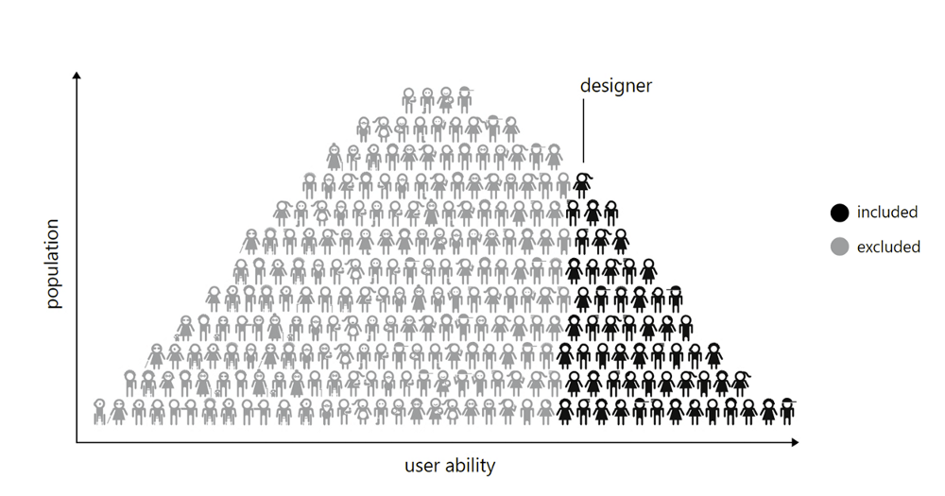
Research Paper
TOPIC: Inclusive Design
Yes, this is a *very* broad topic
Let’s brainstorm some ideas
Feel free to research some ideas during the brainstorm (don’t pick)
Colorblindness - go beyond the basics!
Car navigation systems
Operating systems
Video Games
How does designing for different abilities levels, affect game design (this is the hardest topic on this list)
Artificial Intelligence Bias
How can different biases affect our design and most importantly results
Mobile phone interfaces
what about for those who suffer from tremors
What are the assumptions of social-economic status in most applications?
Snapchat, Facebook, etc – what assumptions are there about the audience?

Slide 7
Things to Include
Case Studies
Every topic, you should find some case students / examples in industry
Admittedly, most of these studies will be ”what not to do” / part of presenting the problem
Ideas to help solve this problem
include resources that support this idea
Include a reference to a class topic (lab, lecture, discussion, etc)
Every paper should present a problem
Most papers should present possible solutions
Not all papers need solutions. There may be only be enough room to talk about the issues, that is fine
References
You *have* to include references
Treat this as research
Rule of thumb – 6 pages max (not including references/bibliography)
6 pages is standard max for a research publication
No minimum # of pages, but really you can’t do this in under 1 page

Slide 8
Do’s and Do nots
Do organize as you go.
Do pick a topic that interests you.
Do start early.
Do write a strong thesis statement that will be able to carry the supporting arguments.
Don't lengthen your paper unnecessarily.
Don't make too many generalizations.
Don't forget to proof-read your paper.
Don't plagiarize. (cite sources!)
What others would you add to this list? Discuss.

Slide 9
Common Style Guidelines
Don’t be overly casual
Don’t use contractions (ok, do not overuse contractions)
Metaphors are fishy, they get old and smell
Similes are like using the wrong emote in chat, they confuse things.
Grammar Check all things!
Remember your voice
Remember the oxford comma is a good thing
The CSU Writing Center is your friend!!!
Use it!
They need time to check your paper.
Citation style
We don’t care. APA or MLA are just fine
There are tools that can help you with all of this!

Slide 10
Labs during this time?
We will continue to have labs next week
Traveling Alchemist (focus for the entire week)
Harder lab – but know, you can wait until week 8 to complete it
It is a hard, but important lab (feedback from students on this one)
We will talk more about traveling alchemist during next weeks Help Session
Don’t miss it!
Really, don’t miss it!

Slide 11
Some Knowledge Checks

Slide 12
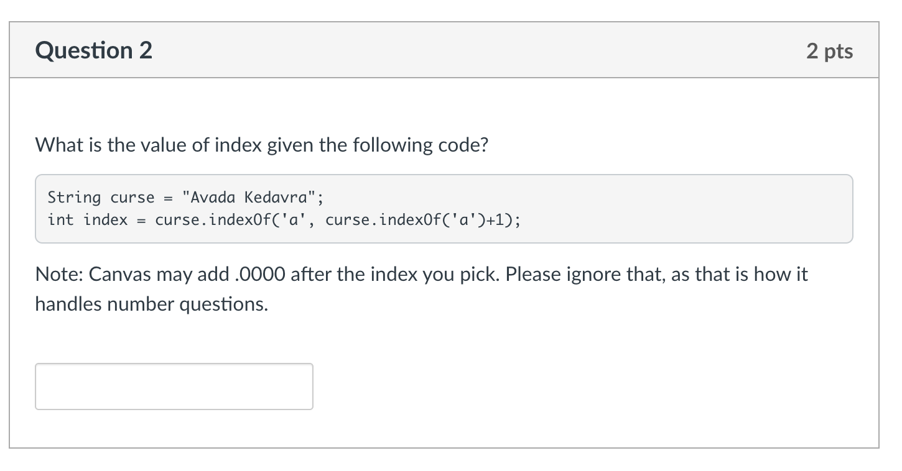
A Knowledge Check

Slide 13
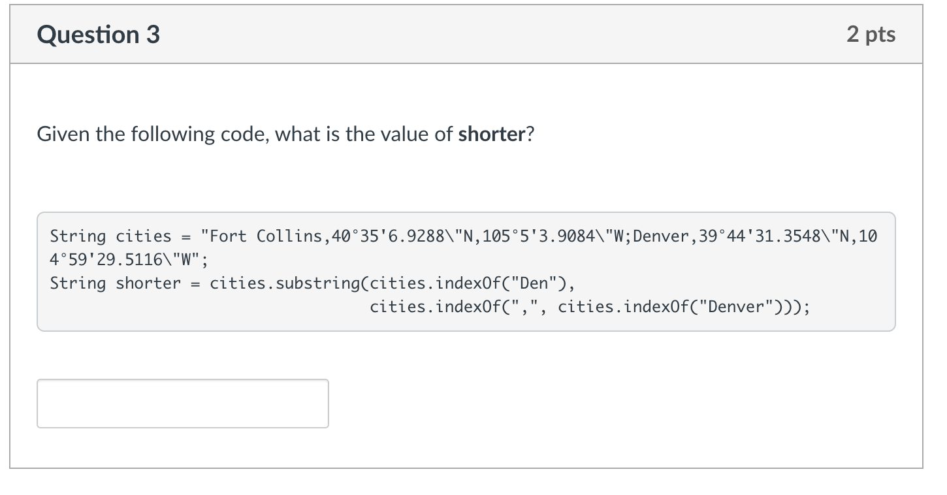
A Knowledge Check
Pro Tip – this may help you on a future lab!

