Slide 1
Inclusive Design Part 3
Traveling Alchemist
Warm Up Question: Is there a time where someone made an assumption about you, that was false? What was it?

Slide 2
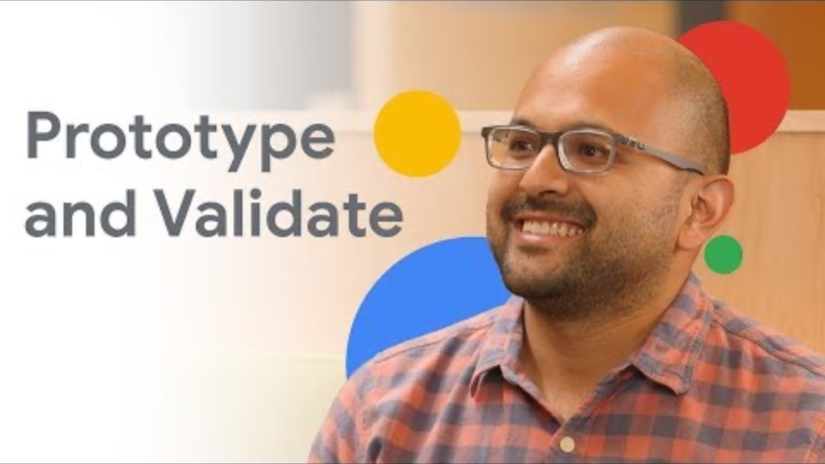
Inclusive Design Part 3

Slide 3
So the real question
Why does inclusive design matter?
The moral argument is the common argument
What about financial?
What about good design principles?
How does inclusive design help us build better products?
Discussion among your peers (5 minutes)
There isn’t an exact answer, but worth discussing

Slide 4
A couple knowledge checks

Slide 5
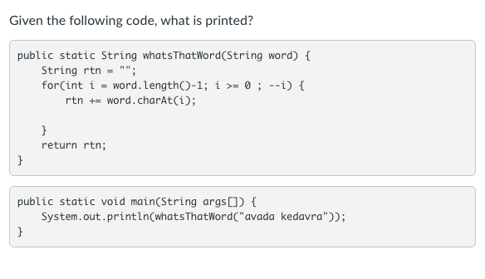
Discuss and Write It Out

Slide 6
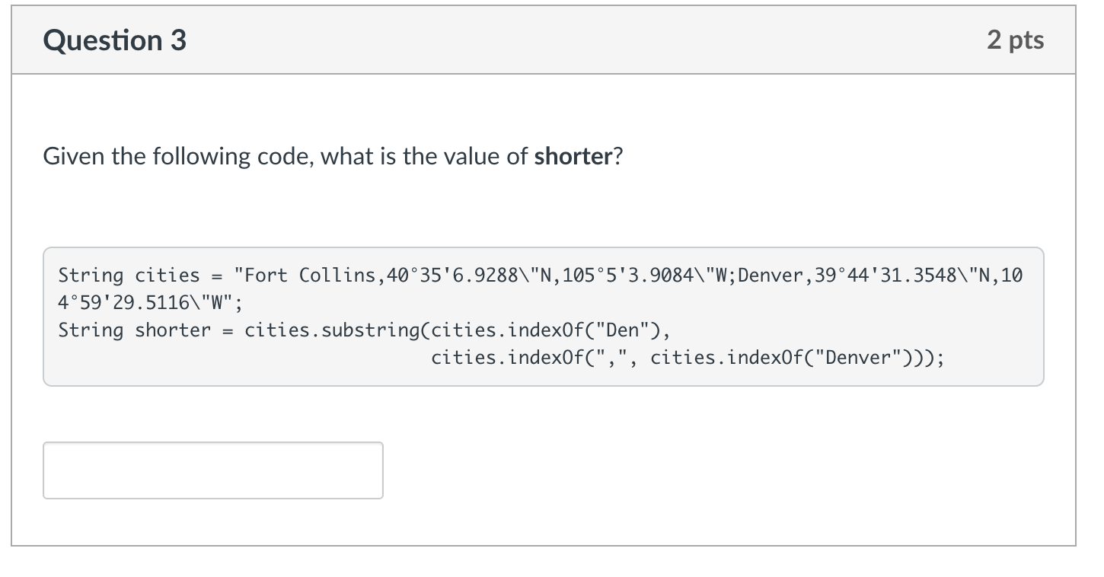
A Knowledge Check – we covered last week

Slide 7
Traveling Alchemist

Slide 8
The Trick
Draw it out
Really, the difficulty with Traveling Alchemist is the logic, not the code
You are pattern matching
Fort Collins,40°35'6.9288"N,105°5'3.9084"W;Denver,39°44'31.3548"N,104°59'29.5116"W
City;City;City
How do you find the index of the semicolon?
str.indexOf(‘;’);
Hint: You will get an OB1 error Fix it by using println to see what your index is!
Once you have the city, focus on only the substring value!

Slide 9
The parts of the city
Every city name has three parts
name
latitude
longitude
Fort Collins,40°35'6.9288"N,105°5'3.9084"W;
int end = str.indexOf(‘,’)
String name = str.substring(0, end);
int start = str.indexOf(‘,’)+1
int end = str.indexOf(‘,’, start) // overloaded!
then use substring to find latitude!

Slide 10
More practice
Let’s go to code (more examples)
indexOf
charAt
substring
Remember hangman or crossword puzzles that we played the second week!!!
Hangman or crosswords
we indexed the words starting at 0

