Slide 1
Week 3: What’s the Method With You?
Warm up question: What are some of your study techniques?
What are some you want to try?
Note: next week, a lot of classes have exams

Slide 2
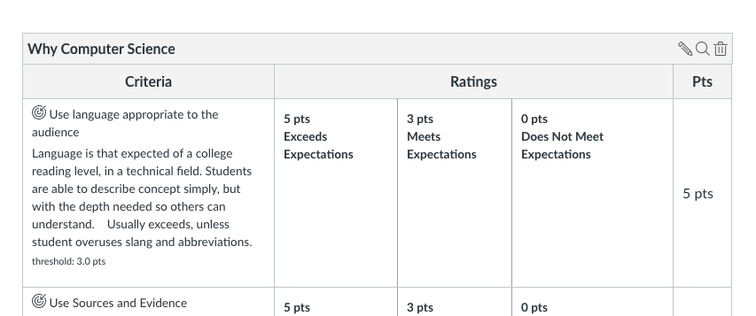
Reminders
Your First Paper “Why Computer Science” is Due *THURSDAY*
Three parts:
Your Interview
Why you are interested in CS
One area of CS that interests you
with at least one citation to a source (yes, training you for citing sources)
Follow the rubric
NEXT WEEK: No on-campus help session (this time)
Yes, labs will still happen on campus
Just part of the rubric, go to the assignment to see it

Slide 3
Warm Up Problem
A farmer with a pet fox goes to the market and buys, a bag of grain and a chicken.
On the way, home she comes to a river, and a boat where she can only put one in at a time.
HOWEVER:
If left alone, the chicken will eat the bag of grain
If left alone, the fox will eat the chicken.
Think-pair-share
How can she get all three items over the river, without loosing any
She has to use the boat, and she has to row it – so what she doesn’t take is alone on the rivers edge.
Part 1: Think About it
Part 2: with a partner(s) attempt to solve it
Part 3: write it down – in a step, by step series of instructions others can follow!
Part 4: share with the class different ideas

Slide 4
Farmer Solution
Row the boat with chicken across the river
Take chicken out of boat and set on bank
Row the boat back
Put the fox in the boat
Row the boat with fox across the river
Take the fox out of the boat
Put the chicken in the boat
Row the boat back with chicken across the river
Take chicken out of boat
Put the grain in the boat
Row the boat with grain across the river
Take the grain out of the boat
Row the boat back
Put chicken in the boat
Row the boat with chicken across river
Take chicken out of boat
Return home with grain, chicken, fox
17-21 steps! (maybe some for farmer)
Notes:
They key on this is pointing out we have to be very literal on every step. Else, the chicken is never removed from the boat. - Also while writing it out, you can easily count every step

Slide 5
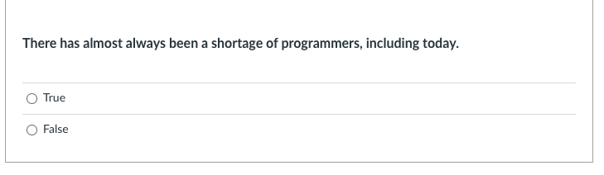
Knowledge Check: Discussion
Discussion – Why would this be true?
Notes:
We can always develop needs for computer science faster than we can graduate people from universities or even coding boot camps. Even a *MINOR* in CS goes a long way towards job prospects.

Slide 6
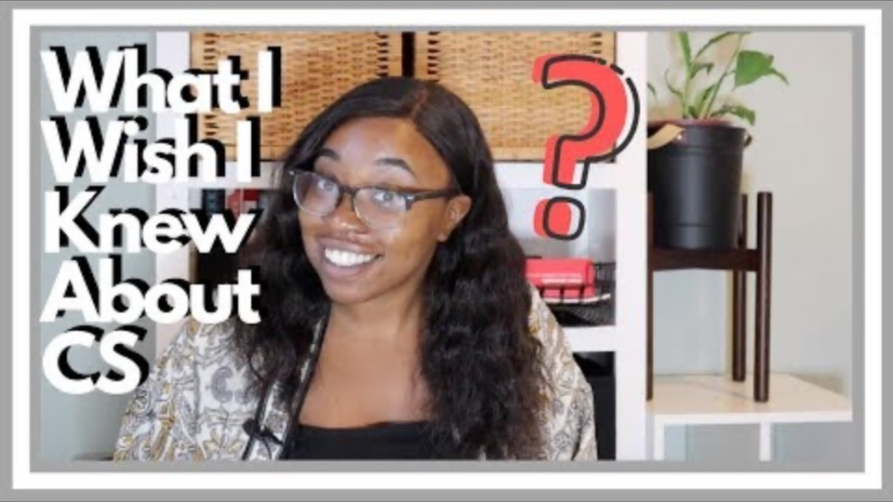
Words From a CS Major - Sosa

Slide 7
Review
Imposter Syndrome
Very real, we all deal with it.
It is OK to ask for help!
Help Sessions (Plan ahead, reach out ahead)
Help Desk (3-8 PM, M-Th)
It is OK to be frustrated!
Walk away, and then come back
But if you get joy when you are done, you are in the right place!
Reinforce Outside The Classroom!
Build something for fun, for yourself
Join clubs (ACM, ACM-W, AR/VR, Hash Dump)
Prepare for Internships or Job Searches
Career Center Helps
Clubs Help!

Slide 8
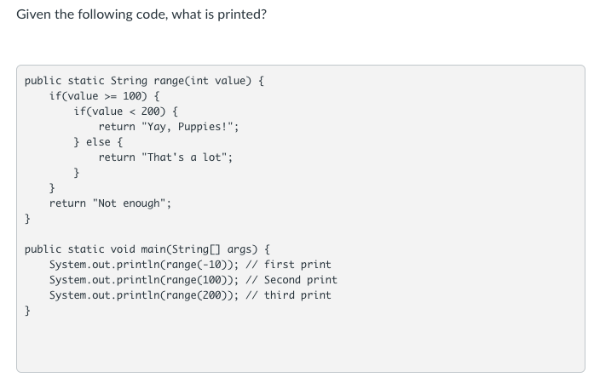
Knowledge Check: Discuss
Notes:
point out how the main method is calling the range method every time, and the range returns the value!

Slide 9
The Method To Our Madness
Divide-Conquer-Glue
Solving problems, takes looking at them different
Take a problem, break it into smaller parts.
Methods
Methods are meant to focus on
ONE idea, one task, one thing!
Designing Methods
Pre-condition – what can you assume going into the method
Post-condition – what will the method produce
When Coding Methods
Focus on the one task (biggest mistake is looking at the entire program)
TEST every method, before coding other methods!
Let’s look at code
Tests done in this class are available in zybooks.

